Slide 1
Strategic Directions Committee
Data Gathering
Name

Slide 2
Strategic Directions Core Team
Todd Coston, Information Technology (Lead)
Grace Commiso, Interim Dean of Counseling, Student Services
Liz Rozell, Dean of Instruction, Academic Affairs
Bill Moseley, Dean of Instruction, AIQ Representative
Jessica Wojtysiak, Faculty, AIQ Representative
Marcelyn Allen, Faculty
Teresa Mcallister, Faculty
Aricia Leighton, Web Team
Somaly Boles, Clerical Support

Slide 3
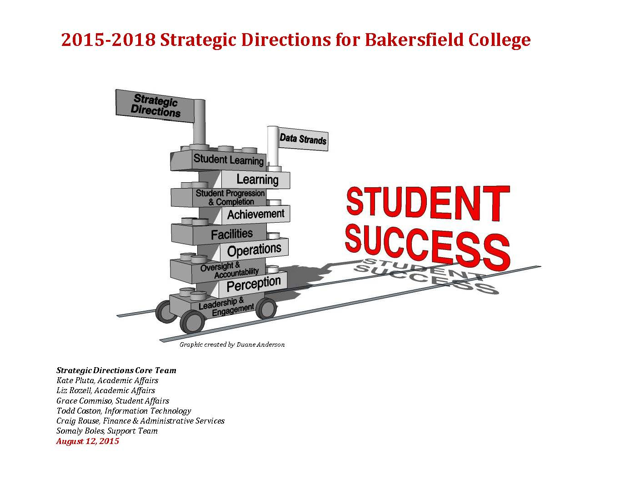
2015-2018 Strategic Directions for Bakersfield College

Slide 4
2018-2021 Strategic Directions for Bakersfield College
In 2015 Bakersfield College completed the three-year strategic plan that would provide the direction through June 30, 2018.
It is time to evaluate, develop and prepare for the next three-year cycle of our strategic plan.

Slide 5
What We Learned
Initiatives must be clearly stated.
Initiatives must be singular, not a list of items (no ands).
Initiatives must be measurable.
  How the initiative will be measured must be stated.
Initiatives must have an end date. (Do not lend themselves to be scored as “perpetually in progress”)
Initiatives should indicate their tie to Pathways where possible.
Initiative scoring must be the responsibility of one person.
  Committees are involved, but a tie breaker must have the final decision.
Strategic Direction #4, Oversight and Accountability is embedded in all directions, no need for separate Direction.

Slide 6
Four Strategic Directions
Student Learning
Student Progression and Completion
Facilities and Technology
Leadership and Engagement

Slide 7
Writing Initiatives
Initiative
Pathways Pillar
How will you evaluate and document the initiative's success?
What manager would be responsible for scoring?
What other positions and committees need to be involved?
Current Score

Slide 8
Activity
From Your Committee’s Perspective what initiatives can you think of to move us in the direction of the four Directions?
Strategic Directions
Student Learning
Student Progression and Completion
Facilities (and Technology)
Leadership and Engagement
Pathway Pillars
Clarify the Path (Mapping Pathways to Student End Goals)
Get Students on the Path (Intake)
Keeping Students on Path (Intrusive Advising and Academic Support)
Learning with Intentional Outcomes

Slide 9
Initiative Form
Survey Monkey: https://www.surveymonkey.com/r/strategic-initiatives

