Slide 1
Safety Advisory Committee
The ISER
What you need to know.
9/12/2018
BAKERSFIELD COLLEGE
Presented by:
Jason Stratton

Slide 2
Accreditation Basics
Accrediting Commission for Community and Junior Colleges (ACCJC) evaluates and accredits Junior Colleges
Accreditation allows our students to receive federal financial aid dollars
Allows us to engage in continuous evaluation and quality improvement

Slide 3
ACCJC
Our evaluation team is comprised of educators and administrators
ACCJC has established four major accreditation standards
Under those four standards are 14 subsections
We demonstrate compliance via a written self report…the Institution Self-Evaluation Report (ISER)

Slide 4
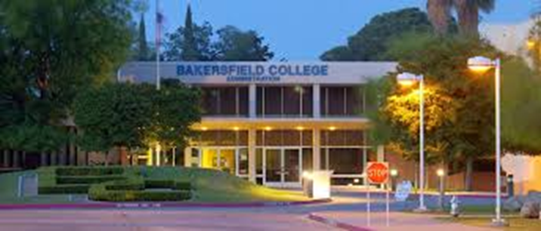
Standards
Standard I: Mission, Academic Quality, and Institutional Effectiveness and Integrity
Standard II: Student Learning Programs and Support Services
Standard III: Resources
Standard IV: Leadership and Governance

Slide 5
ISER
The ISER explains how we meet the 4 standards and all subsections
The ISER also contains a quality focus essay (QFE) describing goals
QFE highlights two projects-Program Mapper and Academic Support Services
ACCJC has our ISER, and peer reviewers are prepping for a site visit.
Our ISER is found here:
https://www.bakersfieldcollege.edu/accreditation/2018ISER
Notes:
Add information about the QFE, link the QFE to the mission

Slide 6
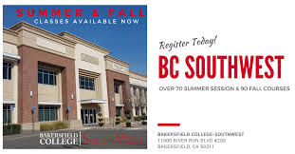
Site Visit
October 1-4th: the peer review team will be on campus, in our classrooms and in our committee meetings.
Each team member is responsible for verifying a specific standard.
They will talk with administrators, faculty, classified personnel, and students .
They will review all of our documents and data.
They will sit in our classes and will talk with committees.
Notes:
Add something about peer review team verifying the information presented in the ISER

Slide 7
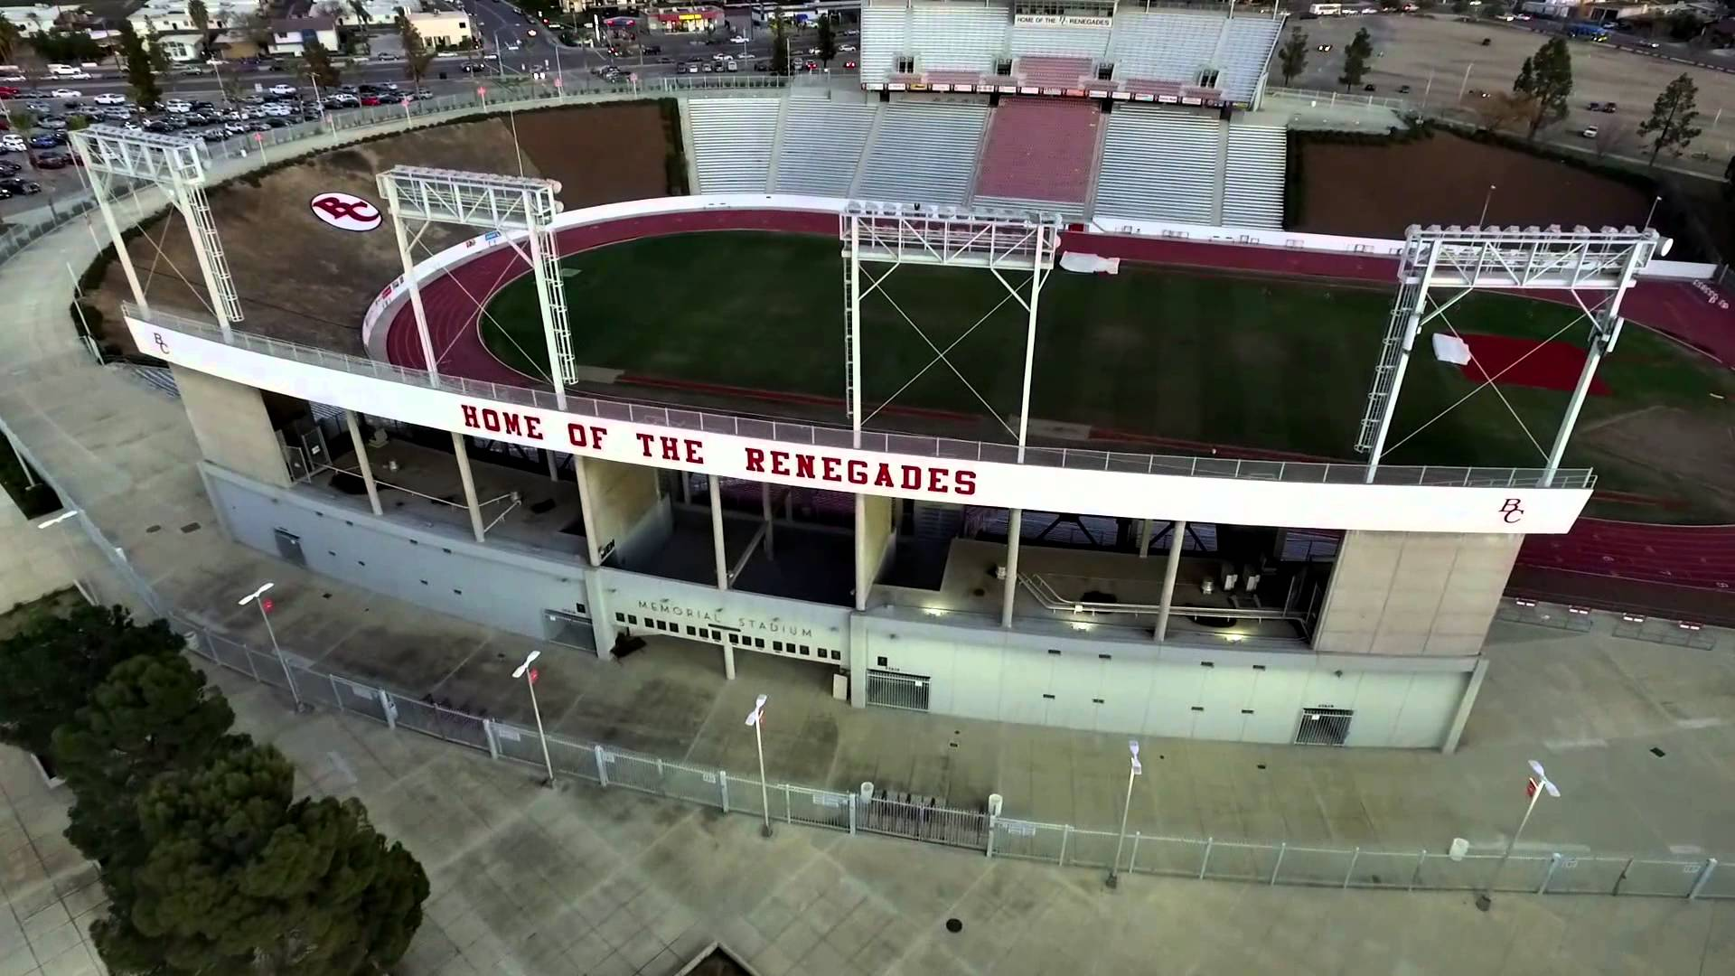
All Campus Preparation
Everyone should be familiar with-
Mission Statement
Strategic Directions
Institutional Learning Outcomes
Core Values
Student population
College Processes
Collegial Governance
See BC Cheat Sheet:
https://www.bakersfieldcollege.edu/download/27323

Slide 8
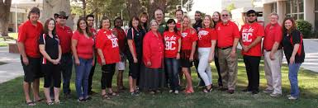
Committee Preparation
What is your committee’s charge? Where do you find it?
Do you understand how you are represented in the ISER?
We should use a common language
What standards and subsections apply to your committee?
How is your committee helping BC meet those standards?
Where can you locate the information?

Slide 9
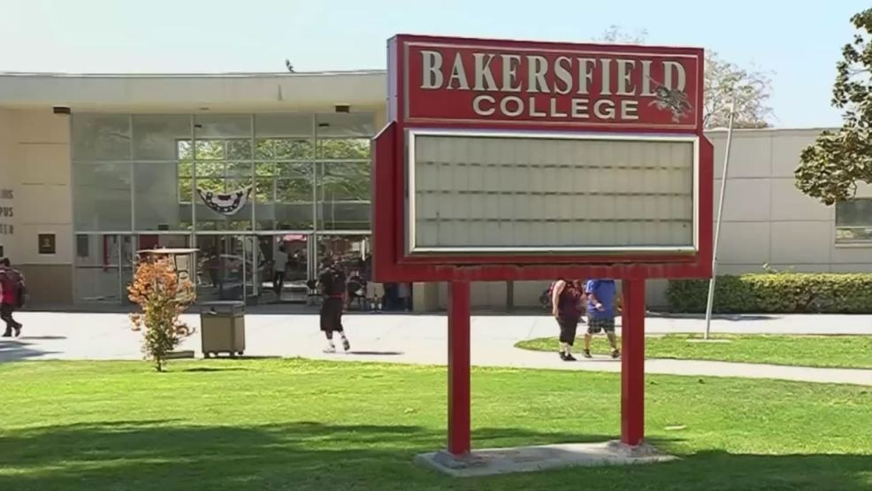
Where Can I Find My Committee Information?
https://committees.kccd.edu/bc/

Slide 10
Safety Advisory Committee
Charge:
“To assist in monitoring, improving, and maintaining campus safety and occupational health as mandated by OSHA regulations. To develop and maintain current emergency response plans. To inform the college community of new policies and procedures as they relate to health and safety. The purpose of the safety advisory committee is to bring employees and managers together to achieve and maintain a safe and healthy workplace.”

Slide 11
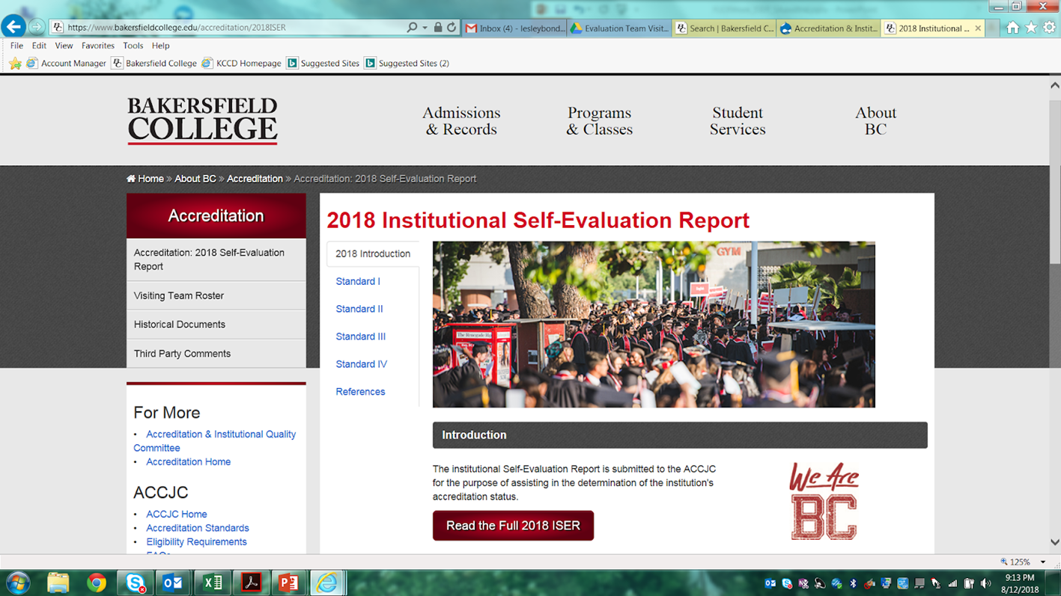
Where Are We Mentioned in the ISER?
https://www.bakersfieldcollege.edu/accreditation
Click “Accreditation: 2018 Self-Evaluation Report” in upper left corner of page.
Click big red button that says “Read the Full 2018 ISER” in middle of page.
The term “Safety Advisory” appears 3 times in the ISER, while “Safety”, in a relevant way, appears 20 times.
ISER Bluff Notes: https://www.bakersfieldcollege.edu/download/27320

Slide 12
Safety Advisory Committee
Safety isn’t just common sense, it is ‘mission critical’ to the wellbeing of all people who set foot on BC’s Campus: Administrators, Faculty, Staff, Students and all campus visitors- invited or otherwise.
The Safety Advisory Committee is referenced 3 times, in Standard III, but ‘Safety’ is Referenced 20 times- spread throughout multiple standards.
Regardless of frequency- no other work can be done on this campus if it isn’t safe- Be it security safety, or accident/workplace safety.
If you see something, say
something, do something.
-BC Department of Public
Safety Slogan
ISER P. 111

Slide 13
Standard III
“III.B.1
The institution assures safe and sufficient physical resources at all
locations where it offers courses, programs, and learning support services. They are constructed and maintained to assure access, safety, security, and a healthful learning and working environment.”
ISER p. 111

Slide 14
Standard III
How does BC meet Standard III?
Very well-
“In recognition that a supportive learning environment needs safe and sufficient physical resources, Bakersfield College (BC) assures safe physical resources in support of our mission via several avenues: around the clock public safety service, updating security and safety features of buildings and other physical resources, and getting input from employees and students on maintenance needs.”
ISER p. 111

Slide 15
Standard III
We live in unfortunate times.
For various reasons, individuals have invaded campuses across the nation and caused harm.
Any reasonable person may ask something like- ‘what do we do to help make people safe from others?’
“We assure public safety 24 hours a day, 7 days per week at all sites where we offer courses,
services, and programs (III.B.1-7; III.B.1-8). We ensure all facilities meet federal, state, and county mandates for access, including the Americans with Disabilities Act. Examples of proactive training and support include:
… .” ISER p. 111

Slide 16
Standard III
What about the facilities?
How does BC and the Safety Advisory Committee make sure that the facilities themselves are safe?
“We ensure safety of our facilities by upgrading safety systems already in place at our sites.
Examples include 1) the fire alarm system project, 2) a card lock system on all buildings, and 3) the switch to LED lamps on the Panorama campus exterior lighting (III.B.1-14; III.B.1-15; III.B.1-16). ISER p. 111

Slide 17
Standard I
Yet, the ACCJC evaluation team might ask something more student oriented.
What if they were to ask how BC makes sure Students are familiar with our Safety Concerns?
Standard I.C.1- on Institutional integrity, gives an answer:
Our website and committees websites are the primary ways we communicate our policies and processes.
HOWEVER, we also have been developing an active social media presence, and our BC Renegades App has information about the student handbook, Campus Safety information, official BC Notifications, and more. ISER p. 48

Slide 18
Quality Focus Essay (QFE)
Continuous quality improvement is a mark of institutional effectiveness. The ISER results in a QFE that identifies areas of needed change, development, institutionalization, and expansion.
Our QFE identifies successes in the Guided Pathways project and development of Completion Coaching Communities. Furthermore, we link Guided Pathways and Strategic Directions for future educational innovations!
Our QFE identifies has two projects for improvement:
1: Clarify the Path with the Program Pathways Mapper.
2: Keep Students on the Path by Scaling and Integrating Student Support &
Learning.

Slide 19
Full ISER Review
The ISER describes how BC has met the four standards and all subsections.
ACCJC peer review team has our ISER and is preparing for our site visit.
The team will be at BC October 1-4th and will talk with administrators, faculty, classified personnel, and students.
They will be talking with committee leaders and members about the ISER.
Please review the documents we’ve provided so that we have a common language and can articulate all we do.

Slide 20
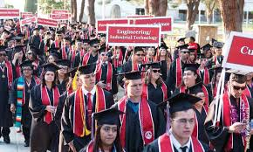
We
Are,
BC!
Brought to you by your friendly neighborhood Accreditation Team.

