Slide 1

Program Mapper Update Meeting
Examples from ANCA Pathway
Anna Melby and Jessica Wojtysiak

Slide 2
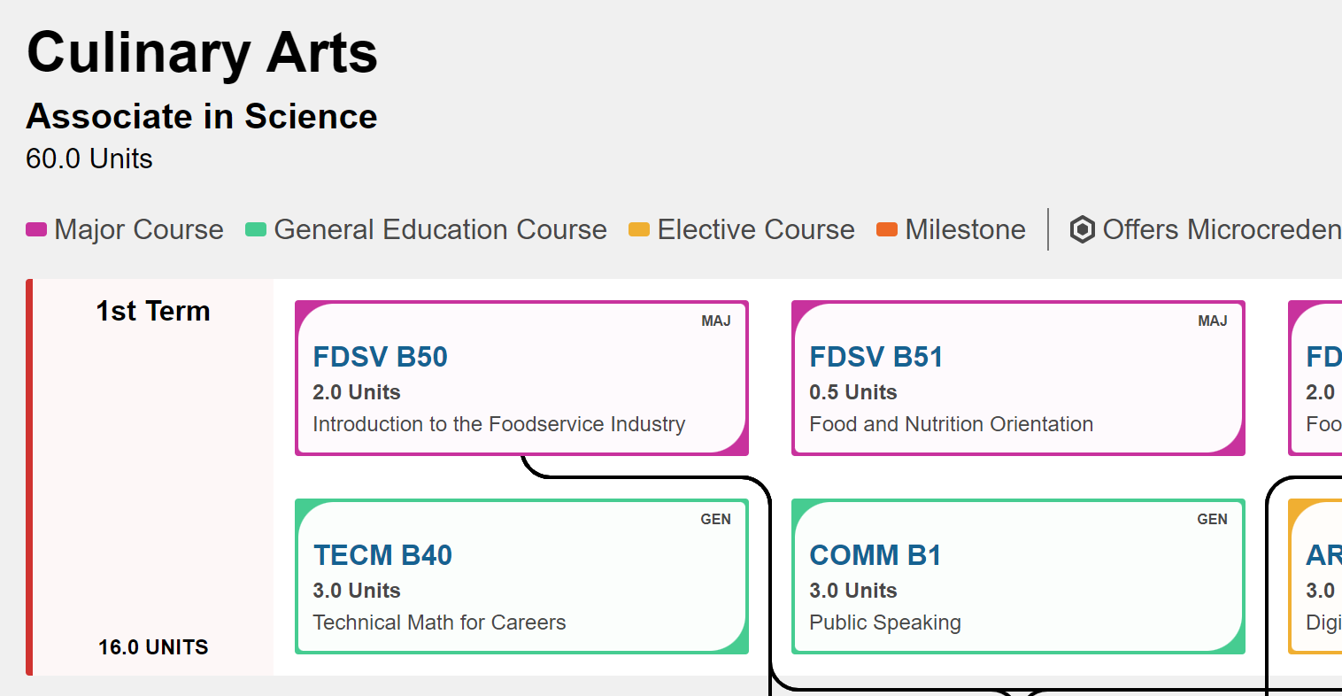
Why is the Program Mapper Important?
Used by:
Students
Counseling
Outreach
Early College

Slide 3
Who Should be Involved
Erica Menchaca - Articulation Officer (Mapper Guru)
Pathway Counselor(s)
Pathway Educational Advisor
Department Chairs
ALL Pathway Faculty

Slide 4
Materials
Print all current maps (AST, AS, AA, COA, COC)
Make a list of missing maps
Book a room with technology so the map being worked on can be displayed and updates can be seen in real time

Slide 5
What to Expect
Pre-prep your faculty at a pathway meeting before your scheduled workday.
Give faculty time to collaborate on changes/updates that need to be made.
  This is also a chance to suggest general education classes that may support students in their education path.
Once changes/updates have been noted, faculty will sit with Erica to update the map.
Once all updates to a map have been input and saved, the new map will be viewable.
It can be a long process, stagger start times.
For larger pathways, consider multiple days, organized by subject.

Slide 6
Takeaways from Our Experience
Schedule the day by subject and stagger the times so not all faculty is there at once.
Our meeting was 11am to 3pm
Culinary Arts first, then Agriculture
Have food available!
Give faculty templates and encourage pre preparation for a quicker day.

