Slide 1

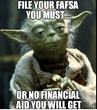
Student Success and Counseling Update
January 31, 2022
Spring Advising Season! February 15, 2022 – March 15, 2022
2. Registration Begins: March 30, 2022
      Order of Registration Appointment Assignments
      Students in special populations such as:
        Veterans who have been discharged within the last three years
        Foster Youth
        EOP&S
        CalWORKS
        DSP&S
        Honors
        Finish in 4
        Athletics
      Continuing students with less than 100 units attempted at Bakersfield College and prior year graduates of local high schools.
      New students not included above.
      Continuing students who have not completed all four enrollment steps will be assigned appointments during the first few days of open registration based on the date they completed their admission/update forms.

Slide 2

Student Success and Counseling Update
April 11th to April 15th!
GO SEE SID! Registration? Holds? Probation? Pre-Requisites Error? Ed Plan ASAP?
Let’s go!!!
The Student Information Desk is online 7-days a week, with help from Admissions,
Financial Aid, Counseling and Advising, and MORE!!! bit.ly/bc-sid
· Monday to Thursday: 8 a.m. - 6 p.m.
· Friday: 8 a.m. - 12 p.m.
· Saturday: 9 a.m. - 1 p.m.
· Sunday: 10 a.m. - 2 p.m.

Slide 3
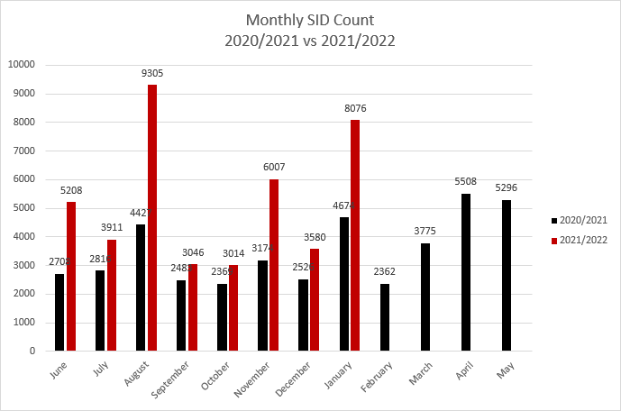
WHY SEE SID?
Approximately
53% of all students coming into the SID in December and January received assistance from Counseling and Advising.
4,280 students had their Advising needs met.

Slide 4


Four Pillars of Guided Pathways System (GPS)
Clarify the Path
Enter the Path
Stay on the Path
Ensure Learning
Create Clear
Curricular
Pathways to
Employment
and Further
Education
Help Students
Choose and Enter Their
Pathway
Help
Students
Stay on
Their Path
Follow Through, and Ensure that Better Practices are Providing Improved Student Results.
(California Community Colleges Chancellor’s Office)
Notes:
Clarify the Path
Dual Enrollment/HS
Ed Plan/Career
The Kern Promise
Enter the Path
Outreach & School Relations
The right courses at the right time
Sathways 0000000000000for non-STEM
Reumme0r Bridge Programs
Math pmedial course acceleration
Stay on the Path
Retention and completion
Academic Support Services
Timely Transfer Progress
Employment in field of study
Ensure Learning
Integrated co-curricular
Reinforce learning in/out of class
Learning Communities
Practical Experience

Slide 5
Bakersfield College
Guided Pathways Goals
Attempting 15+ units in the first term
Attempting 30+ units in the first year
Complete transfer-level English & Math in the first year
Complete 9 core pathway units in the first year

Slide 6

Learning and Career
Pathways
BC has grouped degree and certificate programs together in categories
to better support students.
Select one of the Learning and Career Pathways to access to resources
to stay on track.
Each Pathway has a list of programs, contacts for support and career exploration information.
https://www.bakersfieldcollege.edu/academics/pathways

Slide 7
Agriculture, Nutrition, & Culinary Arts
Degrees
Agriculture Animal Science AST
Agriculture Business AST
Agriculture Plant Science AST
Nutrition and Dietetics AST
Agriculture-Animal Science AS
Culinary Arts AS
Environmental Horticulture AS
Food Science and Technology AS
Food Service Management AS
Forestry AA and Forestry AS
Mechanized Agriculture AS
Plant Science AS
High Unit Certificates ≥ 18.0 units
Agriculture - Animal Science COA
Agriculture Business Management COA
Culinary Arts COA
Dietetic Services Supervisor Program COA
Environmental Horticulture COA
Food Science and Technology COA
Forestry COA
Heavy Equipment Technician COA
Plant Science COA
Low Unit or Non-credit Certificates < 18.0 units
Registered Veterinary Technicians JSC

Slide 8
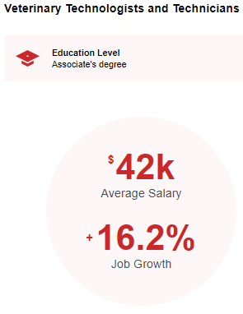
Agriculture, Nutrition, & Culinary Arts
Possible Career Opportunities
Dietetic Technicians
Nutritionist
Environmental Scientist
Farm Equipment Tech
Farm and Home Managnt.
Farmers, Ranchers
Forestry Workers
Food Prep Workers
Food Scientist and Tech
Lodging Managers
Pesticide Handlers, Sprayers, and Applicators Vegetation
Agricultural Equipment Operators
Agricultural Inspectors
Agricultural Sciences Teachers
Aircraft Mechanics and Service Technicians
Animal Breeders
Bakers
Chefs and Head Cooks
Conservation Scientists
Notes:
- degree/certificate/noncredit options in each pathway
- career opportunities
- program mapper tool
- and anything else you deem pertinent to a pathways info session.
We will have 15 minutes for each Pathway listed (Education, SBS, PCE)

Slide 9
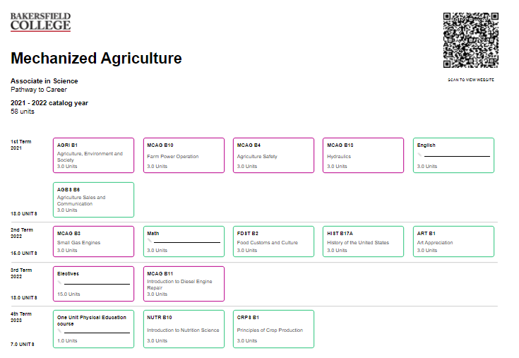
Agriculture, Nutrition, & Culinary Arts
Contact Information for Pathway:
Aneesha Awrey, Lead Counselor (Main)
aneesha.awrey@bakersfieldcollege.edu
(661) 395-4421
Juan Manzano, Educational Advisor, CTE (Main)
juan.manzano@bakersfieldcollege.edu
(661) 395-4520

Slide 10
Arts, Communication & Humanities
Degrees
Art History
Communication Studies
English
Journalism
Music
Philosophy
Spanish
Studio Arts
Theatre Arts
American Sign Language
Japanese
Liberal Arts
High Unit Certificates ≥ 18.0 units
ASL Interpreter Training Program
Commercial Music
Graphic Design
Media Arts
Photography
Low Unit or Non-credit Certificates < 18.0 units
Communication

Slide 11
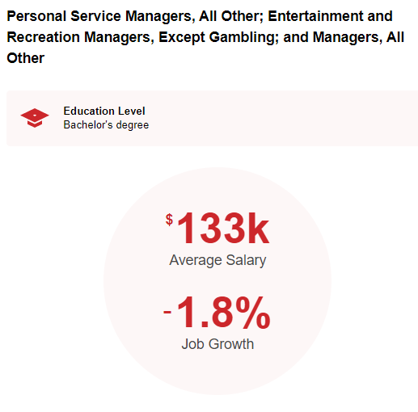
Possible Career Opportunities
Bailiffs
Computer Occupations
Firefighters
Police and Detectives
Forensic Science Technicians
Forest Fire Inspectors and Prevention Specialists
Gambling Surveillance Officers and Gambling Investigators
Health and Safety Engineers
Life, Physical, and Social Science Technicians
Correctional Officers and Jailers
Criminal Justice Teachers
EMT & Paramedics
Detectives and Criminal Investigators
Personal Service Managers
Public Safety Telecommunicators
School Bus Monitors and Protective Service Workers
Security Guards
Arts, Communication & Humanities
Notes:
- degree/certificate/noncredit options in each pathway
- career opportunities
- program mapper tool
- and anything else you deem pertinent to a pathways info session.
We will have 15 minutes for each Pathway listed (Education, SBS, PCE)

Slide 12
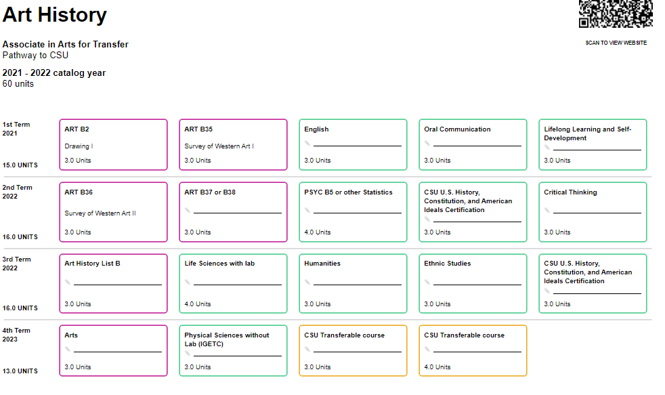
Contact Information for Pathway:
Keri Kennedy, Lead Counselor (Main)
keri.kennedy@bakersfieldcollege.edu
(661) 395-4632
Savannah Andrews, Educational Advisor (Main/BCSW)
savannah.andrews@bakersfieldcollege.edu
(661) 395-4421
Lucy Perez-Dykes, Educational Advisor (Main)
lperez@bakersfieldcollege.edu
(661) 395-4423
Arts, Communication & Humanities

Slide 13
Business
Low Unit or Non-credit Certificates < 18.0 units
Basic Internet Skills
Basic Office Skills
Basic Office Software Skills
Beginning Computer Skills
Customer Relations
Digital Marketing for Small Business
Entrepreneurship
General Business JSC
Office Assistant JSC
Powerful Presentation
QuickBooks Basics for Small Business
Recruiting and Managing Employees
Sales Techniques
Degrees
Business Administration
Economics
Accounting
Administrative Office Assistant
High Unit Certificates ≥ 18.0 units
Bookkeeping
CompTIA
Information Technology
Office Assistant

Slide 14
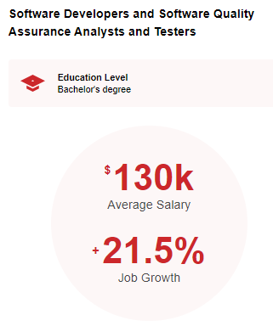
Possible Career Opportunities
Accountant and Auditors
Admin. Services and Facilities Mngrs
Advertising Sales Agents
Promotions Managers
Billing and Posting Clerks
Bookkeeping Account and Auditing Clerks
Budget Analysts
Buyers and Purchasing Agents
Compensation and Benefits Managers
Customer Service Representatives
Door-to-Door Sales Workers, News and Street Vendors, and Related Workers
Computer Network Architects
Computer Programmers
Computer User Support Specialists
Computer and Information Systems Managers
Construction Managers
Correspondence Clerks
Cost Estimators
Credit Analysts
Executive Secretaries and Executive Administrators
File Clerks
Financial Examiners
Financial and Investment Analysts
Financial Risk Specialists
Business
Notes:
- degree/certificate/noncredit options in each pathway
- career opportunities
- program mapper tool
- and anything else you deem pertinent to a pathways info session.
We will have 15 minutes for each Pathway listed (Education, SBS, PCE)

Slide 15
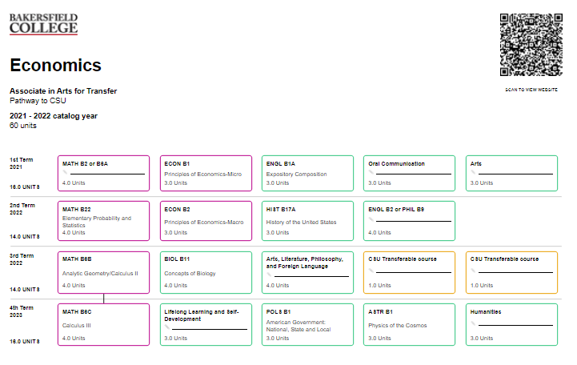
Contact Information for Pathway:
Jonathan Schultz, Lead Counselor (Main/BCSW)
jonathan.schultz@bakersfieldcollege.edu
(661) 395-4421
Evette Lara, Educational Advisor
elara@bakersfieldcollege.edu
(661) 395-4421
Business

Slide 16
Education
Degrees
Early Childhood Education AST
Elementary Teacher Education AAT
Education Studies AS
High Unit Certificates ≥ 18.0 units
Child Development Master Teacher: Infant Toddler
Child Development Master Teacher: Special Edu.
Child Development Teacher
Online Teaching Level II
Paraprofessional Level II
Paraprofessional Level III
Paraprofessional Level IV
Transitional Kindergarten
Low Unit or Non-credit Certificates <18.0 units
Child Development Assistant Teacher
Child Development Associate Teacher
Introduction to Early Care and Education
Online Teaching - Online Teaching Level I
Paraprofessional Level I

Slide 17
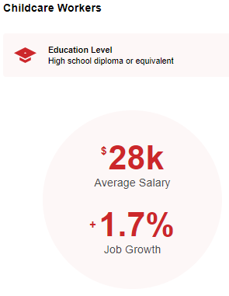
Possible Career Opportunities
School Teachers (k-12)
Childcare Workers
Counselors
Education Administrators
Library Workers
Farm & Home Management Educators
Instructional Coordinators
Tutors
Training and Development Specialist
Therapist
Substitute Teacher
Middle School Teacher
Marriage & Family Therapist
Teacher Assistant
Education
Notes:
- degree/certificate/noncredit options in each pathway
- career opportunities
- program mapper tool
- and anything else you deem pertinent to a pathways info session.
We will have 15 minutes for each Pathway listed (Education, SBS, PCE)

Slide 18
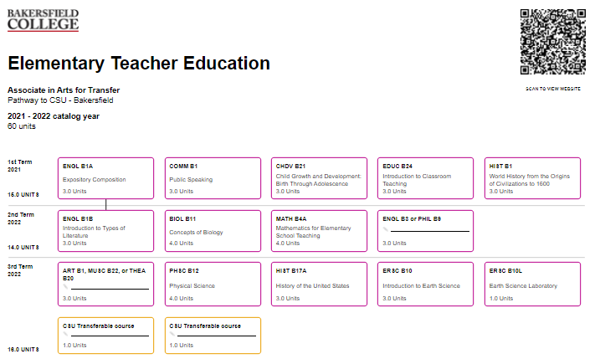
Contact Information for Pathway:
Brynn Schock, Lead Counselor (BCSW)
brynn.schock@bakersfieldcollege.edu
(661) 395-4421
Veronica Lucas, Counselor (Delano)
vlucas@bakersfieldcollege.edu
(661) 720-2078
Esequiel “Zeke” Garcia (Main)
esequiel.garcia@bakersfieldcollege.edu
(661) 395-4567
Jessica Garcia, Educational Advisor (Delano)
jessicga@bakersfieldcollege.edu
(661) 395-4421
Education

Slide 19
Health Sciences Pathway
Degrees
Kinesiology AAT
Public Health Science AST
Health Information Tech AS
Human Biology AS
LVN to Nursing Program AS
Physical Therapist Assistant AS
Radiologic Technology AS
Registered Nursing AS
High Unit Certificates ≥ 18.0 units
Health Navigator
LVN to Non-Degree Nurse (30 unit option)
Principles of Fluoroscopy
Vocational Nursing
Low Unit or Non-credit Certificates < 18.0 units
Nurse Assistant
Principles of Venipuncture

Slide 20
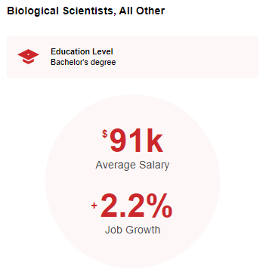
Possible Career Opportunities
Epidemiologist
Forensic Science Tech
Health Education Specialist
Licenced Vocational Nurse
Registered Nurse
Nursing Assistant
Medical & Health Services Manager
Health Technologists and Technicians
School Teachers
Radiology Tech
Radiation Therapists
Physical Therapist
Psychologist
Natural Science Managers
Medical Dosimetrists
Medical Records Specialists
Health Sciences Pathway
Notes:
- degree/certificate/noncredit options in each pathway
- career opportunities
- program mapper tool
- and anything else you deem pertinent to a pathways info session.
We will have 15 minutes for each Pathway listed (Education, SBS, PCE)

Slide 21
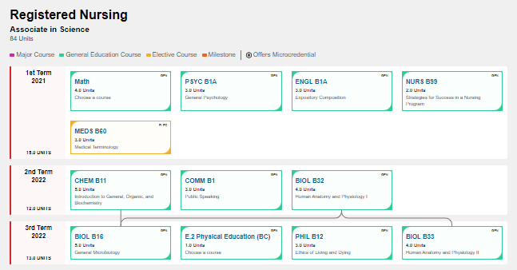
Contact Information for Pathway: Nursing and Radiologic Tech.
Dinorah Castro, Lead Counselor (Main)
dicastro@bakersfieldcollege.edu
(661) 395-4421
Venessa Reyes, Educational Advisor (Main) Nursing/Allied Health
venessa.reyes@bakersfieldcollege.edu
(661) 395-4476
Jesus Cardenas, Educational Advisor (Delano)
jecarden@bakersfieldcollege.edu
(661) 720-2007
Abraham Castillo, Educational Advisor (Main)
abraham.castillo@bakersfieldcollege.edu
(661) 395-4473
Health Sciences Pathway- I

Slide 22
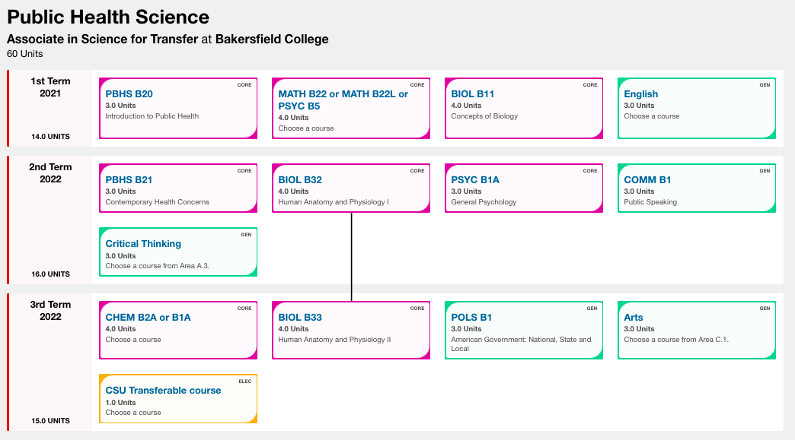
Contact Information for Pathway: Kinesiology, Human Biol., Physical Therapist Asst., Public Health Science, Health Information Tech.
Ryan Huynh, Lead Counselor (Main)
ryan.huynh@bakersfieldcollege.edu
(661) 395-3516
Giovanni “Gio” Garcia, Educational Advisor (Main)
giovanni.garcia@bakersfieldcollege.edu
(661) 395-3566
Health Sciences Pathway- II

Slide 23
Industrial Technology & Transportation
Degrees
Architecture/Architectural Drafting
Automotive Technology
Construction Management
Electronics
Engineering
Engineering Technology
HVAC Technology
Industrial Automation AS
Industrial Automation BA
Industrial Drawing
Degrees
Industrial Technology
Manufacturing Metal Fabrication Technology
Manufacturing Technology
Occupational Safety & Risk Management, Agriculture
Occupational Safety and Risk Management, Business
Occupational Safety and Risk Mngmnt , Health Science
Occupational Safety and Risk Mngmnt, Industrial Tech
Process Technology
Welding
Woodworking/Cabinetmaking

Slide 24
Industrial Technology & Transportation
High Unit Certificates ≥ 18.0 units
Construction Technology
Electronics Technology
Engineering Technology
HVAC Technology
Industrial Drawing
Manufacturing Technology
High Unit Certificates ≥ 18.0 units
Occupational Safety and Risk Management
Process Technology
Welding
Woodworking/Cabinetmaking

Slide 25
Industrial Technology & Transportation
Low Unit or Non-credit Certificates < 18.0
Adv. Electrical Safety and Arc Flash
Architectural Comp Aided Drafting
Automatic Transmissions
Automotive Heating and Air Conditioning
Automotive Management JSC and COA
Basic Machine Tool Operations-Lathe, Mill
Blueprint Reading & Layout for Welders
Brake Systems
Computer Numerical Control
Electrical and Electronic Systems
Electrical Safety
Electronics - Industrial Automation
Electronics: Industrial Communications
Electronics: Industrial Maintenance
Electronics: Manufacturing Automation
Low Unit or Non-credit Certificates < 18.0
Engine Overhaul and Repair
Engine Performance
Gas Metal Arc/Gas Tungsten Arc/Flux Core Arc Welding
Industrial Automation
Industrial Drawing AutoCAD
Light Duty Diesel Performance
Manual Drive Train and Axles
Shielded Metal Arc Welding
Suspension and Steering
Welding
Woodworking & Cabinetmaking

Slide 26
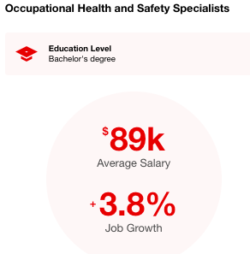
Industrial Technology & Transportation
Possible Career Opportunities
Technologists and Technicians
Civil Engineers
Commercial and Industrial Designers
Computer Hardware Engineers
Computer Numerically Controlled Tool Programmers
Construction Managers
Cost Estimators
Urban and Regional Planners
etc…..
Administrative Services and Facilities Managers
Aerospace Engineering and Operations Technologists and Technicians
Architects
Architectural and Civil Drafters
Automotive Service Technicians and Mechanics
Architectural and Engineering Managers
Cabinetmakers and Bench Carpenters
Calibration Technologists and Technicians
Carpenters
Civil Engineering Technologists and Technicians
Notes:
- degree/certificate/noncredit options in each pathway
- career opportunities
- program mapper tool
- and anything else you deem pertinent to a pathways info session.
We will have 15 minutes for each Pathway listed (Education, SBS, PCE)

Slide 27
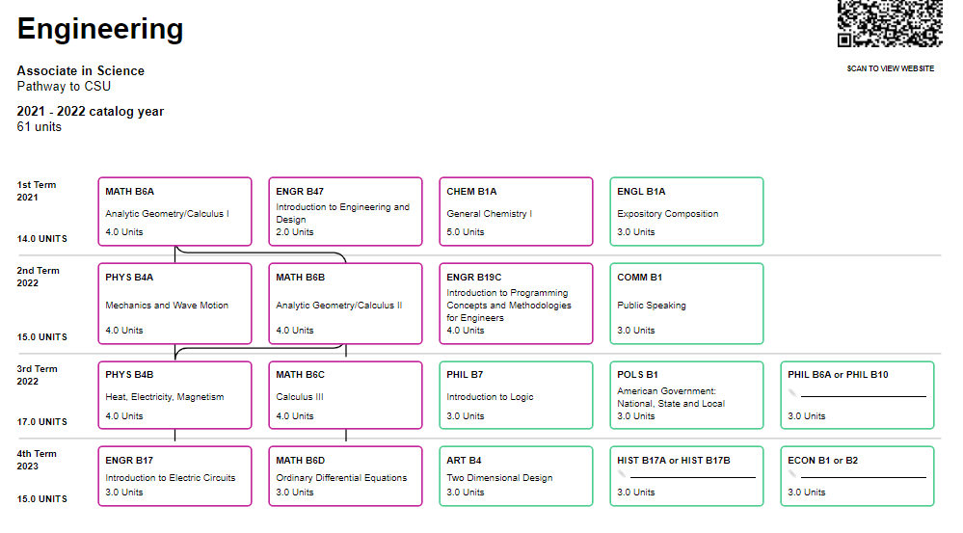
Industrial Technology & Transportation
Contact Information for Pathway:
Stephen Agard, Lead Counselor (Main)
stephen.agard@bakersfieldcollege.edu
(661) 395-4421
Cynthia Quintanilla, Lead Counselor –
B.S. Industrial Automation Degree (Main)
cquintan@bakersfieldcollege.edu
(661) 395-4811
Mark Dylan Jensen, Educational Advisor, CTE (Main)
dylan.jensen@bakersfieldcollege.edu
(661) 395-3571

Slide 28
Public Safety
Degrees
Administration of Justice
Correctional Administration
Criminal Justice
Fire Technology
Paramedic Program
Wildland Firefighting
High Unit Certificates ≥ 18.0 units
Executive Chief Fire Officer
Fire Academy
Firefighter I Academy
Fire Technology
Paramedic Program
Low Unit or Non-credit Certificates < 18.0 units
Application of Transformational Policing
Emergency Medical Technician
Wildland Firefighting

Slide 29
Public Safety
Possible Career Opportunities
Bailiffs
Computer Occupations
Firefighters
Police and Detectives
Forensic Science Technicians
Forest Fire Inspectors and Prevention Specialists
Gambling Surveillance Officers and Gambling Investigators
Health and Safety Engineers
Life, Physical, and Social Science Technicians
Correctional Officers and Jailers
Criminal Justice Teachers
EMT & Paramedics
Detectives and Criminal Investigators
Personal Service Managers
Public Safety Telecommunicators
School Bus Monitors and Protective Service Workers
Security Guards
Notes:
- degree/certificate/noncredit options in each pathway
- career opportunities
- program mapper tool
- and anything else you deem pertinent to a pathways info session.
We will have 15 minutes for each Pathway listed (Education, SBS, PCE)

Slide 30
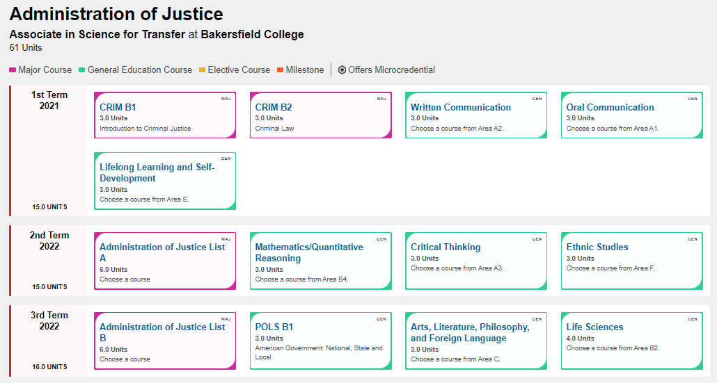
Public Safety
Contact Information for Pathway:
Fabiola Johnson, Lead Counselor (Main/Weill)
fabiola.johnson@bakersfieldcollege.edu
(661) 395-4421
Dominica Rivera-Dominguez, Educational Advisor, CTE (Main)
domriver@bakersfieldcollege.edu
(661) 395-4316
Natalie Castenon, Educational Advisor (Main)
(661) 395-4421

Slide 31
Social & Behavioral Science
Degrees
Anthropology AAT
Economics AAT
History AAT
Political Science AAT
Psychology AAT
Sociology AAT
Human Services AA
High Unit Certificates ≥ 18.0 units
None
Low Unit or Non-credit Certificates < 18.0 units
Human Services

Slide 32
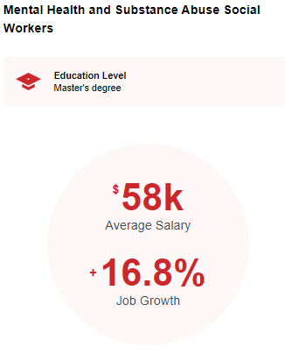
Social & Behavioral Science
Possible Career Opportunities
Anthropologist
Archaeologist
Area, Ethinic and Cultural Studies
Art, Drama and Music Teachers
Artist and Related Workers
Child, Family and Social Workers
Probation/Correctional Officers
Clinical, Counseling, and School Psychologists
Counselors
Economist
Foreign Language and Literature
Historians
Interpreter
Survey Researchers
Tour & Travel Guides
Political Scientists
Notes:
- degree/certificate/noncredit options in each pathway
- career opportunities
- program mapper tool
- and anything else you deem pertinent to a pathways info session.
We will have 15 minutes for each Pathway listed (Education, SBS, PCE)

Slide 33
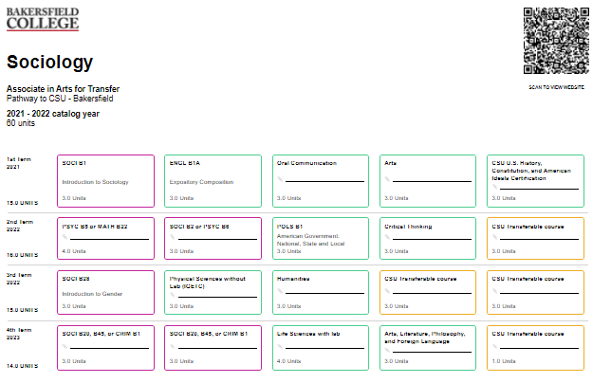
Social & Behavioral Science
Contact Information for Pathway:
Sarah Villasenor, Lead Counselor (BCSW/Main)
svillase@bakersfieldcollege.edu
(661) 395-4421
Jo Ann Acosta, Educational Advisor (Main)
Pre-Law https://www.bakersfieldcollege.edu/prelaw
jacosta@bakersfieldcollege.edu
(661) 395-4667
Lupe Aguirre, Educational Advisor (Job Spot)
lupe.aguirre@bakersfieldcollege.edu
(661) 396-4992
Tiffany Brown, Educational Advisor (Main)
tiffany.brown@bakersfieldcollege.edu
(661) 395-4377

Slide 34
Science, Technology,
Engineering, & Math Pathways
Degrees
Biology AST
Chemistry AST
Chemistry AS for UC
Computer Science AST
Environmental Science AST
Geology AST
Mathematics AST
Physics AST
Physics AS for UCTP
Chemistry AST
Engineering AST
High Unit Certificates ≥ 18.0 units
Web Design and Development COA
Low Unit or Non-credit Certificates < 18.0 units
None

Slide 35

Possible Career Opportunities
Atmospheric and Space Scientist
Atmospheric, Earth, Marine, and Space Science
Biological Science Teachers
Biological Technicians
Chemical Engineers
Compliance Officers
Computer Network Architects
Engineers
Environmental Science and Protection Technicians
Geographers
Information Security Analysts
Mathematicians
Natural Sciences Managers
Physicists
Statisticians
Urban and Regional Planners
Web Developers and Digital Interface Designers
Special Effects Artists and Animators
Forest and Conservation Technicians
Notes:
- degree/certificate/noncredit options in each pathway
- career opportunities
- program mapper tool
- and anything else you deem pertinent to a pathways info session.
We will have 15 minutes for each Pathway listed (Education, SBS, PCE)

Slide 36
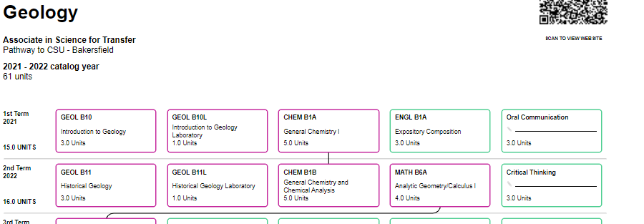
Contact Information for Pathway:
Laurel Mourtzanos, Lead Counselor (STEM Center)
laurel.mourtzanos@bakersfieldcollege.edu
(661) 395-4421
Jesus Oropeza, Counselor (Delano)
jesus.oropeza@bakersfieldcollege.edu
(661) 720-2077
Josh Shackelford, Educational Advisor (STEM Center)
joshua.shackelford@bakersfieldcollege.edu
(661) 395-4421
Jonathan Kim, Educational Advisor (Main)
jonathan.kim@bakersfieldcollege.edu
(661) 395-4346

Slide 37
Personal & Career Exploration
Degrees
Liberal Arts
High Unit Certificates ≥ 18.0 units
California State University (CSU) General Education Breadth
Intersegmental General Education Transfer Curriculum (IGETC)
Intersegmental General Education Transfer Curriculum (IGETC) for STEM
Low Unit or Non-credit Certificates
< 18.0 units
None

Slide 38
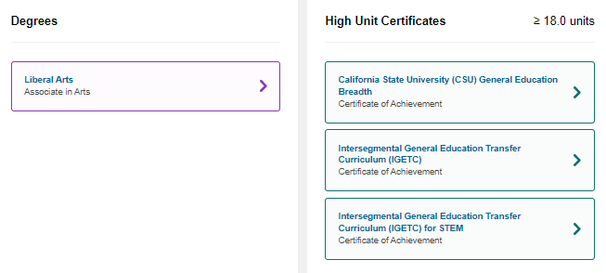
Contact Information for Pathway:
Jonathan Schultz, Counselor (Main/BCSW)
jonathan.schultz@bakersfieldcollege.edu
(661) 395-4421
Aneesha Awrey, Lead Counselor (Main)
aneesha.awrey@bakersfieldcollege.edu
(661) 395-4421
Lupe Aguirre, Educational Advisor
lupe.aguirre@bakersfieldcollege.edu
(661) 396-4992
Personal & Career Exploration

