Slide 1
Today’s Students. Tomorrow’s Workforce.
Powered by:

Slide 2
On-Campus Employment
495
Student Employees employed on-campus as of March 2019
53
Departments on-campus that employ students
37
Departments that utilize Federal Work Study funding

Slide 3
On-Campus Employment Process
On-Campus flow simulates current HR process
Students are filtered for minimum qualifications and sent to the perspective department supervisor
Supervisors conduct interviews and make a selection
Prospective student then comes to Student Employment to complete onboarding paperwork
Students background link is requested and sent
Upon notification of completion of background, student is added to a “board action” and submitted to HR
Once clearance is received from HR student is cleared to work
Provides an equitable process for all students
Requires a resume
More Mobile
More Interactive
More Data Focused
More Engagement
More Social

Slide 4
Improvements to getting students hired
When job closes contact your Job Developer right away
After extending an offer send the student right away to FACE 16 with 2 forms of ID
Follow up with student to see if they have completed the background check
Call Student Employment at anytime for an update to find out where the student is in the process
Communication is key!

Slide 5
Supervisor Support
On-campus Supervisor handbook
Individual Job Developer and first time/ongoing training and support
Support with Needs Improvement Plans and Terminations
KUDOS CORNER!
NEW
Department Trainings for Student Employees

Slide 6
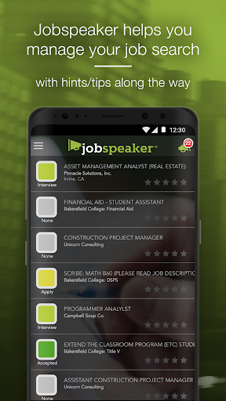
All in One!
Automatically pulls SLOs from declared programs to assist in creating profile and resume
Click of a button students profile turns into a printable resume.
Apply for on and off campus jobs
24 hours a day/7 days per week
Via online or mobile application
Reminder Notifications
For events and interviews
On-Campus event advertising and registration
Include attachments and public links
Learning Center
9 Informational Short Videos
Job Readiness Related
UExplore
Students can explore wages, job trends and career exploration
UVerify
Students can enter employment information which will provide data on employment outcomes
Alumni status
Work Based Learning
Currently in Beta testing

Slide 7
Help Us Get The Word Out
Include in your syllabus
Short statement available
Allow a classroom visit
Share our monthly newsletter
Encourage students to attend a Jobspeaker Workshop – Every Monday 1-3pm in CSS 151
Also available at BC South West Campus and Delano Campus
Work with Student Employment to schedule your own workshop
Look out for us “popping up” around campus
Follow us on social media #BakersfieldCollegeCTE

Slide 8
Questions?

