Slide 1
Inmate Education: Pathways
By Michael P McNellis
Department Chair & Professor, Philosophy
Friday, April 12, 2019
Notes:
By Michael P McNellis
Department Chair & Professor, Philosophy

Slide 2
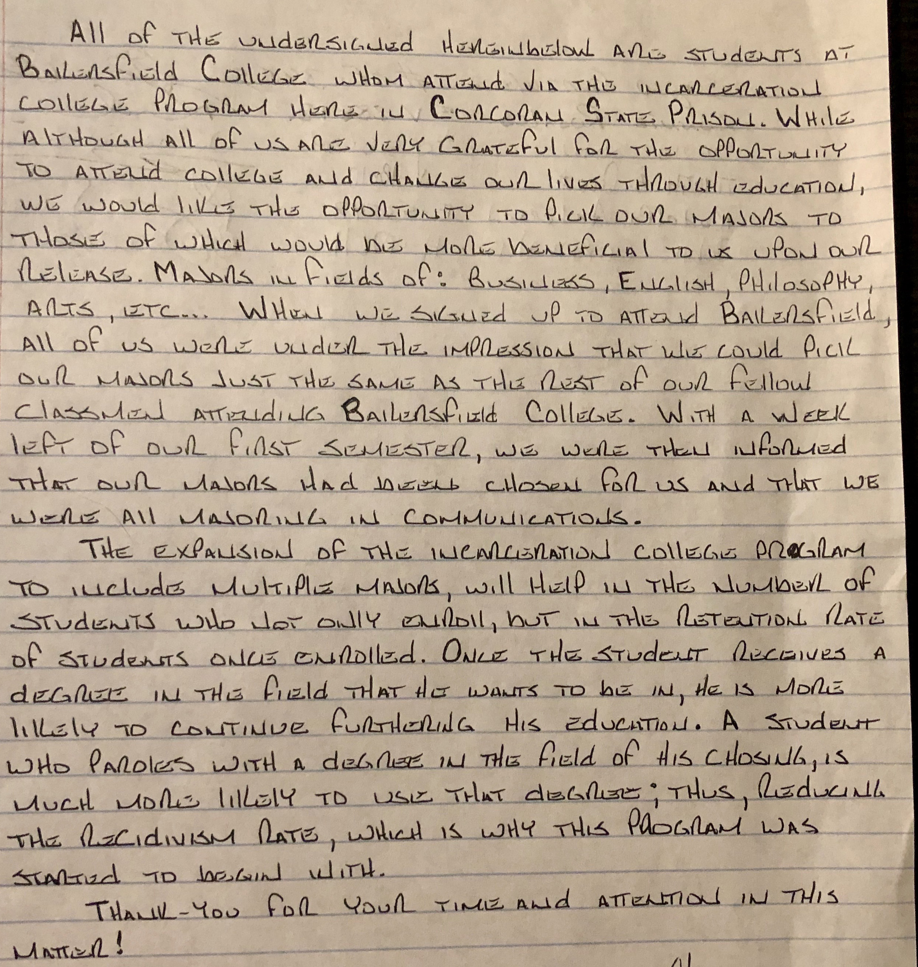
Signed Letter from 12 Inmate Scholars
Notes:
By Michael P McNellis
Department Chair & Professor, Philosophy

Slide 3
Current Degree Options
Only one option is being offered for Inmate Scholars:
Communication Degree [verified]
Another option was mentioned to Inmate Scholars:
Double Major, where one must be Communication
[unverified]
Notes:
By Michael P McNellis
Department Chair & Professor, Philosophy

Slide 4
Inmate Leaders Recurring Message
Regarding Philosophy Majors in particular
Several times, including as early as yesterday, Inmate Leaders told Inmate scholars that they cannot major in philosophy, in particular [verified]
and
[removed this comment – unverified]
and
[removed this comment – unverified]
Message: No philosophy degree is available
Notes:
By Michael P McNellis
Department Chair & Professor, Philosophy

Slide 5
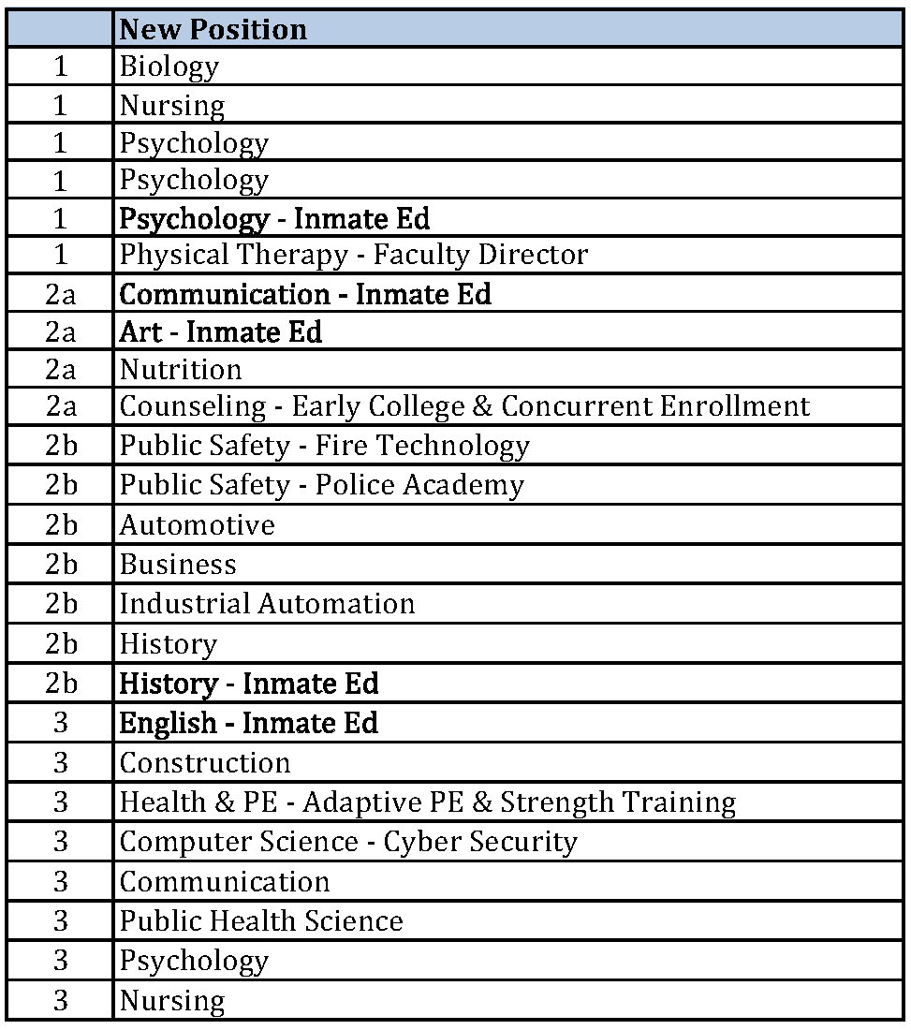
Our 5 Approved New Inmate Positions
Psychology
Communication
Art
History
English
No Philosophy
No Foreign Language
Two areas that were negatively impacted that led to the current Prison MOU
Notes:
By Michael P McNellis
Department Chair & Professor, Philosophy

Slide 6
Handout
Contains two items
Request (separate from Program Review) for Tenure-track position for Inmate Education
  No reply from anyone
Letter from an Inmate Student currently taking a philosophy course and wanting to major in philosophy
Notes:
By Michael P McNellis
Department Chair & Professor, Philosophy

Slide 7
Recommendations
Request an investigation into who decided the curriculum for the Inmate Programs, as when I talked to the VP of Instruction, she was not aware of the process of offering only one degree. The decision is not coming from FCDC or the VPs office. Who is directing all this?
We need to have transparency into this process and clarification of the process. Let’s keep the discussion going.
Should we try to offer more degrees and how can we go about this?
Notes:
By Michael P McNellis
Department Chair & Professor, Philosophy

