Slide 1
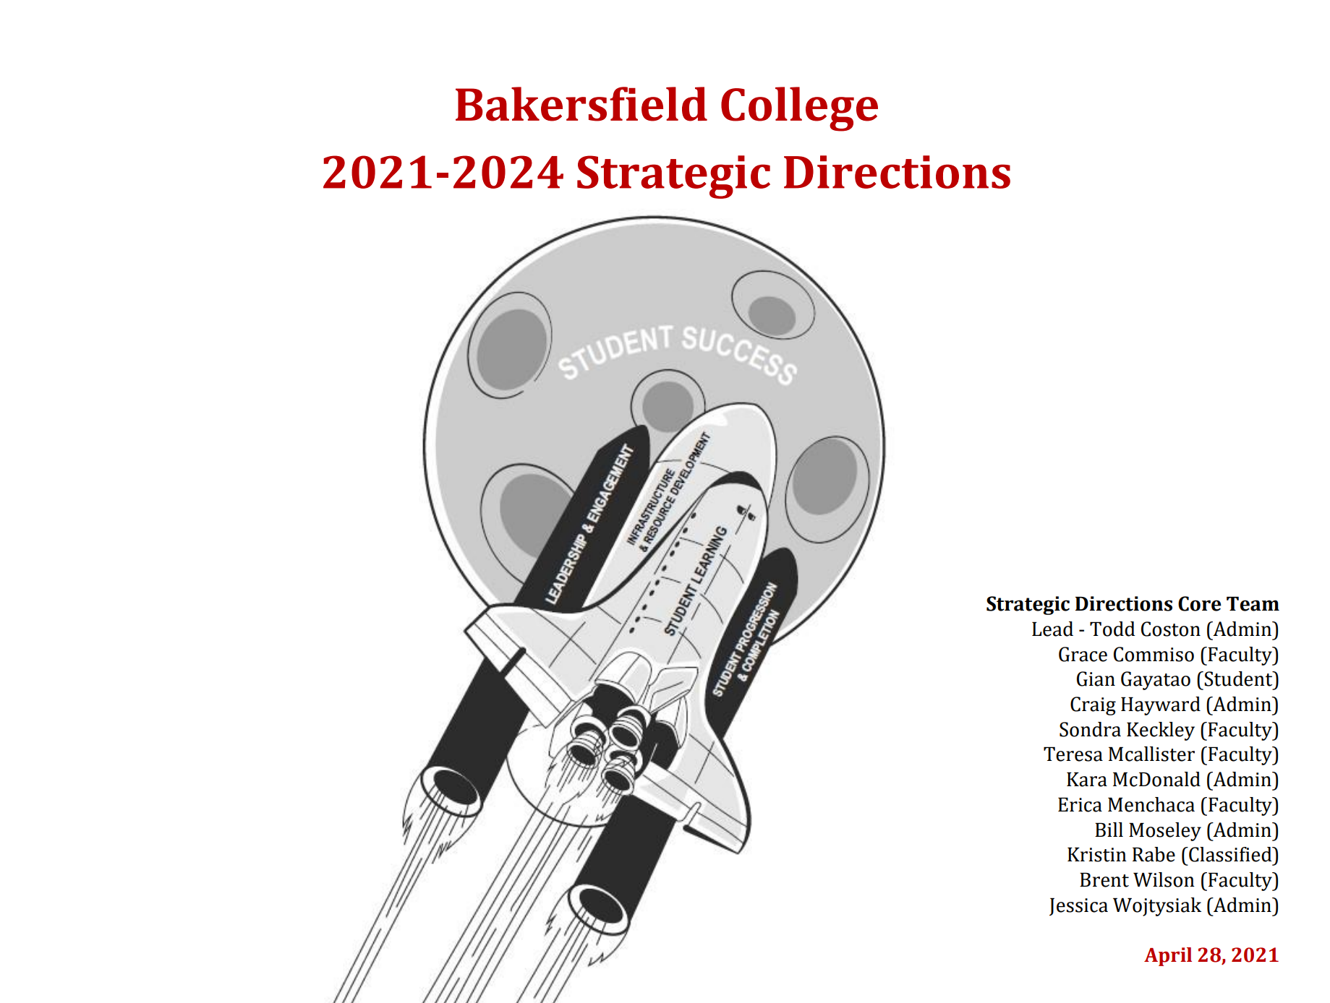

Update to College Council - Spring 2024
Kristin Rabe & Manny Mourtzanos

Slide 2
Presentation at a Glance
Overview of Strategic Directions 2021-24
Structure of Strategic Directions 2021-24
Annual Report on Progress
Recommended Action Item

Slide 3
What is our Strategic Directions document?
BC’s strategic planning document to provide guidance, reporting and transparency to the implementation of our institutional mission, vision and values.
Operationalizes institutional priorities
The ‘how’ behind our ‘what’

Slide 4
Access and Navigation
Home → About → Administration → Accountability → Strategic Directions
https://www.bakersfieldcollege.edu/about/administration/accountability/strategic-directions.html

Slide 5
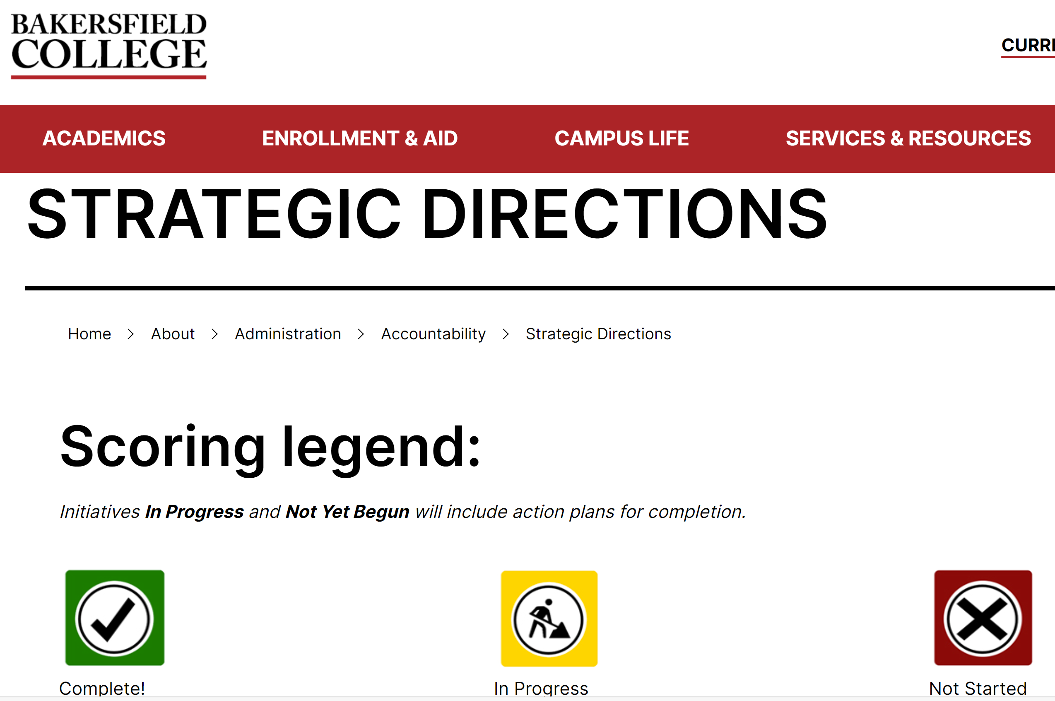
Access and Navigation

Slide 6
Structure of BC Strategic Directions 2021-24
123 pages (April 18, 2021)
Four (4) Goals
26 Areas
73 Strategic Initiatives (objectives)

Slide 7
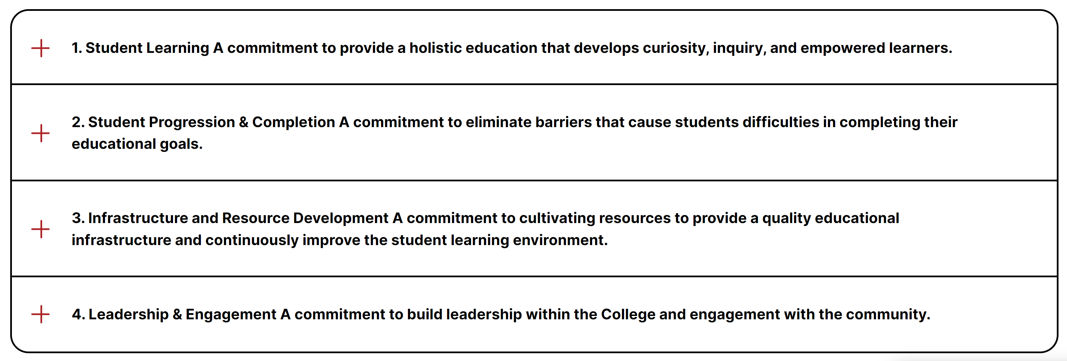
BC Strategic Goals

Slide 8
Goal 1: Student Learning
  Humanizing Learning (3)
  Inmate Education (2)
  OERs/Instructional Resources (2)
  Adult Education (4)
  Career and Technical Education (5)
  CTE Internships (3)

Slide 9
Goal 2: Student Progression and Completion
  Auto-Enrolling Default Pathways (3)
  8-Week Sessions (3)
  Competency Based Education (3)
  Early College (2)
  Non-Credit Courses/Career Development & College Preparation (3)
  Leadership Institute (1)

Slide 10
Goal 2: Student Progression and Completion
  Data Driven Support (3)
  Financial Aid (2)
  Academic Support (2)
  Enrollment Trends Related to the Pandemic (3)
  Student Health and Basic Needs (3)
  Dual Admission (1)

Slide 11
Goal 3: Infrastructure & Resource Development
      Private Philanthropy (3)
      External Internet (3)
      Campus Beautification (5)

Slide 12
Goal 4: Leadership and Engagement
      Economic and Workforce Development (3)
      Faculty Diversification and Development (3)
      Guided Pathways Leadership (2)
      Academic Senate Leadership (3)
      Accessibility (3)

Slide 13
Annual Report on Progress
Campus Lead(s) self-report a progress score
  Complete
  In Progress
  Not Started
100% response rate for 2024-25
No assessment on accompanying action plan

Slide 14
Recommended Action Item
Recommend a one-year extension on Strategic Directions 2021-24 to align with the timing and cycle of Chancellor Bloomberg forthcoming Strategic Initiative Plan for Kern CCD (anticipated sometime in AY25)

Slide 15
Open Mic
&
Thank you

