Slide 1
Accreditation Update
College Council
February 24, 2023

Slide 2
Educational Master Plan
Strategic
Directions
Technology Master Plan
Facilities
Master Plan
Institutional Self-Evaluation Report

Slide 3
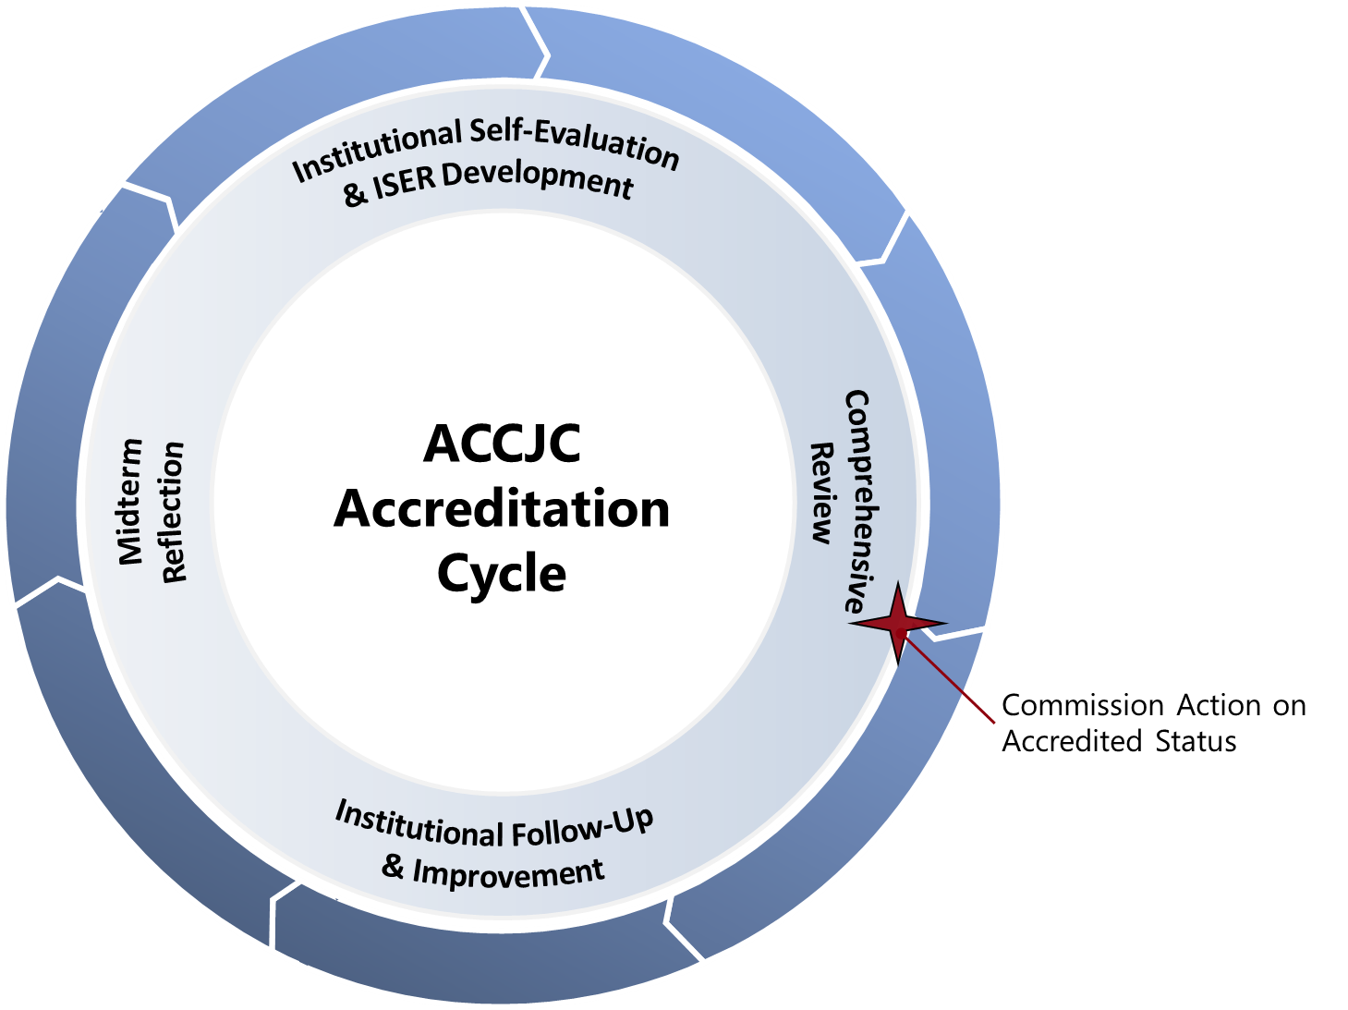
Accreditation Cycle and Reports
Institutional Self Evaluation & Comprehensive Review (every 7 years)
Follow Up Reports (if required)
Midterm Reporting (4th year after comp review)
Ongoing Reporting
Annual Report
Annual Fiscal Report
Substantive Change
November 22 Training with ACCJC liaison to begin ISER work
7 Year

Slide 4
Comprehensive Peer Review
College
Self-Reflection
ISER
Team ISER Review
Standards Validation
Core Inquires
Off-Campus Site
Focused Site Visit
Core Inquires
On-Campus Site
Team Report
Commission Action
(Affirmation)
College
Prep
ISER
Due
12/15/24
Spring
2025
Fall
2025
January
2026

Slide 5
Beyond the ISER
Self-Reflection (ISER)
Peer Review (Team ISER Review & Focused Site Visit)
Affirmation (ACCJC Action)
Ongoing Commitment to Improvement & Educational Excellence

Slide 6
New Standards
Draft 2024 with Draft Review Criteria/Evidence:
https://accjc.org/wp-content/uploads/19.b.i-FirstReading-StandardsCriteriaEvidence-CLEAN-2022-12-09.pdf
Comment Form: https://accjc.org/standards-review-comment-form/
2nd and expected final reading: June 2023

Slide 7
Benefits to the New Standards
Fewer standards to write to: 127 to about 30
No QFE
Revised Data Prelude
Sections focus upon analysis (not Evidence of Meeting the Standard and Analysis of Evaluation)
Shift to 8 year cycle
Support ACCJC by helping to pilot the new standards

Slide 8
Developing the ISER
Collaborative Partnership – multiple groups and perspectives working together!

