Slide 1
2022-25 Student Equity Plan 2.0
Activities Planning and Development
Student Equity Planning Presentation PART 2
11/18/2022
Bakersfield College Student Equity Plan 2.0

Slide 2

Five Key Student Outcomes
Successful Enrollment in the first year [Access]
Completed Transfer Level Math & English in the first year [Progress]
Persisted from First Primary Term to Subsequent Primary Term [Persistence]
Attained the VFS Definition of Completion within 3 years [Completion]
5. Transferred to a 4-Year Institution within 3 years [Transfer]
Bakersfield College Student Equity Plan 2.0
Notes:
Directly from CCCCO SEP data files

Slide 3
Planning and Developing Activities
Data-informed decision-making and dialogues
  Key takeaways from past equity work
  Evaluation of the current structure and resources
  Population experiencing the most significant disproportionate impact
  3-Year Goal Setting
College Workplan
  Strategies, processes, and actionable activities correlated with 5 metrics
Engaging and Communicating with Stakeholders
  Key stakeholders from student affairs, instruction, and OIE
  Focus Groups: Student, Faculty, and Classified Voices
Bakersfield College Student Equity Plan 2.0

Slide 4
Population Experiencing the Most Significant Disproportionate Impact and Metrics
Access
Black/African American
Progress
Black/African American
First Generation
Persistence
Black/African American
Economically Disadvantaged
Hispanic/Latinx
Transfer
Completion
Black/African American
Male
Male
First Generation
Economically Disadvantaged
Hispanic/Latinx
First Generation
Bakersfield College Student Equity Plan 2.0

Slide 5
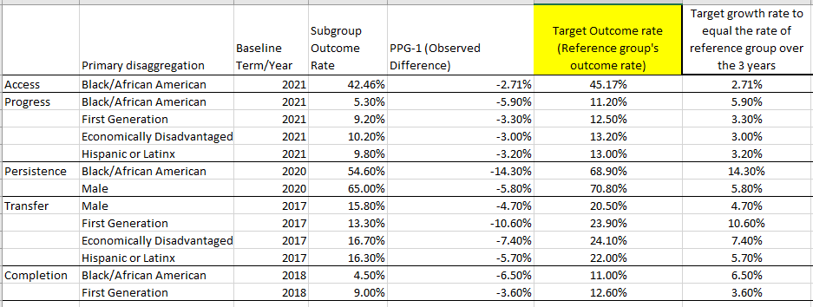
Bakersfield College Student Equity Plan 2.0

Slide 6
Successful Enrollment in the first year
Targeted outreach efforts
High-tech, high-touch advising and counseling support
Expanded community outreach and advertising
Student centered scheduling and course sequencing
Promoting and enhancing BC programs and services
ACCESS Student Equity Plan 2.0

Slide 7
Completed Transfer Level Math & English in the first year
Leveraging institutional data for tracking and assessment through an equity lens
Increasing awareness and access to Academic Support Services
Supporting academic success in English and math
Accurate and Consistent Ed Plan/Pathway Resources and Guidance
PROGRESS Student Equity Plan 2.0

Slide 8
Persisted from First Primary Term to Subsequent Primary Term
Student-centered Scheduling, Course sequencing
Targeted outreach with holistic support
Intrusive Support for Financial Assistance
Encouraging/supporting messages from faculty/counselors/BC
Leveraging College Persistence Initiatives
PERSISTENCE Student Equity Plan 2.0

Slide 9
Attained the VFS Definition of Completion within 3 years
  Leveraging institutional data and initiatives
  Continuous awareness of enrollment process
  Student-Centered Scheduling
  High-tech, high-touch engagement
  Promoting workforce employment opportunities for students
COMPLETION Student Equity Plan 2.0

Slide 10
Transferred to a 4-Year Institution
within 3 years
  Maximizing current transfer pipeline initiatives and events
  Expanding partnership and collaboration with CSU/UC
  Improving our digital tools to increase and support transfers
  Improving transfer advising and counseling services
  4-year College and University Transfer “Next Steps” workshops
  Developing transfer progress & utilizing momentum reports
TRANSFER Student Equity Plan 2.0

Slide 11
  Defining the process to elicit equitable student success outcomes
    Intrusive advising and financial assistance
    Enhancing internal academic support services outreach
    Leveraging institutional data for enhanced tracking and evaluation
    Maximizing College’s digital tools to support students’ education goals
    Coordinated and focused efforts between Instruction and Student Affairs
Key Themes Student Equity Plan 2.0

Slide 12
Student Equity Plan 2.0
Imelda Valdez
Rebecca Farley
Marisa Marquez
Ben Perlado
Ashlea Ward
Office of Institutional Effectiveness
Focus Groups: Students, Faculty, and Classified Voices
Bakersfield College Student Equity Plan 2.0

