Slide 1
Student Success:
Exploring online tools to track course success rates
College Council
10/21/2022
Bakersfield College Office of Institutional Effectiveness
Notes:
Data as a tool to identify success and challenges, continuous improvement of student outcomes

Slide 2
Online Tools
Institution-Set Standards (no login):
https://datamart.cccco.edu/Outcomes/Course_Ret_Success.aspx
Course Retention and Success Dashboard (no login):
https://public.tableau.com/app/profile/bc.office.of.institutional.effectiveness/viz/CourseRetentionandSuccessRates/CourseSuccess
Course Bottleneck Dashboard* (no login):
https://public.tableau.com/app/profile/bc.office.of.institutional.effectiveness/viz/BakersfieldBottleneckAnalysis/BottleneckSuccess
* EW grades are not counted in the success calculations for Spring 2020
Historical Course Success Dashboard (requires login):
https://ir.kccd.edu/data-directory/historical-course-success-dashboard/index.html
Transfer-Level Gateway Completion Dashboard (no login):
https://www.cccco.edu/About-Us/Chancellors-Office/Divisions/Educational-Services-and-Support/transfer-level-dashboard
Data Mart Course Success Link (no login):
https://datamart.cccco.edu/Outcomes/Default.aspx
Bakersfield College Office of Institutional Effectiveness

Slide 3
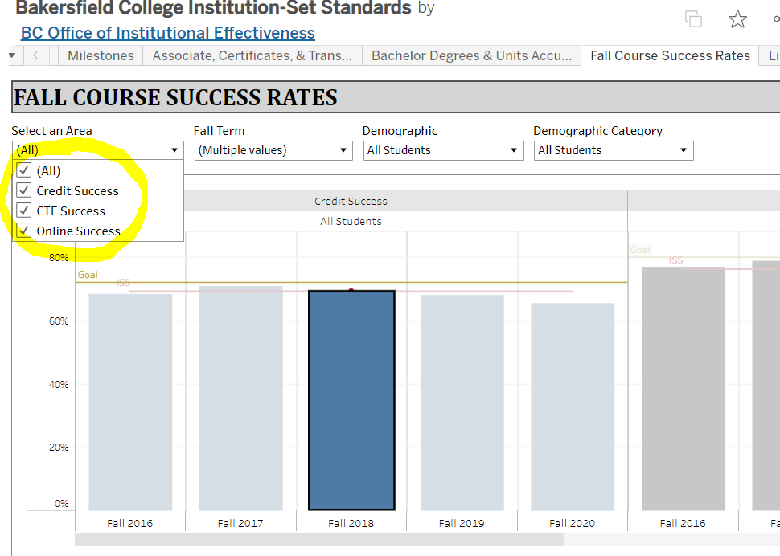
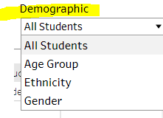
Fall Credit Course Success Rates
ISS metrics are updated on an annual basis to track and evaluate student success over time
Bakersfield College Office of Institutional Effectiveness

Slide 4
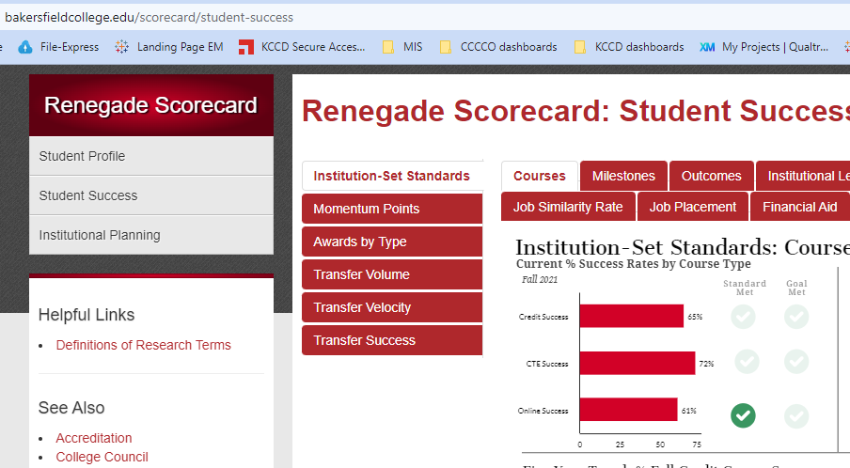
Renegade Scorecard also shows the historical trends of Student Success metrics
Bakersfield College Office of Institutional Effectiveness

Slide 5
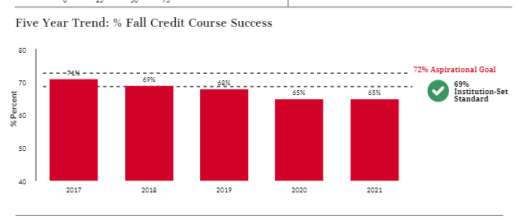
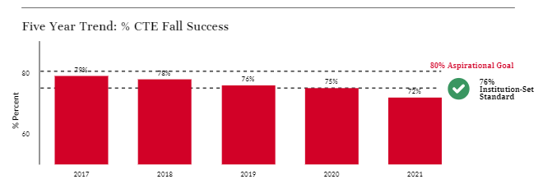
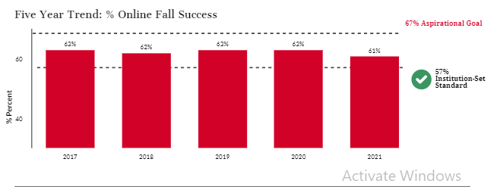
Average credit success rates have dipped below our ISS over the past 3 years
Bakersfield College Office of Institutional Effectiveness

Slide 6
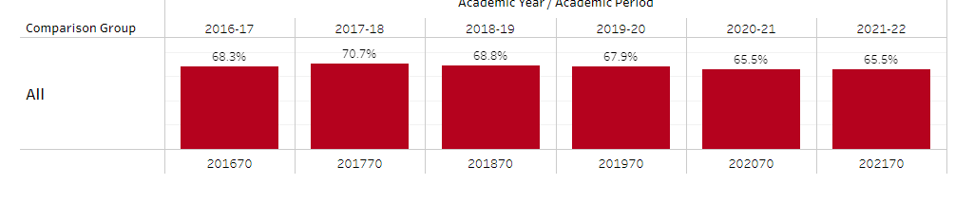
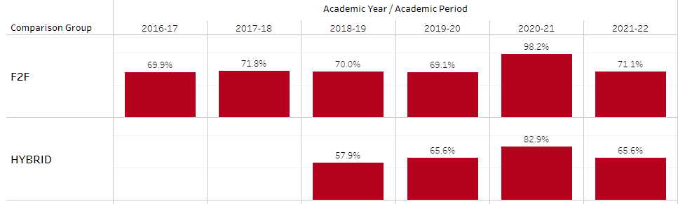
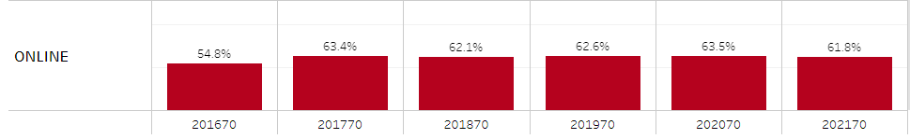
Decline in the average success rates during the pandemic are driven by higher proportion of online classes.
Success rates tend to be higher in F2F classes than in online classes.
In Fall 2020 and Fall 2021, enrollments in online classes made up 92% and 57% of total enrollments, respectively.
% Enrollments by modality | Fall 2016 | Fall 2017 | Fall 2018 | Fall 2019 | Fall 2020 | Fall 2021
F2F | 89% | 88% | 85% | 81% | 3% | 36%
Hybrid |  |  | 2% | 2% | 5% | 7%
Online | 11% | 12% | 13% | 17% | 92% | 57%
All | 61346 | 61190 | 66314 | 69376 | 67279 | 61343

Slide 7
Course Enrollments | Fall 2016 | Fall 2017 | Fall 2018 | Fall 2019 | Fall 2020 | Fall 2021
F2F | 89% | 88% | 85% | 81% | 3% | 36%
Hybrid |  |  | 2% | 2% | 5% | 7%
Online | 11% | 12% | 13% | 17% | 92% | 57%
All | 61346 | 61190 | 66314 | 69376 | 67279 | 61343

Slide 8
On the average, our students perform better in an in-person environment compared to in an online format. In Fall 2020, only a very few particular classes were offered in-person leading to unusually large differences in the average student success rates between traditional classes and online classes.
Source: CCCCO Management Information Systems Data Mart
Note: In Fall 2020, Non-DE classes account for 3% of the total enrollments.

Slide 9
FA 2020 | Ag_ | Arts | Bus | Educ | HSI | ITT | Pub_Sfty | Soc_Beh_Sci | STEM
F2F | 89.4% (n=47) | 98.3% (n=59) | 96.3% (n=54) | 100% (n=4) | 98.3% (n=121) | 95.6% (n=296) | 99.8% (n=612) | 100% (n=30) | 92.3% (n=65)
Hybrid | 86.6% (n=164) | 75.5% (n=335) | 81.5% (n=195) | 81.4% (n=59) | 91.2% (n=1250) | 74.3% (n=896) | 86.2% (n=239) | 84.1% (n=157) | 77.7% (n=184)
Online | 65.8% (n=3819) | 60.1% (n=7688) | 64.8% (n=6565) | 65.1% (n=5406) | 63.5% (n=11420) | 59.1% (n=2957) | 60.9% (n=5191) | 65.2% (n=7936) | 62.5% (n=6766)
All | 66.9% | 61% | 65.6% | 65.3% | 66.5% | 65% | 65.9% | 65.7% | 63.2%

Slide 10
Summary & Recommendations
Though the gap between in-person and online classes has narrowed, there remains a substantial gap in student success
Overall credit success rates have dipped as online courses have become a much larger proportion of the college’s offerings
BC has a separate ISS for online classes and for CTE classes
Recommendation: Adopt a separate standard for in-person credit classes as a complement to the standard for online classes.
  Discontinue setting a standard for all credit courses lumped together
Recommendation: Evaluate the appropriateness of the online class success rate standard as average success rates of online classes has increased in recent years

Slide 11

Discussions

