Slide 1

Finish Fast and Late Start Sections
College Council
September 2, 2022

Slide 2
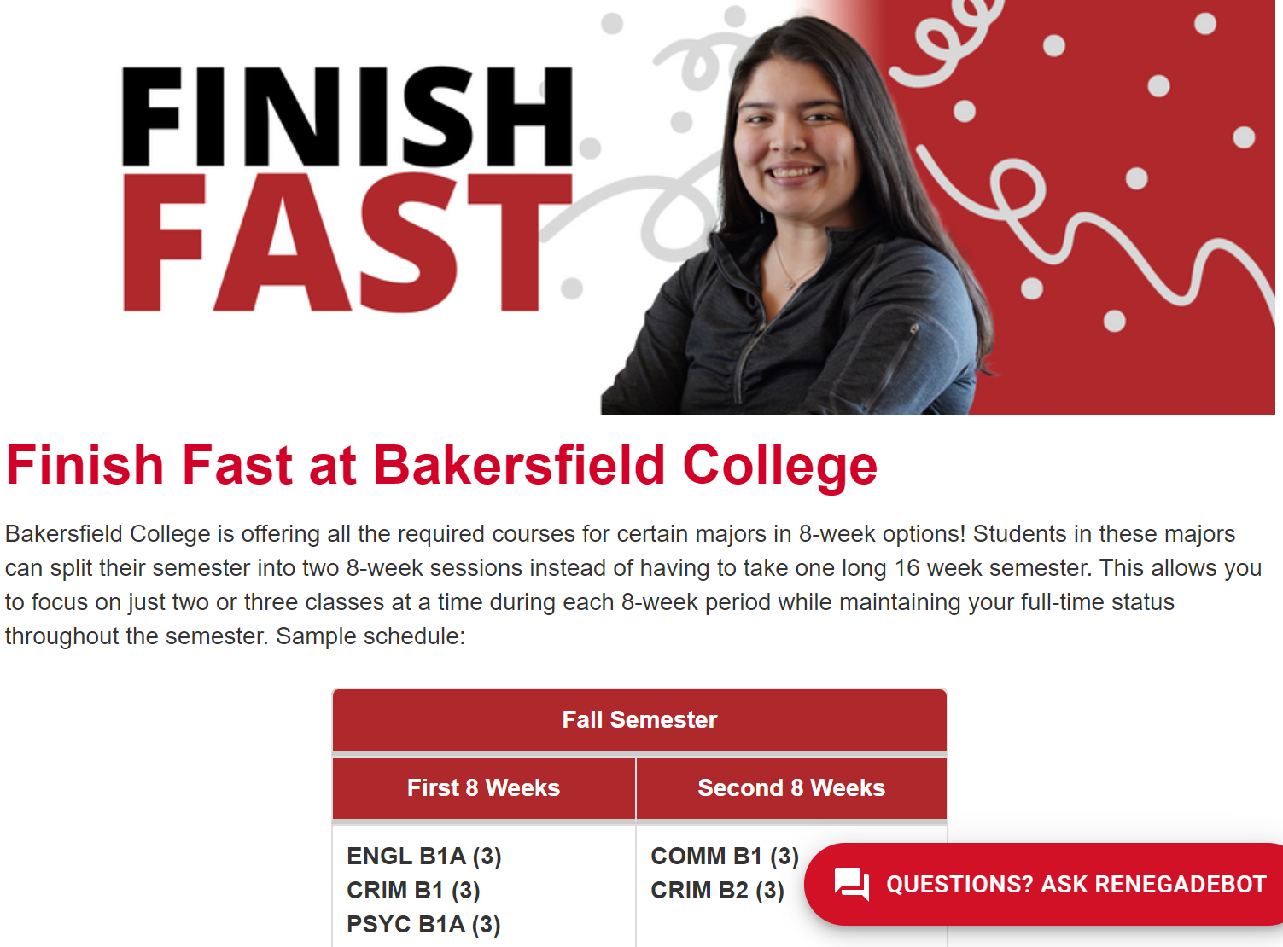
At a glance…
Rebranding of 8+8 program
Offers students the option to complete programs through 8-week sequences
Often hybrid sections

Slide 3

Finish Fast: Background
(Was 8+8)
Includes late start 8 week courses

Slide 4
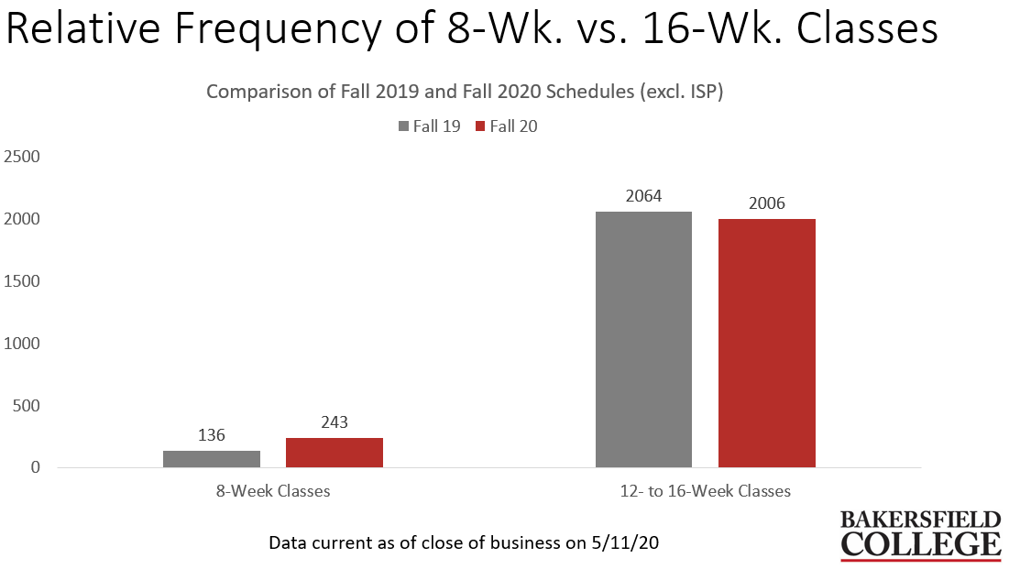
History: 2020 Proposal for BCSW
Pilot:
Complete 8 week scheduling for four degrees:
Psychology ADT
Business Administration ADT
Administration of Justice ADT
Communication ADT

Slide 5
Exact Comparison: Within-Subjects t-test
t(175) = 3.67, p < 0.001
Notes:
The comparison in success rates is for the same course taught by the same instructor in the same modality (i.e., the only important independent variable was course length). Moreover, there is not a statistically significant difference in cumulative college GPA between students in 8-week classes vs. 16-week classes (2.47 vs. 2.48). Eight-week classes tend to be scheduled in primary terms like fall or spring semester, for the most part, whereas summer classes typically tend to be 6 weeks (or, less often, 4 weeks) in length. Students in summer classes (i.e., 6-week classes) do have a significantly higher GPA than students in either 8-week or 16-week classes.

Slide 6
Finish Fast and Late Start Courses
Where are we now?

Slide 7
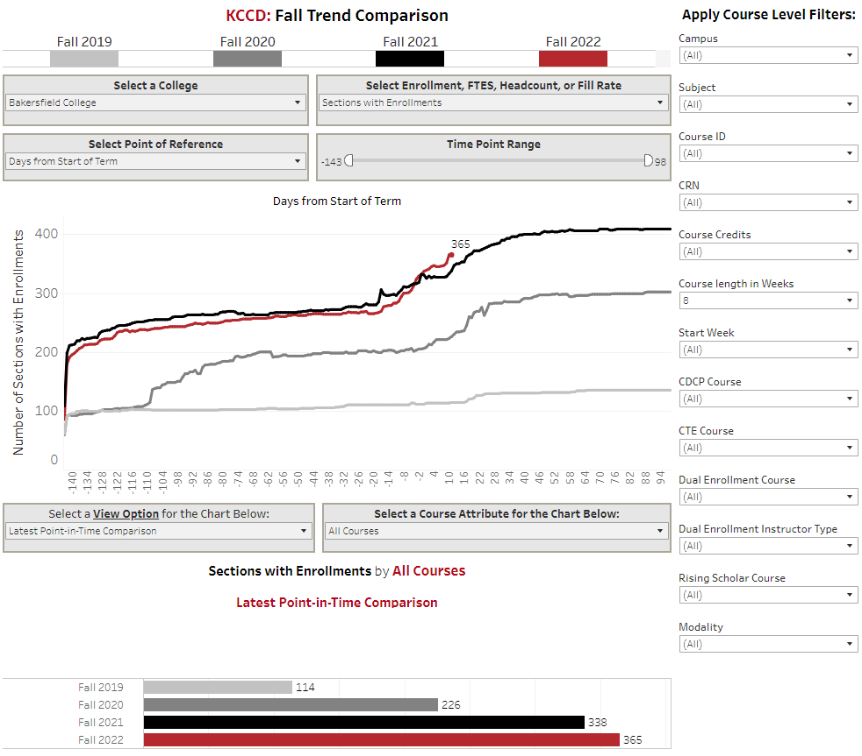
Finish Fast (8 week)
Sections

Slide 8
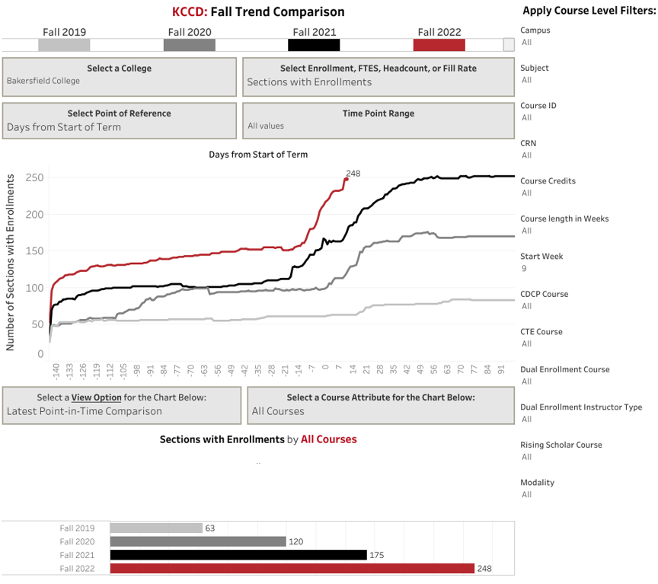
Late Start Sections

Slide 9
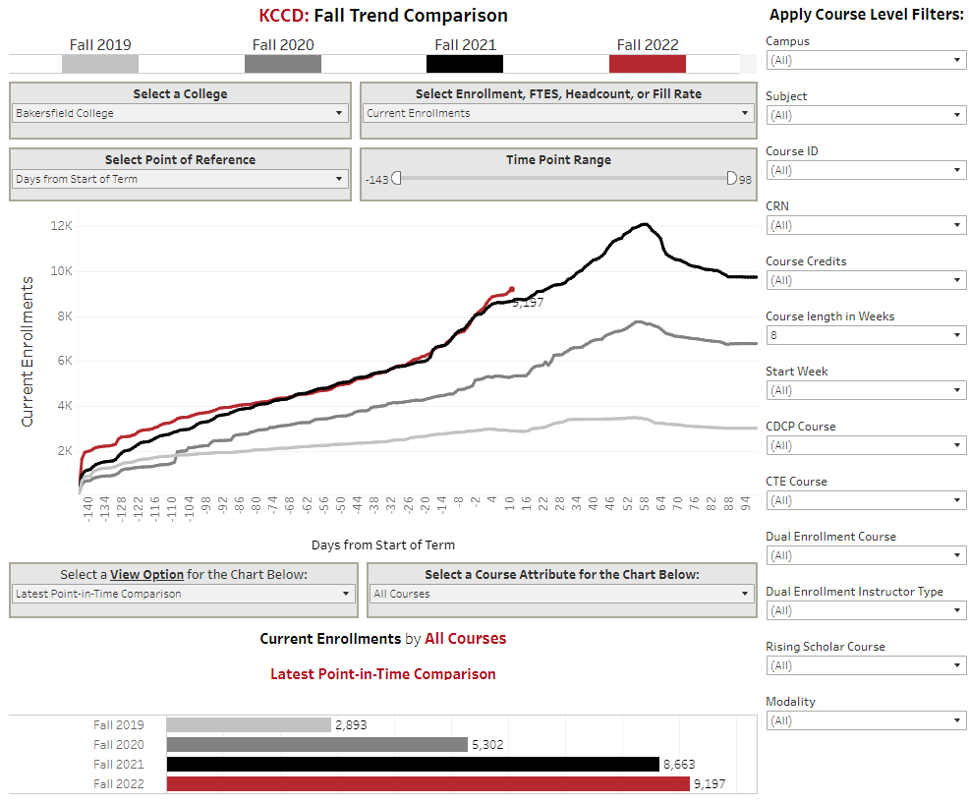
Finish Fast
(8 week)
Enrollments

Slide 10
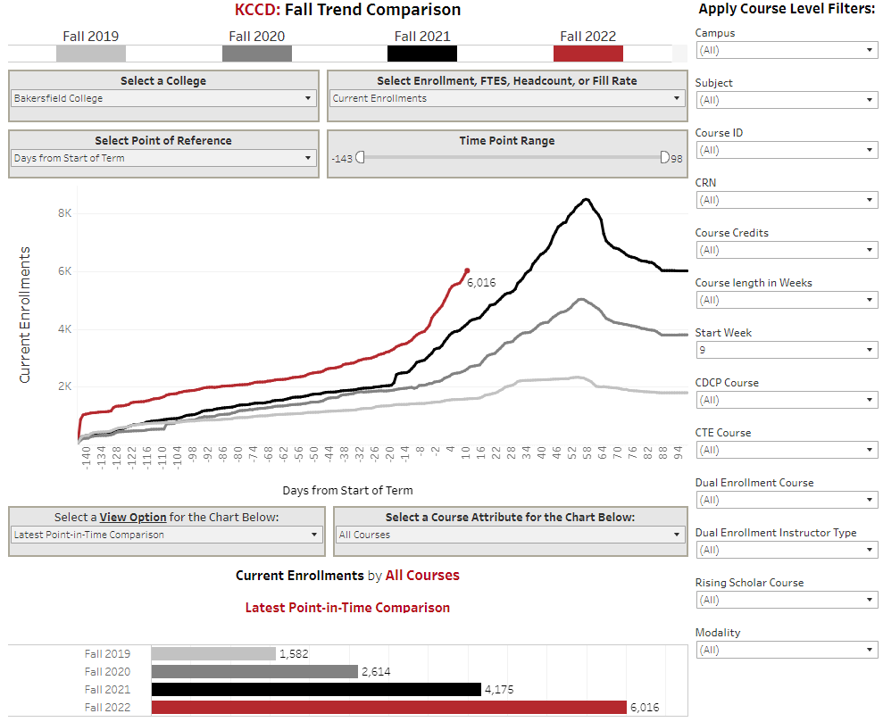
Late Start Enrollments

Slide 11
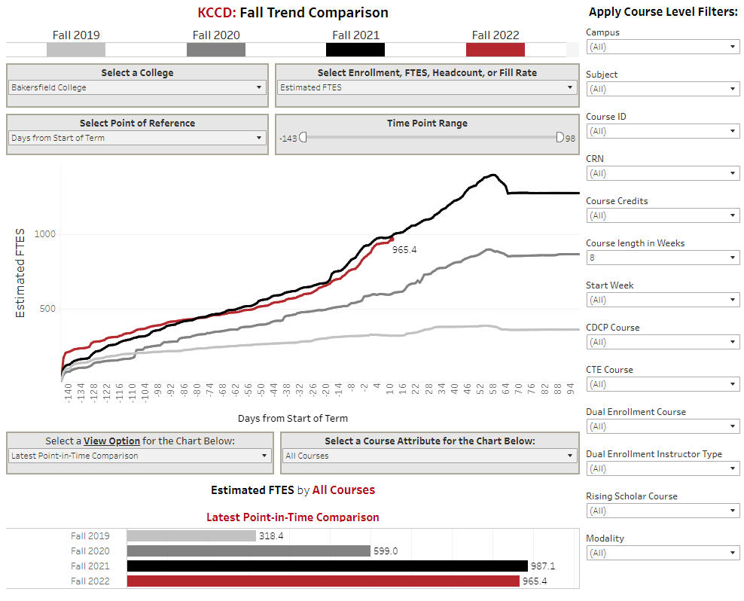
Finish Fast
FTES

Slide 12
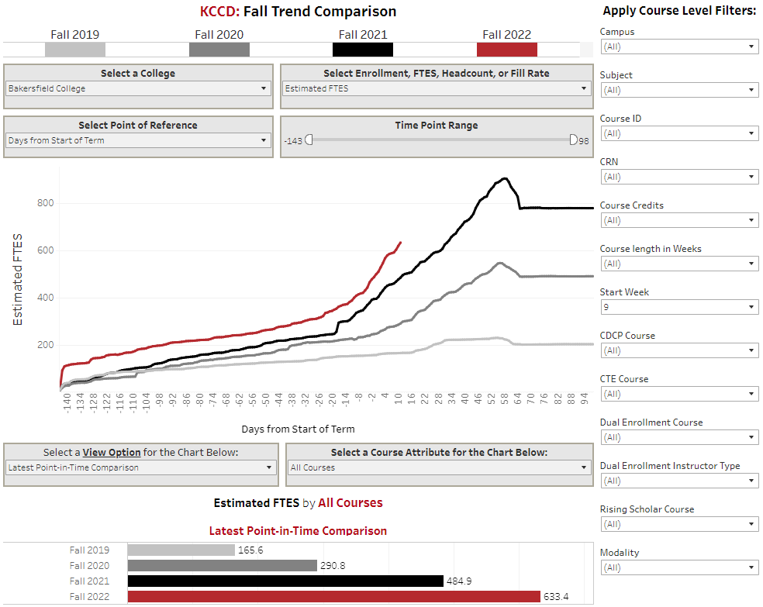
Late Start FTES

Slide 13
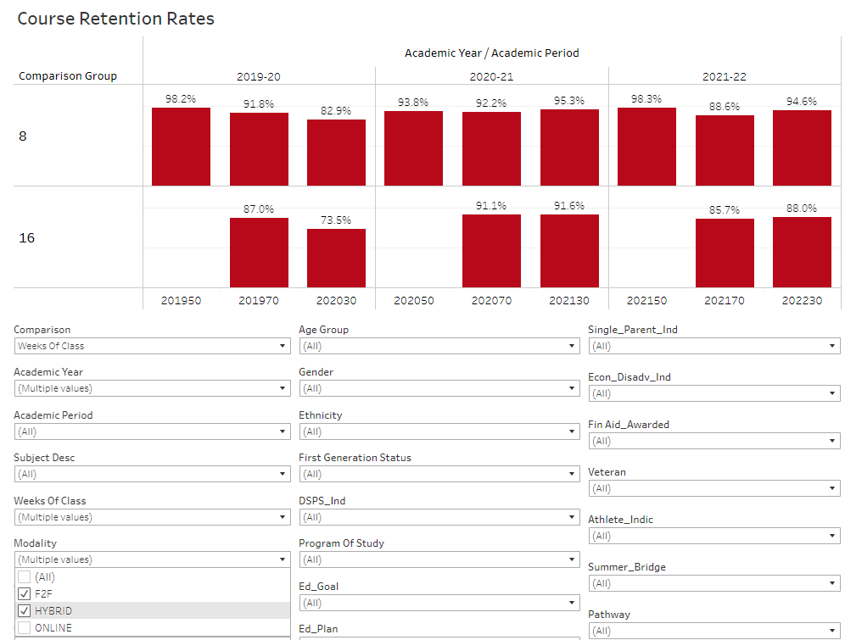
How are students doing?
Course retention
8 v 16 wk
F2F and Hybrid

Slide 14

How are students doing?
Course retention
8 v 16 wk
Online

Slide 15
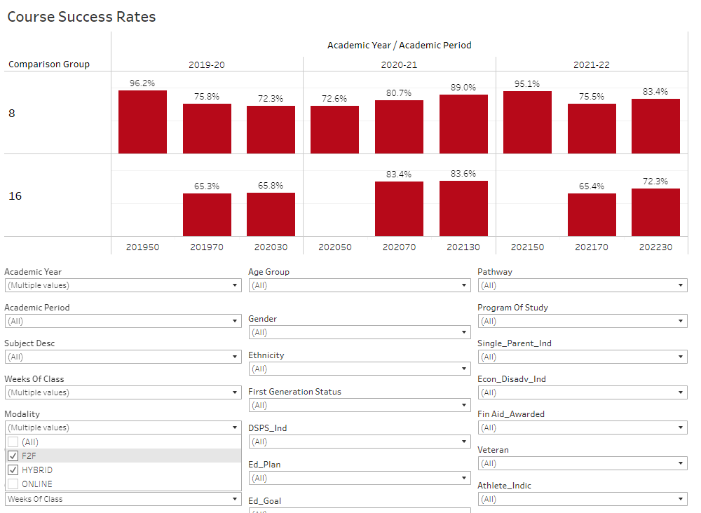
How are students doing?

Slide 16
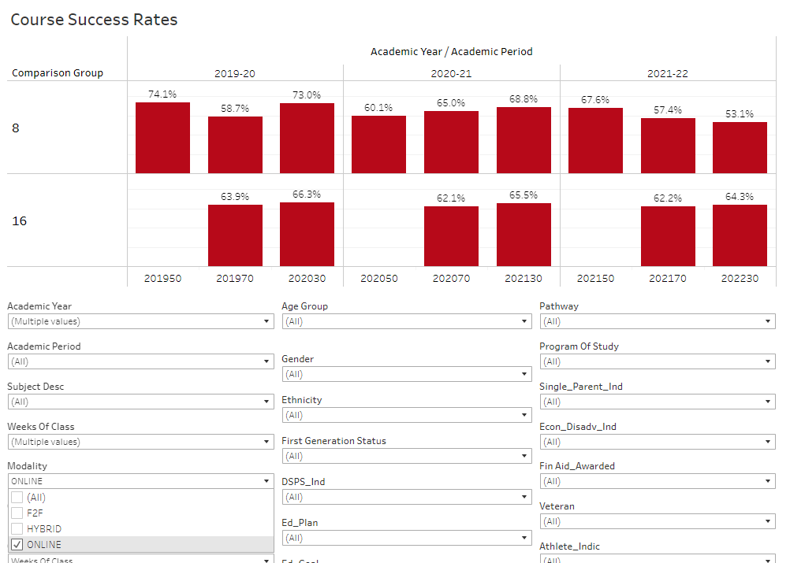
How are students doing?

Slide 17
Opportunities for Thoughtful Spring Planning
Increase combinations of 8 week course sequences
Increase cooperations across departments to pair course
Build face to face and hybrid options to fit student needs

Slide 18

Any Questions?

