Slide 1

Bakersfield College Enrollment Update: Fall 2022
College Council
9/2/22
Zav Dadabhoy
Craig Hayward

Slide 2
Overview
Enrollment growth: Strong but uneven
  Enrollment particularly strong for:
    First-time students
    Dual Enrollment students
Dual Enrollment students are a large component of overall enrollment
Age is a factor preference for in-person vs. online classes
Role of persistence in a robust enrollment management strategy
Notes:
Weaker for:
Returning students & older students

Slide 3
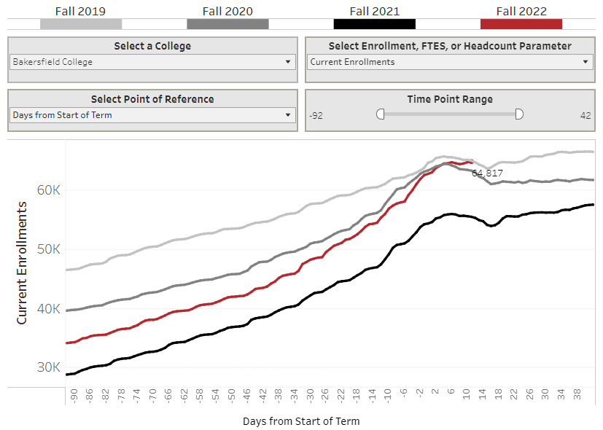
Fall 2022 Enrollments are Up 16.8%
Notes:
Over the summer got together to talk about targets and tactics. Sixteen to eighteen meetings, various groups. Sent a ten people to the EMA in the summer. People were really connecting across areas and getting the sense of how to work together to really take our work to the next level. We are all keeping an eagle eye on the data. We have a Google doc with all our tactics that we are sharing.

Slide 4
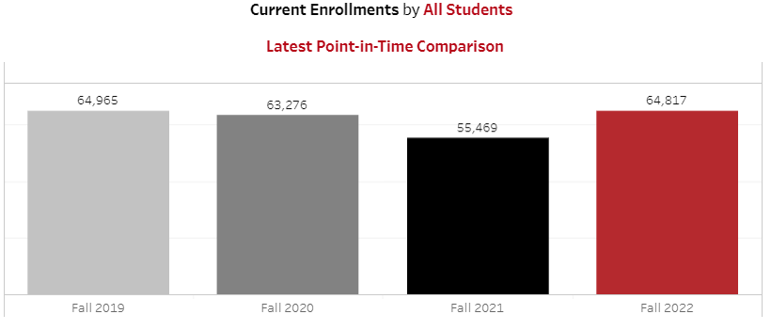
Fall 2022 Enrollment is On Par with Fall 2019

Slide 5
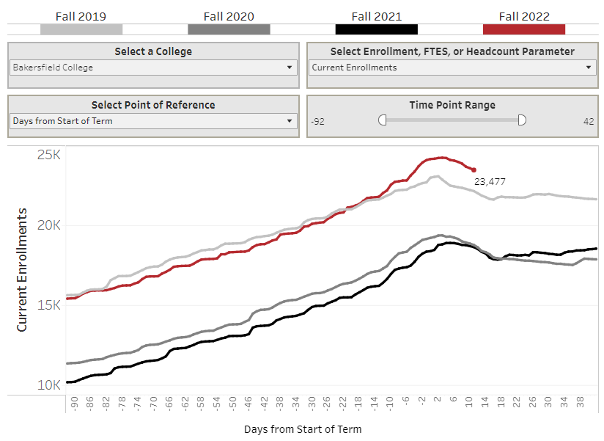
First Time Student Enrollments Higher Than Ever

Slide 6
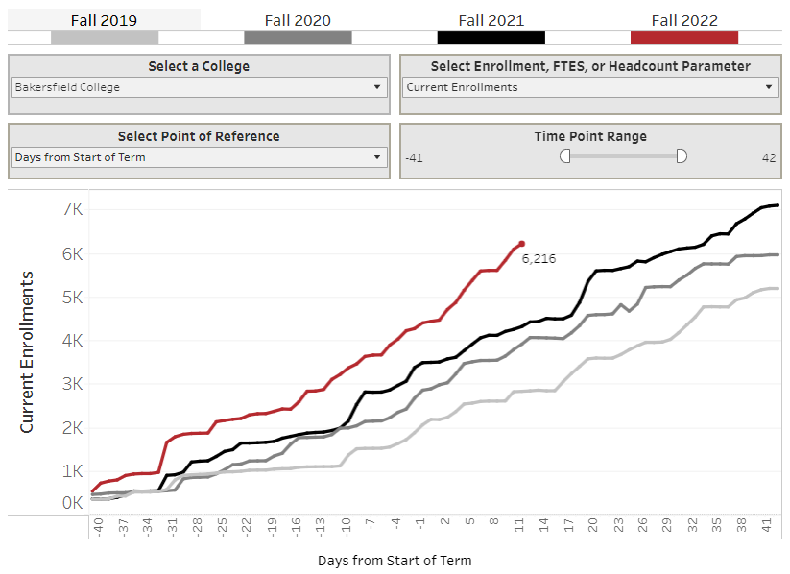
Dual Enrollment: Growing Fast
Notes:
In fall 2019 dual enrollment represented

Slide 7
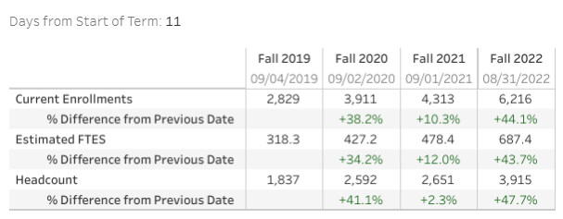
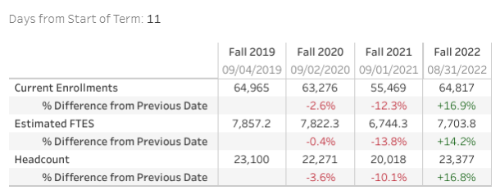
Dual Enrollment a Growing Share of All Enrollments
Dual Enrollment
All Enrollments
In Fall 2019, dual enrollment represented 4.5% of all enrollments at this point in the semester
In Fall 2022, dual enrollment represents 9.6% of all enrollments as of 11 days into the semester
Dual enrollments projected to represent 18% of all enrollments this semester, once all are recorded.
Notes:
Dual enrollments represented 16.7% of all enrollments in spring 2022.

Slide 8
Modality Preferences
Online vs. In-Person

Slide 9
Modality Preferences Vary by Age

Slide 10
The Importance of Persistence

Slide 11
Attrition is the Enemy of Success
Historically at BC:
  We lost 25% of first time fall students by the spring semester.
  We lost 33% of students from their first spring to their 2nd fall
  Historically, only half of 1st semester students made it to their 3rd semester
Our persistence numbers have been declining recently

Slide 12
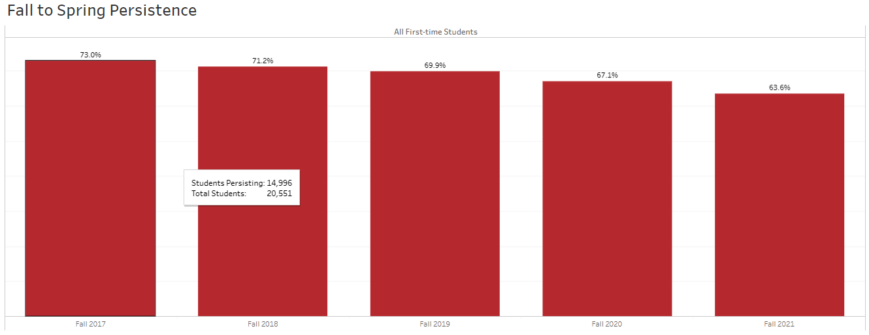
Persistence Trends: Fall to Spring

Slide 13
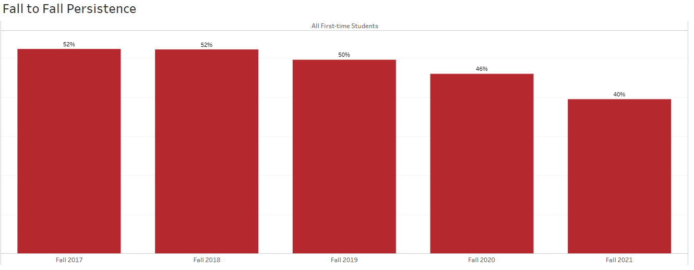
Persistence Trends: Fall to Fall
Explore on your own - https://tabsoft.co/3RrfpHK

Slide 14

Discussion

