Slide 1
Accreditation Midterm Report Update
College Council
April 8th, 2022
Grace Commiso- AIQ Faculty Co-Chair
Jason Stratton- Faculty Lead,
Midterm Report Team

Slide 2
2018 External Evaluation Visit
Accreditation Reaffirmed for 7 Years!
No Recommendations!
2025 Next Accreditation Visit!

Slide 3
2018 External Evaluation Visit
Accreditation Reaffirmed for 7 Years!
No Recommendations!
Midterm Report!
  Update on plans and goals set during previous evaluation visit
2025 Next Accreditation Visit!

Slide 4
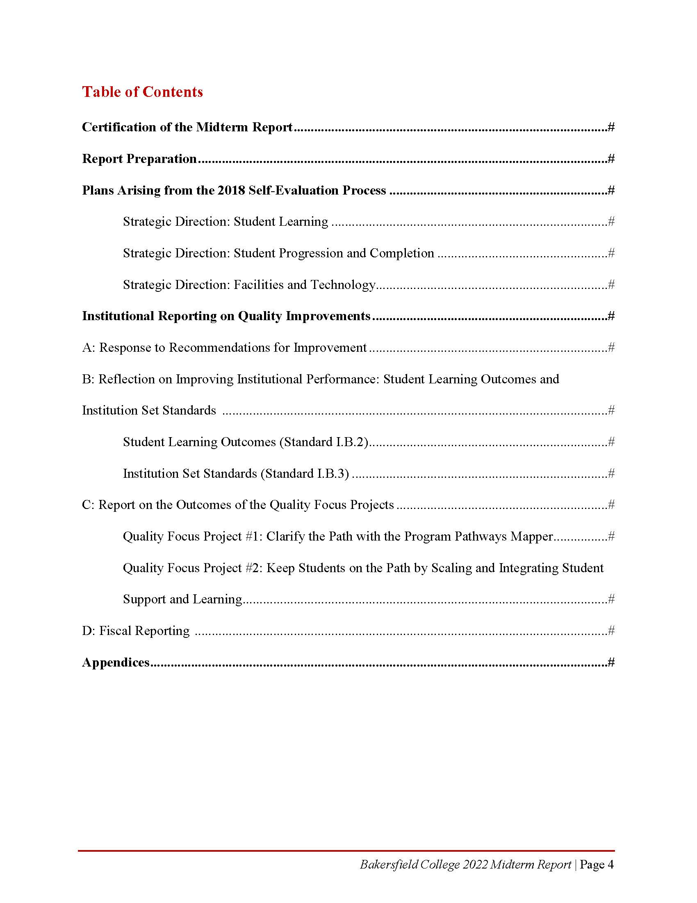
ACCJC Guidelines for Preparing Institutional Midterm Reports

Slide 5
Plans Arising from the 2018 Self-Evaluation Process
Initiatives
Curriculum Development and Assessment using eLumen
Visually represent clear pathways through the Program Pathways Mapper tool
Strategically expand dual enrollment
Scale up Summer Bridge
Launch the Pathways Program Mapper
Redesign student support services, specifically the role of educational advisors
Implement the Facilities Master Plan using the funds secured through the Measure J Bond

Slide 6
Institutional Reporting on Quality Improvements
Response to Recommendation for Improvement
Reflection on Improving Institutional Performance: Student Learning Outcomes
Reflection on Improving Institutional Performance: Institution Set Standards

Slide 7
Quality Focus Projects
1: Clarify the Path with Program Pathways Mapper
2: Keep Students on the Path by Scaling and Integrating Student Support and Learning

Slide 8
Fiscal Reporting
1: No enhanced fiscal monitoring required, thus no explanations of processes required.
2: Provide a copy of the most recent Annual Fiscal Report.

Slide 9
Transparency in Action
The following consultations were held to solicit feedback, as many of you have experienced.
Academic Senate 1st Read 03/15 | Academic Senate 2nd Read 03/30
Administrative Council 03/14 | Curriculum Committee 03/10
Information Systems and Instructional Technology Committee 03/07 | Student Government Association 03/09
Faculty Chair & Directors’ Council 03/04 | Assessment Committee 03/04
Student Gov. Assoc. Exec Board 03/02 | Campus Wide Open Forum 03/03
Program Review Committee 03/01 | Facilities & Sustainability Committee 03/02
Budget Committee 02/28 | Guided Pathways Strategies Team 02/28
AIQ Committee 02/08 | Enrollment Management Committee 02/17

Slide 10
Current Status
Main document revisions relevant to the substance of the document are completed.
Awaiting final access to most recent Fiscal Report to update the relevant link.
Marketing and Public Relations proceeding to format for visual impact.
Once above completed, final synchronizing of evidence and documentation will be conducted to connect with new formatting.

Slide 11
Timeline for Approval
Academic Senate April 20th | College Council April 22nd, [or electronic vote by April 29th?]
Board of Trustees Submitted: May 6^{th,} for June 9th meeting.
ACCJC Goal: Submit July 15th. [or earlier] ACCJC Deadline: September.
Please contact the Team with any remaining questions:
The following hyperlink will send an email to all members of the team: Midterm Report Team
Or, send individual emails to:
  Jason Stratton: jstratto@bakersfieldcollege.edu
  Leo Ocampo: gamaliel.ocampo@bakersfieldcollege.edu

Slide 12
Thank you for your support throughout this process.
Brought to you under the auspices of the AIQ Committee and ACCJC Midterm Report Team.

