Slide 1
Graduation Increase Initiative
By
Imelda Simos-Valdez
Marisa Marquez
Michelle Smith
Ben Perlado

Slide 2
Approach
1. Target “Low Hanging Fruits” (Ben Perlado)
Potential ADT
Potential AS/AA
Potential Certificates
Graduated – two reverse transfer (graduated not transferred / transferred not graduated)
2. Prioritization – Efficiency of Workflow
Spring ➔ green, blue, yellow for students who qualifies for another degree, orange with 1-3 classes (if classes needed offered spring 2022)
Summer ➔ Orange (recovery/overload)
Fall ➔ Orange & Red
3. Training
- not the same as our previous grad check events
- provided preliminary review for all students on the list (no sign up)
- increase spring late start enrollment
- increase mid-year transfer rate to CSUB (ADT)

Slide 3
Color Coding for Team A & B

Slide 4
Division: Teams A & B (Team Captains)
Captains / Teams Communication – used Microsoft group Teams (Affinities – DSPS/Veterans/EOPS/CalWORKs/AB540/Athletics/Job Spot, Counseling/Advising, A&R, SID, Rural Initiatives, CTE, Student Life)
Team A Duties
Complete grad check
Add notes on the SharePoint excel document
Copy excel notes for each student you complete a grad check for onto Starfish
If necessary, refer to the first list for notes if not included in the new spreadsheet (saved on the counseling drive)
Team B Duties
Use Team A’s notes on the SharePoint document to follow up with students, referencing the email sent.
Get students to review the email sent
Help them complete the Graduation Petition form and submit to bcrecords@kccd.edu
Help students register for any remaining classes – push for late start Spring classes (before summer and fall)
Do the Update Form (if needed)
Complete the CARES Act application for tuition assistance (if registering for classes)

Slide 5
Student Communication
1. Ocelot Text
2. Student Email
3. Postcard
4. Social Media (SGA & Student Orgs)
5. Team B Calling
6. SID
7. Media Interviews (org by Monika Scott)
UPDATE: 2,074 petitions received for spring 2022 + 1,269 green & blue pending submission of grad petition

Slide 6
Challenges & Next Steps
Challenge:
Starfish – Close to Completion List
- 500K+ lines (5 years back)
- took last 3 years: condensed to 12,700 unduplicated number of students
- messaging went out to 12,700 students
- found that many of these students graduated 5-10 years ago, some already with master’s degrees
Next Steps:
-OIE Cognos Report (Banner – system of record) – will be auto generated daily, monthly, quarterly, etc.
-Institutionalized Processes, streamlined procedures
-Survey / debriefing of all involved

Slide 7
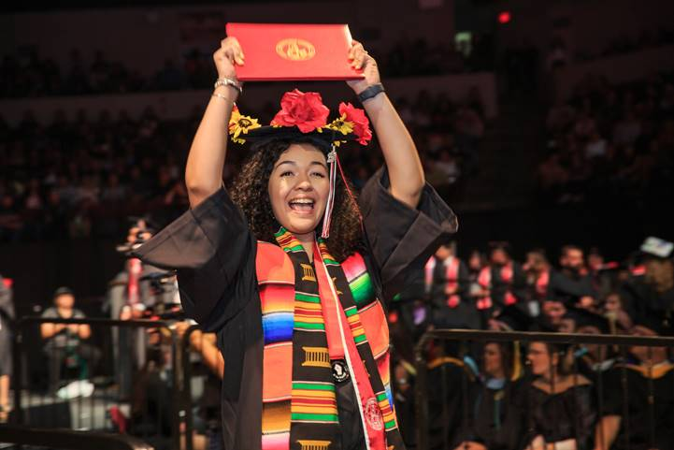
Questions?
Imelda Simos-Valdez
imelda.valdez@bakersfieldcollege.edu
(661) 395-4538
Marisa Marquez
marimarq@bakersfieldcollege.edu
(661) 395-4881
Michelle Smith
michelle.pena@bakersfieldcollege.edu
(661) 395-4318
Ben Perlado
ben.perlado@bakersfieldcollege.edu
(661) 395-4031

