Slide 1
COVID-19 Team Updates
3/24/22
https://docs.google.com/presentation/d/1VUlg8DFuighVcgNxMS8_dhOwCUkDDsGI8boRln4lpiU/edit?usp=sharing

Slide 2
BC Interventions & California Pandemic Plan
BC Interventions
In-Person Commencement!
Fireside Room
All services moving to Levinson Hall (Apr 4th)
COVID Hotline
Student and general questions
DO for employee and work questions
Services
RN on duty
COVID vaccines (all approved)
COVID testing
KN-95 (highly recommended) and surgical masks
Contact tracing
SMARTER Plan
Shots
Masks
Awareness
Readiness
Testing
Education
Rx

Slide 3
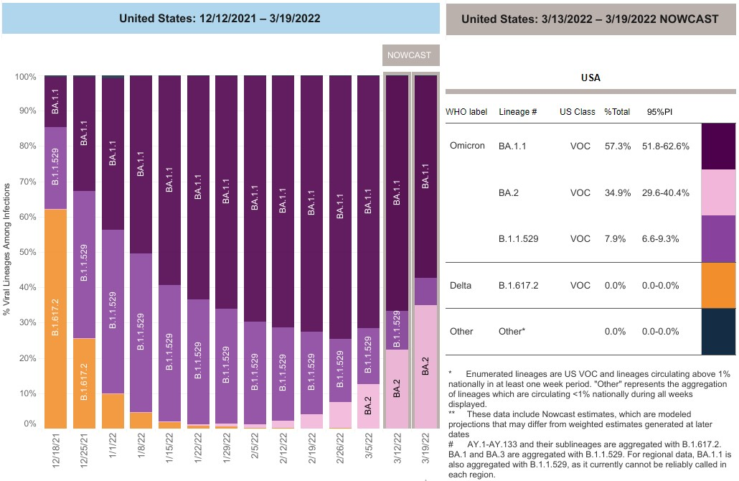
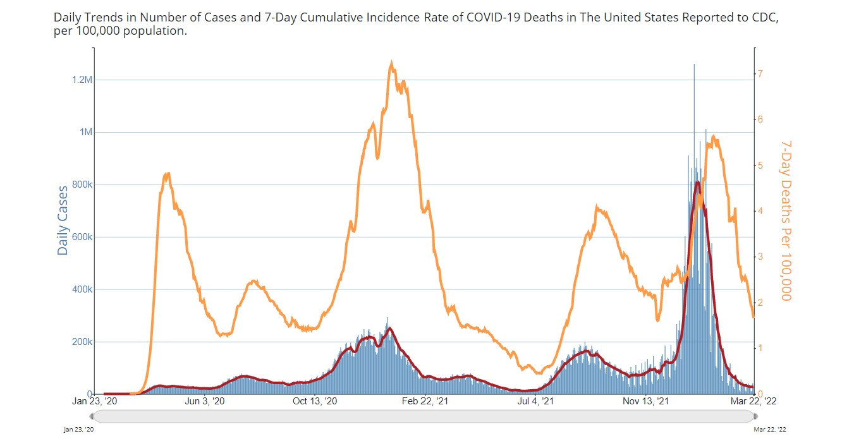
CDC COVID Surveillance

Slide 4
30 Day Positivity Rate: 1.6%
Point (Daily) Positivity and Volume (Daily) Over Time (YTD)

Slide 5
Takeaways
COVID Surveillance
Infections rates remain low
BA.2 is fighting for share of non-expanding pie
COVID Response
No change in services provided
Location change: Lev Hall
BC is agile in its response
COVID-19 team continues to monitor situation

