Slide 1
Student Persistence at Bakersfield College
Craig Hayward, Ph.D.
College Council
2/11/22

Slide 2
About Student Persistence
“Retention” can refer to students staying enrolled to the end of a class (i.e., non-withdrawal retention)
Sometimes also refers to being retained at the institution from term to term
“Persistence” can be used to specify continued enrollment across terms
Persistence tracks cohorts of students over a specified period of time
NSC uses persistence to indicate continued enrollment at any institution while retention indicates continued enrollment at the same institution
To be considered a “persister” students must
Be present in the base term student cohort & present in the target term
Typically measured as “fall to spring persistence” or “fall to fall persistence”
We don’t always want students to persist
Students should leave the college when it is time to graduate, transfer, get promoted, and/or become gainfully employed

Slide 3
Resources
Public dashboard:
https://bit.ly/1st-Time-Cohort-Profile-Public
Password-Protected dashboard (more disaggregation options):
https://bit.ly/1st-Time-Cohort-Profile
National Student Clearinghouse Persistence Research
https://nscresearchcenter.org/snapshotreport35-first-year-persistence-and-retention/

Slide 4
National Benchmarks for Persistence #1
Notes:
Overall retention is 48.9% for the Fall 2017 cohort
https://nscresearchcenter.org/snapshotreport35-first-year-persistence-and-retention/#Figure6

Slide 5
National Benchmarks for Persistence #2
Notes:
https://nscresearchcenter.org/snapshotreport35-first-year-persistence-and-retention/#Figure6

Slide 6
BC Persistence Rates vs. National Average

Slide 7
Trend in BC Persistence Rates

Slide 8
Bakersfield College Students’ Fall-to-Fall Persistence Data

Slide 9
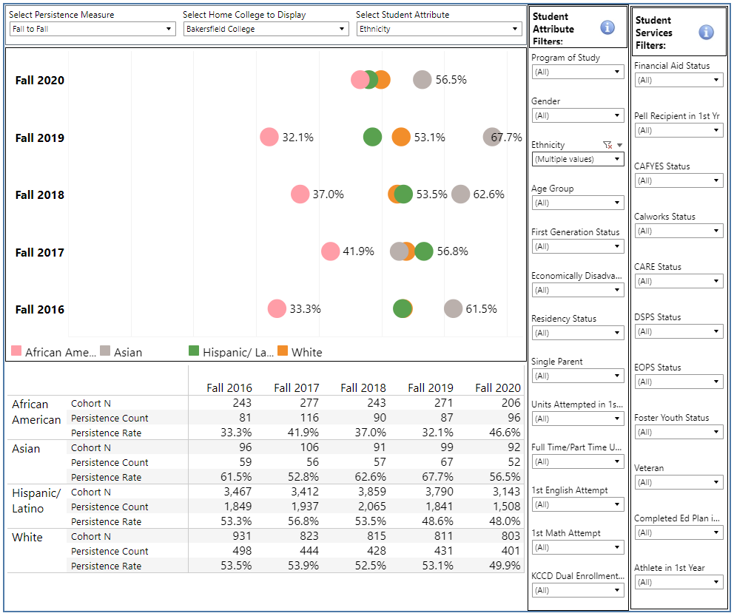

Slide 10
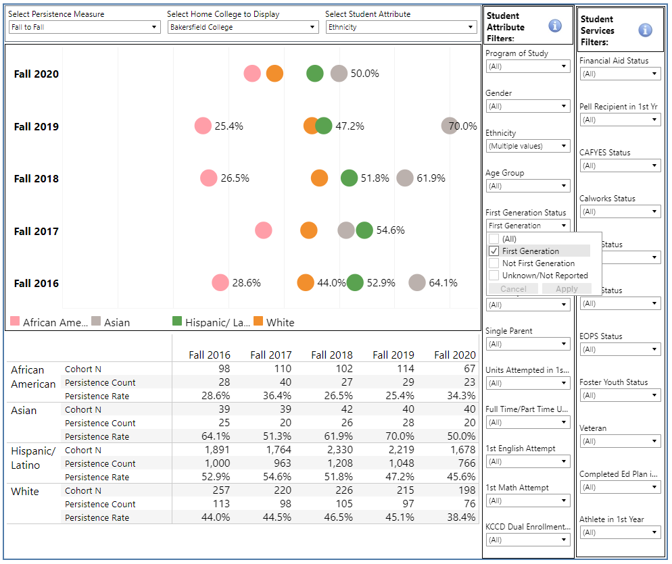

Slide 11
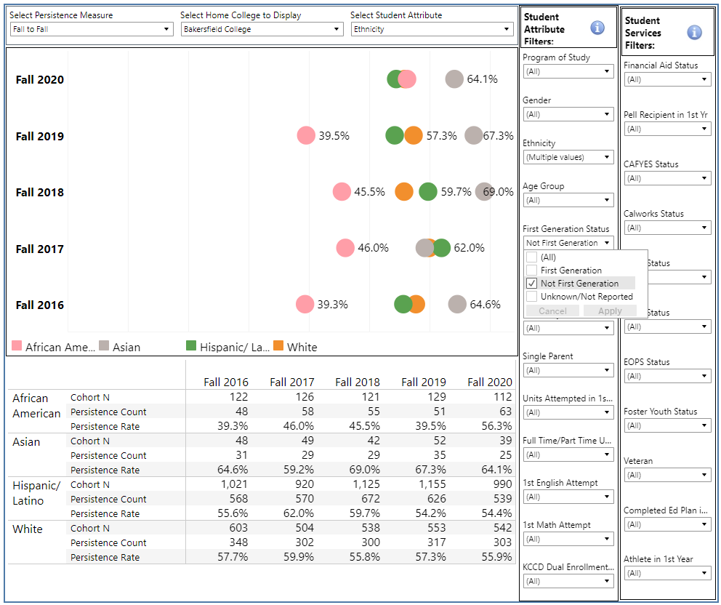

Slide 13
Bakersfield College Students’ Fall-to-Spring Persistence Data

Slide 14
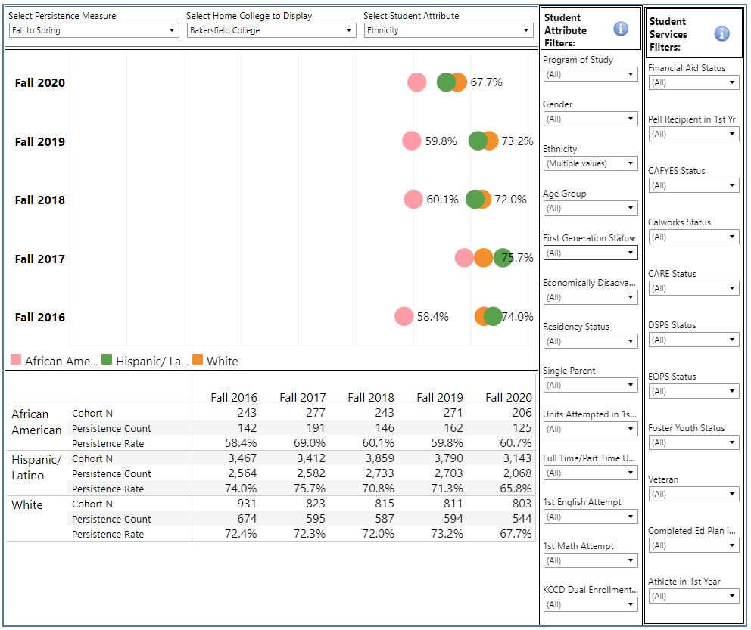

Slide 15
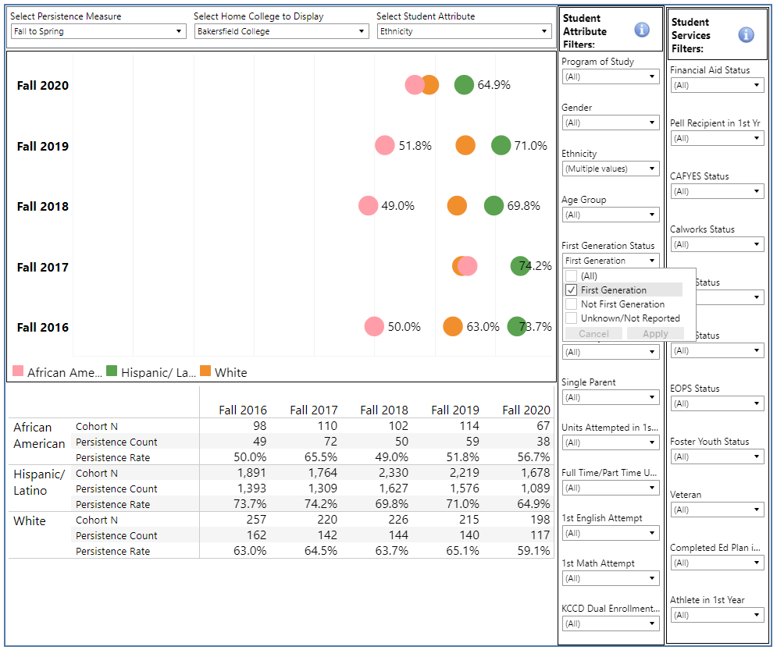

Slide 16
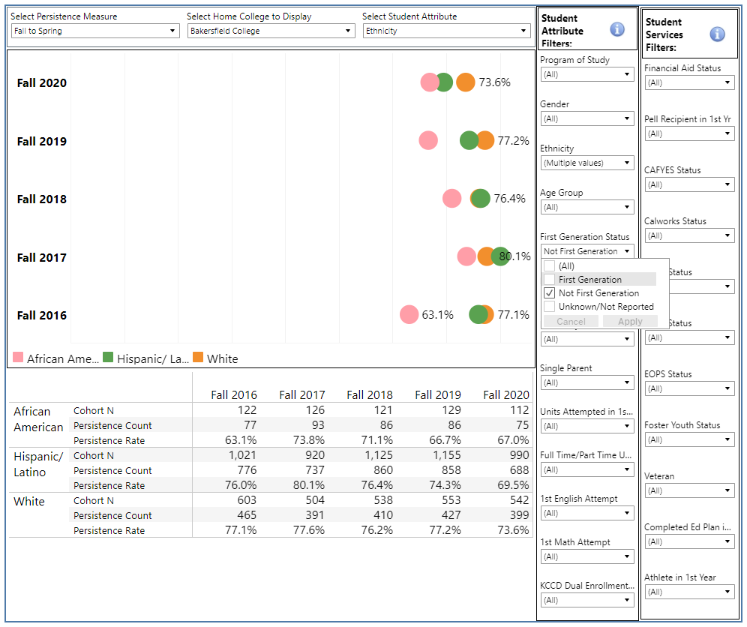

Slide 17
Taking Action to Increase Persistence
Persistence is a necessary precursor to completion
More engaged students persist at higher rates
Mental health of college students is being referred to as a “crisis”
How can we increase students’ mental well-being and feelings of engagement?
We have reports that identify students who didn’t come back who should have
Can we proactively identify currently enrolled students who are at risk for not persisting?
How do we re-engage students whose engagement is dropping, placing them at risk for non-persistence?

Slide 18
Students share their mental health struggles in pandemic
“In the last week, how often have you been bothered by the following problems?”
% experiencing issue several days, over half of the days or nearly every day

Slide 19
“In the last week, how often have you been bothered by the following problems?”
Not being able to meet basic needs can challenge students’ mental health and emotional well-being
Notes:
Basic needs- food insecure, housing insecure or homeless
Targeted assistance to those in the greatest need
Even if we are back on the campus face to face, these basic needs are not being met

Slide 20
Discussion
What can you do to increase student persistence at BC & KCCD?

