Slide 1
COVID-19 Update: Spring 2022 College Council
Presented by
BC COVID Response Team
Friday, January 28, 2022

Slide 2
BC COVID Response Team
The BC COVID Response Team includes constituents from throughout the college. The team works together to address COVID related concerns and to ensure the health and safety of our community.
The team is:
Dr. Nicky Damania - Dean of Students (Co-Lead)
Dr. Charles Collom - Director, Student Health & Wellness Center (Co-Lead)
Trudi Blanco – Human Resources
Mike Medeiros - Athletics Trainer Program Director
Aaron Barber - Marketing & Public Relations
Marcos Rodriguez - Executive Director, Facilities & Operations
Christopher Glaser - Executive Secretary, College Safety
Richard McCrow - Dean of Instruction
Kathleen Rush - Department Chair, Mathematics
Kimy Salazar - COVID Hotline Lead
Shehrazad Barraj - BCSGA Officer
Additional members include: Student Contact Tracers, Exemption Reviewers, Registered Nurses, Student Nurses, etc.

Slide 3
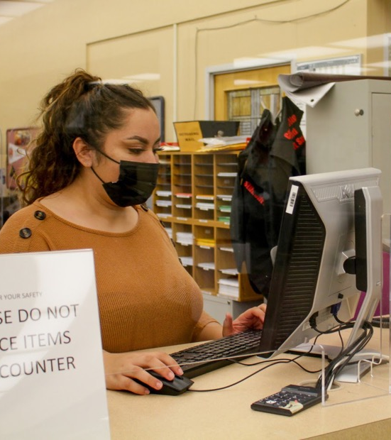
Our continued priority is the health and safety of our community.

Slide 4
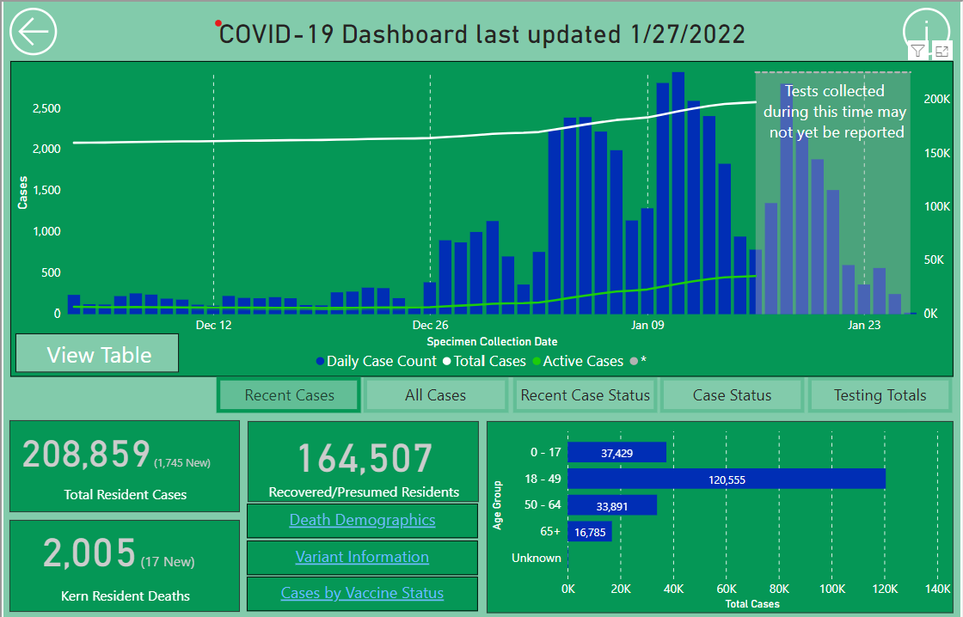
Kern County & OMICRON Variant

Slide 5
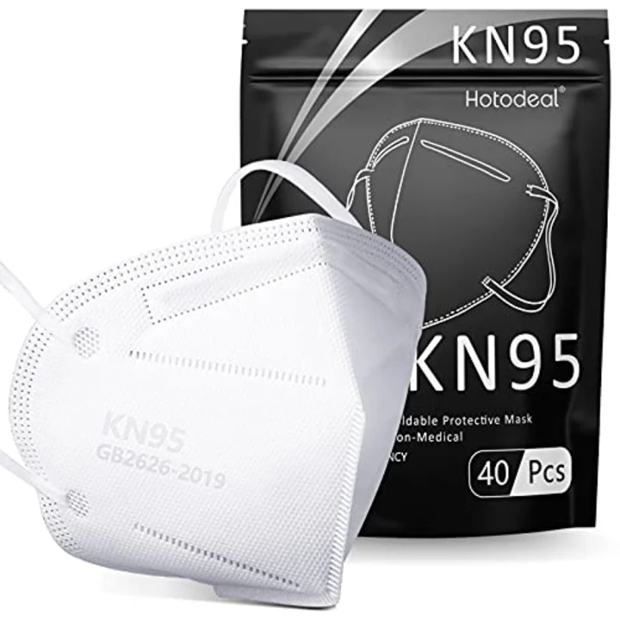
Masks Required Indoors

Slide 6
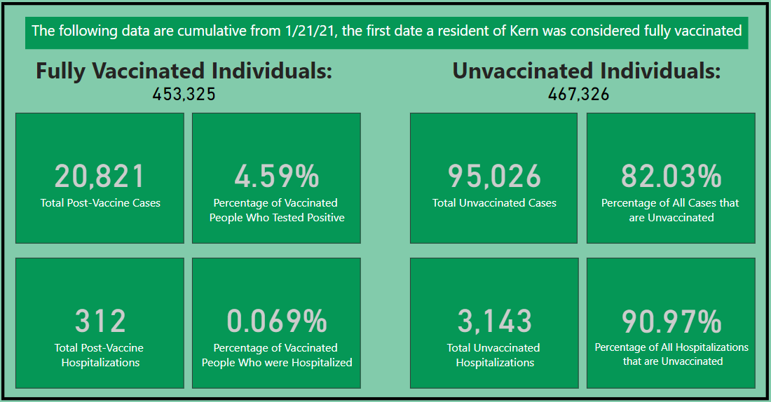
GET Your:
VACCINATION
TEST
MASKS
Information
Fireside Room: 9am to 3pm | Monday through Thursday
Moderna, Pfizer (5+), or J&J: First dose, Second dose, Third Doses, or Boosters
Flu Shots
PCR Tests with a typical 2-3 day turnaround
KN-95 Masks
No appointment necessary (12-12:30 Lunch)

Slide 7
Spring 2022 Protocols

Slide 8
Spring 2022 Protocols
Our BC COVID-19 protocols have protected our community well. To protect our BC community through the evolving pandemic, we remind every person to continue to follow protocols.
If you do not feel well, stay home. Contact your medical provider if you develop symptoms such as fever & chills, sore throat, cough, nasal congestion, shortness of breath/difficulty breathing, unexpected muscle pain, new loss of taste or smell, etc.
If you are unable to attend class due to illness, notify your professor as soon as possible to arrange for missed classwork.
Masks are required to be worn indoors by students, employees, and visitors on all of our campus properties until further notice. Your face mask must cover your mouth and nose. Face coverings may be available upon request.
All students will complete the Health Checker form in the KCCD Campus Pass app before coming to campus each day.
Individuals will scan facility QR Codes as they enter classrooms, offices, and navigate our campuses.
Social/physical distancing requirements have been removed.
www.bakersfieldcollege.edu/covid19/protocols

Slide 9
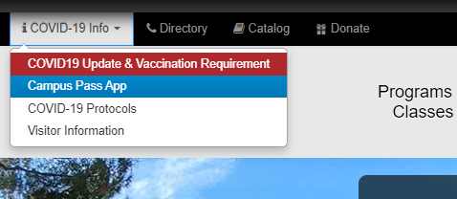
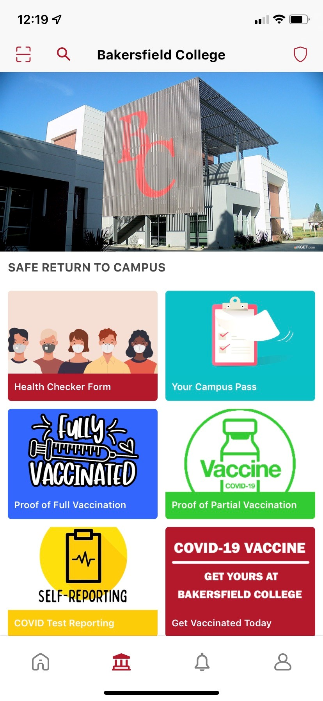
KCCD Campus App: Health Checker
Complete the Health Checker form DAILY
You still need to complete the Health Checker form on your computer before coming onto campus.
The pass can be loaded onto their chromebook to show or printed on campus at the Library or Office of Student Life.
Once the Web form is completed, a color pass will be emailed to the email address provided in the form within 2-3 minutes.

Slide 10
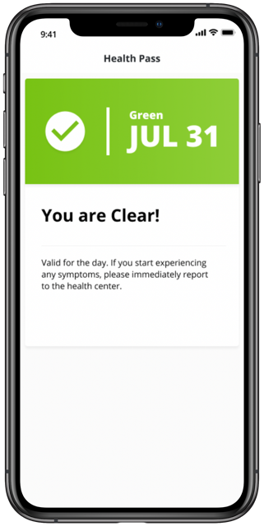
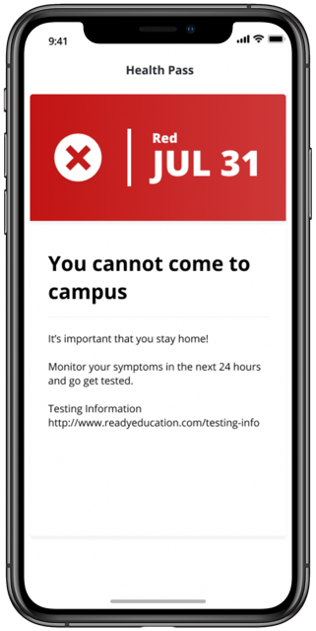
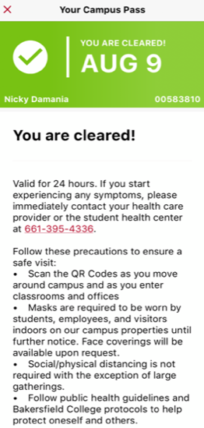
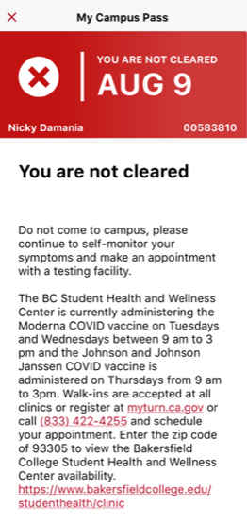
To display your Campus Pass, from the Campus screen, tap the “Your Campus Pass” icon.
Green Campus Pass: If you do not have any COVID-related symptoms, you will receive a green Campus Pass. A green Campus Pass allows you to engage in-person on campus (attend classes in person, utilize labs, etc.).
Red Campus Pass: If you identify any COVID-related symptoms you will receive a red Campus Pass. In this case, you must stay home. A red pass will initiate a call from the BC COVID Response Team. The Team works with you to clear you or determine next steps.

Slide 11
Scanning QR Codes Around Campus
Open the KCCD Campus Pass App
Tap the QR icon in the upper left-hand corner, and your camera will open
(You may need to give permission when prompted by your phone).
Point it at the QR code and it will automatically take scan the code.
After successfully scanning, the app will show Your Campus Pass.
To help us effectively contact trace any positive cases on campus, BC is requesting all students, faculty and staff to check in when they enter classrooms, offices or other areas around campus.
QR codes identify physical locations on campus. Individuals scan QR codes with the Campus Pass App to indicate that they were in a particular place at a particular time.
It allows the BC COVID Response Team to effectively perform contact tracing and determine appropriate action. It does NOT track your movement.

Slide 12
Visitors on Campus
Visitors are:
Vaccinated Visitors (Continuous/Routinely)
Unvaccinated Visitors (One Day Visit)
Access to all BC campuses and sites is restricted to students, faculty, staff, designated vendors, and invited visitors.
Individuals not registered as visitors may not be admitted.
Additionally, campus visitors should comply with the College’s face covering policy and other campus COVID-19 Protocols.
Invited Visitors include:
Invited guests of students, faculty, and staff
Family members or invited guests of on-campus employees
Designated vendors, service operators, and food delivery drivers
Prospective students and their families arriving for scheduled meetings or events
Ticketed patrons or spectators of college-sponsored meetings or events
www.bakersfieldcollege.edu/covid19/visitors
2-3 business day turnaround

Slide 13
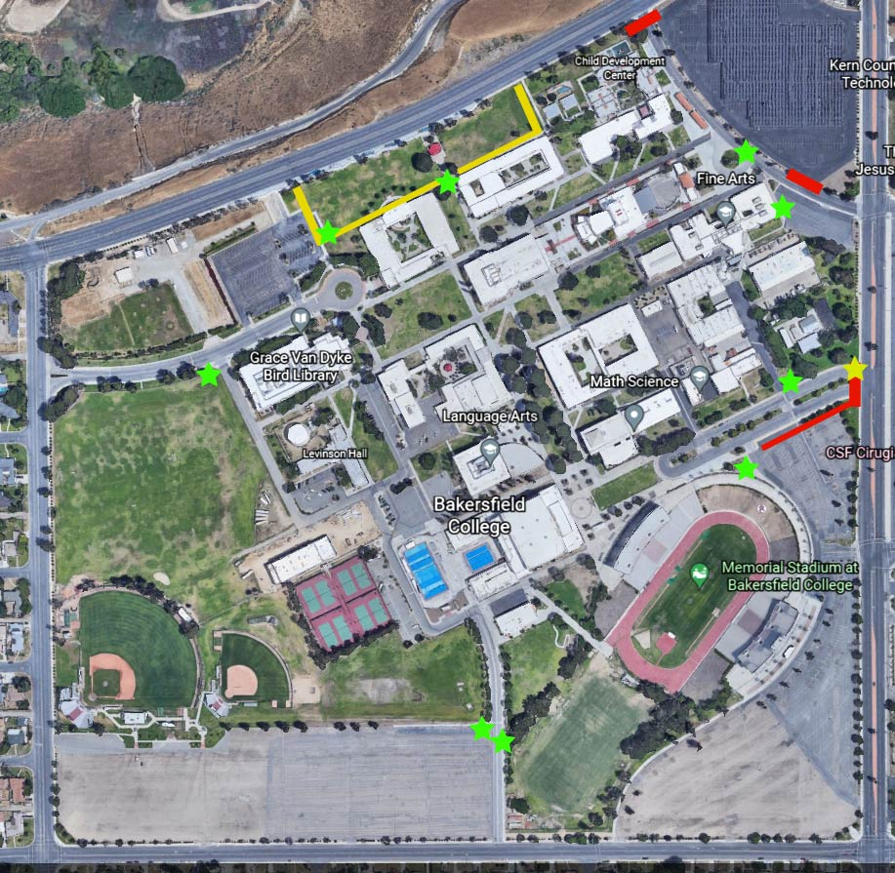
Campus Pass Check-In Stations

Slide 14
Post Check-In Station
22%
Percent reduction in seroprevalence after the introduction of the
Check-In Stations
Outer Circle: Year to date
Inner Circle: Last Work Week

Slide 15
COVID Notifications
For a classroom exposure, faculty member will receive a notification email to send to the class. Classes are not automatically moved online. The subject line will be:
Potential Covid-19 Exposure Notification
Potential Indirect Contact Notification
Additionally, a campus-wide notification will be sent out regarding exposure
Emails will come from covidnotifications@bakersfieldcollege.edu

Slide 16
Returning To Campus After An Exposure Or Positive Case
Students → Individualized information and guidance will be provided by the COVID Team
Employees → Human Resources will be connecting and providing information regarding returning to work. All employees must inform their supervisors.

Slide 17
Students of Concern Update
If you have a student in need for any situation or matter:
Submit a Starfish Alert
Email nicky.damania@bakersfieldcollege.edu or studentlife@bakersfieldcollege.edu
Send the Student to Student Life (Campus Center)
Services include, but not limited to:
SOC Intern follow-up and case management
Pantry Services and Basic Needs
Homeless and Displaced
Financial Review and CalFresh Requests
Mental and Health Services and CoverCalifornia
Behavioral and Academic Stressors

Slide 18
Thank you!
We Are BC!

