Slide 1
SPRING 2022 ENROLLMENT
Billie Jo Rice, VPI
January 28, 2022

Slide 2
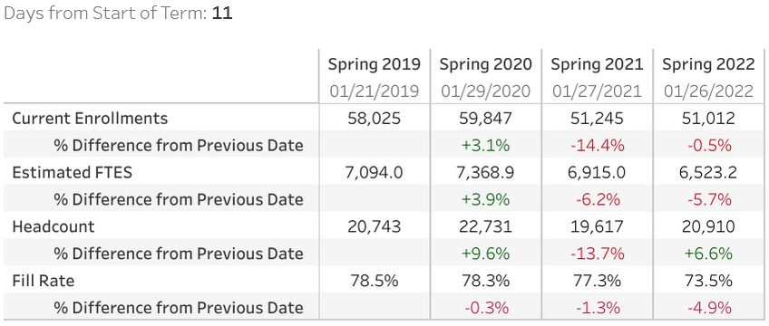
Enrollment Dashboard

Slide 3
Enrollment by Modality

Slide 4
Enrollment by Site

