Slide 1
Bakersfield College Enrollments Update
College Council
Manny Mourtzanos, Krista Moreland, and Jessica Wojtysiak
November 12, 2021

Slide 2
Fall 2021 Enrollment Management Successes

Slide 3
Fall 2021 Enrollment Management Successes
8-Week Late-Start Semester

Slide 4
Spring 2021 Enrollment Management Strategies

Slide 5
Spring 2021 Enrollment Management Strategies
8-Week Late-Start Semester
Waitlist Students at Census Day
Direct Recruitment of Dropped Students
Student Enrollment Outreach by Pathway

Slide 6
Spring 2021 Enrollment Management Strategies
8-Week Late-Start Semester
Waitlist Students at Census Day
Direct Recruitment of Dropped Students
Student Enrollment Outreach by Pathway
Priority Registration Outreach & Tracking

Slide 7
Spring 2021 Enrollment Management Strategies
8-Week Late-Start Semester
Waitlist Students at Census Day
Direct Recruitment of Dropped Students
Student Enrollment Outreach by Pathway
Priority Registration Outreach & Tracking
FTES Targets by Pathway

Slide 8
Spring 2021 Enrollment Management Plans
8-Week Late-Start Semester
Waitlist Students at Census Day
Direct Recruitment of Dropped Students
Student Enrollment Outreach by Pathway
Priority Registration Outreach & Tracking
FTES Targets by Pathway
‘Responsive & Flexible’ Scheduling Practices to match enrollment trends through careful monitoring

Slide 9
Spring 2021 Enrollment Management Plans
8-Week Late-Start Semester
Waitlist Students at Census Day
Direct Recruitment of Dropped Students
Student Enrollment Outreach by Pathway
Priority Registration Outreach & Tracking
FTES Targets by Pathway
‘Responsive & Flexible’ Scheduling Practices to match enrollment trends through careful monitoring
Enrollment Data Dashboard

Slide 10
Faculty Messaging
Faculty & Adjunct Email listserv
Specific message
Student update forms
Student registration
Financial aid
Late start offerings
Mindful of frequency/length

Slide 11
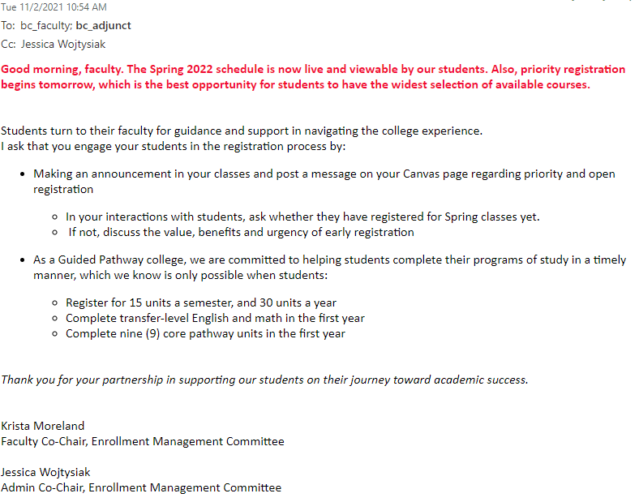
Email Example

Slide 12
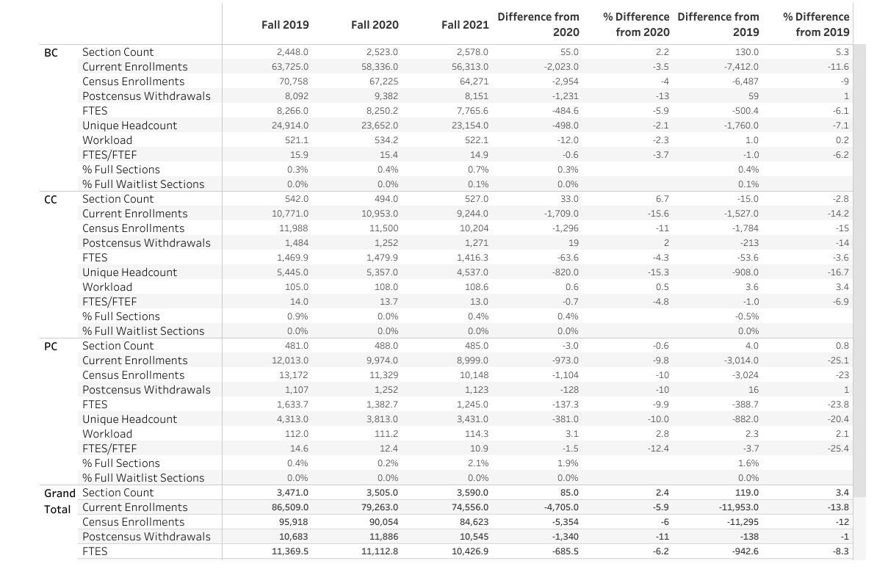
Agendized Discussions
Current Enrollment Data
Discuss changes
Student Services Updates

Slide 13
EMC Identity Crisis
Traditionally EMC served as a ‘thinktank’ for solving issues as they arose
Faculty/Admin (instruction) + Student Services
Changes
Admin is now Dean
Campus has expanded instruction and CTE offerings
+ campus locations
+ modalities
Focus shifted to include Communication
Proposed Structural change
Department or Pathways representation

Slide 14
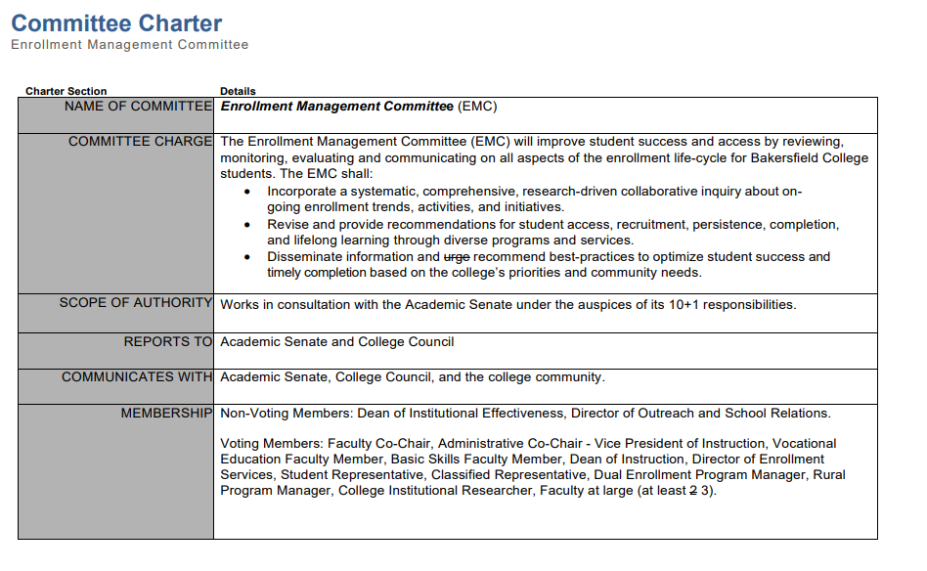
Proposed Structural change
Department or Pathways representation
Questions/concerns in
Info out (Instruction & student services)
Concern
Too big to properly function as a thinktank
Which best serves the college now and the near future?

Slide 15
Guided Pathways Implementation Team
Spring Registration Documents shared with faculty via team page
https://committees.kccd.edu/bc/committee/guided-pathways-implementation-team
Ocelot messages

Slide 16
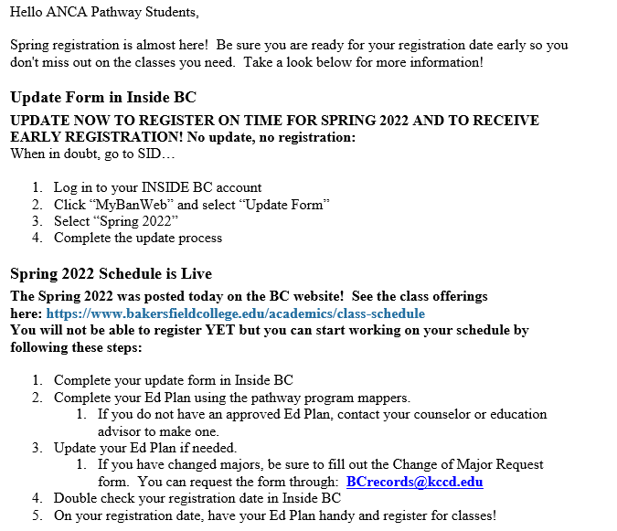
Guided Pathways Implementation Team: Email Announcement

Slide 17
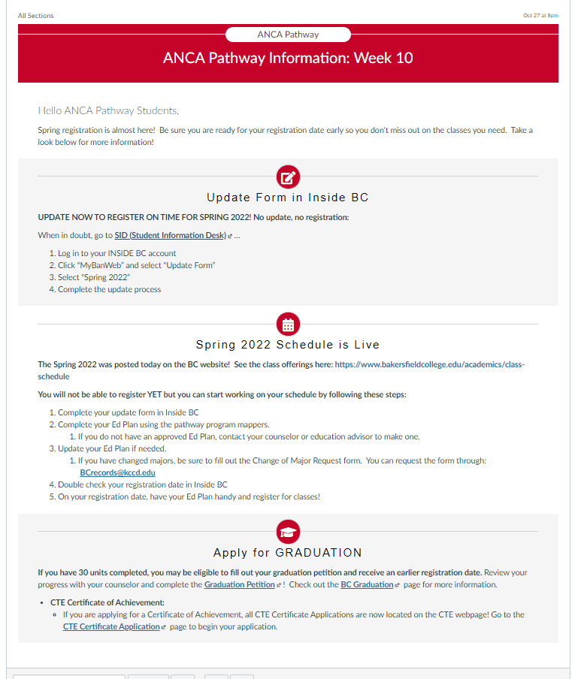
Guided Pathways Implementation Team: Canvas Announcement

Slide 18
Satellite Campuses and Spring Enrollments
Updating Social Media/BC site webpage
Contacting <12 unit students
Counseling/Advising Classroom visits (Rural)
Enrollment Events
Ocelot messages

Slide 19
Any Questions?

