Slide 1
Bakersfield College Workforce & Economic Development

Slide 2
Historical Purpose of California Community Colleges
To meet the immediate educational and economic needs of the community we serve through:
Transfer (opening doors to education)
Workforce Readiness (opening doors to employment) → Economic Growth and Development
Lifelong Learning
Basic Skills Development (AB-540)

Slide 3
Historical Purpose of California Community Colleges
To meet the immediate educational and economic needs of the community we serve through:
Transfer (opening doors to education)
Workforce Readiness (opening doors to employment) → Economic Growth and Development
Lifelong Learning
Basic Skills Development (AB-540)

Slide 4
Our vision is to the point: making sure students from all backgrounds succeed in reaching their goals and improving their families and communities, eliminating achievement gaps once and for all.
CCCCO Vision for Success

Slide 5
The success of California's workforce development rises and falls with the California Community Colleges. The CCCs are the primary system for delivering career technical education and workforce training to Californians, preparing individuals for skilled jobs in an ever-changing labor market.
CCCs: Poised and Ready

Slide 6
Purpose of Workforce & Economic Development
Prepare students for 21st century jobs and careers (including entrepreneurship)
Labor Market research → Responsive to needs of employers to close regional employment gaps in supplying trained and skilled talent needed to propel local and regional economies and ecosystems.

Slide 7
California Adult Education Program (CAEP) California Apprenticeship Initiative (CAI) Strengthening Career and Technical Education for the 21st Century Act (Perkins V) & Strong Workforce Program (SWP) Nursing Competency Based Education (CBE)
Workforce and Economic Development Programs

Slide 8
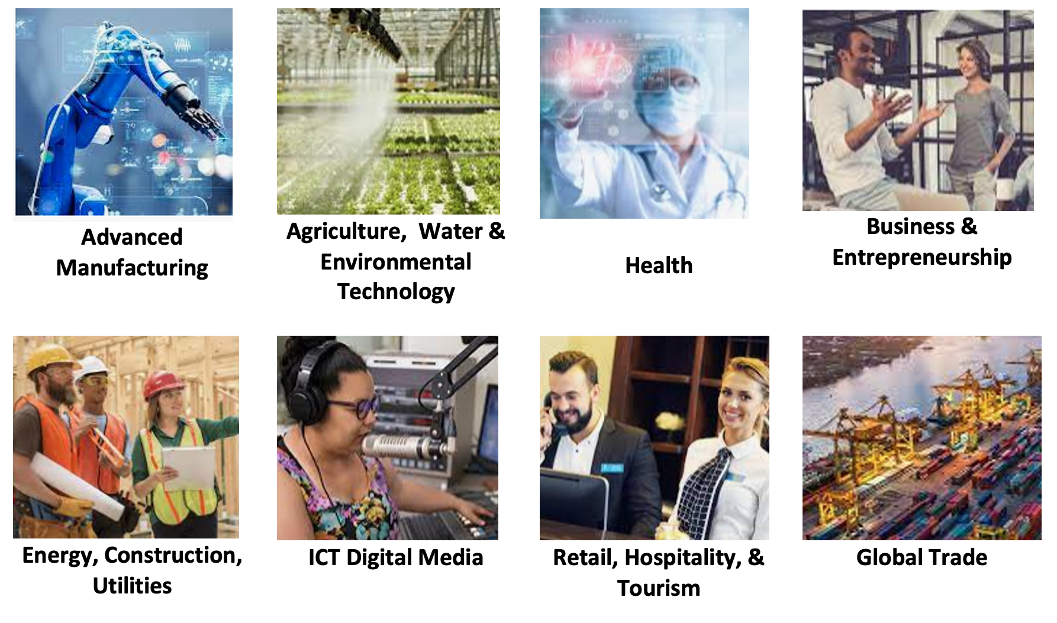
Key Industries and Emerging Sectors

Slide 9
Area Name | Labor Force | Employment | Unemployment | UI Rate
Alpine County | 550 | 520 | 40 | 7%
Amador County | 14,530 | 13,660 | 870 | 6%
Calaveras County | 20,800 | 19,610 | 1,180 | 6%
Fresno County | 444,700 | 402,400 | 42,400 | 10%
Inyo County | 8,860 | 8,390 | 470 | 5%
Kern County | 388,100 | 347,700 | 40,400 | 10%
Kings County | 57,200 | 51,400 | 5,700 | 10%
Madera County | 61,100 | 55,400 | 5,700 | 9%
Mariposa County | 7,570 | 7,050 | 520 | 7%
Merced County | 114,300 | 102,200 | 12,100 | 11%
Mono County | 8,370 | 7,920 | 450 | 5%
San Joaquin County | 318,300 | 292,400 | 25,900 | 8%
Stanislaus County | 242,700 | 221,800 | 21,000 | 9%
Tulare County | 203,300 | 180,500 | 22,800 | 11%
Tuolumne County | 21,570 | 20,220 | 1,350 | 6%
TOTAL | 1,911,950 | 1,731,170 | 180,880 | 9%

Slide 10
Meeting Strategic Needs
Economic and Workforce Development initiatives at BC are addressing the regional supply/demand gap, provide professional development in emerging economies; pursue and strengthen strategic partnerships; evaluate projects, make interventions where needed, and utilize data to develop and/or innovate strategies.
Increase in adult ed students served since 2015 - with a dip in FY20-21 due to COVID Building trades apprenticeships Early College programs Leading the State in Guided Pathways | Logistics / Supply Chain Management Clean Energy programs, expanding sustainability programs throughout all three colleges. Accelerated time to completion Credit for Prior Learning, Competency Based Education

Slide 11
EWD Initiatives and Funding Opportunities
Healthcare
Grants Awarded
US HHS Public Health Information Technology
Partnership with CSULB, Futuro Health, and others
Grants in progress or under consideration
CCCCO CA Apprenticeship Initiative
California Workforce Development Board - High Roads Training Partnership (HRTP)

Slide 12
EWD Initiatives and Funding Opportunities
Energy
Grants Awarded
California Air Resource Board: Kern COG EV Ready Communities $2.5M (BC $500k)
CWDB: High Roads Training Partnership $2 M
Grants in progress or under consideration
CWDB HRTP – Energy sector workforce development
Projects In Development
Electric Vehicle Training Center
Advanced Electrician Training & Testing
California Renewable Energy Lab
Applied research, campus as a living lab, tech transfer & workforce development
Energy Resilience / Microgrid
Carbon Capture & Storage
Carbon Management

Slide 13
EWD Initiatives and Funding Opportunities
Agriculture and Water

Slide 14
EWD Initiatives and Funding Opportunities
Entrepreneurship and Economic Development

Slide 15
Potential Federal Legislation
Biden’s Infrastructure Bill $1.2 T over 8 years
Transportation – Modernize transit & rail
Repair roads & bridges
National network of EV chargers along highways, rural & disadv communities
Electrify thousands of school & transit buses
Eliminate lead services lines & pipes to deliver clean water
Connect every American to high-speed internet
Upgrade power infrastructure
Create infrastructure financing authority
Clean up efforts to address legacy pollution
Prepare infrastructure for impacts of climate change, cyber attacks and extreme weather events

Slide 16
Discussion and Questions
Thank you!

