Slide 1
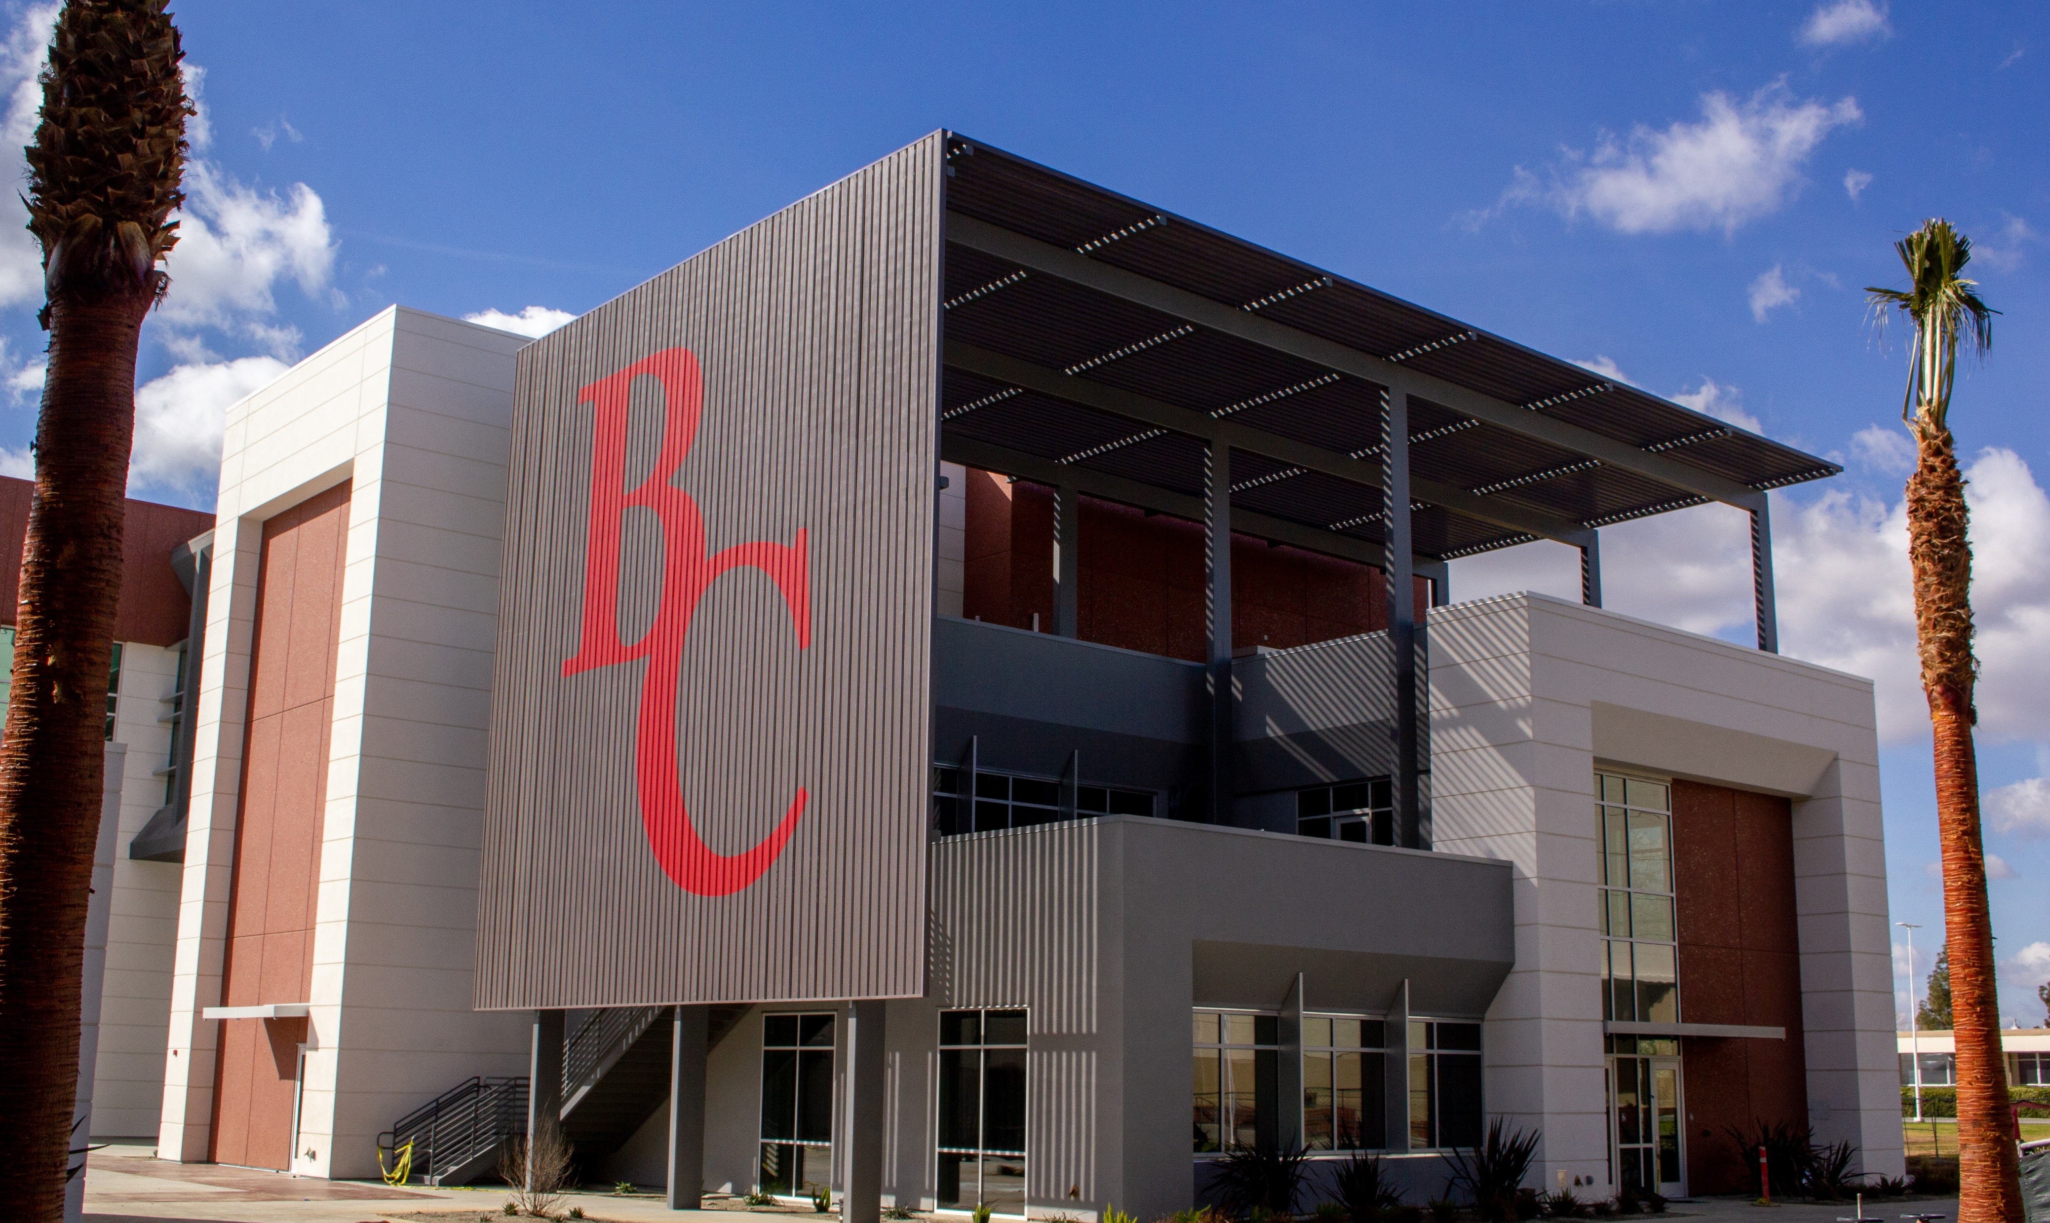
A Better BC: Updates from Measure J

Slide 2
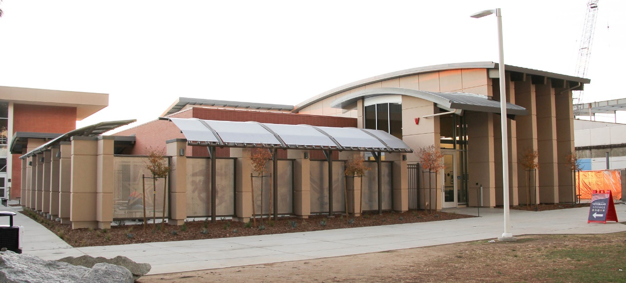
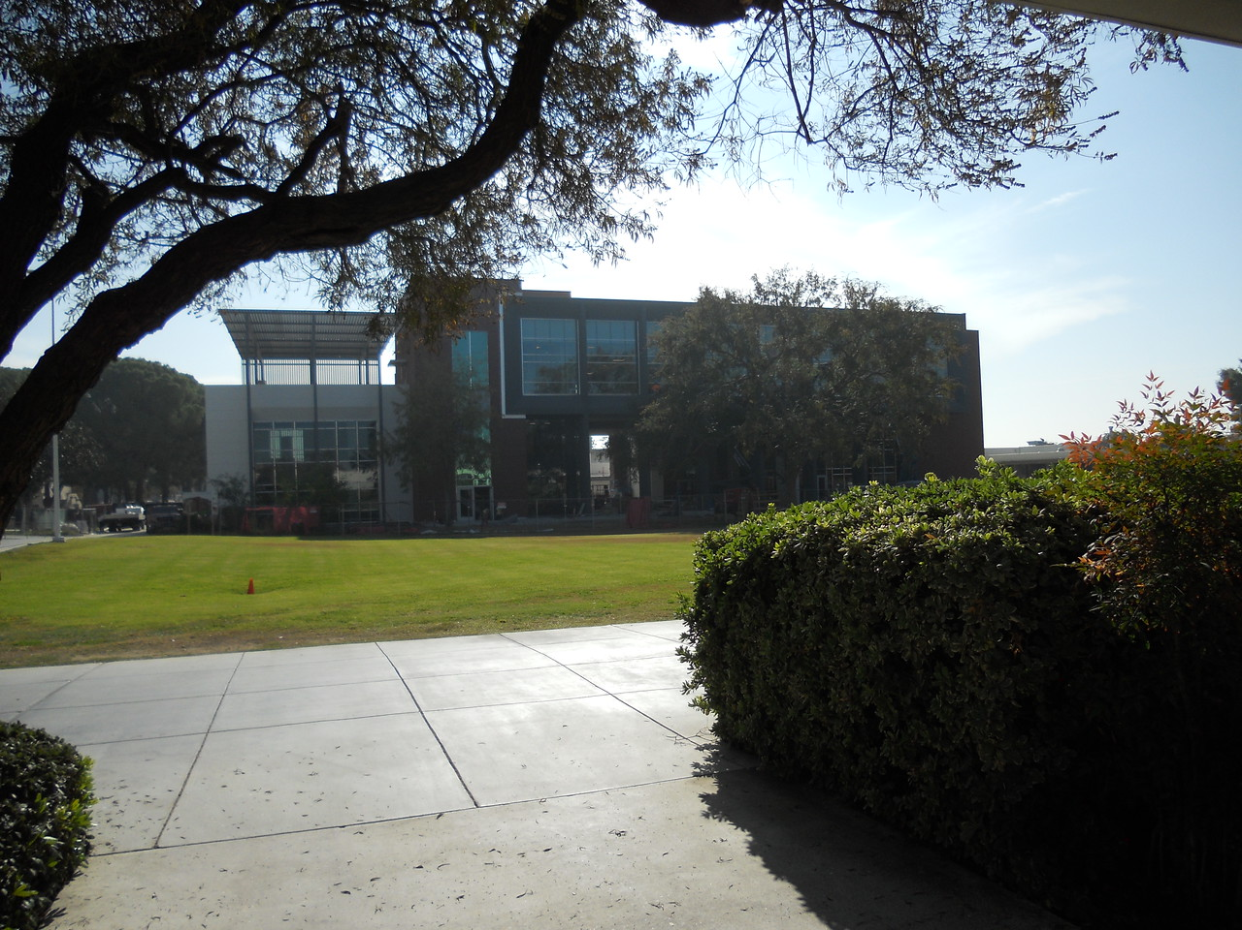
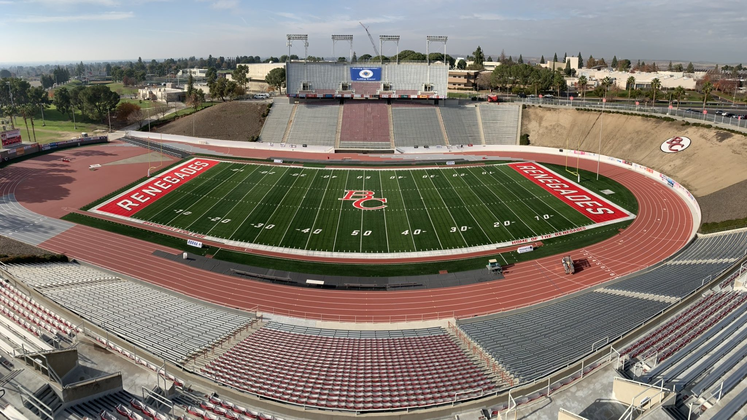
Completed
Veteran’s Resource Center
Campus Center and Dining Commons
Memorial Stadium

Slide 3
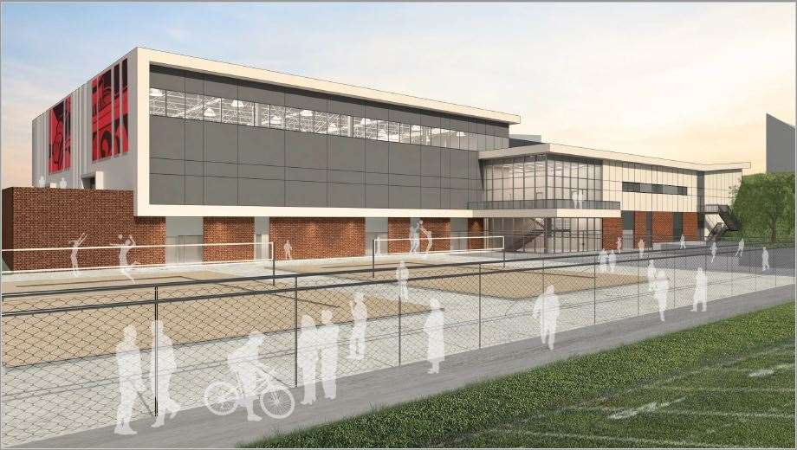
In Construction
68,300 sq ft - Science and Engineering Building
71,100 st ft - Combined Gym and Fieldhouse
Welcome Center modernization
Administrative Services modernization

Slide 4
Design/DSA/Pre-Construction
Arvin Campus scheduled completion in February 2023
Delano LRC scheduled completion in May 2023
Ag Building and Hort Lab scheduled competition in April 2024

