Slide 1
Bakersfield College Planning for Summer and Fall 2020
Zav Dadabhoy, Vice President, Student Affairs
Mike Giacomini, Vice President, Finance & Administrative Services
Billie Jo Rice, Vice President, Instruction
Presentation for College Council
April 16, 2020

Slide 2
Student Affairs
Dr. Zav Dadabhoy

Slide 3
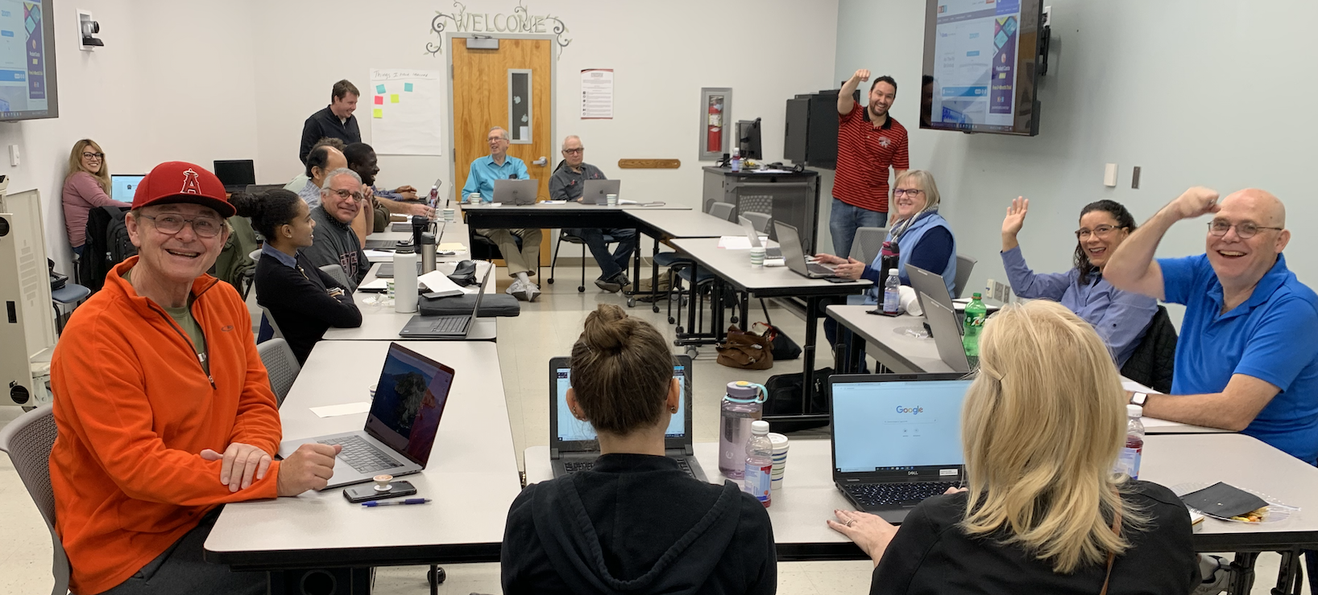
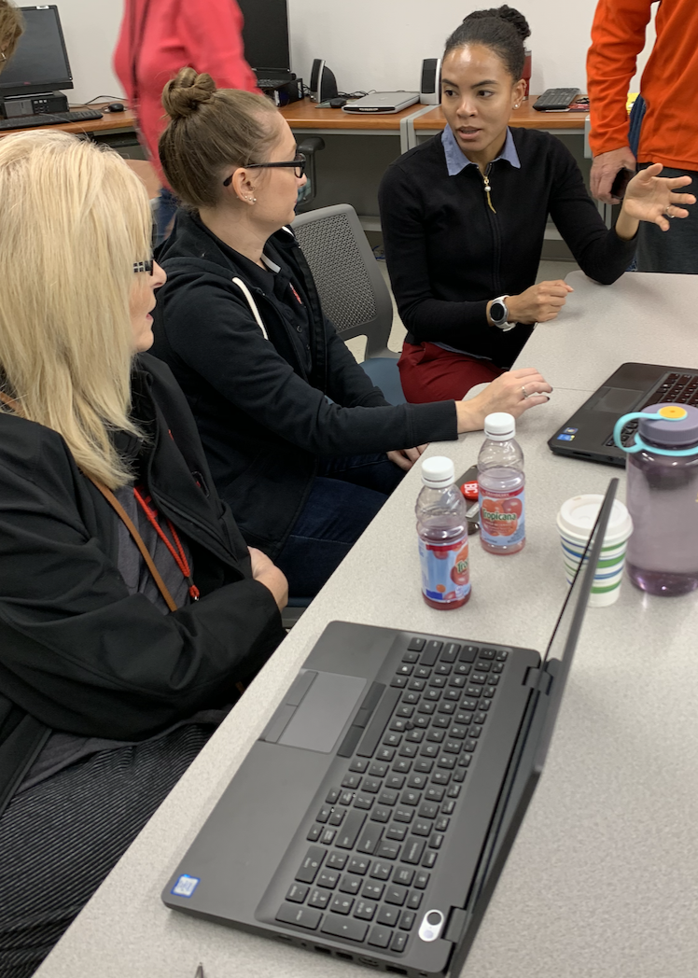
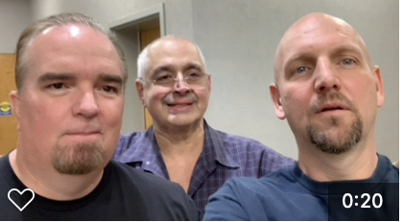
Reflections – Herculean Transition
We got a “jump” on the Stay-at-Home Order
Focus
Planning and Preparation
Training
Gathering & Deploying Resources

Slide 4
Phases of Student Affairs’ Transformation
Transition to mobile/remote work environment
Laptops
Remote Access
Communication Systems
Remote Work Plan
Accountability Measures
+ Community!
Support for Instruction & Learning
Student Needs
MEDS, NURS, RADT, ADMJ, CADM, EMTC

Slide 5
Phases of Student Affairs’ Transformation
Student Needs
My Opinion
As a collective, what we had is a piecemeal approach to online services.
Each department has gallantly assumed an entrepreneurial approach and done the best job they can with the resources available to them.

Slide 6
Phases of Student Affairs’ Transformation
Student Needs
Financial
Refunds
Grants
Food Insecurity/Pantry
Laptops
“EW”
Answers
Refining our Online Work

Slide 7
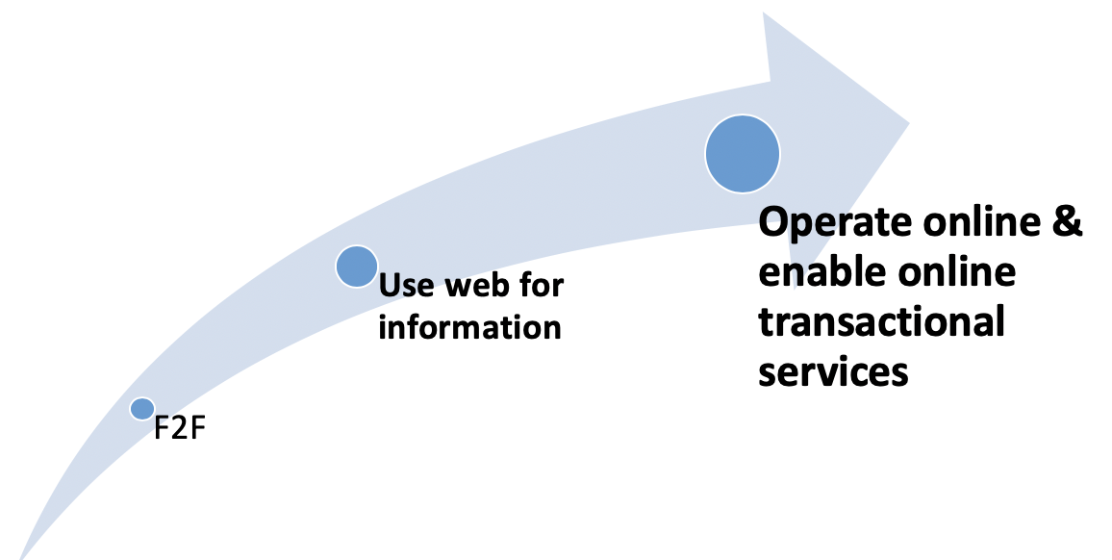
Phases of Student Affairs’ Transformation
Refining our work: How do faculty and STUDENTS interact with our services?
Front Counter (Walk Up) and In Person
Telephone
Email
Web

Slide 8
Back 2 the Future
Dadabhoy, Z. From student affairs pedagogies to online practice: Developing a didactic collegiate portal rooted in student affairs paradigm. Doctor of Philosophy dissertation, University of Colorado at Denver.
Retrieved April 16, 2020 from https://www.learntechlib.org/p/115928/.

Slide 9
My Current Foci
Taking care of our students
Enrollment
Budget and Funding

Slide 10
Finance & Administrative Services
Mike Giacomini

Slide 11
M & O
Working with Instruction to plan an appropriate sanitation schedule
Looking to minimize students, staff and faculty on campus as we incrementally come back to campus
This also means continuing to consolidate buildings so the custodians can focus on the heightened cleaning schedule
Sanitation will need to be a combined classroom management and M&O tag team to effectively reduce potentiality of any transmission
M&O is actively procuring the necessary supplies for this transition to be successful

Slide 12
Food Services
Continues to do professional development, menu development and planning for the new Dining Commons once the Campus Center construction is complete
Will incrementally come back to campus with our summer enrollment as staff, faculty and student numbers begin to warrant it
Campus Safety
Continues to protect our campus locations and do professional development through the stay at home
Will incrementally ramp up day time coverage as staff, faculty and student numbers begin to warrant it

Slide 13
Instruction
Billie Jo Rice

Slide 14
VPI: Spring Semester
Balance
Maintain health and safety of students, faculty, and staff
Meet student need to complete their courses
24 Hard-to-Convert Courses
NURS, MEDS, ELET, WELD, EMTC
Social Distancing Guidelines

Slide 15
VPI: Summer Planning
Balance
Mission: Meet student need to complete their programs
Maintain health and safety of students, faculty, and staff
833 Courses – 97% online – 24 hard-to-convert courses
MEDS, NURS, RADT, ADMJ, CADM, EMTC
Summer Schedule is not finalized
Anticipate will hover around 90% online
Anticipate additions of hard-to-convert courses (e.g., AUTO)

Slide 16
VPI: Fall Planning
Balance
Mission: Meet student need to complete their programs
Maintain health and safety of students, faculty, and staff
Seeking Faculty Volunteers
Two 8-week sessions (online, hybrid, or face-to-face)
BC Online – Flexible (asynchronous)
BC Online – Scheduled (synchronous)
Hybrid
Fall Schedule in not Finalized
Students are being messaged

Slide 17
VPI: Ongoing Conversations
CCCCO DE Blanket Addendum
ACCJC Substantive Change Report
Transfer Institutions
Accommodations/Accessibility
Continued Academic Technology Trainings
Canvas, Zoom, Labster, Pedagogy

