Slide 1
Bakersfield College Annual Admin Structure Review
Jennifer Achan
Todd Coston
Mike Giacomini
Bernadette Gutierrez
Craig Hayward
Krista Moreland
Cristal Rios
Jennifer Serratt
Jason Stratton
Andrea Thorson
2/7/2020
Notes:
Introduce team:
Chair: Todd Coston
Management: Jennifer Achan, Andrea Thorson, Craig Hayward
Classified: Bernadette Gutierrez
Faculty Krista Moreland, Jason Stratton
Ex-officio Financial Analysis: Mike Giacomini, Cristal Rios
Support: Jennifer Serratt

Slide 2
Timeline Review
Phase I: February 7 – February 14
February 7: Provide overview and workplan to College Council
Task Force completes initial work, reviews current structure, develops work plan
Phase 2: February 17 – February 28
Engage in college-wide discussion and identify areas of need
Communicate with various college constituencies (such as FCDC, SALT, EAC, CSEA, Academic Senate) to explain the process, answer questions and gather input
Phase 3: March 2 – March 6
Continue campus engagement and finalize details of proposal
March 6: Provide document for 1st read to College Council
Phase 4: March 9 – March 16
February 26: Provide initial draft of proposed structure for College Council review (electronically)
March 20: Review final proposal with College Council
Notes:
Timeline with workplan and key College Council meetings/checkpoints.

Slide 3
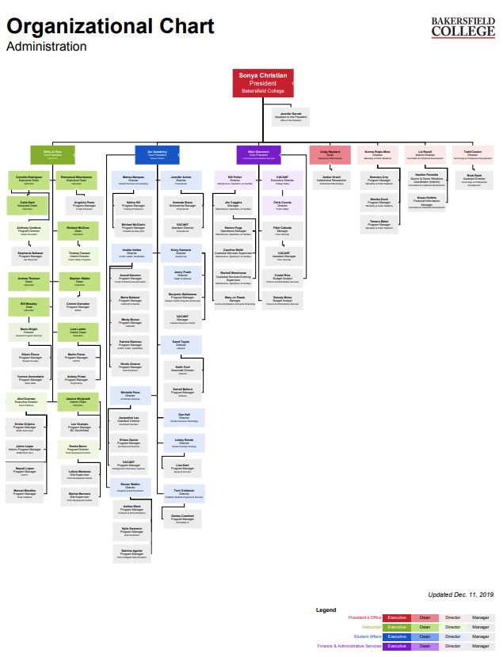

Slide 4
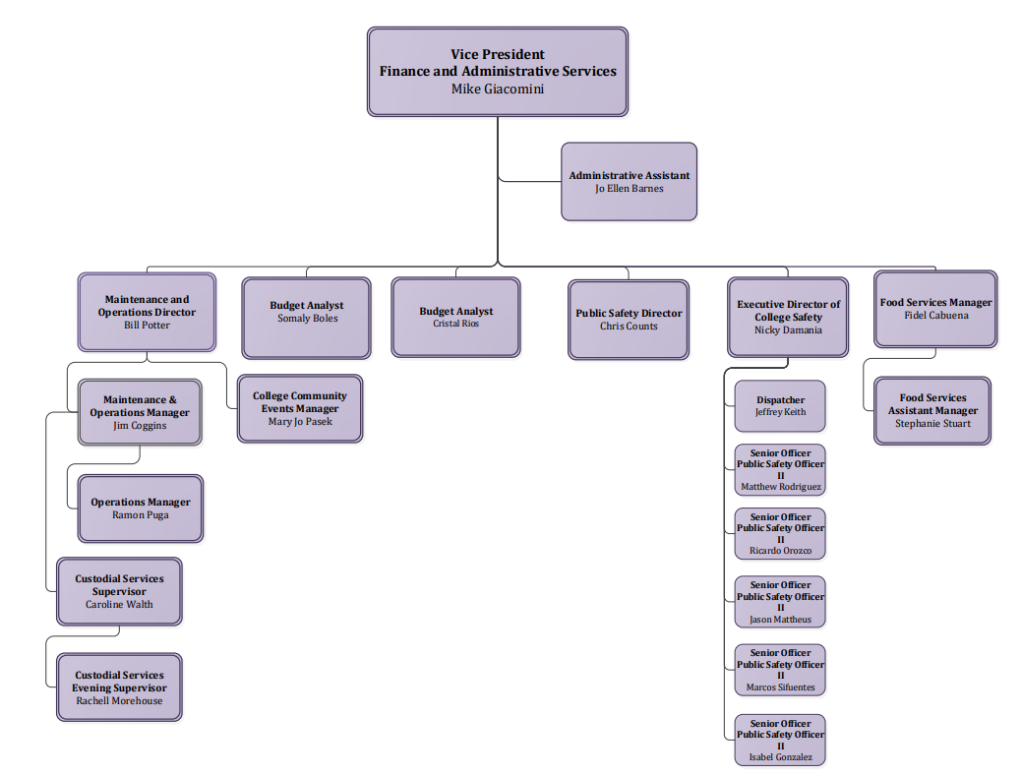
Finance and Admin Services
Notes:
Finance and Admin Services Org chart

Slide 5
Instruction
Notes:
Instruction Org Chart

Slide 6
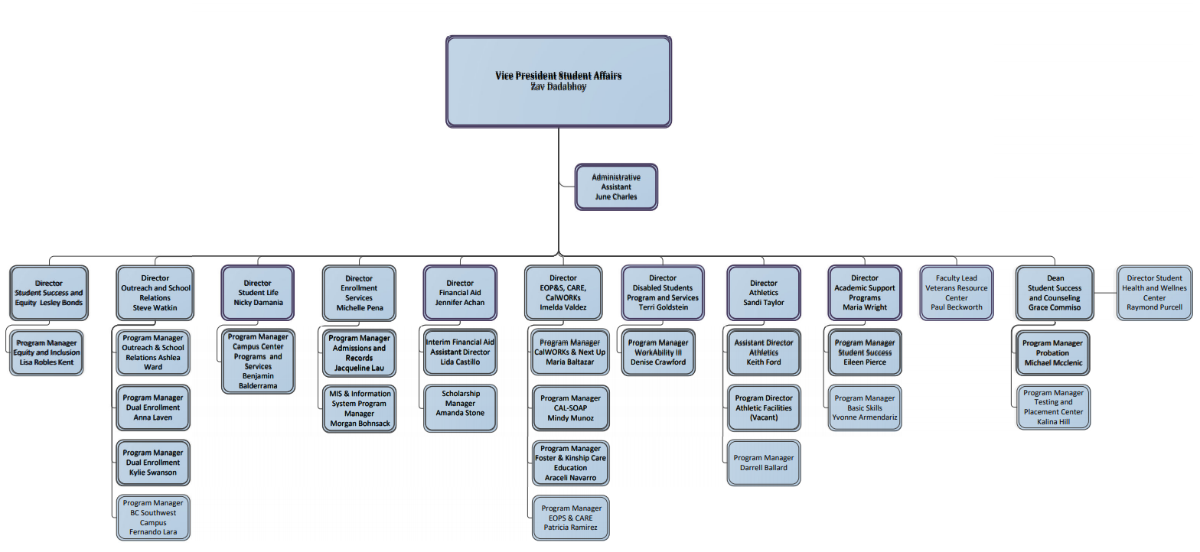
Student Affairs
Notes:
Student Affairs Org chart

Slide 7
Org Charts
Go to: http://www.bakersfieldcollege.edu
Choose “About BC”
Choose “Office of the President”
Click the “Team” tab
Scroll down for all the org charts.

Slide 8
Additional info
Timeline adjustment
Budget considerations

Slide 9
Next Steps
Task Force will be engaging with the various committees to solicit feedback.
Task Force will work with VP’s and their areas to get recommendations for changes.
Budget team will prepare for budget analysis.
Next Admin Structure Review committee meeting: February 13, 2020
Next College Council update will be March 6, 2020

