Slide 1
Personal & Career Exploration Pathway
Grace Commiso, Dean of Student Success & Counseling
Evette Lara, Education Advisor

Slide 2
Completion Team
Grace Commiso, Dean
Jonathan Schultz, Counselor
Lupe Aguirre, Ed Advisor
Evette Lara, Financial Aid
Ashlea Ward, Data Coach
Anna Laven, Program Manager
Michael McClenic, Program Manager
Notes:
We are a small team
No faculty have volunteered outside of our counselor

Slide 3
Notes:
Want to see this number decline
This will be impacted by CCCApply as well – if it is no longer an option. Discussions have been taking place about this.
- Evette talk to Summer Bridge as potential reason for lower numbers as well as work we have done in the high school

Slide 4
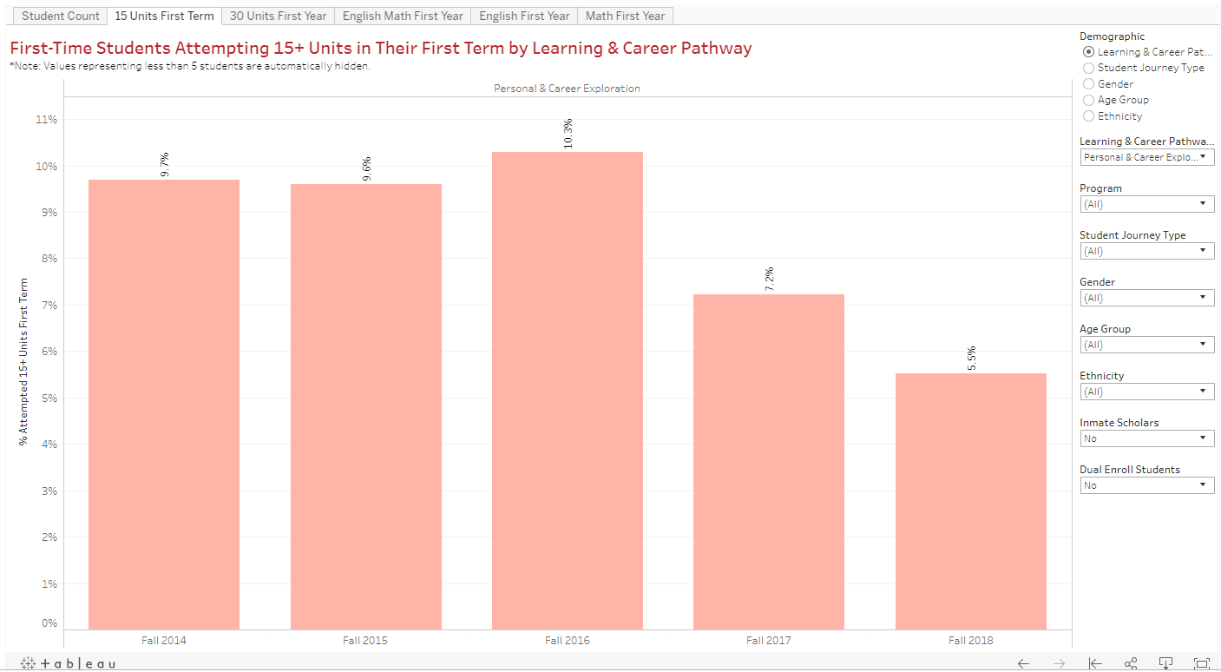

Slide 5
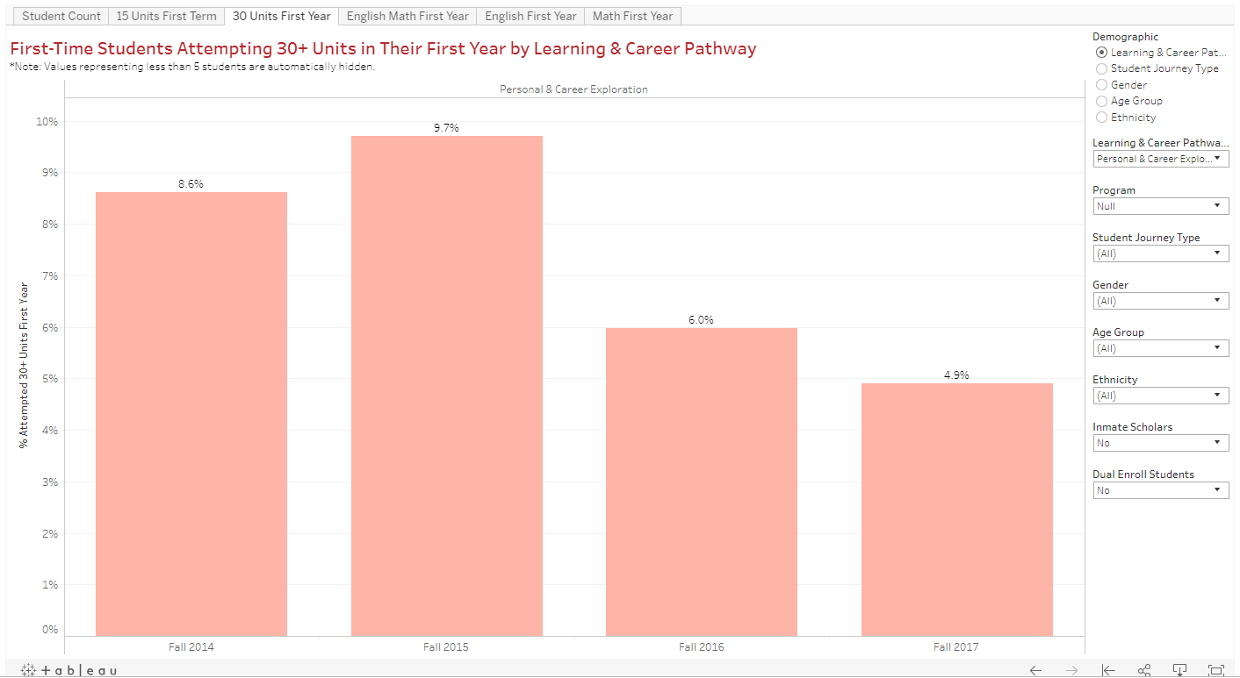

Slide 6
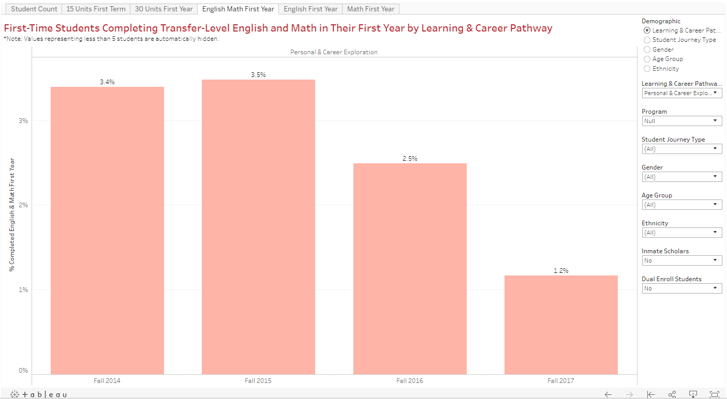

Slide 8
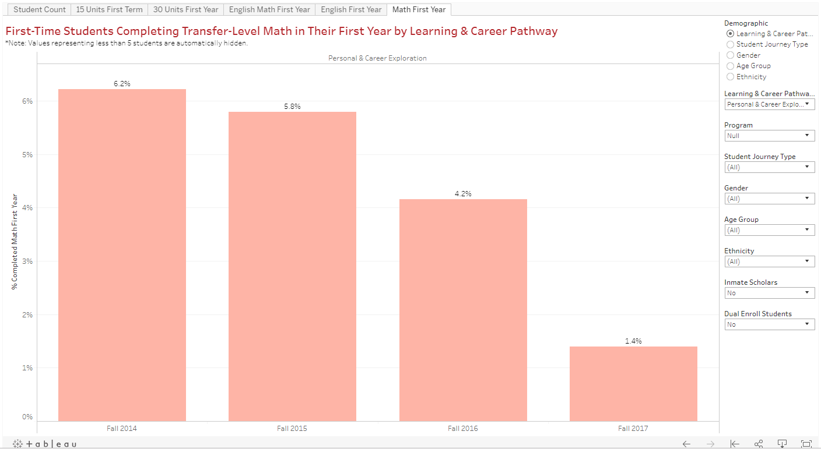

Slide 9
Starfish Data
5613 Students – past 4 years
478 - S19 Current Students
410 – NOT Enrolled in 15 Units
87.5%
Notes:
87.5% did not enroll in 15 units.
Found that a large number of those students were seeking skills courses or apprenticeship, or recertifying in areas such as FIRE therefore incorrect in banner so we have been working to do change of majors and suspect that this number will change significantly for next year.

Slide 10
Starfish Data
S19 - 478 Current Students
8 – Faculty Raised Flags
7 – Through Progress Surveys
5 – Referrals
3 – Counseling or Advising
1 – Financial Aid
1 – Academic Support

Slide 11
Success Strategies
Career Exploration Opportunities - Strong Interest Inventory
All students - Change of major process
Students with over 40 units – Individual contact
Notes:
All of these have been offered remotely as well so students do not have to schedule an appointment with counseling

