Slide 1


BUSINESS PATHWAY
Presentation to
BC College Council
Friday, March 1, 2019

Slide 2
Business Pathway
Mission Statement
The Business Pathway at Bakersfield College is dedicated to providing opportunities to help develop students skills, knowledge, and abilities, enhance their problem-solving skills, and provide hands-on-experiences within the industry of Business, Commerce, Economics, Entrepreneurship, Supply Chain Management and Information Technology. We equip students with tools to help them succeed in their desired field of study while providing an academic environment that fosters critical thinking and innovation. The Business Pathway offers high-quality educational programs and opportunities for students seeking the next level of professional skills to enter the workforce directly, or continue their education at a four-year university.

Slide 3
Bakersfield College has come up with a way to clarify and streamline our pathways. They include:
Assessing current pathways to degrees and transfer (ADTs, new paths, etc.)
Identifying institutional barriers for student progress (financial aid, etc.)
Aligning of expectations (among K-12, Community Colleges and transfer institutions, etc.)
Clarifying pathway components (enrollment management, etc.)

Slide 4
Advisors will be case managing more closely the enrollment and on boarding of our first time students while counselors will be monitoring progression and completion of our returning students.

Slide 5
Business Pathway
Mission Statement
Creighton magers, BMIT faculty chair

Slide 6
Business Pathway
Mission Statement
Manny mourtzanos, dean

Slide 7
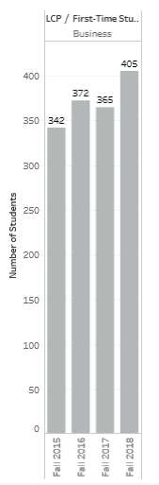

Business Pathway
Momentum Point Data Trends
First Time Student Enrollment

Slide 8
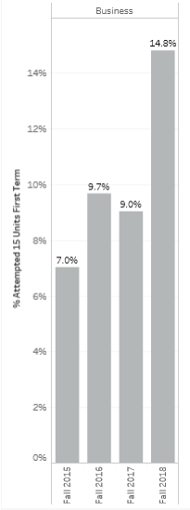
Business Pathway
Momentum Point Data Trends
15 Units Attempted

Slide 9
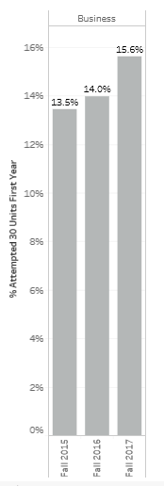
Business Pathway
Momentum Point Data Trends
30 Units Attempted

Slide 10
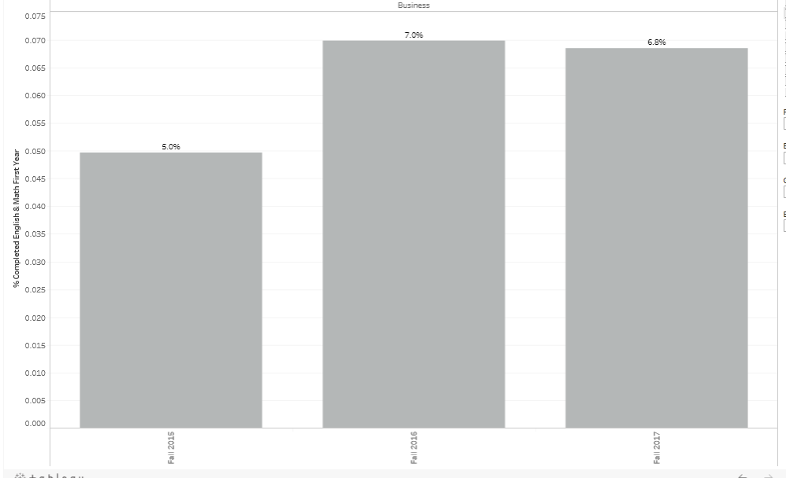
Business Pathway
Momentum Point Data Trends
English and Math in the First Year

Slide 11
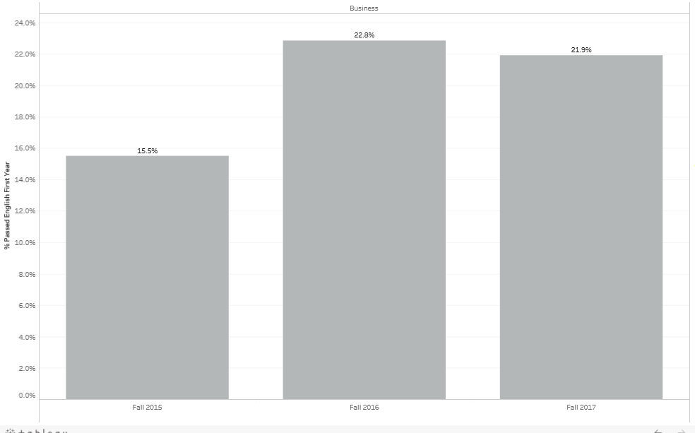
Business Pathway
Momentum Point Data Trends
English Only in the First Year

Slide 12
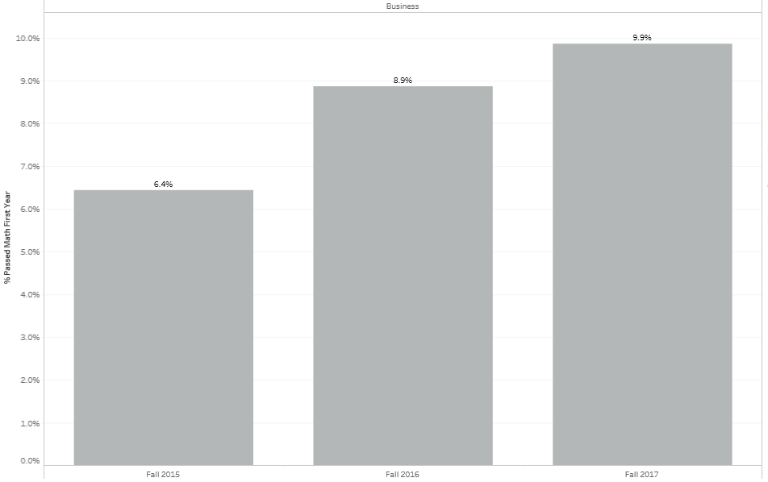
Business Pathway
Momentum Point Data Trends
Math Only in the First Year

Slide 13
Business Pathway
Data Inquiries
Fall to Spring Attrition

Slide 14
Business Pathway
Campus Collaborative Grant
BCSGA Campus Collaborative Grant - $1,000
Professional Etiquette ‘Lunch & Learn’ Event

Slide 15
Business Pathway
Professional Etiquette Event
Tuesday, April 9 – 11:00 am to 1:00 pm
Nicky Damania, Guest Speaker
Funded by Campus Collaborative Grant
Entrée to Career Expo

Slide 16
Business Pathway
Career Expo
Wednesday, April 24, 9:00 am to 1:00 pm
Career exploration from business leaders, community & industry partners, educational institutions and vendors
Funded by Office of Student Success & Equity

Slide 17
BUSINESS PATHWAY
Presentation to
BC College Council
Friday, March 1, 2019

