Slide 1

Food Services Update
College Council Meeting
December 7, 2018

Slide 2
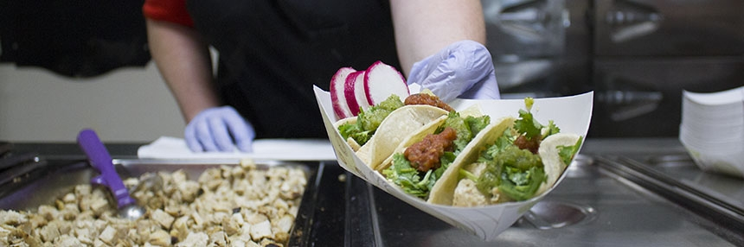
Measure J & Food Services
Cafeteria/grill will be closed December 8-January 12
  Food Services will still accept catering requests during this time
Notes:
Help to model this behavior
Sonya giving up parking space
If taking shuttle, don’t park in BC parking lot. Park across the street

Slide 3
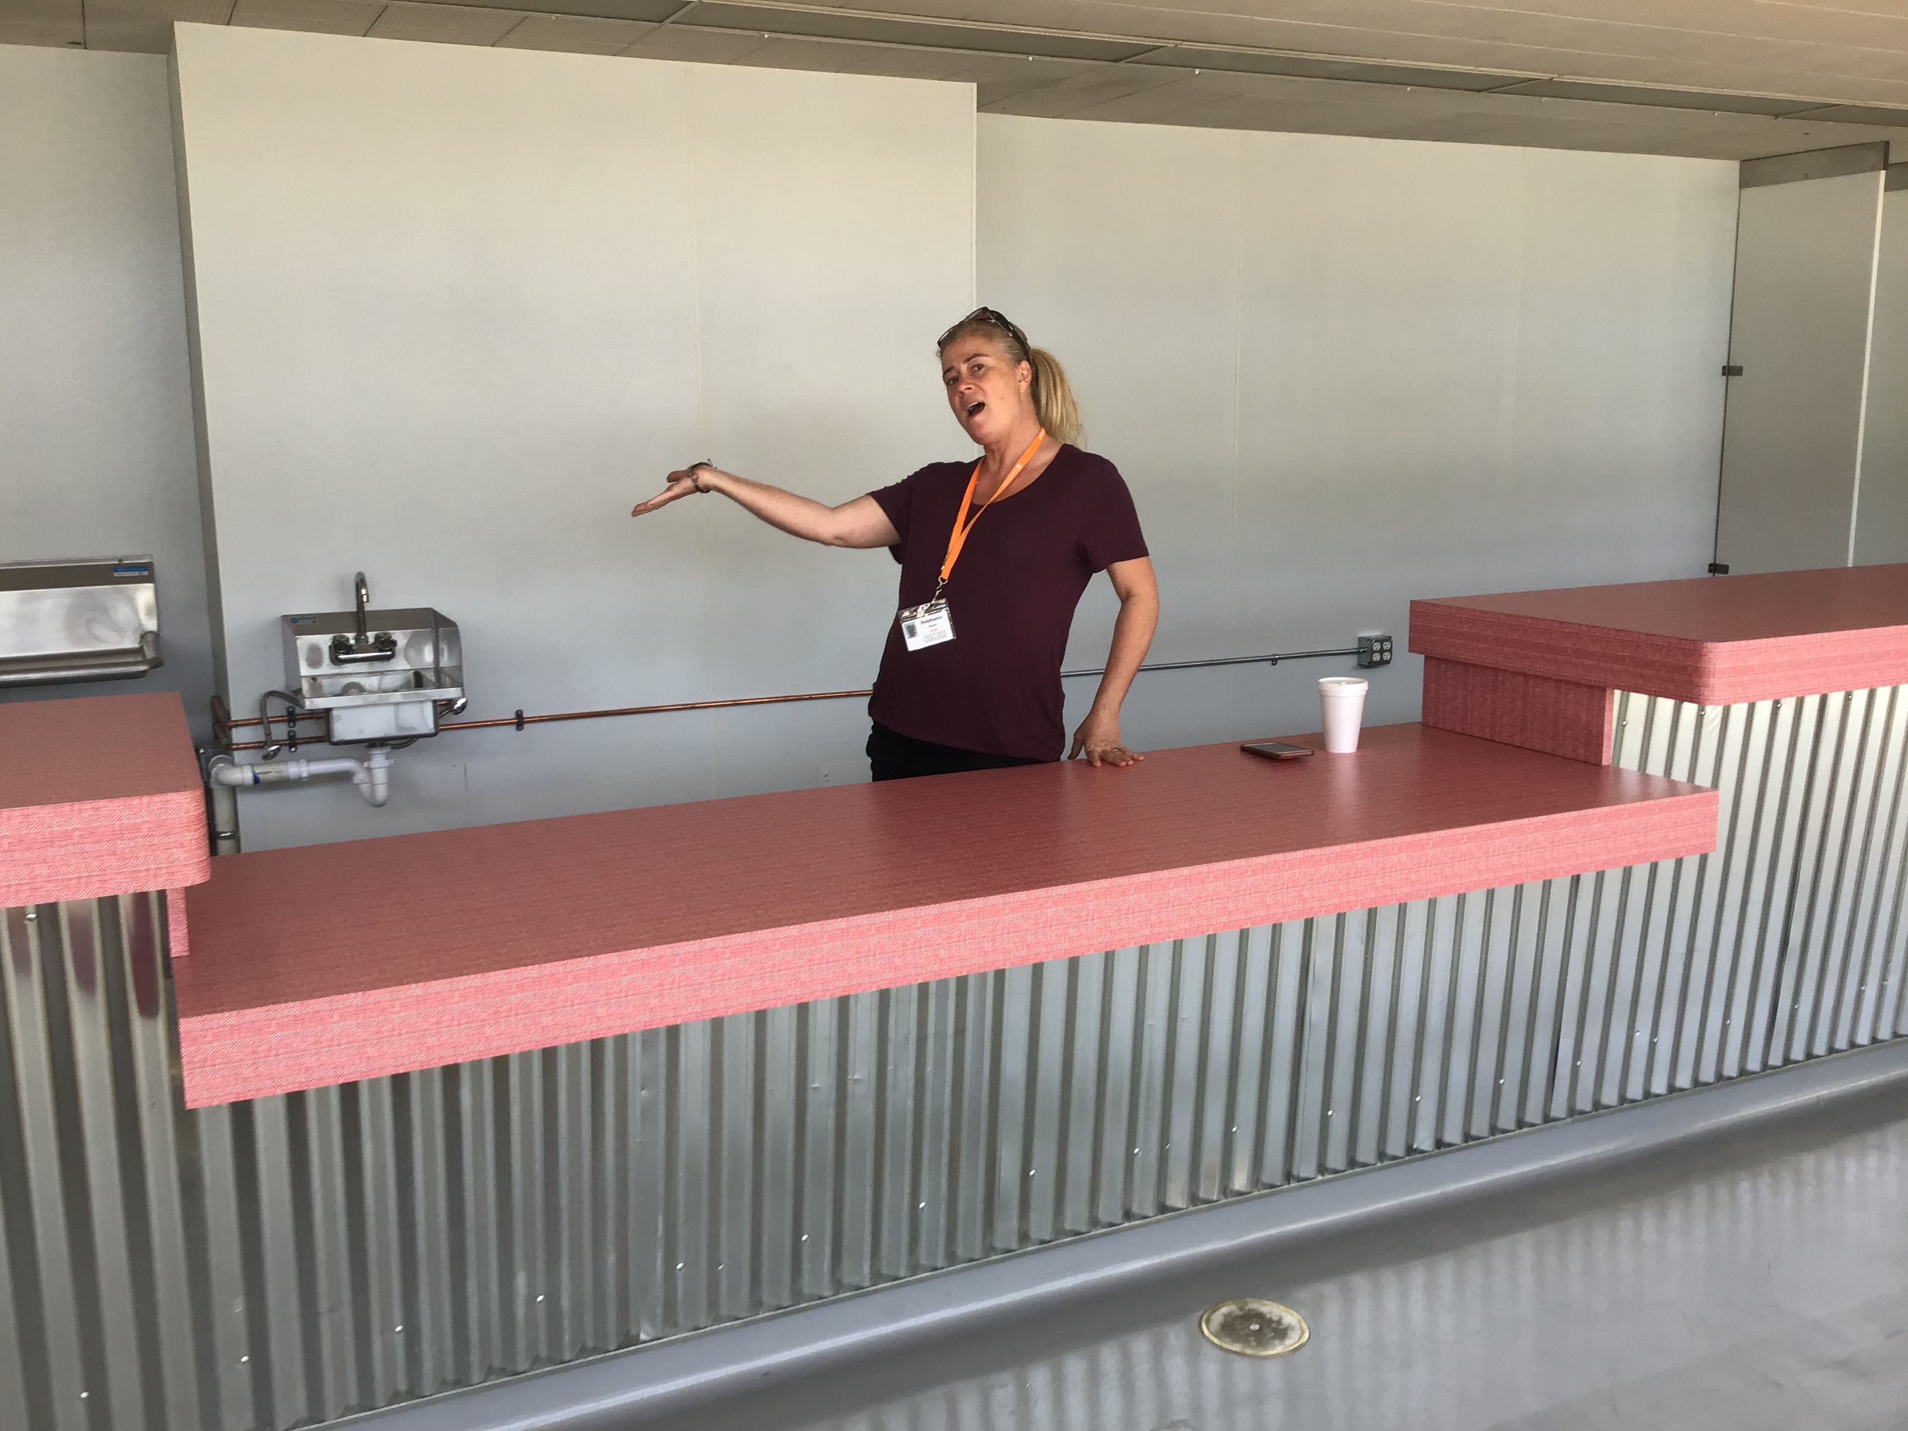
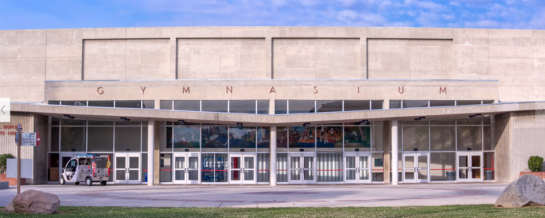
The Huddle
Cafeteria will move to Huddle starting December 8 and will be ready for the start of the spring semester.
Notes:
Help to model this behavior
Sonya giving up parking space
If taking shuttle, don’t park in BC parking lot. Park across the street

Slide 4
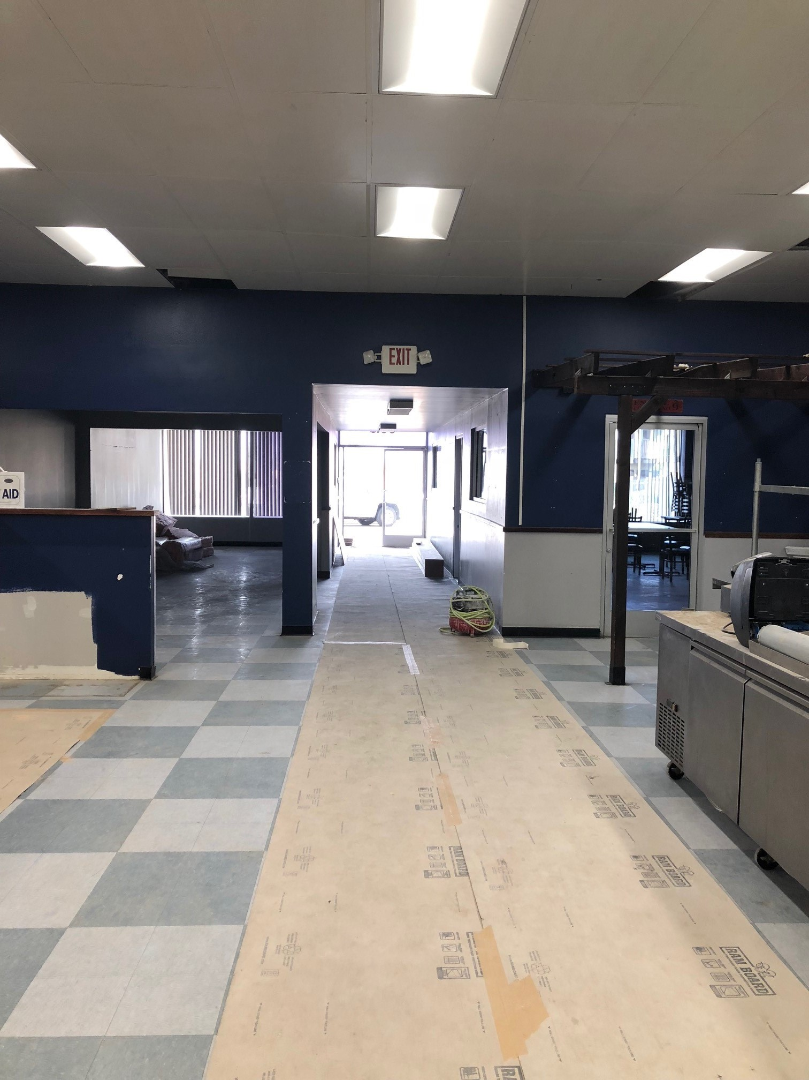
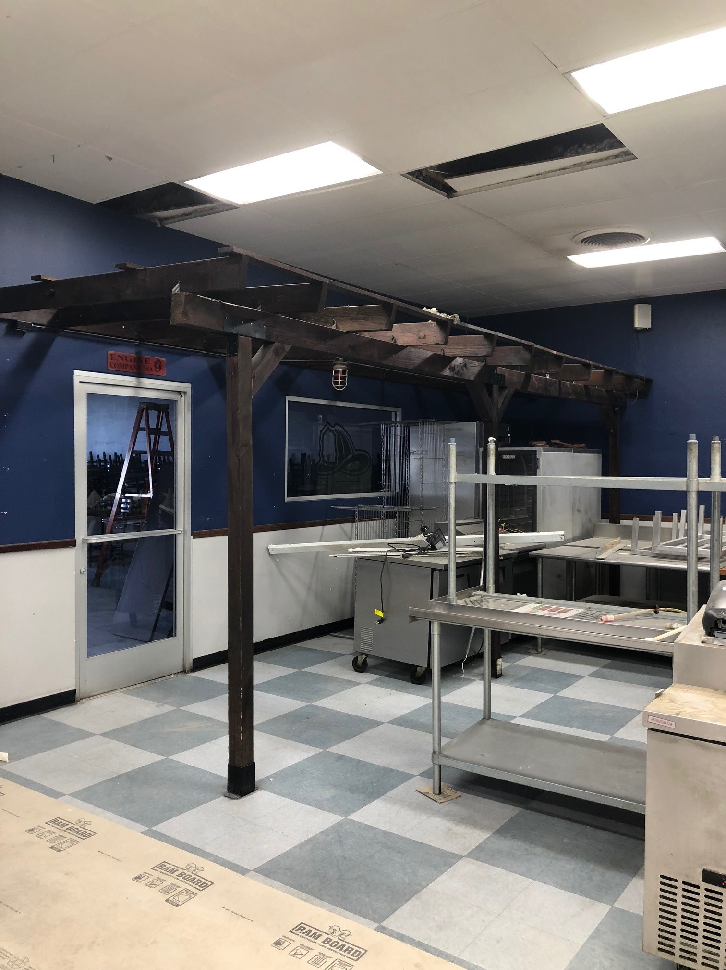
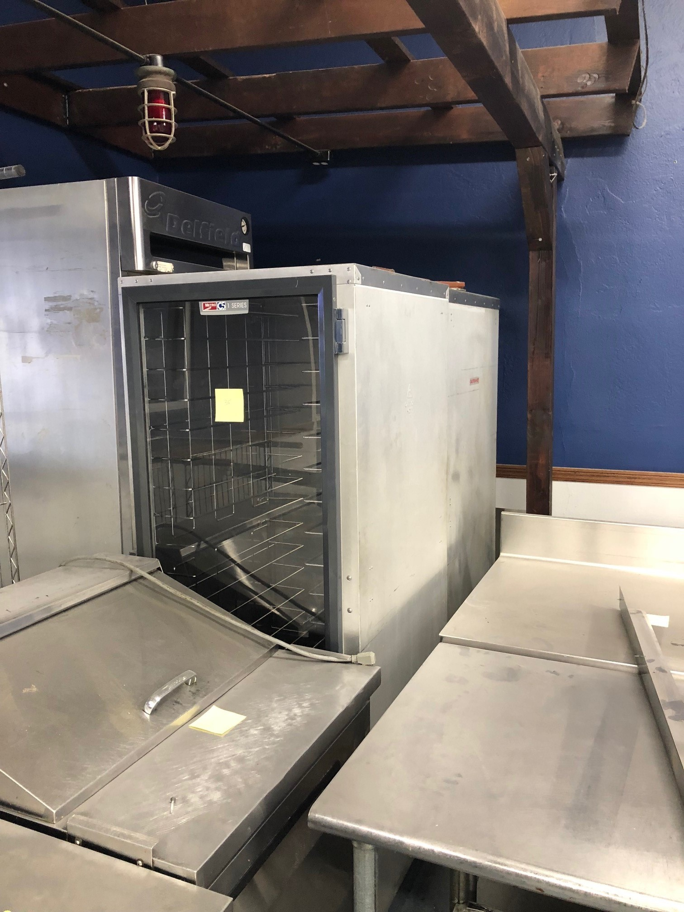
Tony’s Pizza
The kitchen will move to Mount Vernon Commissary (formerly Tony’s Pizza) starting December 8 for catering preparation
Notes:
Help to model this behavior
Sonya giving up parking space
If taking shuttle, don’t park in BC parking lot. Park across the street

Slide 5

Gades Grub Food Trailer
Food trailer will serve hot food on campus in addition to the offerings being served in the Huddle
Will be open beginning January 12
Food Services will continue to contract with independent food trucks to service the campus
Notes:
Office space is very limited so everyone is sharing. President Christian is will be offering up space in her office. We ask that everyone be understanding. Sharing is caring! ☺

Slide 6
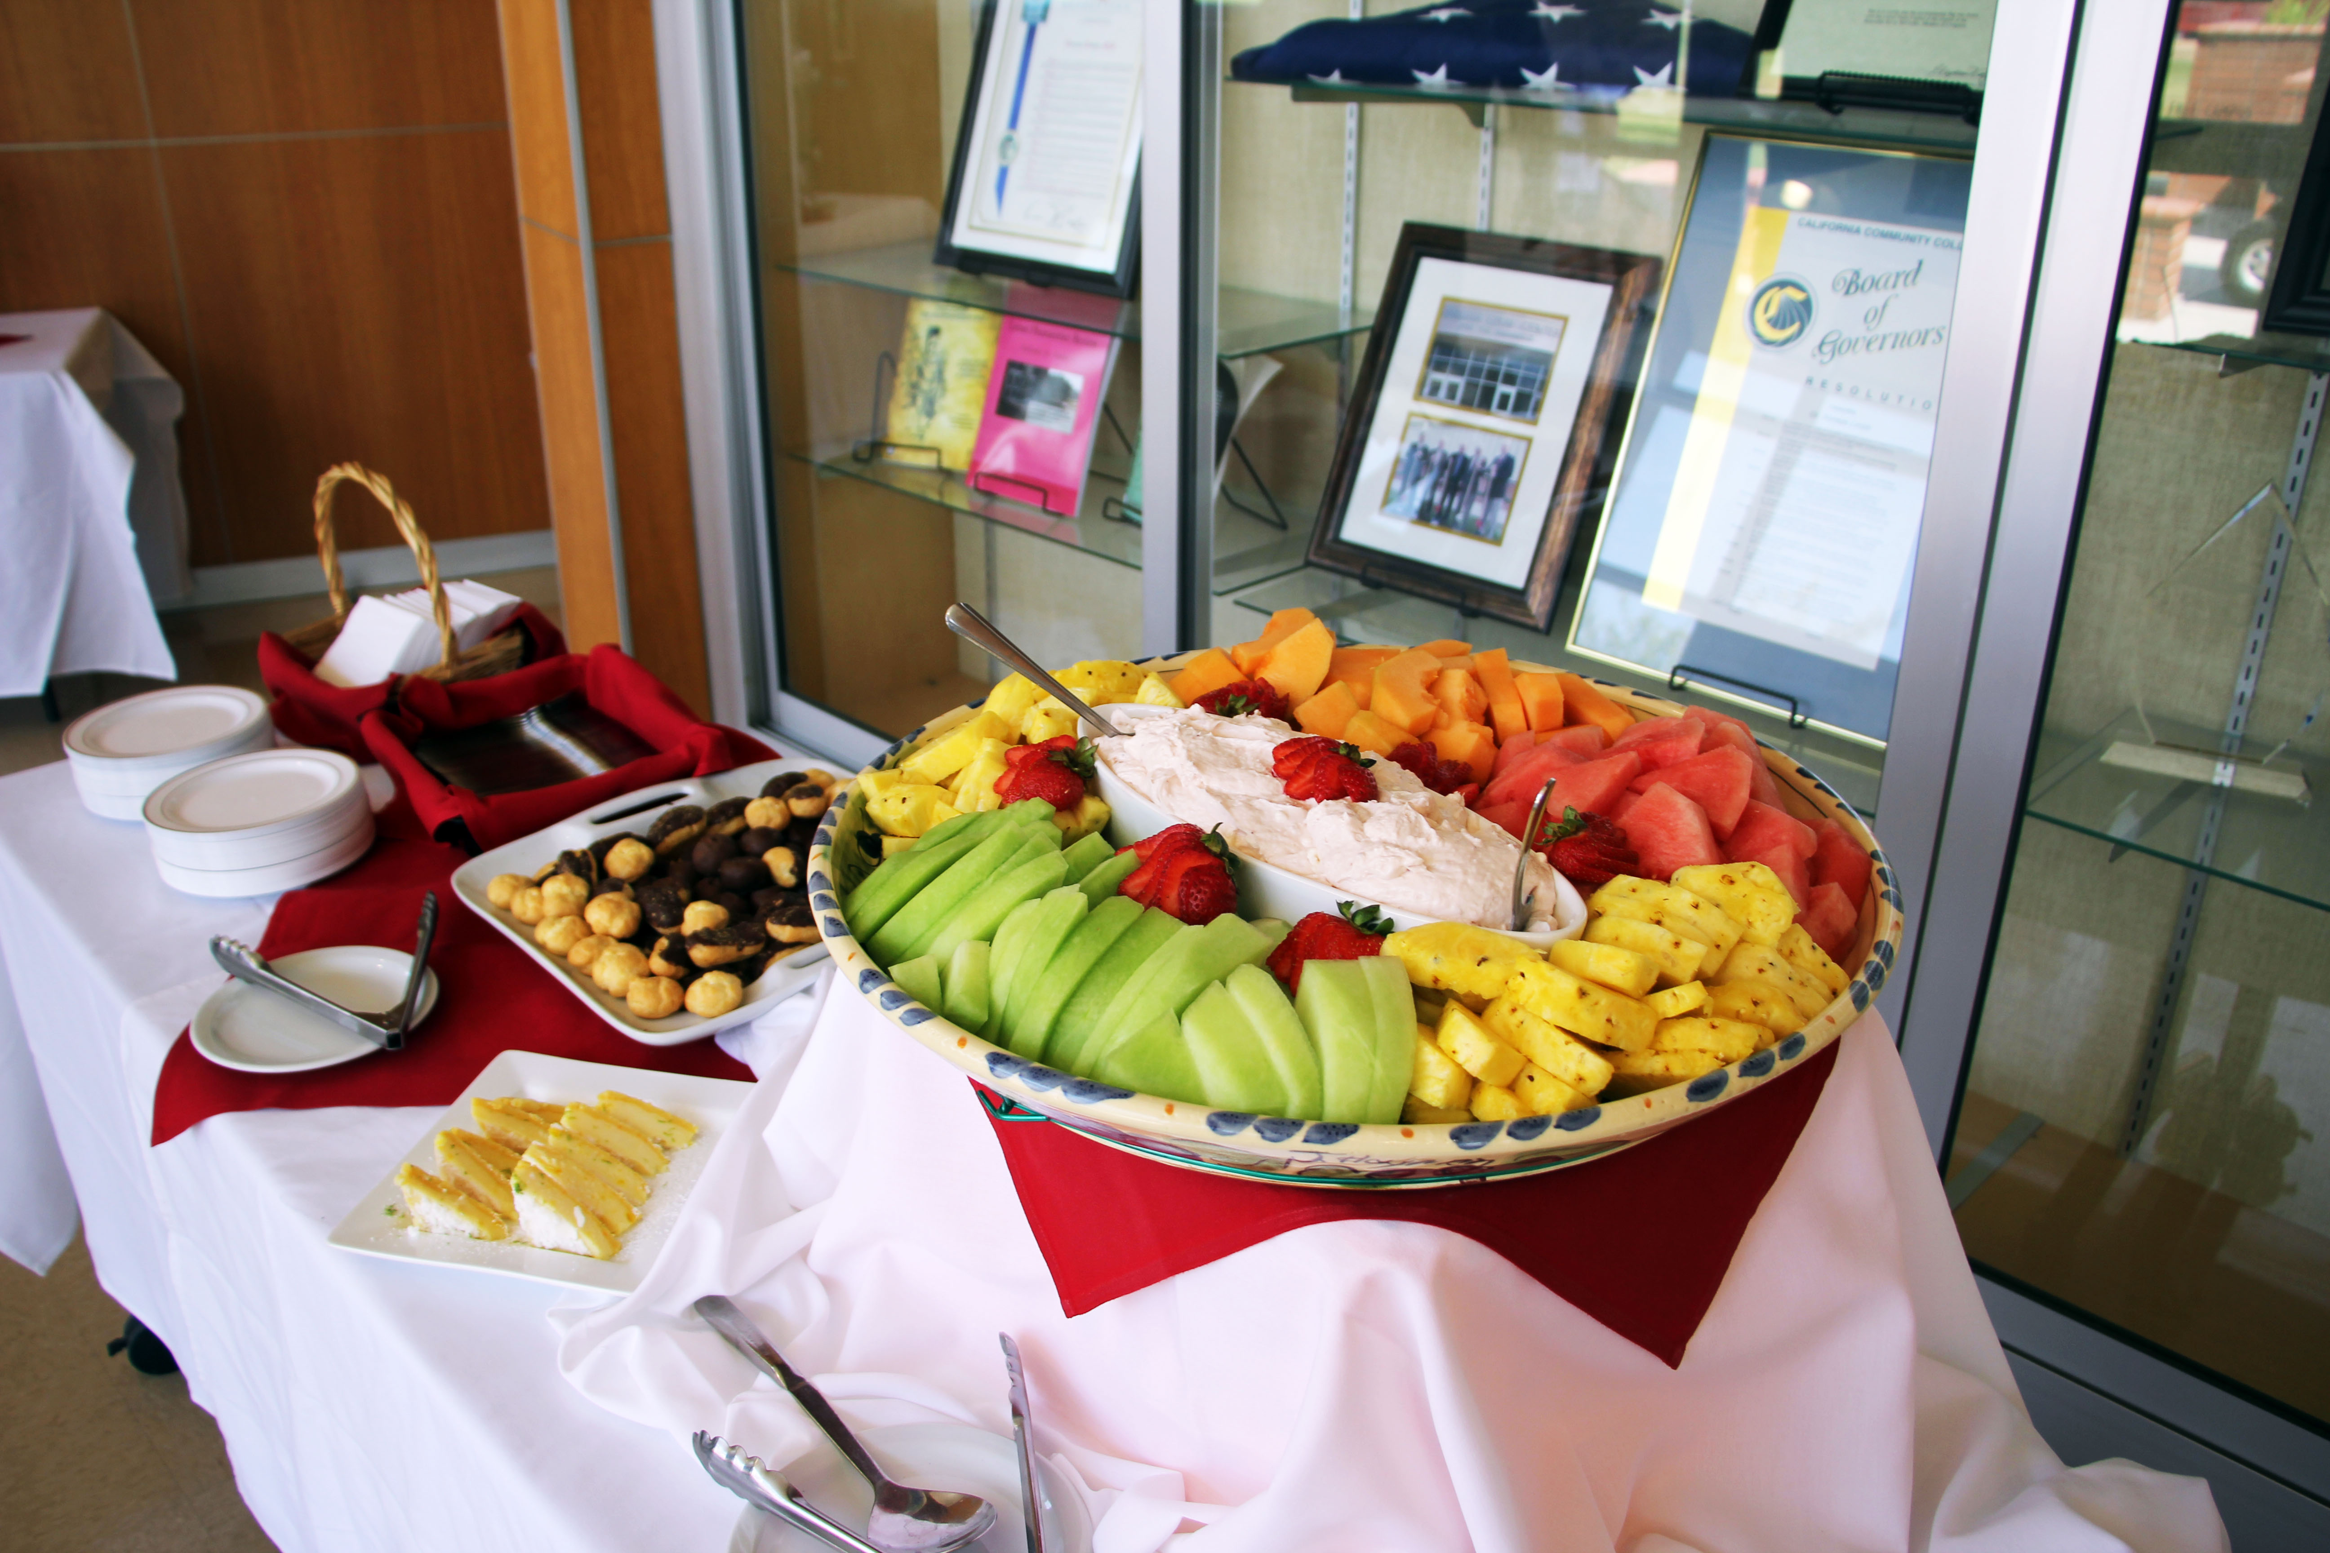
Catering Requests
All catering requests must be made through Food Services
Open for catering during Winter Recess
Independent Contractor Agreements (ICA's)

Slide 7
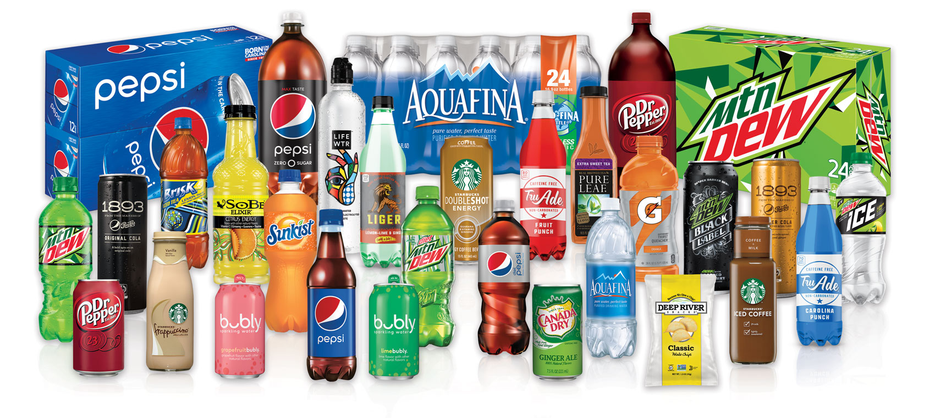
Pepsi Contract
Only Pepsi products can be sold/distributed on campus
If selling, must request products from Food Services to place the order

Slide 8

Social Media
Twitter, Instagram & Facebook
@BCFoodScene

