Slide 1
BAKERSFIELD COLLEGE
SOUTHWEST
Mike Giacomini – College Council – 10.19.18

Slide 2
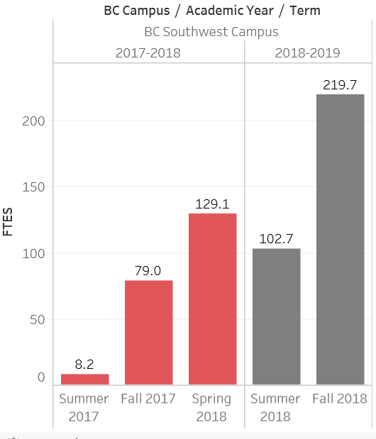

BCSW ENROLLMENT GROWTH

Slide 3
Capacity Challenges
Enrollment is reaching capacity at our current sub-leased site in Southwest Bakersfield.
The sub-lease for this location ends on March 31, 2019. Working to extend through the end of 2019.
BC had been working with the building on renewing the lease and adding nearly double the space.
Negotiations have fallen though primarily due to the high parking to sq. ft. ratios that colleges need.

Slide 4
The Search for A Better BC - SouthWest
We’ve located seven potential sites that could possibly work just based on the amount of sq. ft. we’ll need to facilitate the growth in our SouthWest location.
Most of these sites weren’t desirable due to a combination of the following reasons
  Inadequate parking
  Poor access
  No visibility from main arterials
  Developer isn’t interested in developing their land at this time.

Slide 5
The Search for A Better BC – SouthWest – Continued
The best prospect in the area is the future home of the University Office Center. Co-located with CSUB.
Parking, construction timelines, access and visibility are not issues with this site.
Cost could be a challenge as the building is currently designed based on DSA guidelines.
The site is the only option to offering continuous education in the SouthWest without having to attempt a temporary/portable environment.

Slide 6
Advantages of a CSUB Collaboration
  Increasing Transfer Rates (Funding Model)
  Decreasing Time to Completion (Funding Model)
  Enhanced Student Success and Performance (Funding Model)
  Enhanced Campus Experience for BC Students (Student Success)
  Collaborative Operations (reducing single-institution costs)

Slide 7
Timeline Implications
 | Fall 2018 |  | Spring 2019 |  | Summer 2019 |  | Fall 2019 |  | Spring 2020 |  | Summer 2020 |  | Fall 2020 |  | Spring 2021 |  | Summer 2021 |  | Fall 2021 |  | Spring 2022
Current Lease | Educating |  | Educating |  | Educating |  | Educating
Proposed Lease @ CSUB | BOT Approval |  | Construction |  | Construction |  | Construction |  | Educating |  | Educating |  | Educating |  | Educating |  | Educating |  | Educating |  | Educating
Current Lease | Educating |  | Educating |  | Educating |  | Educating |  | Lost FTES |  | Lost FTES |  | Lost FTES |  | Ramping Up |  | Ramping Up |  | Still Behind |  | Still Behind
Proposed Bolthouse Lease | Negotiate |  | BOT Approval |  | Planning |  | Planning |  | Construction |  | Construction |  | Construction |  | Educating |  | Educating |  | Educating |  | Educating
Current Lease | Educating |  | Educating |  | Educating |  | Educating |  | Lost FTES |  | Lost FTES |  | Lost FTES |  | Lost FTES |  | Lost FTES |  | Lost FTES |  | Ramping Up
Purchase/Build | Planning |  | Planning |  | Working Drawings |  | Complete Drawings |  | DSA Review |  | DSA Final Approval |  | Bid & Award |  | Construction |  | Construction |  | Construction |  | Educating

Slide 8
BAKERSFIELD COLLEGE
SOUTHWEST

