Slide 1
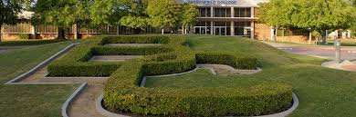
College Council *Round 2
The ISER
What you need to know…
9/21/2018
BAKERSFIELD COLLEGE
Presented by:
Sarah Baron and Alisha Loken
Notes:
Alisha opens

Slide 2

Objectives
Test learning on Standards I and IV
Discuss how College Council is represented in the ISER related to Standards II, III and the QFE
Notes:
Alisha

Slide 3
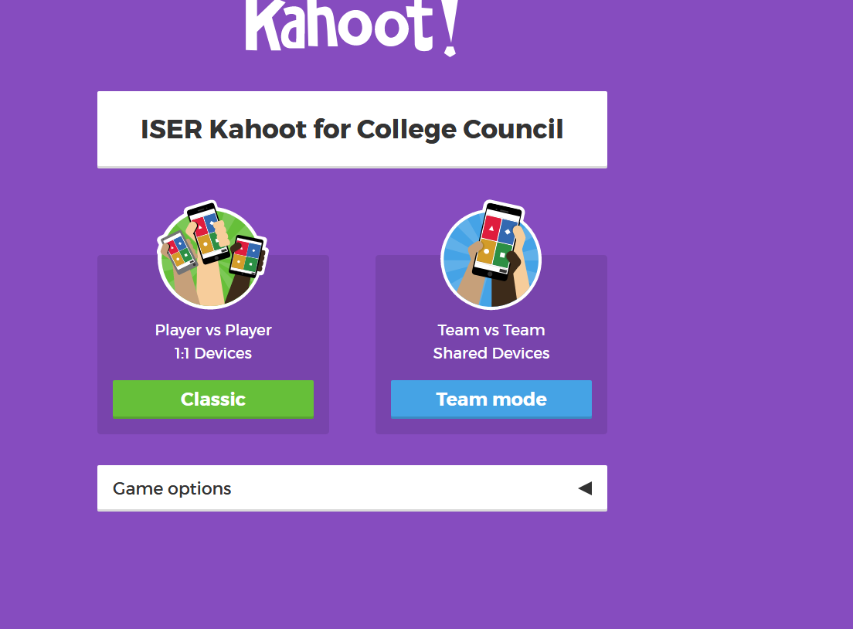
Pop Quiz!!
Please go to Kahoot.it
Our three winners from last visit will have to sit this one out-want to test your knowledge from last time
Notes:
Sarah

Slide 4
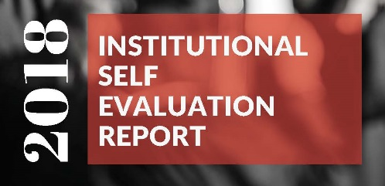
Student Learning Programs and Support Services
College Council not specifically mentioned in Standard II
Want to make you aware of some Assessment information in Standard II
Standard II
Notes:
Sarah

Slide 5
II.A.3: The institution identifies and regularly assesses learning outcomes for courses, programs, certificates and degrees using established institutional procedures.
The institution has officially approved and current course outlines that include student learning outcomes. In every class section students receive a course syllabus that includes learning outcomes from the institution’s officially approved course outline.
Assessment & YOU
Notes:
Sarah

Slide 6
Student Learning Outcomes (SLOs)
Program Learning Outcomes (PLOs)
Institutional Learning Outcomes (ILOs)
Assessment Evidence
Notes:
Sarah

Slide 7
PLAN
REFINE
ASSESS
REFLECT
BC is on PARR with Assessment
Notes:
Sarah

Slide 8
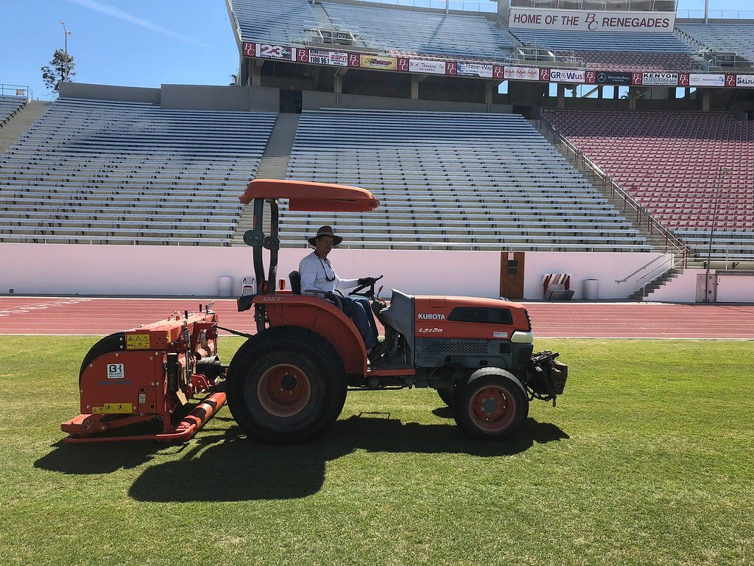
Resources
STANDARD III
Notes:
Alisha

Slide 9

College Council and Standard III
III.A-Reorganization task force makes recommendations to CC and the President re administration positions/responsibilities
III.C-BC Technology Plan updated every 3 years-approved by CC
III.D
CC provides budget recommendations to the President-posted on CC committee website
CC creates a work plan each Fall to review mission, goals, Strategic Directions
Program Review evals resource allocations and makes recommendations via annual report to CC
AIQ coordinates eval of Strategic Directions and makes recommendations via annual report to CC
Notes:
Alisha

Slide 10
Quality Focus Essay
Outlines 2 Quality Focus Projects
Program Pathway Mapper-streamline degree progress
Student Support Services
  “Ramp up” Summer Bridge
  Embed Ed-Advising in each Learning and Career Pathway
  Use data analytics from Starfish
Notes:
Alisha

Slide 11
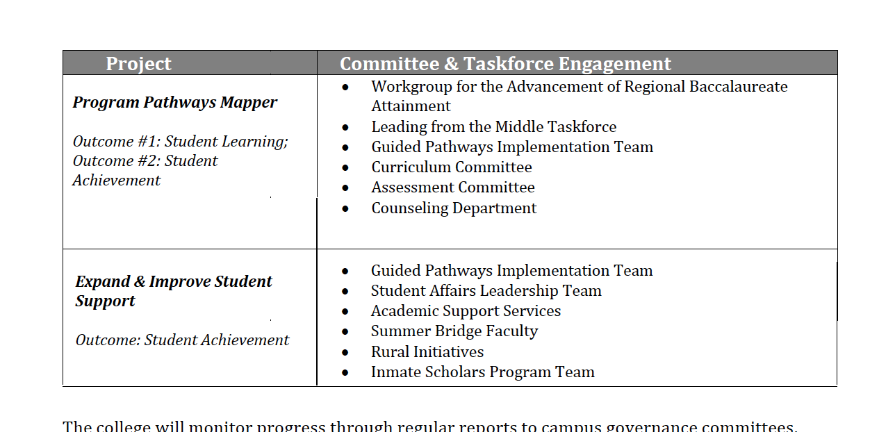
Notes:
Alisha

Slide 12
Where does College Council come in?
“The college will monitor progress through regular reports to college governance committees, including College Council”
Notes:
Alisha

Slide 13
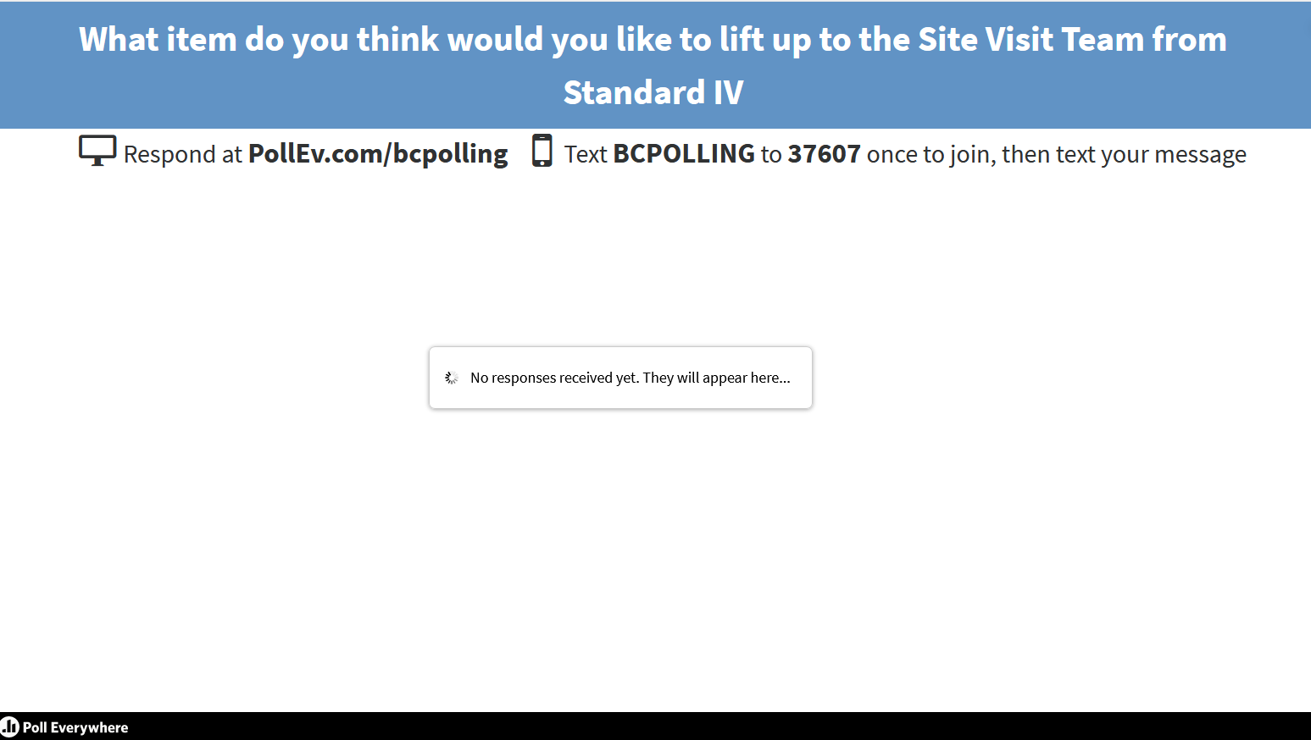
ISER Engagement Activity
www.polleverywhere. com
Notes:
Sarah

