Slide 1
Accreditation Midterm Report Update Student Government Association March 2nd, 2022
Leo Ocampo- Admin Lead
Jason Stratton- Faculty Lead
Midterm Report Team

Slide 2
2018 External Evaluation Visit
Accreditation Reaffirmed for 7 Years!
No Recommendations!
2025 Next Accreditation Visit!

Slide 3
2018 External Evaluation Visit
Accreditation Reaffirmed for 7 Years!
No Recommendations!
Midterm Report!
Update on plans and goals set during previous evaluation visit
2025 Next Accreditation Visit!

Slide 4
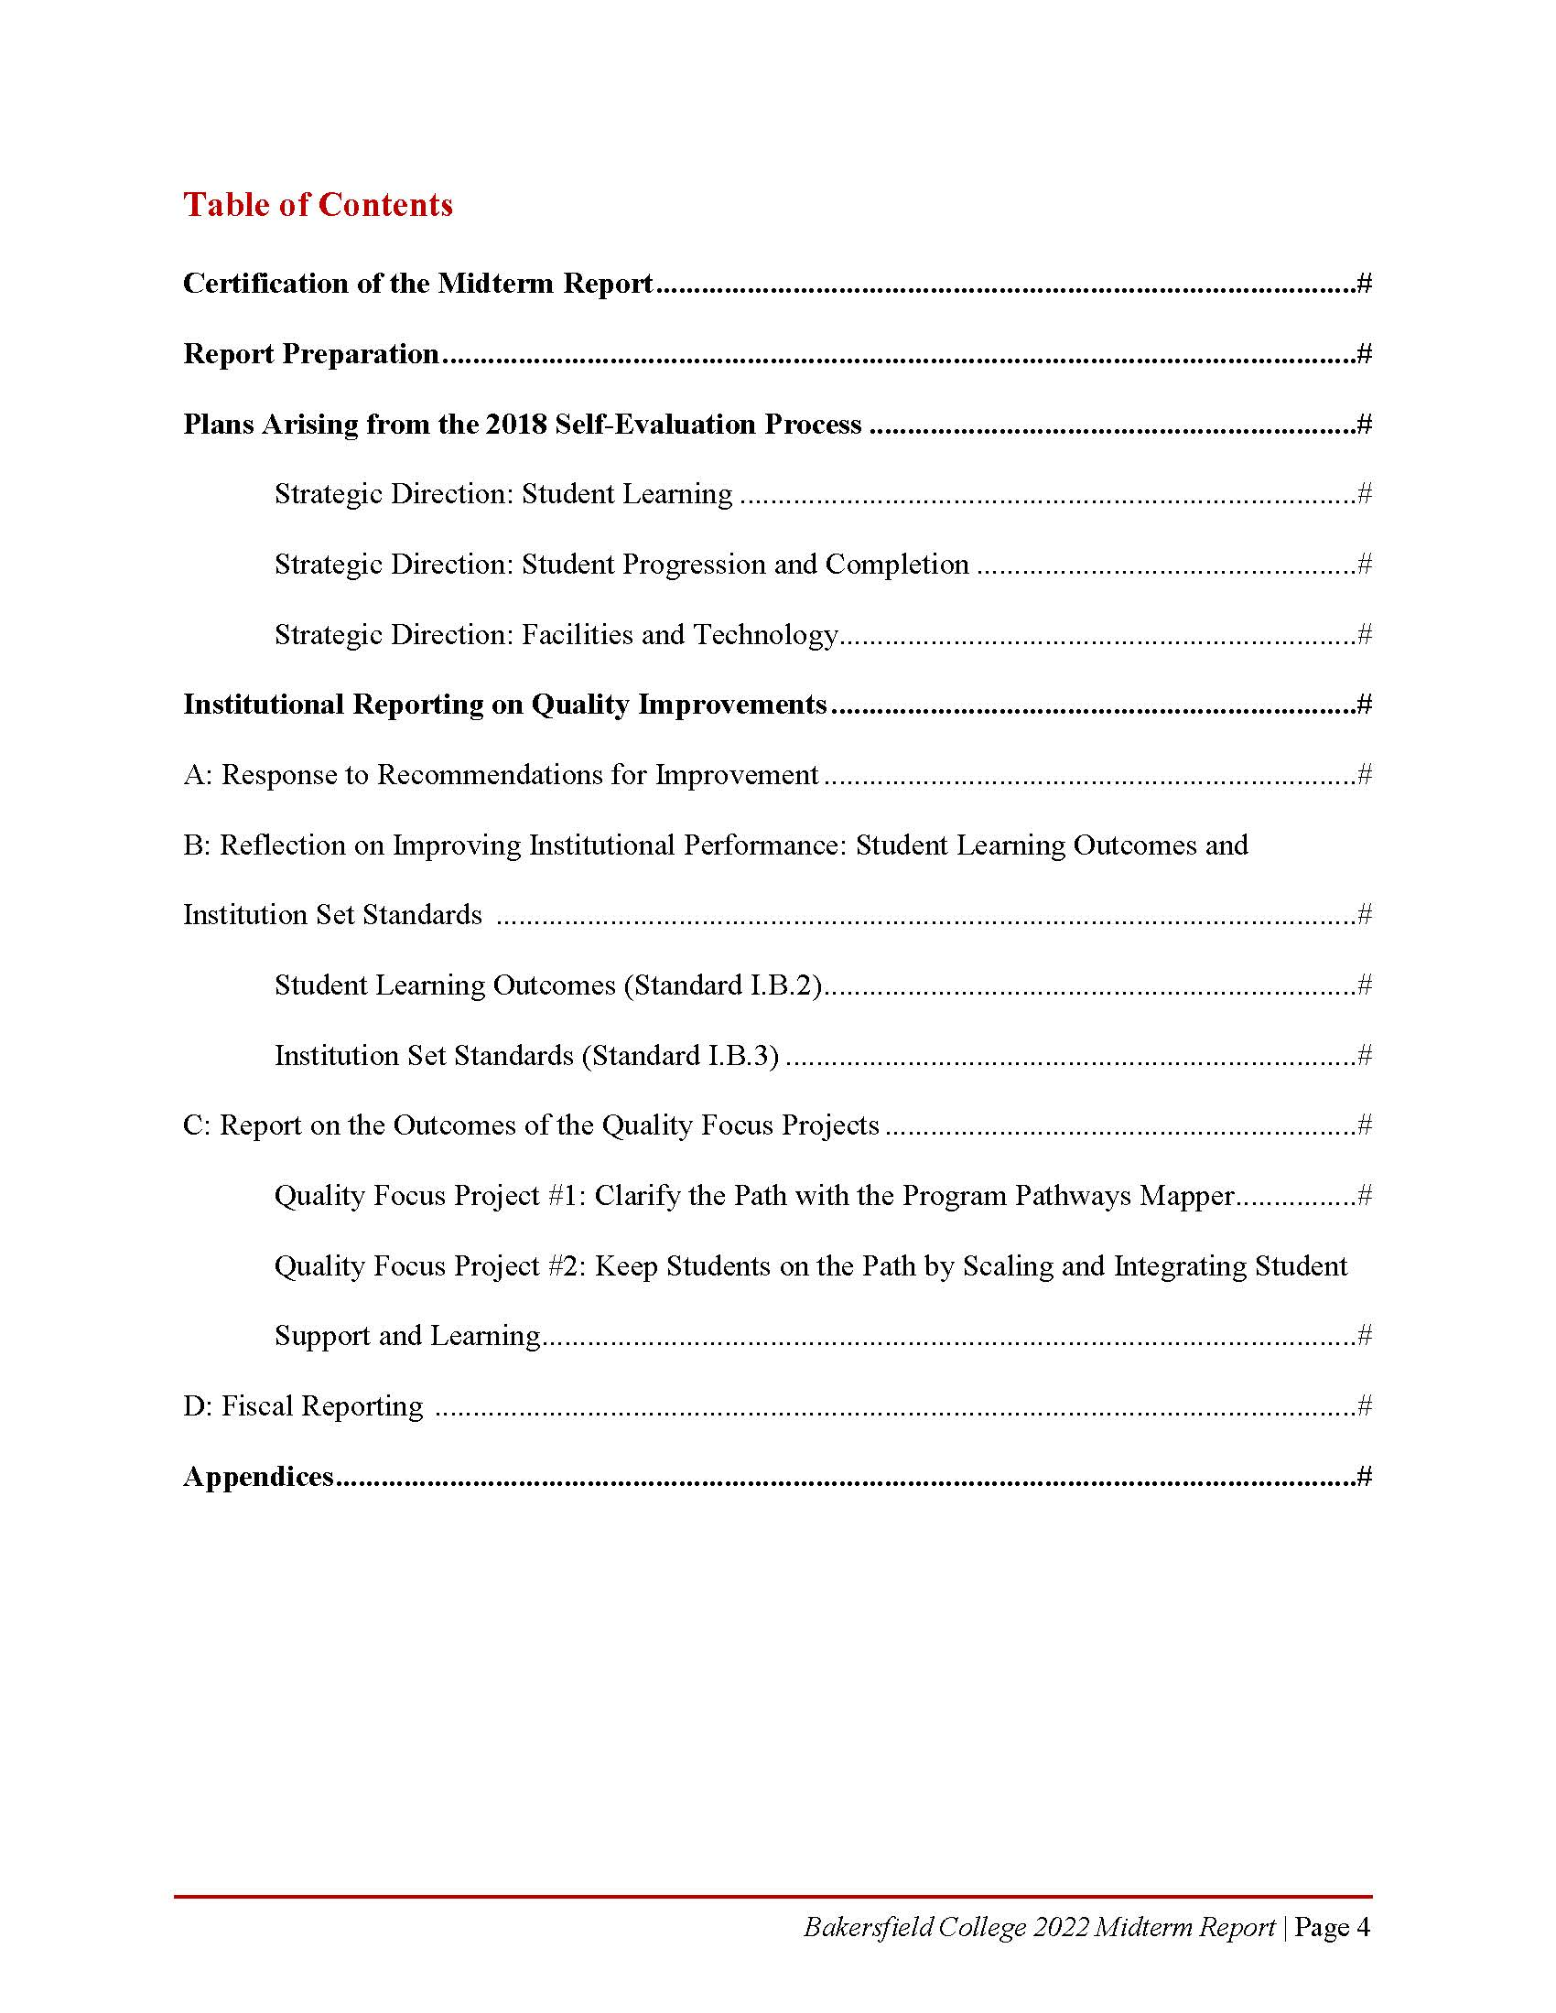
ACCJC Guidelines for Preparing Institutional Midterm Reports

Slide 5
ACCJC Guidelines for Preparing Institutional Midterm Reports

Slide 6
Plans Arising from the 2018 Self-Evaluation Process
Initiatives
Curriculum Development and Assessment using eLumen
Visually represent clear pathways through the Program Pathways Mapper tool
Strategically expand dual enrollment
Scale up Summer Bridge
Launch the Pathways Program Mapper
Redesign student support services, specifically the role of educational advisors
Implement the Facilities Master Plan using the funds secured through the Measure J Bond

Slide 7
Institutional Reporting on Quality Improvements
Response to Recommendation for Improvement
Reflection on Improving Institutional Performance: Student Learning Outcomes
Reflection on Improving Institutional Performance: Institution Set Standards

Slide 8
Quality Focus Projects
1: Clarify the Path with Program Pathways Mapper
2: Keep Students on the Path by Scaling and Integrating Student Support and Learning

Slide 9
Fiscal Reporting
1: No enhanced fiscal monitoring required, thus no explanations of processes required.
2: Provide a copy of the most recent Annual Fiscal Report.

Slide 10
We want your feedback! Please respond no later than March 23rd, 2022
The following hyperlink will send an email to all members of the team: Midterm Report Team
Or, send individual emails to:
Jason Stratton: jstratto@bakersfieldcollege.edu
Leo Ocampo: gamaliel.ocampo@bakersfieldcollege.edu

Slide 11
Thank you!

