Slide 1
Assessment Open House
September 1, 2023
10:30am-12pm
Zoom
Notes:
Welcome from the co-chairs

Slide 2
Agenda
Introductions
What is the Assessment Committee?
A day in the life of an Assessment member
Work expected
Accomplishments 2022-23
Housekeeping
Questions

Slide 3
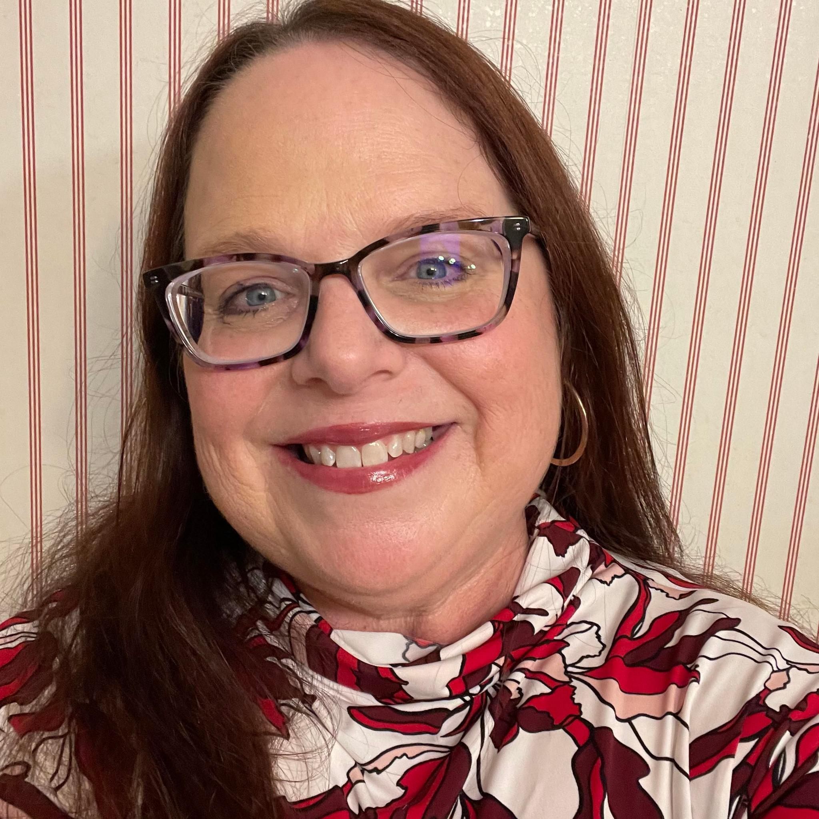
Your co-chairs
Becka Zepeda
Assessment Faculty Co-Chair
(Biology Dept.)
Mindy Wilmot
Assessment Administrative Co-Chair
(& Dean of Instruction)

Slide 4
What is Assessment?
The primary purpose of this committee is to help support student learning by ensuring that all processes related to assessment are consistent with the mission of the college, addresses the needs of students and the community, and meets the requirements of law and regulation.

Slide 5
The Assessment Committee…
Reviews and approves all Student Learning Outcomes (SLOs) and Program Learning Outcomes (PLOs)
Reviews and approves mappings to Institutional Learning Outcomes (ILOs) and General Education Learning Outcomes (GELOs)
Provides assessment training and dissemination of assessment information
Provides support for development, implementation, and evaluation of assessment

Slide 6
What does this mean for you?

Slide 7
Assessment members…
Evaluate SLOs & PLOs for new and revised courses & programs
Evaluate the Assessment Reports within Program Review
Help faculty import their SLO data into eLumen each semester
Complete other faculty support & training as needed

Slide 8
You can anticipate
A team assignment taking up 30-60 minutes of your time every 1-2 weeks **Opportunity to opt-out if you are interested in being a faculty designee for other committees involving assessment**
2 x 90 minute meetings per month
Acting as your dept/area’s Assessment go-to
The option to co-present Assessment Flex workshops

Slide 9
So what did you do last year?

Slide 10
2021-22 Accomplishments
Conducted a mixed-methods assessment of ILO 3
Reviewed the learning outcomes for 214 courses & programs
Evaluated 61 Program Review Assessment Reports
Updated 61 Assessment Plans
Presented 5 FLEX workshops
Spotlighted 1 learning outcome assessments by Assessment member – Jana Richardson
Assisted 10 faculty in drop-in assessment entry zoom sessions (Spring 2022 only)

Slide 11
Housekeeping
Our first regular meeting is September 15, 10:30am-12pm, via Zoom
Calendar invites have been sent out.
We will be providing training on reviewing SLOs to prepare for first team assignments

Slide 12
Questions about Assessment?
Rebecka.Zepeda@bakersfieldcollege.edu

