Slide 1
Understanding Learning Outcomes
Assessment Committee
Fall 2022
Notes:
Welcome from the co-chairs

Slide 2
Our committee is in charge of all things learning outcome!
A large part of our workload is reviewing new & revised student learning outcomes

Slide 3
Learning outcomes at BC
SLO = student learning outcome
PLO = program learning outcome
ILO = institutional learning outcomes
GELO = general education learning outcome
AUO = administrative learning outcome
Notes:
Most of our work focuses on SLOs, but a lot of work

Slide 4
What makes a good SLO?

Slide 5
Student learning outcomes...
Are concise, measurable statements
Reflect what a student should know, think, or be able to do upon leaving the course
May involve knowledge (cognitive), skills (behavioral), or attitudes (affective) that provide evidence that learning has occurred

Slide 6
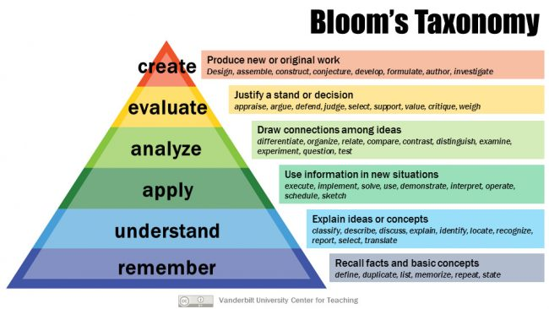
Outcomes are written using higher order action verbs from Bloom’s Taxonomy.

Slide 7
SLOs vs. Objectives
SLOs
Measure the skill-set students should have when they leave the classroom
3-5 outcomes are sufficient to cover an entire course
Objectives
Are the items that must be taught or covered in order to achieve the learning outcomes
Specify distinct steps to reach a goal (outcome)
Are the means, not the ends

Slide 8
An SLO
3. Upon successful completion of the course, the student will be able to produce written work that reflects appropriate mastery of argument skills, writing process, and control of mechanics.
An objective
Develop varied and flexible strategies for generating, drafting, and revising essays.

Slide 9
Resources
Assessment Committee Handbook
Long Beach City College SLOs vs. Objectives

Slide 10
We’re going to play a Kahoot now!

