Slide 1
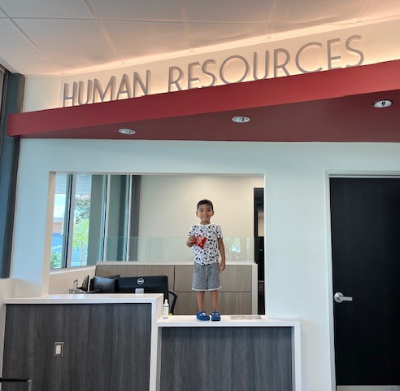
HR Updates
Admin Council 9.12.22

Slide 2
Staff Changes
Trudi Blanco, Human Resources Technician – District
Joe Grubbs, Executive Director of Public Safety
Workman's Comp, Leaves, Accommodations handles by HR Managers at Campus
Vacancy – Manager, Risk & Safety
Vacancy – HR Assistant
HR Student Assistant – Annaliese Johnson

Slide 3
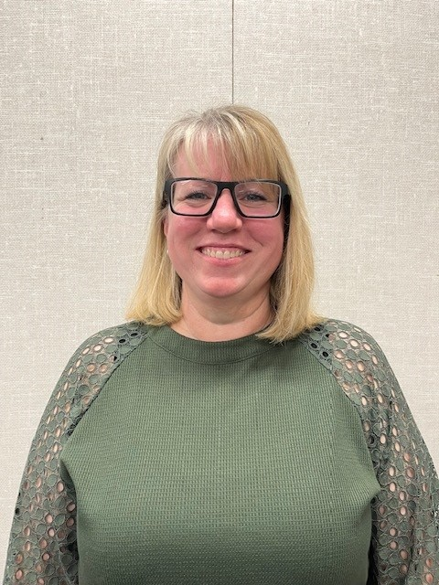
HR Staff
Amalia Calderon
HR Manager
Karla Quintero
HR Technician
(Recruitments)
Lori Carlson
HR Assistant
(Faculty & Special Comps)
Leah Burch (Temp)
HR Assistant
(Classified & Temps)
Kellie Tucker
HR Assistant- (Adjuncts & Management)

Slide 4
Classified Updates
Effective Jan. 1, 2022, Assembly Bill 438 modified the Education Code’s classified layoff statutes, creating additional protections for classified employees and changing how school districts must conduct classified layoffs.
The process for laying off permanent classified employees now mirrors the process for certificated employees.
Except for employees whose positions must be eliminated as a result of the expiration of a specially funded (categorical) program, permanent classified employees can only be laid off for the following school year if notified by March 15.
https://publications.csba.org/california-school-news/february-2022/march-15-layoff-notices-what-boards-should-know/

Slide 5
Classified Evaluations
With the passage of AB 275, effective January 1, 2022, the Classified probationary period is no longer 1 year. Education Code 88013(a) states the following in relevant part:
The governing board of a community college district shall prescribe written rules and regulations governing the personnel management of the classified service. These written rules and regulations shall be printed and made available to employees in the classified service, the public, and those concerned with the administration of this section, whereby these employees are, except as provided in Section 72411, designated as permanent employees of the district after serving a prescribed period of probation that shall not exceed six months or 130 days of paid service, whichever is longer.
Although the current CSEA CBA and board policy have a one year probationary period those provisions are no longer valid because the CBA terminated 6/30/2021 and board policy is preempted by the Education Code.
Probationary Employees: 3 months & 5 Months
1- year annual evaluations

Slide 6
NeoEd Updates
Add Department in NeoEd
Make sure your committee members have completed the screening committee training
Add Screening Committee Member
Onboard Launch by November 30th

Slide 7
Final updates
Submit TEAs and Statement to hire forms to HRonboarding@bakersfieldcollege.edu
FRISK Training coming soon
HR ACHRO: October 24th -October 28th

