Slide 1

The Bakersfield College Foundation
Working with YOU to make BC even BETTER!
Today’s Topic: Social Media (especially LinkedIn)

Slide 2
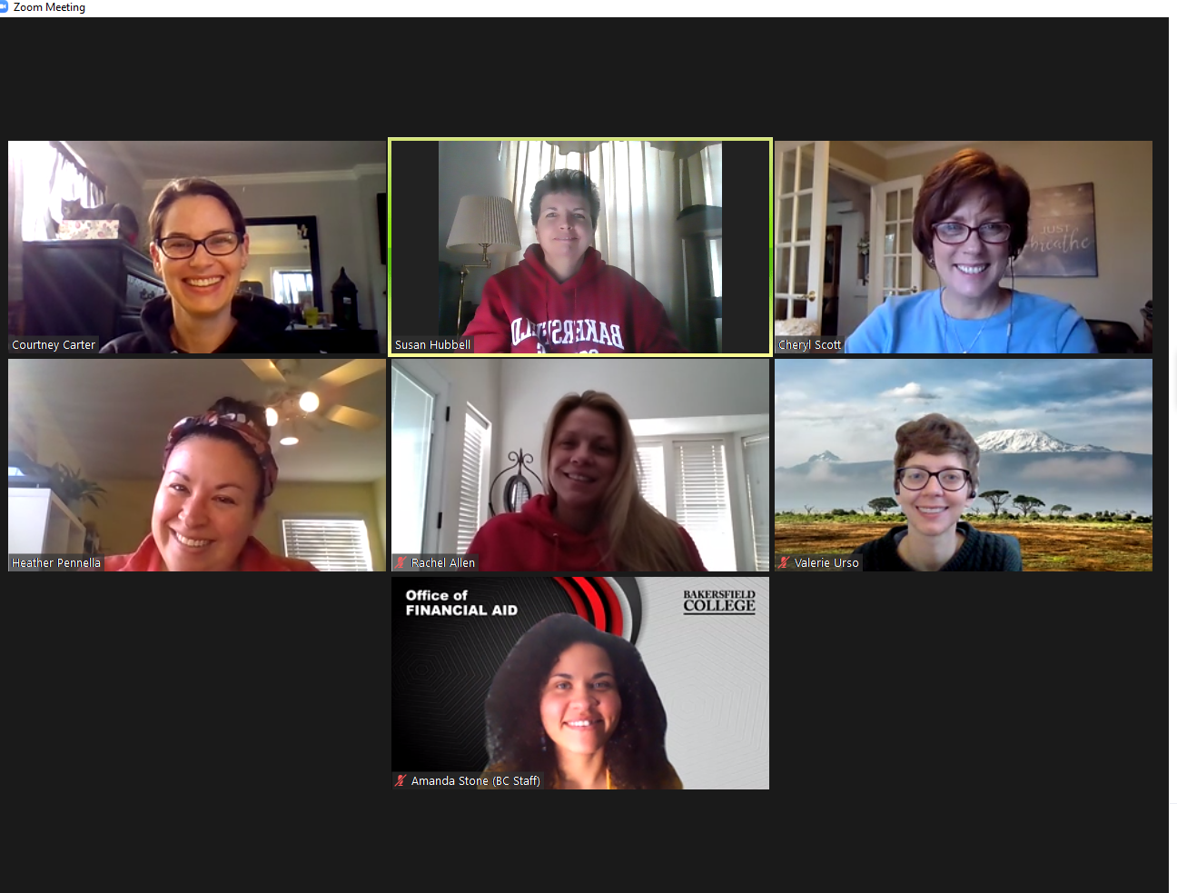
The Foundation Team

Slide 3
The BC Foundation’s Mission
Creating partnerships and building support for the benefit of students, staff, and faculty at
Bakersfield College

Slide 4




Slide 5

Creating partnerships and building support for the benefit of students, staff, and faculty at
Bakersfield College

Slide 6
The world's largest
professional network on the internet--
756 million users!
Not just for finding a job!
Connect and strengthen professional relationships around the world
Stay up to date on your areas of interest

Slide 7
How does this help Bakersfield College?
Share your own professional knowledge and accomplishments
Tell your network what’s happening in your area of expertise
Share posts you see about BC
When your expertise and talent shines, people also see the quality of the BC team!

Slide 8
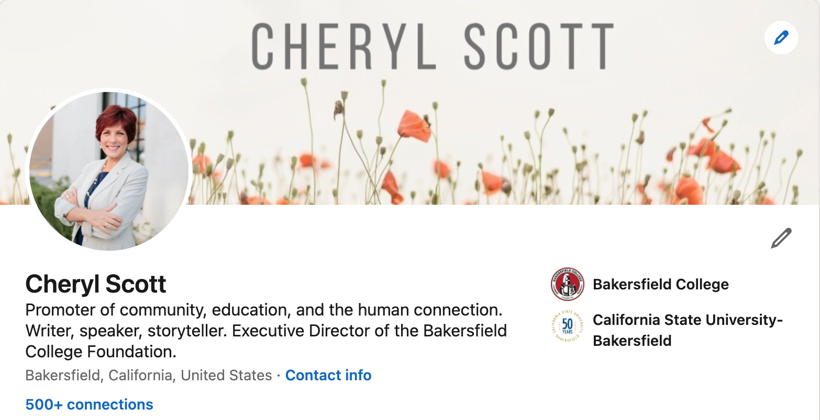

Slide 9
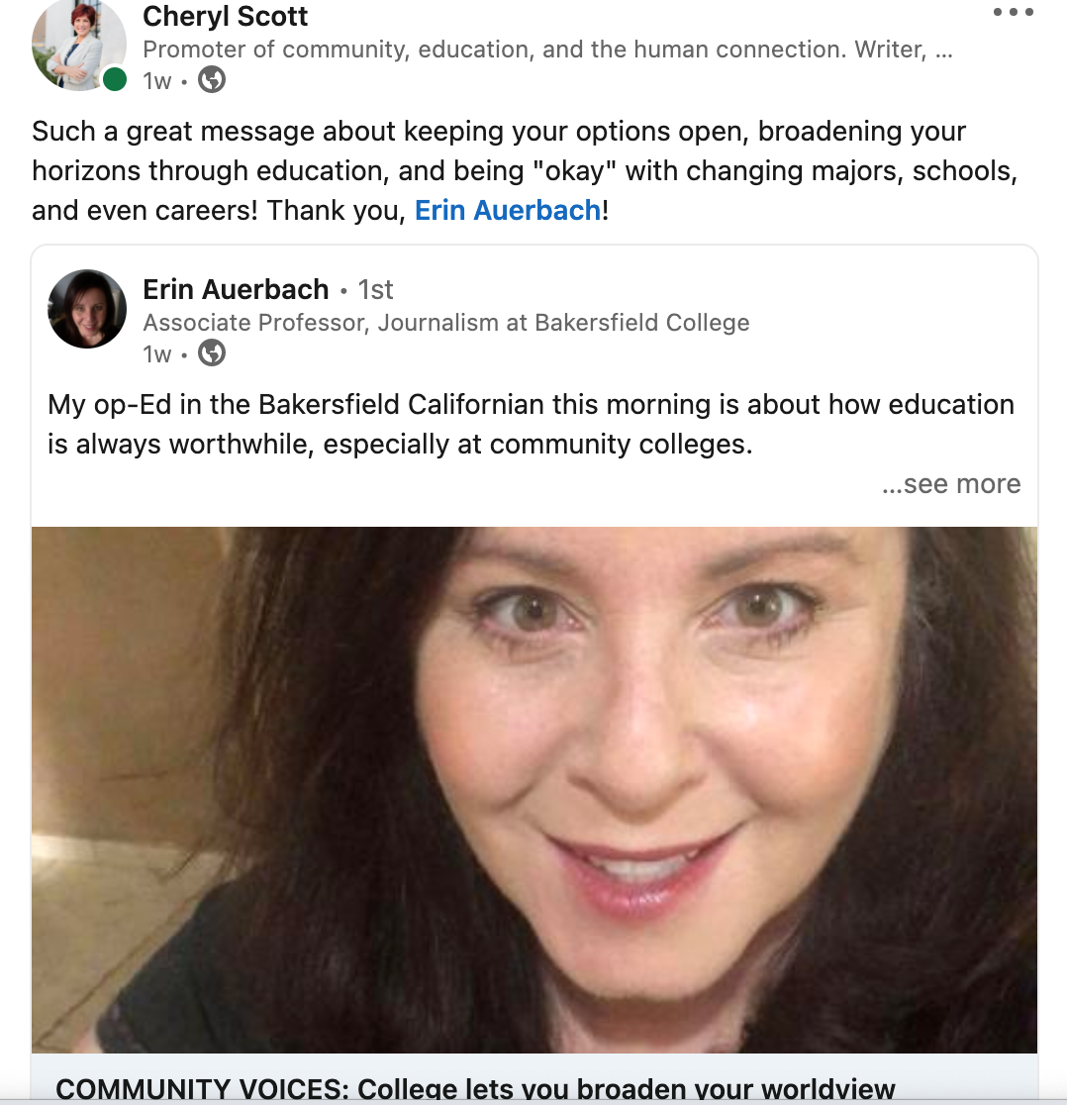
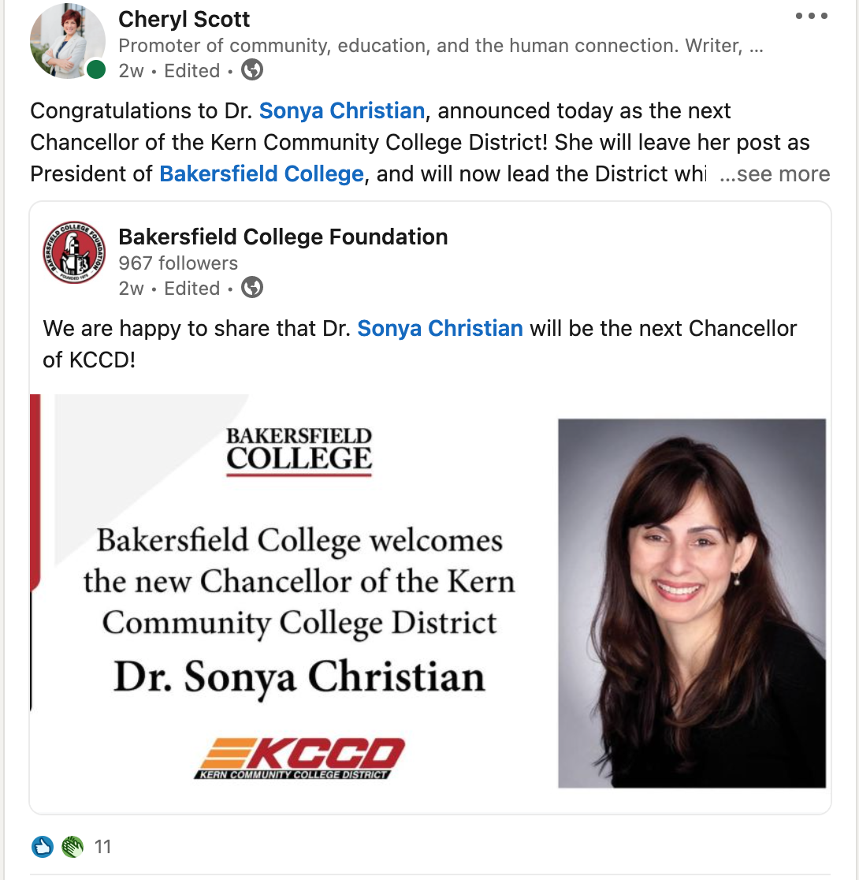

Slide 10
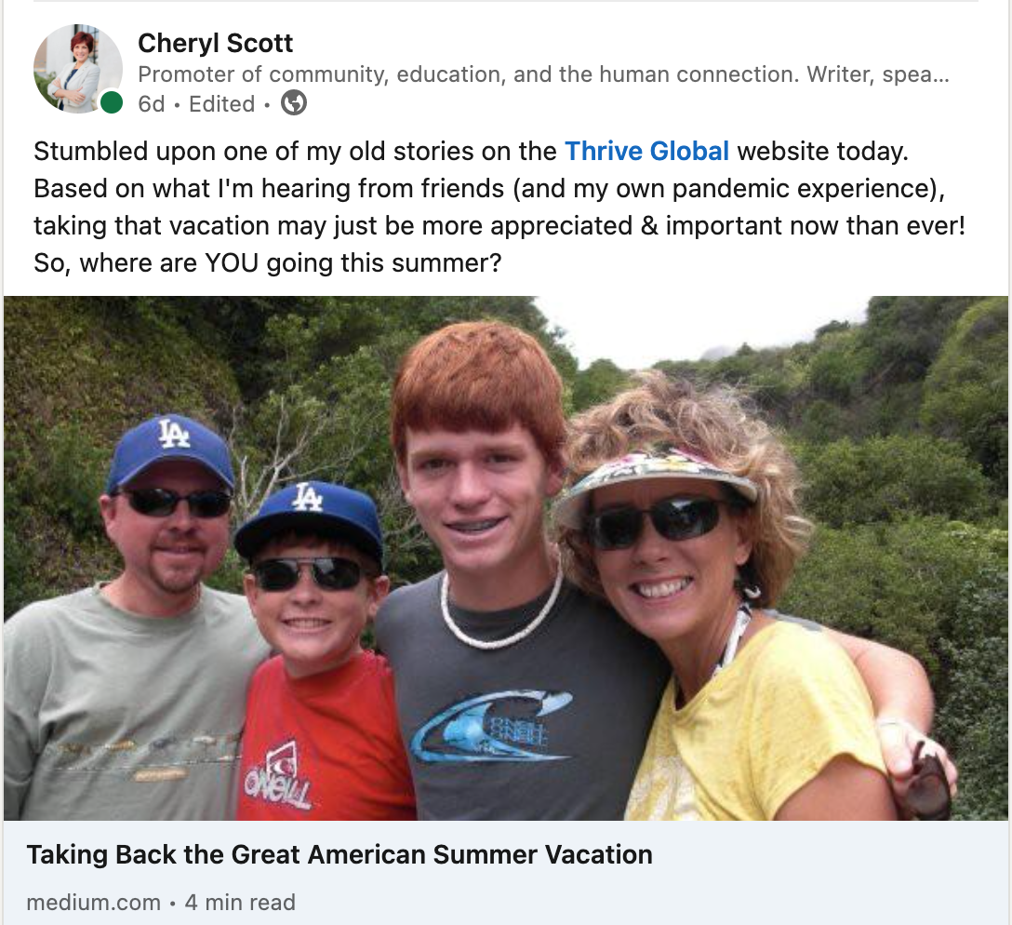
Mix it up!

Slide 11
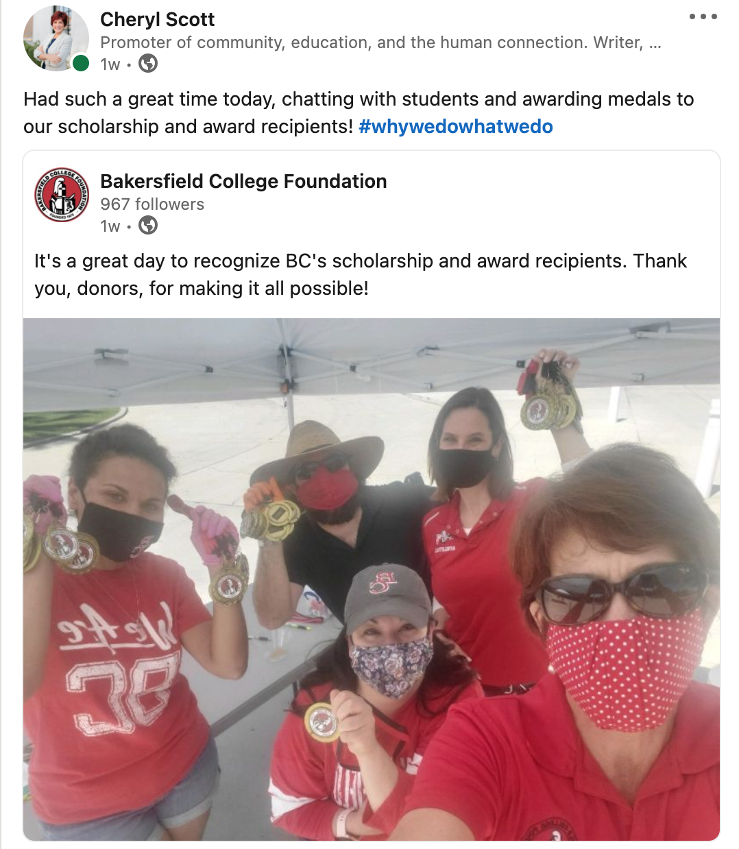
Nearly 500 Views

Slide 12
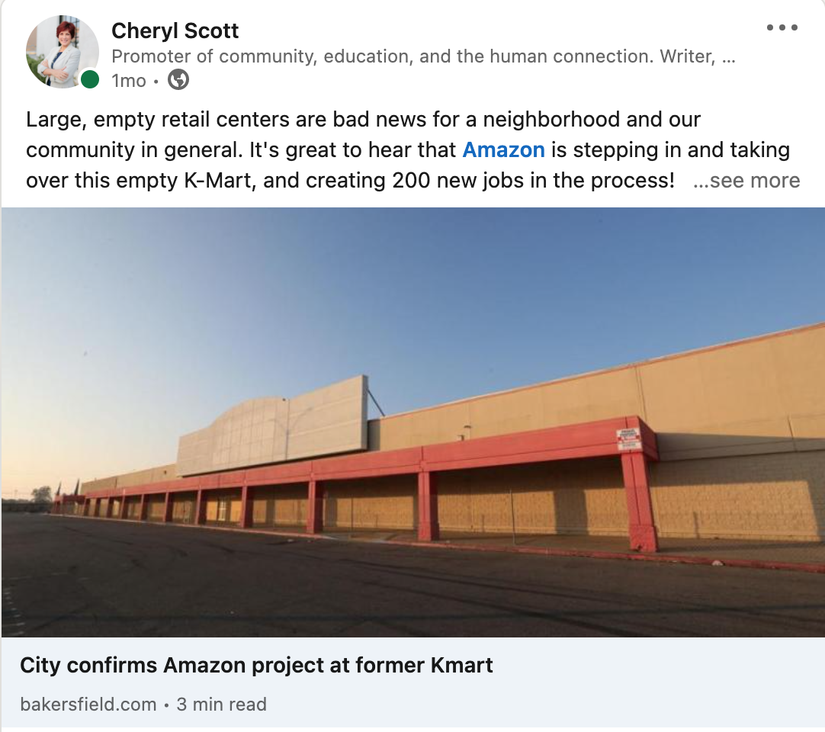
Nearly 5,000 Views!

Slide 13
Building Your Brand on LinkedIn
Share YOUR knowledge to benefit others (and yourself, too!)
Share other posts that are related to your area of expertise
Share posts from the BC Foundation and/or your colleagues
Promote BC’s mission and inform the community while giving others something positive to share about BC

Slide 14
Questions & Comments?

