Slide 1
Chief Chris Counts Department of Public Safety Bakersfield College
Active Shooter Response
for the Higher Education
Environment

Slide 2
Active Shooter Response
Active Shooter Events
Who are the Shooters?
Culture and Prevention
Response
Q&A

Slide 3
An Ongoing Trend

Slide 4
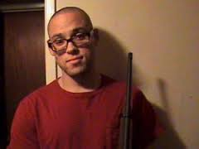
Umpqua Community College, OR
October 1st, 2015 – Umpqua Community College
One gunman – 26 year old Chris Harper Mercer
9 students killed
9 wounded
Incident ended when Two police detectives arrived on-scene and engaged the suspect who entered a classroom and killed himself

Slide 5
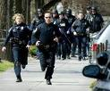
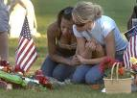
VIRGINIA

Slide 6
VIRGINIA
April 16th, 2007 – Virginia Tech
Lone gunman – Seung-hui Cho, 23
Handguns only
32 killed
29 wounded
Blocked escape routes / chained doors
Incident ended when suspect killed himself

Slide 7
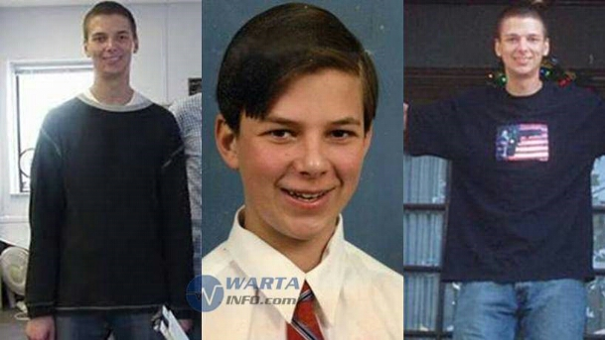
ILLINOIS
February 14, 2008
Northern Illinois University
Lone gunman – Stephen
Kazmierczak, a graduate student
Legally purchased shotgun and 3 handguns
5 killed
16 wounded
Incident ended when suspect killed himself

Slide 8
ARKANSAS
March 24th, 1998 – Jonesboro, Arkansas
Two gunmen (Mitchell Johnson 13/Andrew Golden 11)
Three rifles
False fire alarm
4 students, 1 teacher killed
10 wounded
Incident ended when police
caught the fleeing suspects

Slide 9
OREGON
May 21st, 1998 – Springfield, Oregon
Lone gunman, Kip Kinkel, 14
Two pistols, one rifle
2 killed
22 wounded
Killed both parents the day prior
Incident ended when seven students subdued suspect and held him until police arrived

Slide 10
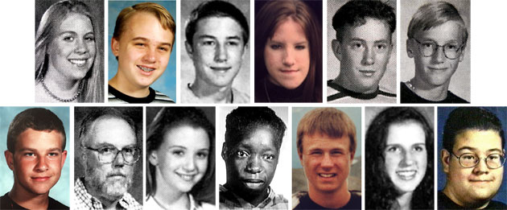
COLORADO

Slide 11
COLORADO
April 20th, 1999 – Littleton, Colorado
Columbine High School
Two gunmen Dylan KELbold, 17 and Eric Harris, 18
12 students, 1 teacher killed
23 wounded
Planned to kill 500 and blow up school
Multiple IEDs lit and thrown, timed devices utilized
Incident ended when both suspects killed themselves

Slide 12
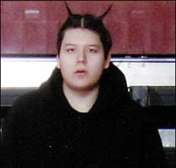
MINNESOTA
March 21st, 2005 – Red Lake, Minnesota
Indian reservation high school
Lone gunman Jeff Weise, 16
5 students, a teacher,
and a guard killed
Murdered his grandfather, a
tribal policeman, before the incident
Incident ended when suspect killed himself

Slide 13
COLORADO

Slide 14
COLORADO
September 26th, 2006 – Bailey, Colorado
Platte Canyon High School
Lone gunman, Duane R. Morrison, 53
1 student killed
6 students sexually assaulted
Incident ended when SWAT team entered room and suspect killed one hostage and himself

Slide 15
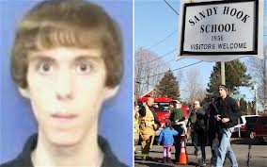
CONNECTICUT
December 14th, 2012-Sandy Hook Elementary school
Lone gunman, Adam Lanza 20
Heavily armed
20 children and 6
adults killed
Incident ended when
suspect killed himself
Notes:
The Sandy Hook Elementary School shooting occurred on December 14, 2012, in Newtown, Connecticut, when 20-year-old Adam Lanza fatally shot 20 children and 6 adult staff members

Slide 16
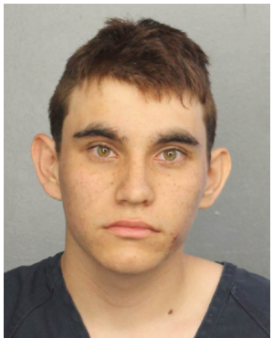
Florida
February 14, 2018 – Parkland Florida
Marjory Stoneman Douglas High School
Lone gunman, Nikolas Cruz 19 yrs. old
Heavily armed, Simi automatic rifle with
extra magazines
14 children and 3 teachers killed
Incident ended when law enforcement took him into custody an hour after the shooting

Slide 17
What’s the profile of an Active Shooter?

Slide 18
Who Are Active Shooters?
Usually an individual but not always
Actively engaged in killing or attempting to kill people
Confined and populated area
In most cases weapons used are firearms
Usually no pattern or method to their selection of victims
Many have a history mental health related illnesses
In nearly all incidents, somebody else knew

Slide 19
Culture
and
Prevention

Slide 20
Culture and Prevention
Creating a culture where, when somebody else knows, they tell and the school responds appropriately
School shooters are not living, going to school and planning these events in a vacuum – somebody else knows
If you see something, say something
Create a culture of safety
How do we do this?

Slide 21
School Shooting Averted! Someone Said Something....
A woman prevented a potential tragedy this week when she reported her 18-year-old grandson to police after learning of his plot to carry out a mass shooting at his high school.
"I need to make this count," O’Connor reportedly wrote in the journal. "I’ve been reviewing many mass shootings/bombings (and attempted bombings) I’m learning from past shooters/bombers mistakes."

Slide 22
Results of saying something
Since the Florida high school shooting on February 14, 2018 there have been six arrests for people planning mass shootings at schools
All because someone who knew said something
There is no telling how many lives have been saved because these courageous people decided to say something
If you see something, say something so we can do something about it!
Will you be that person to speak up and save lives?

Slide 23
Culture and Prevention
Behavioral Intervention/Threat Assessment/ Students of Concern Team Strategies
Team effort to determining threats
Multi-disciplined approach
Mental Health Professionals
Public Safety
Educators
Faculty
School Administrators
Social Workers

Slide 24
Response

Slide 25
Response
Unpredictable
Evolve quickly
Usually last 10-15 minutes or less
Police response usually 5-10 minutes
Can occur anywhere
Schools
Stores
Office
“What if?”

Slide 26
Response
Take note of the two nearest exits in any facility you visit
Be aware of your environment and any possible dangers
If you are in an office, stay there and secure the door
If in a hallway, get into a room and secure the door
Take action against the shooter ONLY as a LAST RESORT
CALL 9-1-1 AS SOON AS IT IS SAFE!!

Slide 27
Response
RUN
If there is an escape path:
Have predetermined routes in mind
Leave your belongings behind
Help others escape if possible
Evacuate regardless of whether others agree to follow
Distance is your friend in a shooting situation

Slide 28
Response
RUN
Prevent individuals from entering an area where the shooter may be
Keep your hands visible
Follow the instructions of any police officers
Do not attempt to move wounded people
Call 9-1-1 when you are safe if you have something to report

Slide 29
Response
HIDE
If evacuation is not possible
Choose a hiding place that:
Is out of shooter’s view
Provides protection if shots are fired toward you
Does not trap you or restrict your options for movement
Make sure to:
Lock the door
Blockade the door with heavy furniture

Slide 30
Response
HIDE
If the shooter is nearby:
Lock the door
Silence your cell phone
Turn off any source of noise (radios, TV’s, etc.)
Hide behind large items (Cabinets, desks)
Remain quiet
Active shooters are not breaching locked doors!! use this fact to your advantage

Slide 31
LOCK THE DOOR!!!!
Survivor of Florida High School Active Shooter Incident
He praised the school’s practice of locking classroom doors in an active-shooter situation.
"We have had meetings and teachers talking about what to do in these type of situations, actually, pretty recently and had initiatives to lock all the doors,” he said, “and I think, honestly, that worked and easily saved a couple hundred if not a thousand lives because all those doors were locked."

Slide 32
Response
IF EVACUATION OR HIDING IS NOT POSSIBLE
Try to remain calm
Staying calm will help others calm down
Dial 9-1-1, if possible, to alert police to the shooter’s location
If you cannot speak, leave the line open and allow the dispatcher to listen

Slide 33
Response
ACTION AGAINST THE ACTIVE SHOOTER – FIGHT!!!
As a last resort, and only when your life is in imminent danger, attempt to disrupt his/her plan and/or incapacitate the active shooter by:
Acting as aggressively as possible against him/her
Throwing items and improvising weapons
Yelling
Committing to your actions
Buy first responders time

Slide 34
Response
Take ACTION AGAINST THE ACTIVE SHOOTER – FIGHT!!!
Disrupt the shooter’s plan
Overwhelm the shooter with numbers of people
This is the point where it’s okay to get angry and fight back!
Ask yourself.... Will I be a sheep or will I be a sheep dog?

Slide 35
Stop the Bleeding
Literally…STOP THE BLEEDING
Initiate basic bleeding control – B-CON
A person can bleed to death within three minutes of a major arterial wound
B-CON attempts to control that bleeding for 15-20 minutes until first responders arrive on scene to provide advanced life saving measures
Tourniquets
Wound packing material

Slide 36
To schedule an active shooter presentation for your class, individual department or student club please contact public safety
Chief Chris Counts
661-395-4554
ccounts@bakersfieldcollege.edu

Slide 37
Question and Answer

