Slide 1

Balanced scorecard slide 1
Student Success Metrics
Administrative Council
Bakersfield College
Craig Hayward, PhD
2/11/2019
BC OIE

Slide 2

Balanced scorecard slide 2
Student Success Metrics
There is a lot of change across the California community college system right now. How does the Student Success Metrics Dashboard fit in?
Student Centered Funding Formula
Student Equity and Achievement
In addition to FTES, colleges are now being funded on student success and access, especially to financial aid. Some of these data points are found in the Student Success Metrics Dashboard.
An integration of Student Equity, BSI, and SSSP, student equity and achievement metrics are driven directly off the SSM Dashboard.
A new dashboard that is accessed via the LaunchBoard which presents an integration and evolution of our statewide accountability metrics.
The Vision for Success directs colleges to increase completion and jobs attainment while decreasing equity gaps and units at graduation.
Student Success Metrics
Vision for Success
Notes:
I don’t have all the answers. In fact, some of the answers are still up in the air as the metrics are currently still in the process of being completely developed and refined.

Slide 3
So many questions, so little time
What is it?
How does it interface with other initiatives?
  Vision for Success
    Goal setting
  Student Centered Funding Formula
  Student Equity and Achievement (SEA)
  NOVA
Who can access it?

Slide 4
What is it?
Began as the Simplified Metrics initiative
  Wasn’t necessarily simpler, though it was more integrated
  It’s about streamlining and integrating metrics with major plans & initiatives
It will replace the Student Success Scorecard and the IEPI Indicators Portal
It will feed the NOVA portal
21 metrics (depending on how you slice it)
Equity disaggregation built in (but not yet available)

Slide 5
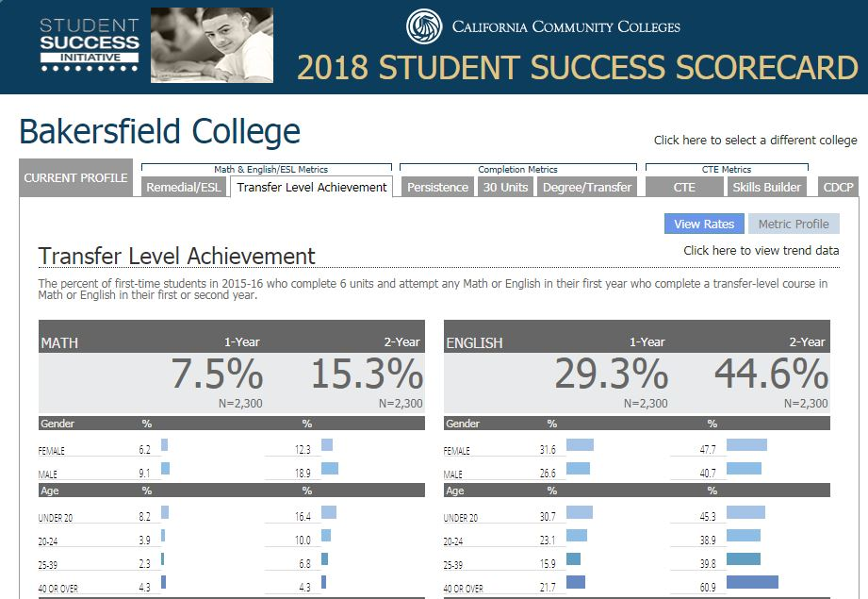
Student Success Scorecard

Slide 6
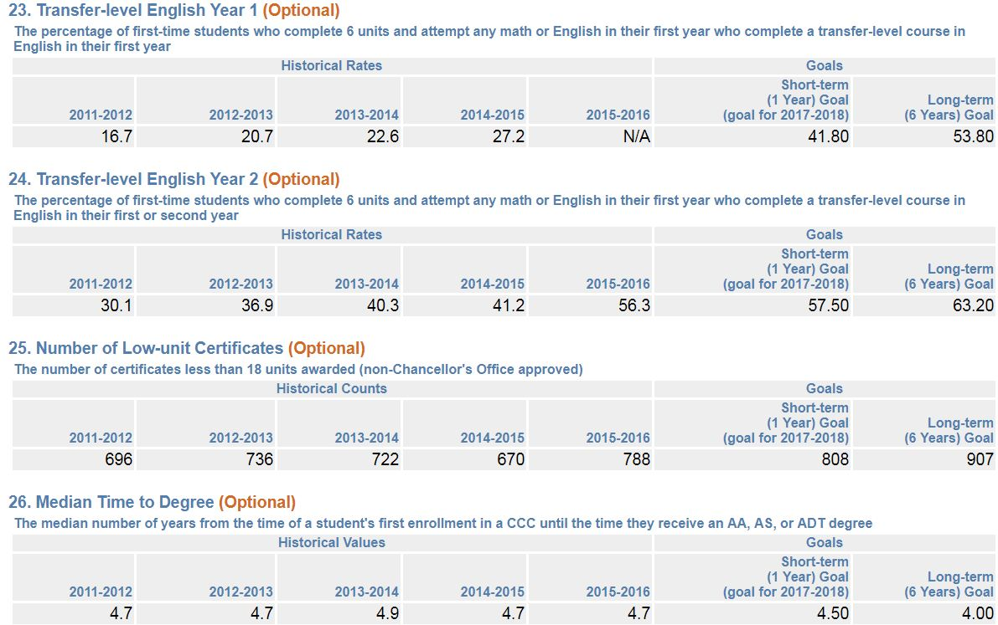
IEPI Indicators Portal

Slide 7
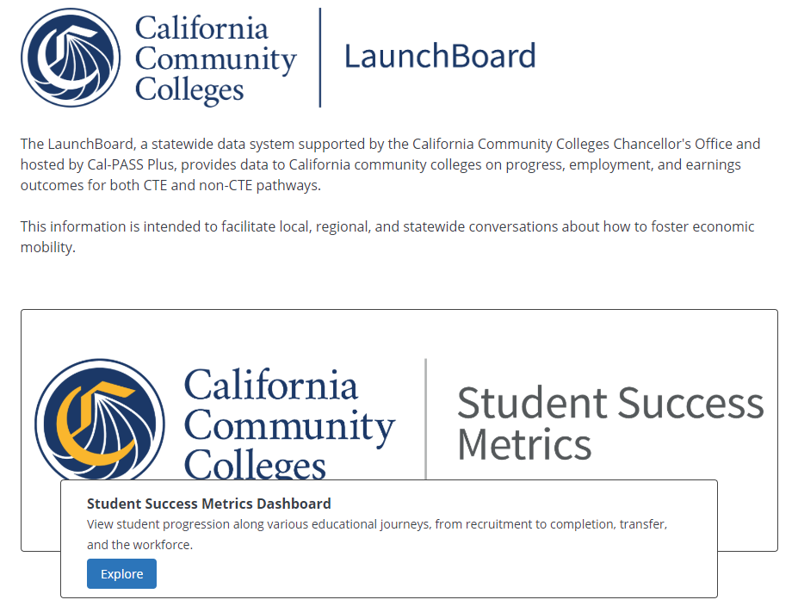
http://bit.ly/LaunchBoard-2019

Slide 8
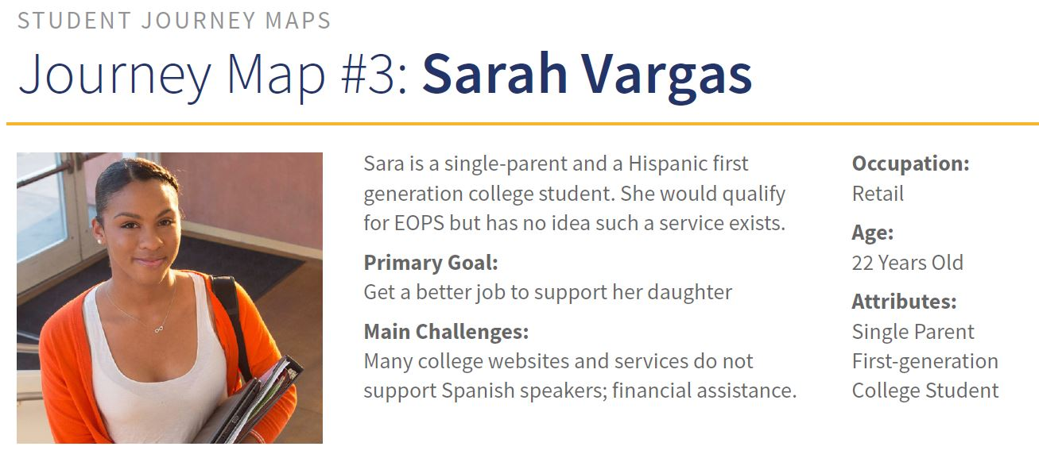
Student Journey Maps & Ed Goals

Slide 9
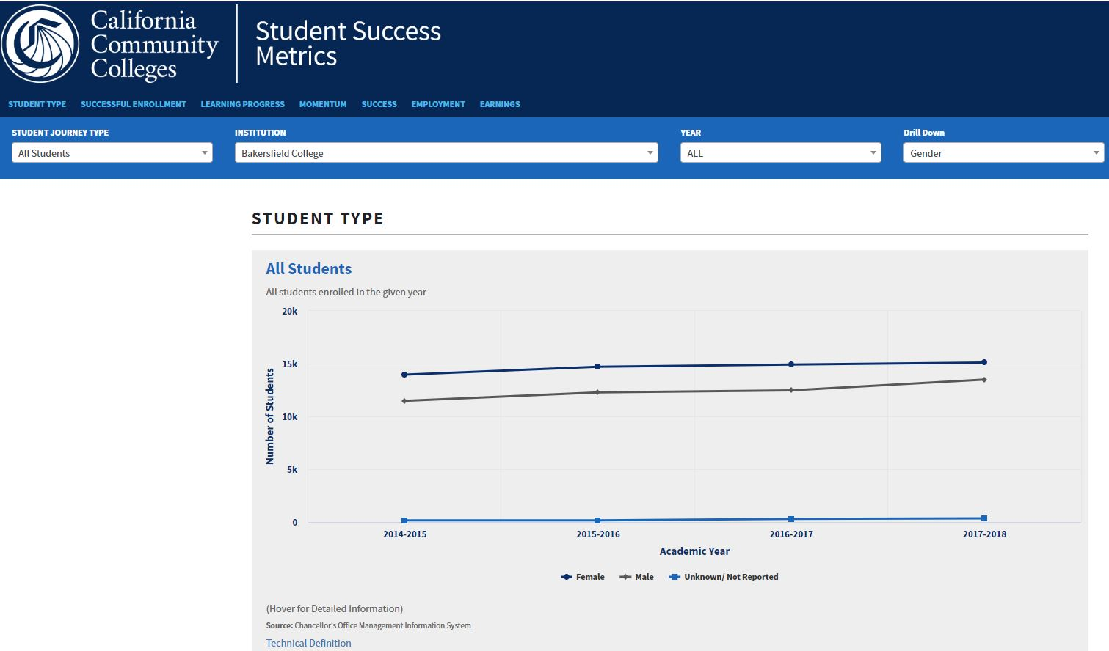
Student Success Metrics Dashboard

Slide 10
Metrics
Applicants who enrolled within one year at the same college (same college or any college)
Course success rate
Students who completed both transfer-level English and math within one year of enrolling in a district*
Students who completed 9+ career educ. units*
Students who successfully completed unit thresholds in the fall
Students who successfully completed unit thresholds in the academic year
Unduplicated count of students who earned each of the following award types:
  A noncredit certificate over 48 hours
  A Chancellor’s Office approved credit certificate
  Associate of science or associate of arts degree
  Associate degree for transfer
  CCC bachelor’s degree
  Apprenticeship journey status
  Vision goal completion
Students who transferred:
  to UC/CSU
  to a private in-state college
  to an out-of-state college
Average number of units accumulated by associate degree earners
Students who transitioned to post-secondary
Students who completed a level of adult education
Students with an adult education or ESL skills gain
Students with a noncredit workforce milestone
Students who were unemployed who became employed
Career education students with job is closely related to their field of study who did not transfer
Median annual earnings for non-transfer exiting students
Median change in earnings for non-transfer exiting students
Students who exited but did not transfer who attained the living wage for a single adult*

Slide 11
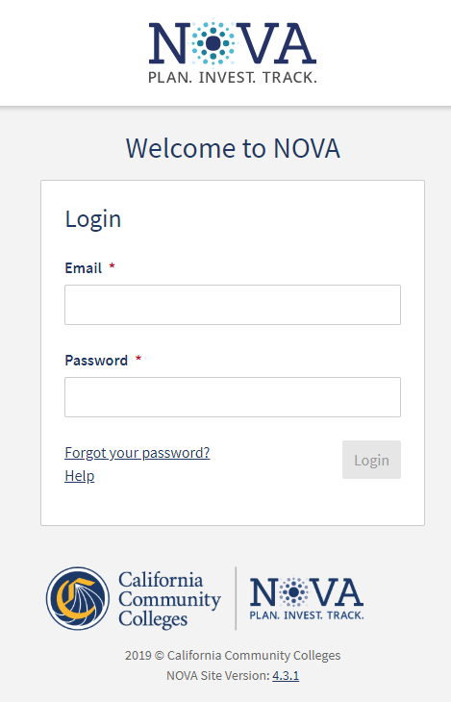
A planning and fiscal accountability platform whose logo is “Plan. Invest. Track.”
SSM will push metric data into NOVA to use for goal-setting and accountability

Slide 12
Resources to explore
Student Success Metrics website
  https://digitalfutures.cccco.edu/Projects/Student-Success-Metrics
  Explanation & support documents
  Development process
Student Success Metrics Dashboard
  https://www.calpassplus.org/LaunchBoard/Student-Success-Metrics.aspx

Slide 13
Accessing the SSM Dashboard

Slide 14
http://bit.ly/LaunchBoard-2019

Slide 15
Tips on using the SSM Dashboard

Slide 16
Tips
Metrics are organized by four student journey types
  The “All Students” view actually excludes special admit/high school students.
Cohort views will be released in May, allowing longitudinal tracking
  The SSM Dashboard is still undergoing revision and development.
SSM Dashboard data is derived from our MIS submissions as well as from employment data.
Not all SSM definitions line up directly with SCFF definitions.
  Completion of transfer-level math and English
  Students who completed 9+ career educ. Units
  Students who exited but did not transfer who attained the living wage for a single adult

Slide 17
Balanced scorecard slide 10
BC OIE
THANK YOU

