Slide 1

Online Student Success
Talita Pruett
Angela Bono
Neeley Hatridge
Fabiola Butcher
Alex Rockey

Slide 2


Overview
What the Research Tells Us
The Power of Professional Development
Person Up
The COMM Research
Recommendations
https://bit.ly/renegadeonlinesuccess
Notes:
https://olj.onlinelearningconsortium.org/index.php/olj/article/view/2731
Strength-based approach
https://www.urban.org/sites/default/files/publication/101782/supporting20community20college20learners20online.pdf
Joosten article

Slide 3

What the Research Tells Us

Slide 4
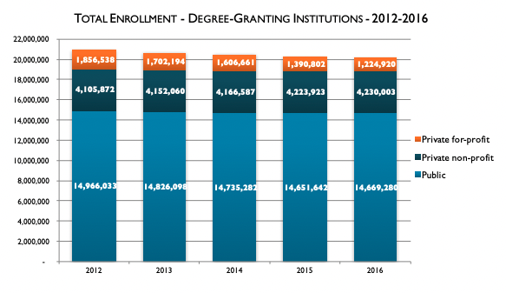
Declining Higher Education Enrollment
Figure retrieved from Seaman et al., 2018

Slide 5
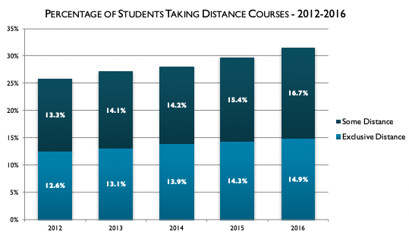
Increasing Online Enrollments
Figure retrieved from Seaman et al., 2018

Slide 6

A Need for Flexibility and Online Courses
Macdonald, 2018
Notes:
We also know so-called nontraditional students benefit from online courses

Slide 7
Confusing Data on Online Student Success
Students are less successful in online courses when compared to face-to-face courses (e.g., Johnson & Cuellar-Mejia 2014; Johnson et al., 2015)
Students are more successful in online courses when compared to face-to-face courses (Allen et al., 2004; Means et al., 2013)
Notes:
Although inconsistent findings in regard to the efficacy of online courses in comparison to face-to-face courses have been reported, meta-analyses indicate that online courses are just as effective if not more effective when it comes to student outcomes (e.g., Allen, Bourhis, Burrell, & Mabry, 2002; Allen, Mabry, Mattrey, Bourhis, Titsworth, & Burrell, 2004: Means, Toyama, Murphy, Bakia, & Jones, 2009) Joosten & Cusatis, 2019)
Shea and Bidjerano (2014) reported in their national study that community college students who take courses online have a significantly better chance of obtaining a degree than students who only take courses taught in a physical classroom. Joosten & Cusatis, 2019)

Slide 8
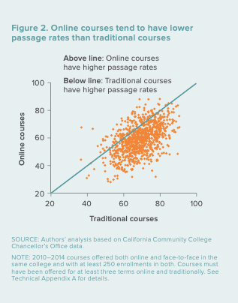
The Reality… It’s Complicated
Student success in online courses can be lower than face-to-face courses (Johnson & Cuellar-Mejia 2014; Johnson et al., 2015)
Online courses can have larger equity gaps in terms of student success than face-to-face courses (Johnson & Cuellar-Mejia 2014
Figure retrieved from Johnson et al., 2015
Notes:
Are there certain cohorts that do better online? Certain discipline types of course? Instructors?
But evidence also shows the positive impacts of online learning formats on longer-term outcomes for students, specifically two-year associate degree attainment (Johnson and Mejia 2014; Shea and Bidjerano 2016). Case studies of exemplary programs suggest that institutions that offer these programs can see positive impacts, such as increased efficiency and affordability (Bailey et al. 2018), *p. 2- Briggs et al., 2020

Slide 9
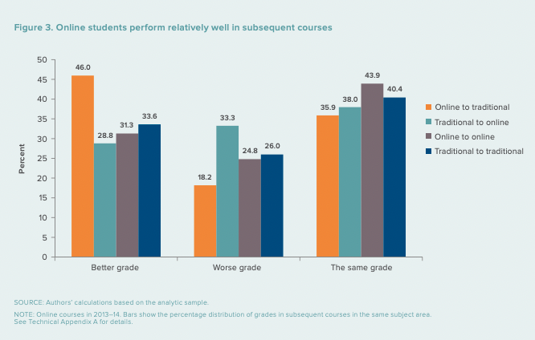
Figure retrieved from Johnson et al., 2015

Slide 10
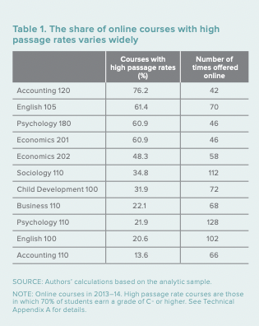
What We Know…Teaching Matters
Effective online teaching can support student success (Johnson et al., 2015; Joosten & Cusatis, 2019; Orlov et al., 2021)
Figure retrieved from Johnson et al., 2015
Notes:
we conclude that the success of online courses in California’s community colleges has depended on the trial and error of individual instructors and others who help develop and present the courses. This hit-or-miss approach indicates that best practices have not been systematically implemented in California’s community colleges. Instead, it has been left to those on higher education’s front line—the instructors—to discover and follow the best practices for administering online courses. Johnson et al., 2015

Slide 11

The Power of Professional Development

Slide 12


Course Design and Online Teaching
Solo Course Design
Supported Course Design
Johnson et al., 2015
Notes:
Some BRIEF background on our COMM research project (pre-covid, dept discussion on the rigor of Online Asynch for COMM courses, the birth of COMMB11, Sonya's view of the NEED to build online options for fully online students)

Slide 13

Faculty Expertise
The
Person Up
System
Production Values
OER
Badging
Professional Dev.
Mobile
Friendly
Humanized
& Equity
Minded
Instructional
Design
Expertise

Slide 14

The COMM Research Project
Notes:
Some BRIEF background on our COMM research project (pre-covid, dept discussion on the rigor of Online Asynch for COMM courses, the birth of COMMB11, Sonya's view of the NEED to build online options for fully online students)

Slide 15
Background of the COMM Research Project
Need for fully Online Degree at BC
Birth of COMM B11
COMM Pilot Project for Asynchronous Courses
Notes:
https://www.bakersfieldcollege.edu/academics/online-degree-programs#chdvast

Slide 16
Demand for Oral Communication Online
Semester | # of Sections | # of Faculty
Fall 2020 | 2 | 1
Fall 2021 | 9 | 3
Summer 2022 | 7 | 3
Fall 2022 | 11 | 4
Notes:
Focus on demand
Consider: eLumen-- assessment data
Student success data
COMM B11- online only degree , enrollment data, survey questions *why it’s rigorous
Student surveys

Slide 17
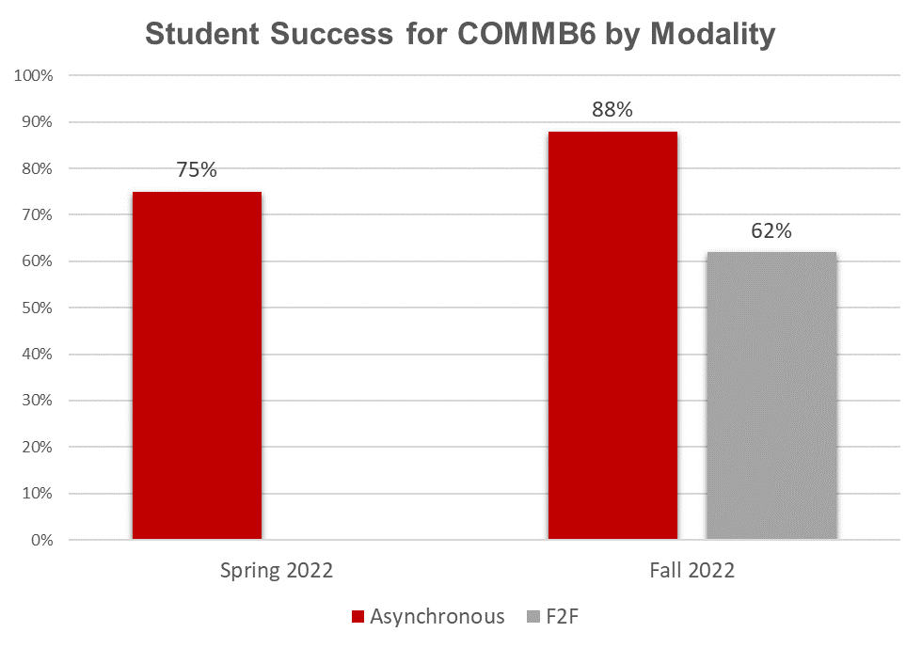
Talita
69% Overall ISS
57% Online ISS
Source: Office of Institutional Effectiveness
Notes:
Talita: above ISS even for CTE (76%), Above Aspirational Goals ( 67% Online, 72% Overall and 80% CTE)
Limitations: small sample, 2 sections/ semester: Spring 2022 n=33/44 Fall 2022 n=51/58 Fall 2022 f2f n=25/35

Slide 18
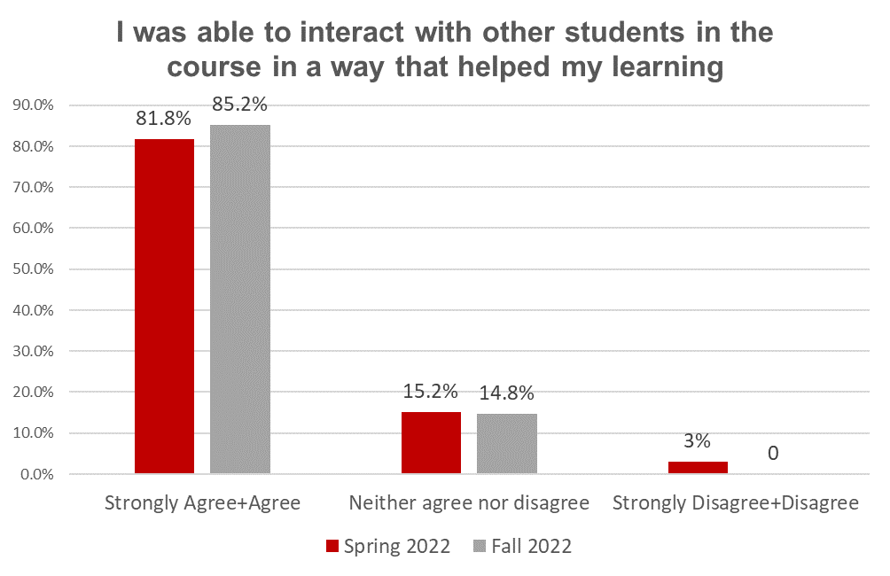
Talita
Source: Student Experience Survey
Notes:
Talita:*90% response rate 27/30 Only one online class surveyed Fall 2022, 33/44 for Spring 2022. Second section was early college and because they were minors they could not take the survey.
F2F students were given the survey, but did not take it

Slide 19
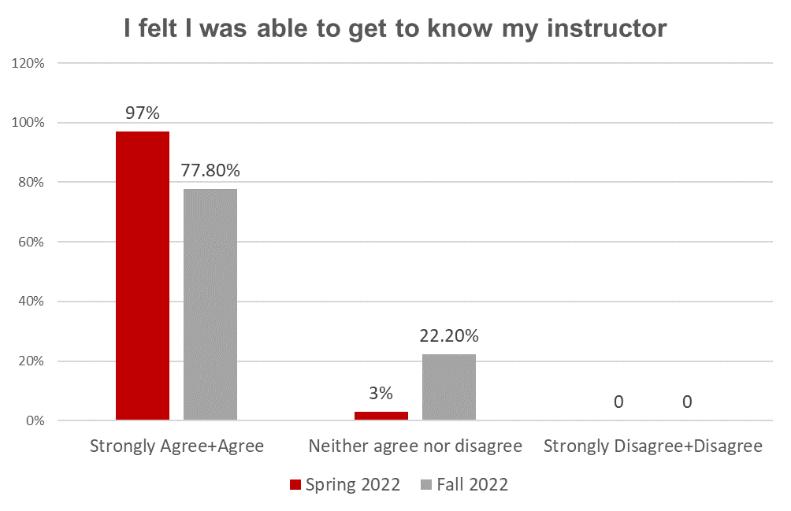
Talita
Source: Student Experience Survey

Slide 20
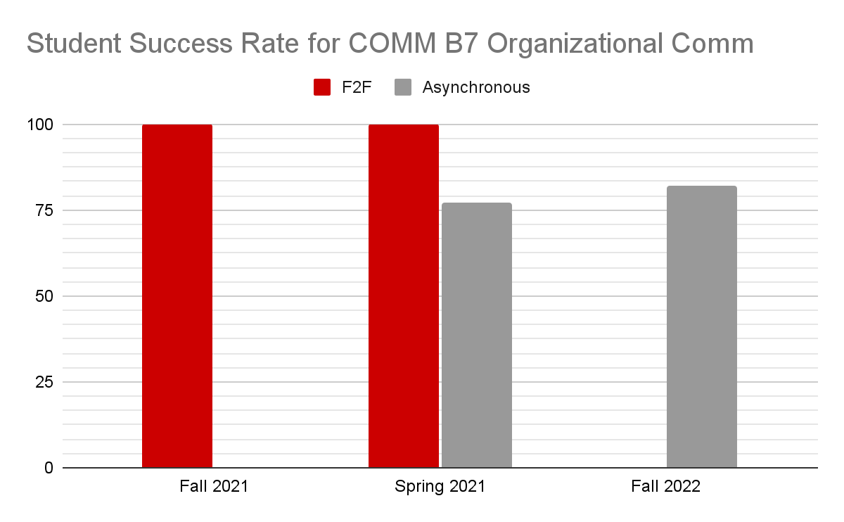
Fabiola
Source: instructor grade sheets
Notes:
Consider: eLumen-- assessment data
Student success data
COMM B11- online only degree , enrollment data, survey questions *why it’s rigorous
Student surveys

Slide 21

Obstacles that limit BC student’s online success
Notes:
Consider: eLumen-- assessment data
Student success data
COMM B11- online only degree , enrollment data, survey questions *why it’s rigorous
Student surveys

Slide 22
Obstacles that limit BC student’s online success
Quality and consistency of online course design
Availability and curation of course-appropriate OER materials
“Nearly Fraudulent” students
Limited number of sections offered during Priority Registration
Underdeveloped skills for students new to asynchronous courses
Notes:
Consider: eLumen-- assessment data
Student success data
COMM B11- online only degree , enrollment data, survey questions *why it’s rigorous
Student surveys

Slide 23

Recommendations
Notes:
Some BRIEF background on our COMM research project (pre-covid, dept discussion on the rigor of Online Asynch for COMM courses, the birth of COMMB11, Sonya's view of the NEED to build online options for fully online students)

Slide 24
Recommendations
Professional Development: Support faculty with course design through faculty-driven professional development programs like Person Up! and action research fellowships
Analytics: Incorporate predictive analytics to identify and connect students at-risk of low success rates in online courses with resources and support (Johnson et al., 2015)
Student Support: Increase student supports and orientations for online courses (Johnson et al., 2015)
Personalized Learning: Provide faculty support in integrating open-source interactive course software to offer just-in-time feedback (Johnson et al., 2015)
Data Visualization: Provide faculty data visualization tools to quickly gauge student engagement in class and provide customized learning experiences (Johnson et al., 2015)
Early Online Course Availability: Ensure online course options are provided early and in-time for priority registration
Notes:
Successful online learning depends on adopting a systems approach to course design: offering effective faculty support, setting appropriate student expectations, and promoting interaction among faculty, students, and course materials. Without these practices, faculty become frustrated, students become discouraged, and success rates decline. However, these practices generally follow the paradigm of replicating the face-to-face classroom experience. In the next section, we look at the next generation of online learning, in which the goal is not merely to recreate face-toface pedagogy, but to identify the unique advantages and opportunities of online learning p. 12
Rio Salado College identified three main
predictors of success: how often the student logs into a course; site engagement, i.e., whether he or
she reads the course materials online, does practice exercises, and shows other signs of engagement; and how many points the student scores on assignments. Using these indicators, Rio Salado
categorizes students into one of three groups based on whether a student is likely to successfully
complete their online course. When students log into the course management system, they see a
Online learning provides
opportunities to collect data
on student preparedness,
performance, and preferences
that are far more difficult to get
in traditional courses.
14 SUCCESSFUL ONLINE COURSES IN CALIFORNIA'S COMMUNITY COLLEGES
green, yellow, or red indicator showing how well they are doing compared with students who
completed the course within the past year. The system also shows these indicators to the instructor and to the student advisor, allowing them to identify each student’s risk level. This makes it
possible for focus instructors, advisors, and other institutional resources to quickly help those students most at
risk. For example, faculty and advisors may call, email,
or text students PACE identifies as at-risk to find out why
they are struggling and to determine ways to help them

Slide 25
References
Allen, M., Mabry, E., Mattrey, M., Bourhis, J., Titsworth, S., & Burrell, N. (2004). Evaluating the effectiveness of distance learning: A comparison using meta-analysis. Journal of Communication, 54(3), 402–420.
Johnson, H., & Cuellar-Mejia, M. (2014). Online learning and student outcomes in California’s Community Colleges. Public Policy Institute of California.
Johnson, H., Cuellar-Mejia, M., & Cook, K. (2015). Successful online courses in California’s Community Colleges. Public Policy Institute of California.
Joosten, T., & Cusatis, R. (2019). A cross-institutional study of instructional characteristics and student outcomes: Are quality indicators of online courses able to predict student success? Online Learning, 23(4), 354-378. doi:10.24059/olj.v23i4.1432
MacDonald, K. (2018). A review of the literature: The needs of nontraditional students in postsecondary education. Strategic Enrollment Management Quarterly, 5(4), 159-164.
Means, B., Toyama, Y., Murphy, R., & Baki, M. (2013). The effectiveness of online and blended learning: A meta-analysis of the empirical literature. Teachers college record, 115(3), 1-47.
Orlov, G., McKee, D., Berry, J., Boyle, A., DiCiccio, T., Ransom, T., ... & Stoye, J. (2021). Learning during the COVID-19 pandemic: It is not who you teach, but how you teach. Economics Letters, 202, 109812.
Seaman, J., Allen, E., & Seaman, J. (2018). Grade increase: Tracking distance education in the United States. Babson Survey Research Group. https://www.bayviewanalytics.com/reports/gradeincrease.pdf

