Slide 1

BC and KCCD Services and Institutional Quality Survey
For Services rendered in Academic Year 2020-21
April 2021

Slide 2
Survey Information
Survey Summary:
The Accreditation and Institutional Quality survey of BC and KCCD Services rendered in Academic Year 2020-21 is an anonymous survey that will be shared and used to improve Bakersfield College.
Participants and Active Dates:
All BC Faculty, Staff, and Managers/Administrators were invited to participate using the BC All listserv
  An estimated 1,108 Employees received the survey (KCCD Fast Facts on 2019-20 BC Employees)
The anonymous survey was released on March 24th and closed on April 9th
Responses Received:
109 unique responses were received (9.8% Response Rate)
Duplicate responses were removed and only the first submission was used

Slide 3
Indicate the extent to which you agree that the following Bakersfield College services and departments have provided you with effective service.

Slide 4
Indicate the extent to which you agree that the following Bakersfield College services and departments have provided you with effective service. (Continued)

Slide 5
Indicate the extent to which you agree that the following Bakersfield College services and departments have provided you with effective service. (Continued)

Slide 6
Indicate the extent to which you agree that the following Bakersfield College services and departments have provided you with effective service. (Continued)

Slide 7
Indicate the extent to which you agree that the following Bakersfield College services and departments have provided you with effective service. (Continued)

Slide 8
Indicate the extent to which you agree that the following Bakersfield College services and departments have provided you with effective service. (Continued)

Slide 9


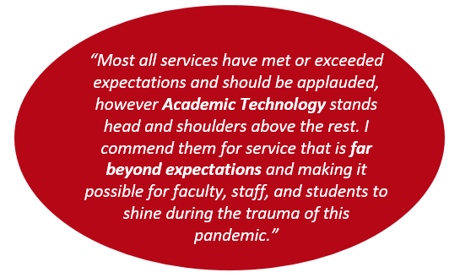
Academic Technology
Student Information Desk (SID)
Writing Center
Feedback
“The Writing Center team has been so supportive of the Inmate Scholars Program! We are incredibly grateful for all they've done for our students! I wish all departments on campus were equally as proactive and invested in our students' success!”
Technical Support (IT)
“The IT department has been phenomenal in assisting with any technology issues. They have been effective and efficient.”
“IT provides fast and friendly service”
Tutoring
“The Writing Center and Tutoring adapted quickly and effectively to online formats (COVID)”
“The IT department has been wonderful. Always available to help with remote issues.”

Slide 10
Please indicate the extent to which agree that the office staff of the following offices provided you with effective service.
“The various Dean's offices have been very supportive in providing faculty to teach in the ISP.”
“Office of Dean Jett: Quality information when sending out emails; quick responses to emails;”

Slide 11
Please indicate the extent to which agree that the office staff of the following offices provided you with effective service. (Continued)

Slide 12
Indicate the extent to which you agree that the following KCCD offices and services (located in the downtown office building) are effectively supporting Bakersfield College in achieving its mission.
“Everyone I interact with in Business Services at the DO is helpful and kind. They are always willing to answer questions and provide training on processes I am unfamiliar with… I appreciate this so much!”
“The IT group does a good job keeping us up to date about software updates, outages, and so forth. They have done a tremendous amount of work this year.”
“Institutional research has found innovative ways to support Program review this year. “

Slide 13
The BC president provides effective leadership in planning, organizing, budgeting, selecting and developing personnel, and assessing institutional effectiveness
(Standard IV.B.1).

Slide 14
The District clearly delineates the operational functions of the District from those of Bakersfield College (Standard IV.D.2).

Slide 15
The Kern Community College District effectively controls its expenditures (Standard IV.D.3).

Slide 16
The District and Bakersfield College effectively communicate with each other (Standard IV.D.7).

Slide 17
The District and Bakersfield College exchange information in a timely manner (Standard IV.D.7).

Slide 18
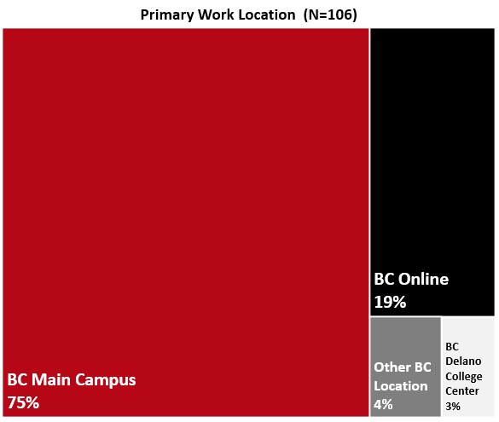
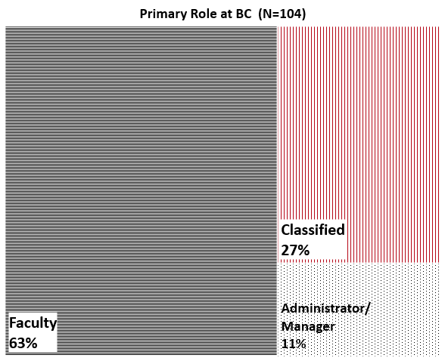
Work Location and Role at BC

Slide 19
Work Status and Years at BC

Slide 20
Committee Participation at BC

Slide 21
Committee Participation by Work Status
• Academic Senate
• Accreditation & Institutional Quality Committee (AIQ)
• Administrative Council
• Assessment Committee
• Budget Committee
• College Council
• Curriculum Committee
• Educational Administrators Council (EAC)
• Equal Opportunity & Diversity Advisory Council (EODAC)
• Facilities & Sustainability Committee
• Faculty Chairs/Directors Council (FCDC)
• Information Services & Instructional Technology (ISIT)
• Professional Development Committee
• Program Review Committee
• Safety Advisory Committee
• Student Affairs Leadership Team (SALT)

Slide 22
Gender Information

Slide 23
Sexual Orientation

Slide 24
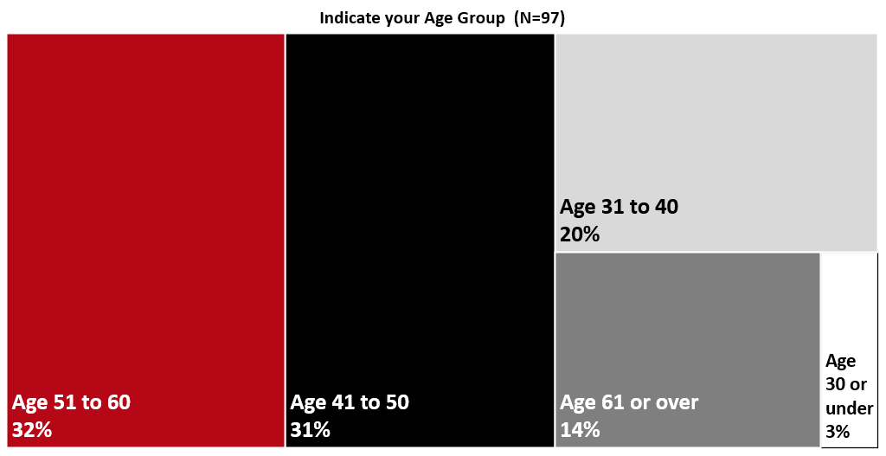
Age Group

Slide 25
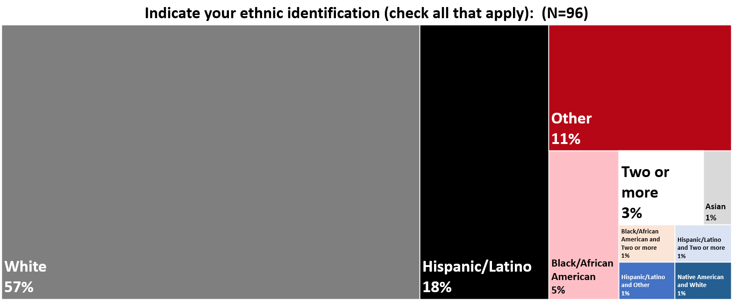
Ethnic Identification

