Slide 1
2016 Bakersfield College Services Survey
Tuesday, September 13, 2016

Slide 2
191
Total Responses
Date Created: Wednesday, April 13, 2016
Complete Responses: 191

Slide 3
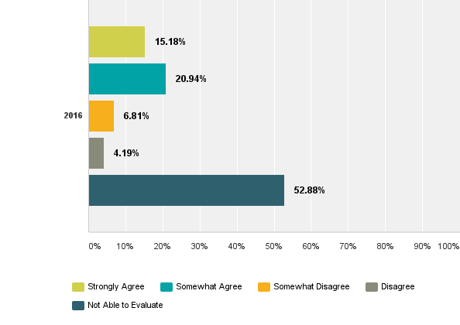
Q1: Do you agree that Academic Instructional Technology (Moodle, etc) has provided effective service to you?

Slide 4
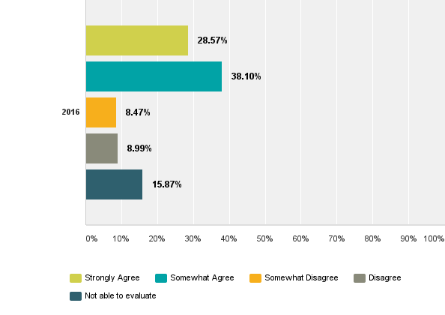
Q2: Do you agree that Admissions & Records has provided effective service to you?

Slide 5
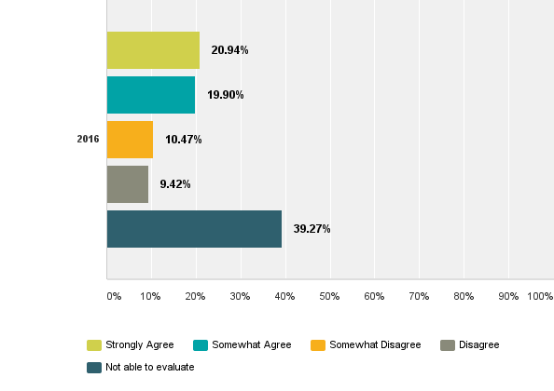
Q3: Do you agree that the Assessment Center (Placement Testing and Accommodations) has provided effective service to you?

Slide 6
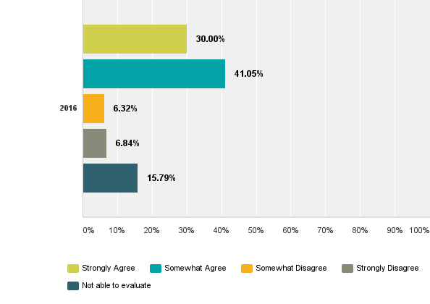
Q4: Do you agree that the Bookstore has provided effective service to you?

Slide 7
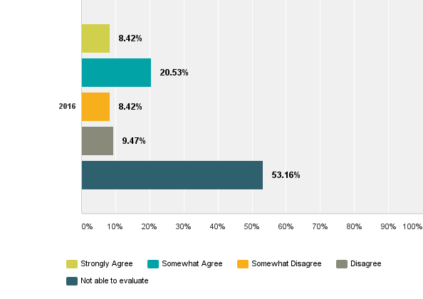
Q5: Do you agree that the Budget & Finance office has provided effective service to you?

Slide 8
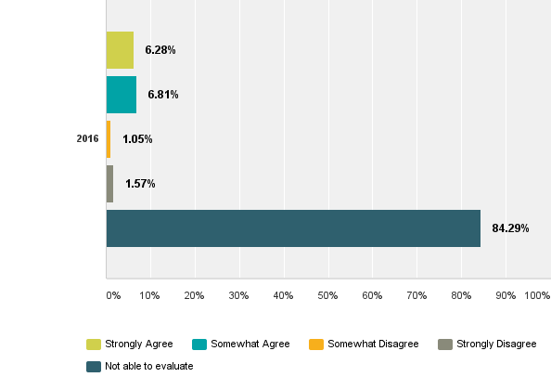
Q6: Do you agree that the Child Development Center (Child Care) has provided effective service to you?

Slide 9
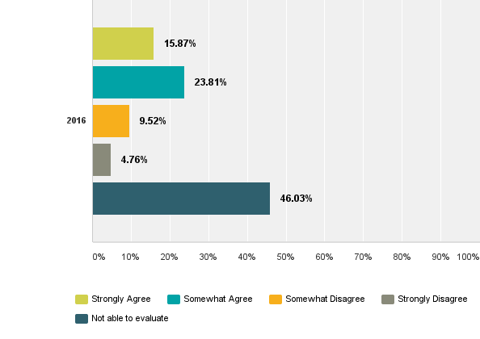
Q7: Do you agree that the District Business Services office on the BC campus (facilitate procurement processes, ticketing for events) has provided effective service to you?

Slide 10
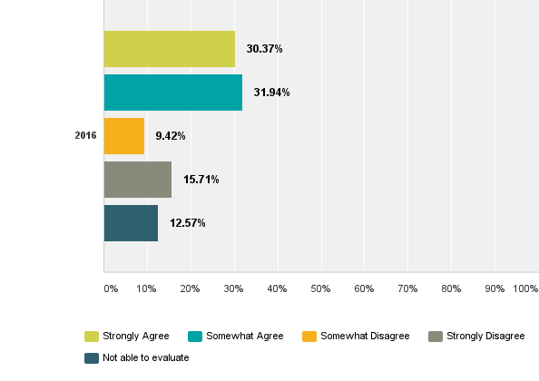
Q7: Do you agree that the District Business Services office on the BC campus (facilitate procurement processes, ticketing for events) has provided effective service to you?

Slide 11
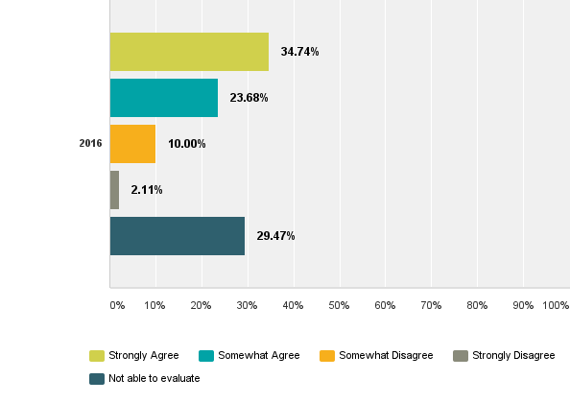
Q9: Do you agree that Event Scheduling (Meetings, Campus Events) has provided effective service to you?

Slide 12
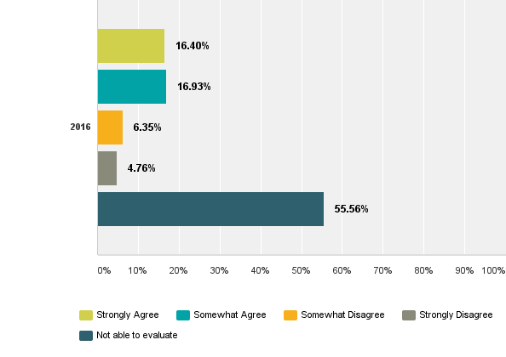
Q10: Do you agree that the Facilities/Construction office (Major capital outlay projects) has provided effective service to you?

Slide 13
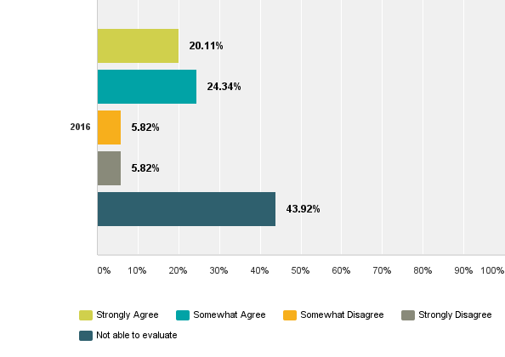
Q11: Do you agree that Financial Aid (Scholarship process and student grants) has provided effective service to you?

Slide 14
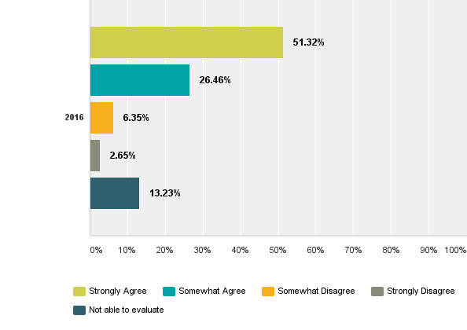
Q12: Do you agree that Food Service (Cafeteria, Special Events) has provided effective service to you?

Slide 15
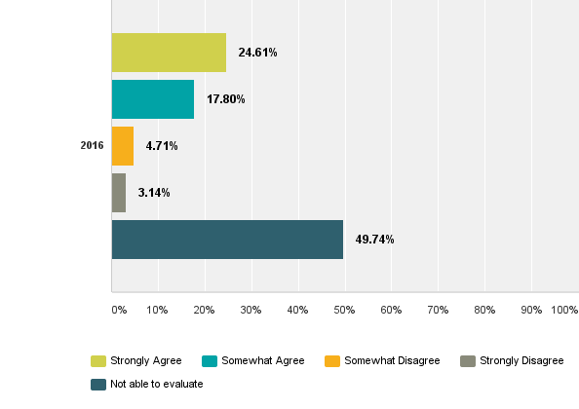
Q13: Do you agree that the Foundation (Donor contributions, account management) has provided effective service to you?

Slide 16
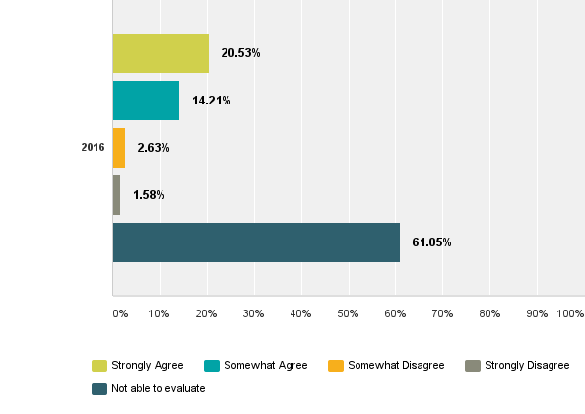
Q14: Do you agree that the Health and Wellness Center has provided effective service to you?

Slide 17
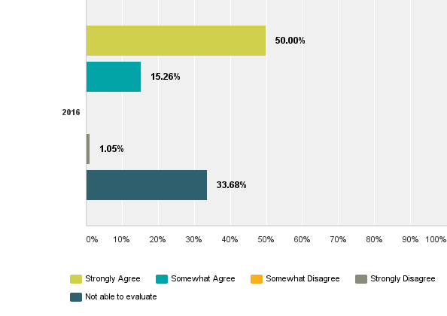
Q15: Do you agree that the Library has provided effective service to you?

Slide 18
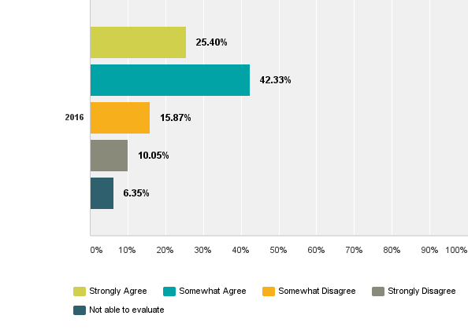
Q16: Do you agree that Maintenance & Operations (Cleanliness, maintenance, work orders, repairs) has provided effective service to you?

Slide 19
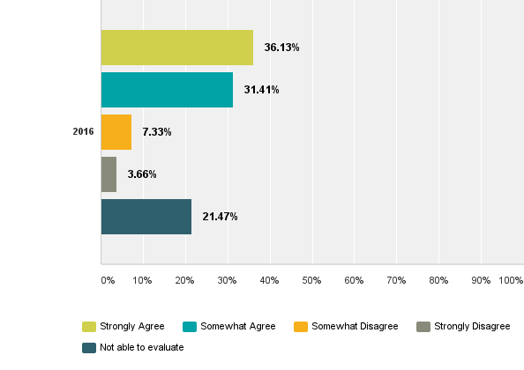
Q17: Do you agree that Mail Service (Letters, interoffice) has provided effective service to you?

Slide 20
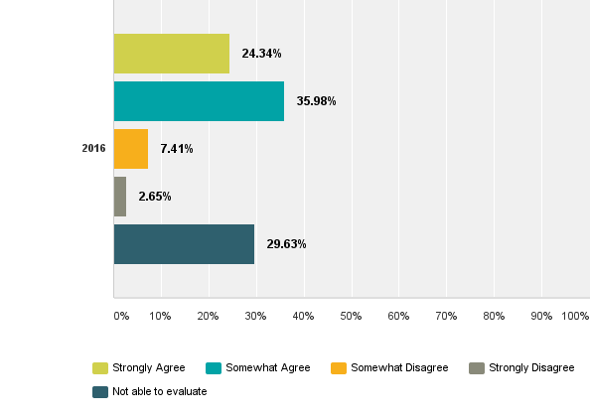
Q18: Do you agree that Marketing & Public Relations (Web, Graphic Design, Media Public Relations) has provided effective service to you?

Slide 21
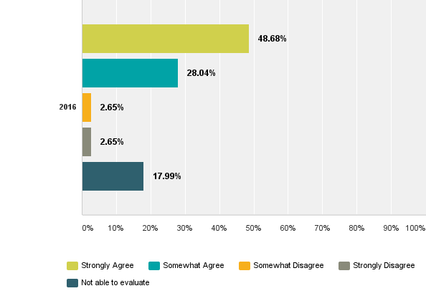
Q19: Do you agree that Media Services (Audio visual support) has provided effective service to you?

Slide 22
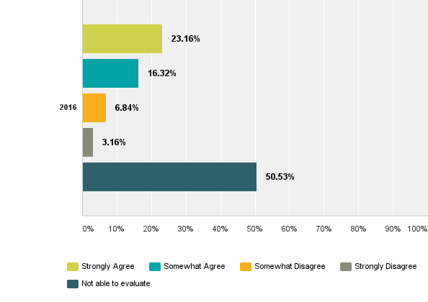
Q20: Do you agree that Outreach (Community engagement) has provided effective service to you?

Slide 23
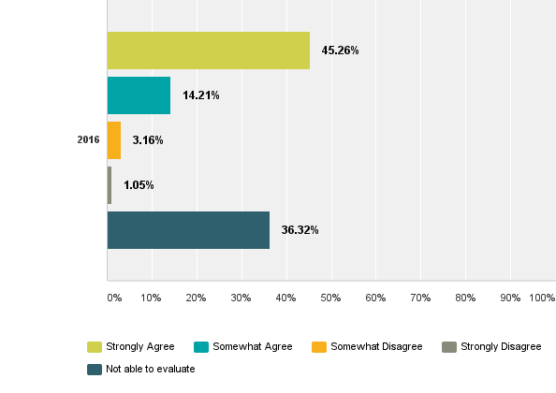
Q21: Do you agree that the President's Office support staff have provided effective service to you?

Slide 24
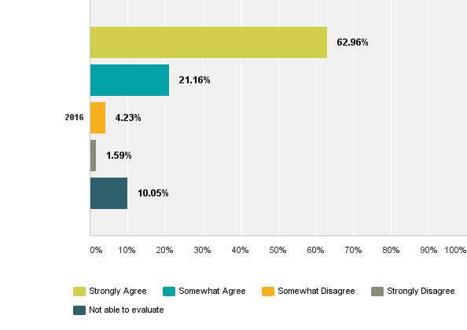
Q22: Do you agree that the Print Shop (Campus printing) has provided effective service to you?

Slide 25
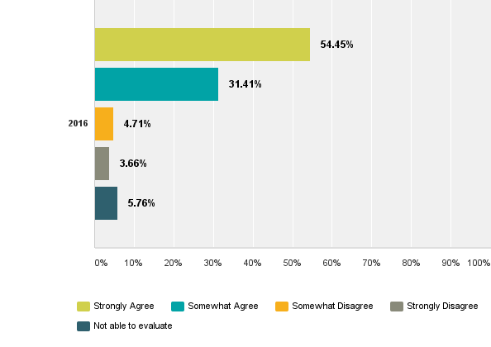
Q23: Do you agree that Public Safety (Parking, Security) has provided effective service to you?

Slide 26
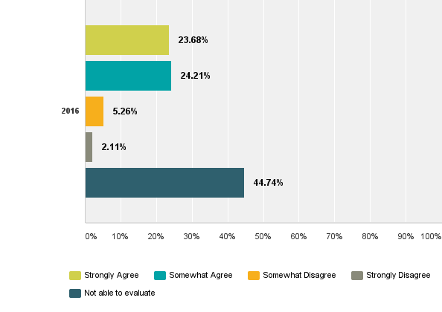
Q24: Do you agree that Shipping & Receiving (FedEx and other large packages/items) has provided effective service to you?

Slide 27
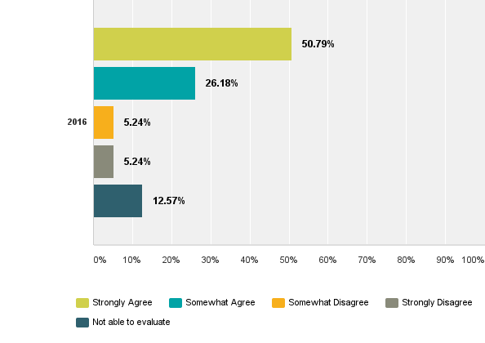
Q25: Do you agree that Technology Support (Local Network, WiFi, Lab Support) has provided effective service to you?

Slide 28
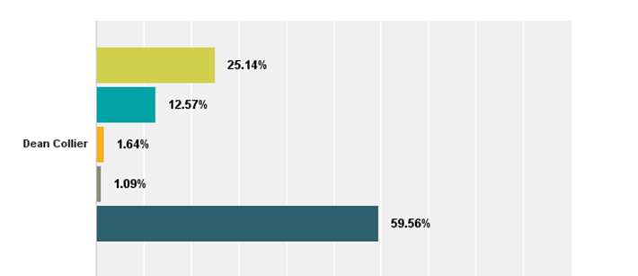
Q26: Do you agree that this Dean's or Director's Office support staff have provided effective service to you?

Slide 29
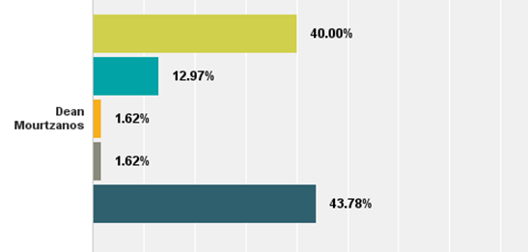
Q26: Do you agree that this Dean's or Director's Office support staff have provided effective service to you?

Slide 30
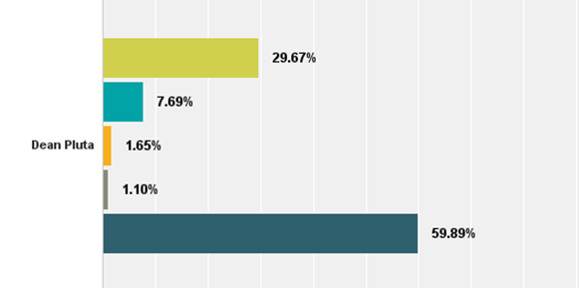
Q26: Do you agree that this Dean's or Director's Office support staff have provided effective service to you?

Slide 31
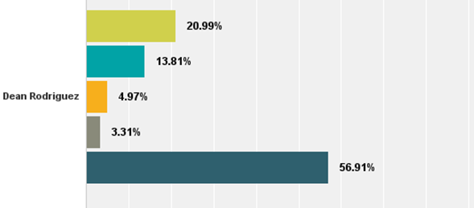
Q26: Do you agree that this Dean's or Director's Office support staff have provided effective service to you?

Slide 32
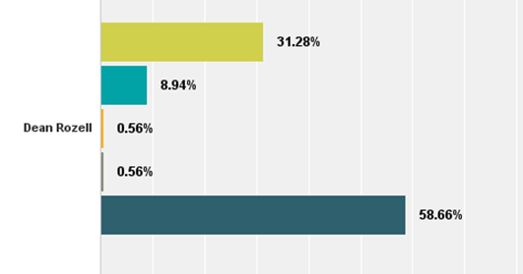
Q26: Do you agree that this Dean's or Director's Office support staff have provided effective service to you?

Slide 33
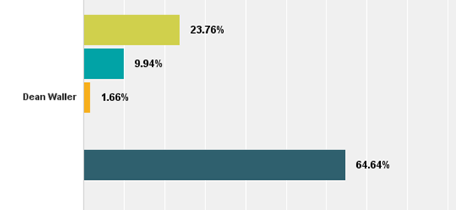
Q26: Do you agree that this Dean's or Director's Office support staff have provided effective service to you?

Slide 34
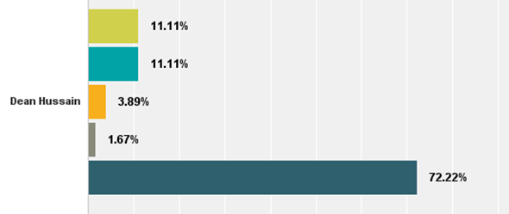
Q26: Do you agree that this Dean's or Director's Office support staff have provided effective service to you?

Slide 35
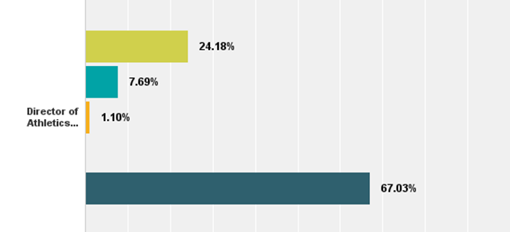
Q26: Do you agree that this Dean's or Director's Office support staff have provided effective service to you?

Slide 36
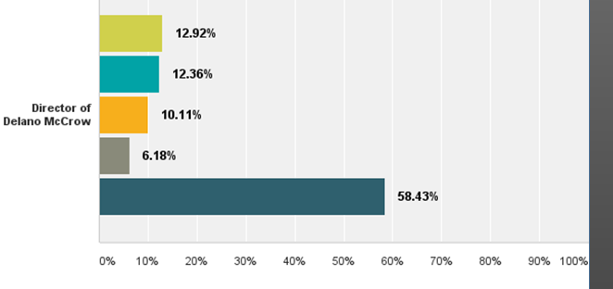
Q26: Do you agree that this Dean's or Director's Office support staff have provided effective service to you?

Slide 37
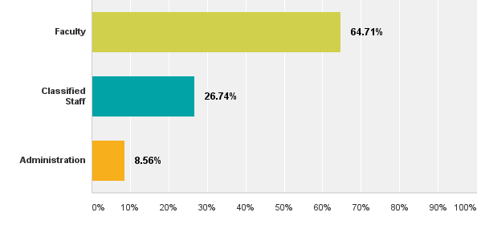
Q27: How would you describe your position?

Slide 38
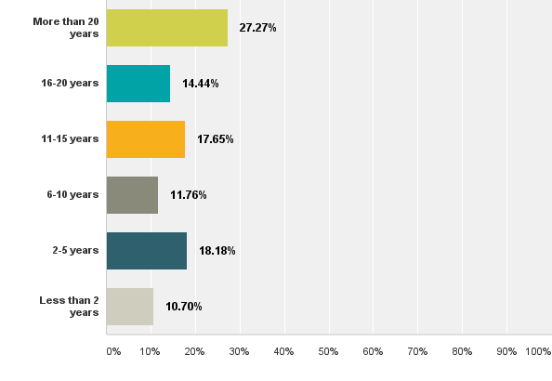
Q28: How long have you worked for Bakersfield College?

Slide 39
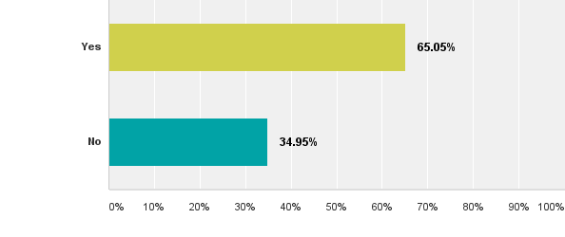
Q29: Are you a member of any collegewide committees or councils?

Slide 40
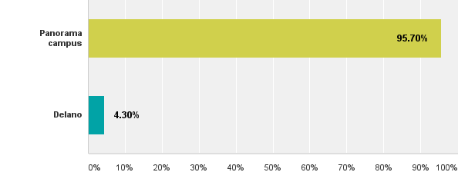
Q30: What is your primary work location?

