Slide 1
Strategic Directions Report
2015-16
Presented by AIQ
May 6, 2016

Slide 2
The “Amazing” Strategic Directions Task Force Team
2013-2014 Strategic Focus Document
12 Governance Committees
SGA
Academic Senate
2 Retreats
Online Survey
2015-2018 Strategic Directions Document

Slide 3
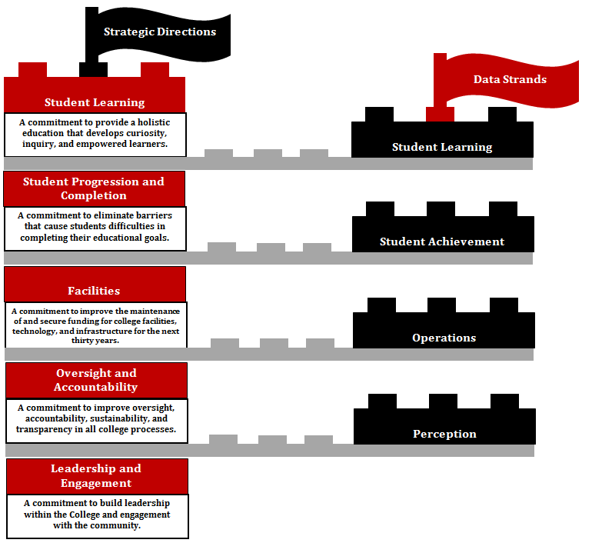

Slide 4
Submissions
 | # Required SD Reports | # Submitted SD Reports | % Submitted
Fall, 2015 | 50 | 20 | 40%
Spring, 2016 | 51 | 45 | 88%

Slide 5
Renegade Scorecard
https://www.bakersfieldcollege.edu/scorecard/strategic-directions

Slide 6
Reflection
What have you learned from the process?
How will the information inform your goal-setting and decision-making?
3. How can you improve evidence collection?

