Slide 1
Notes:
We are all new at this project, so we start at the same place.
Embedding and integrating planning and evaluation in everything we do.
Not relying on anecdotal evidence but collecting data to support our work.
Not working in silos but working together.
It is a good time to be at BC.

Slide 2
Notes:
I picked an open path—one that I would like to travel.
No finish line→ it’s not a race
It is a cycle of continuous quality improvement.
We are all on this path, working together.

Slide 3
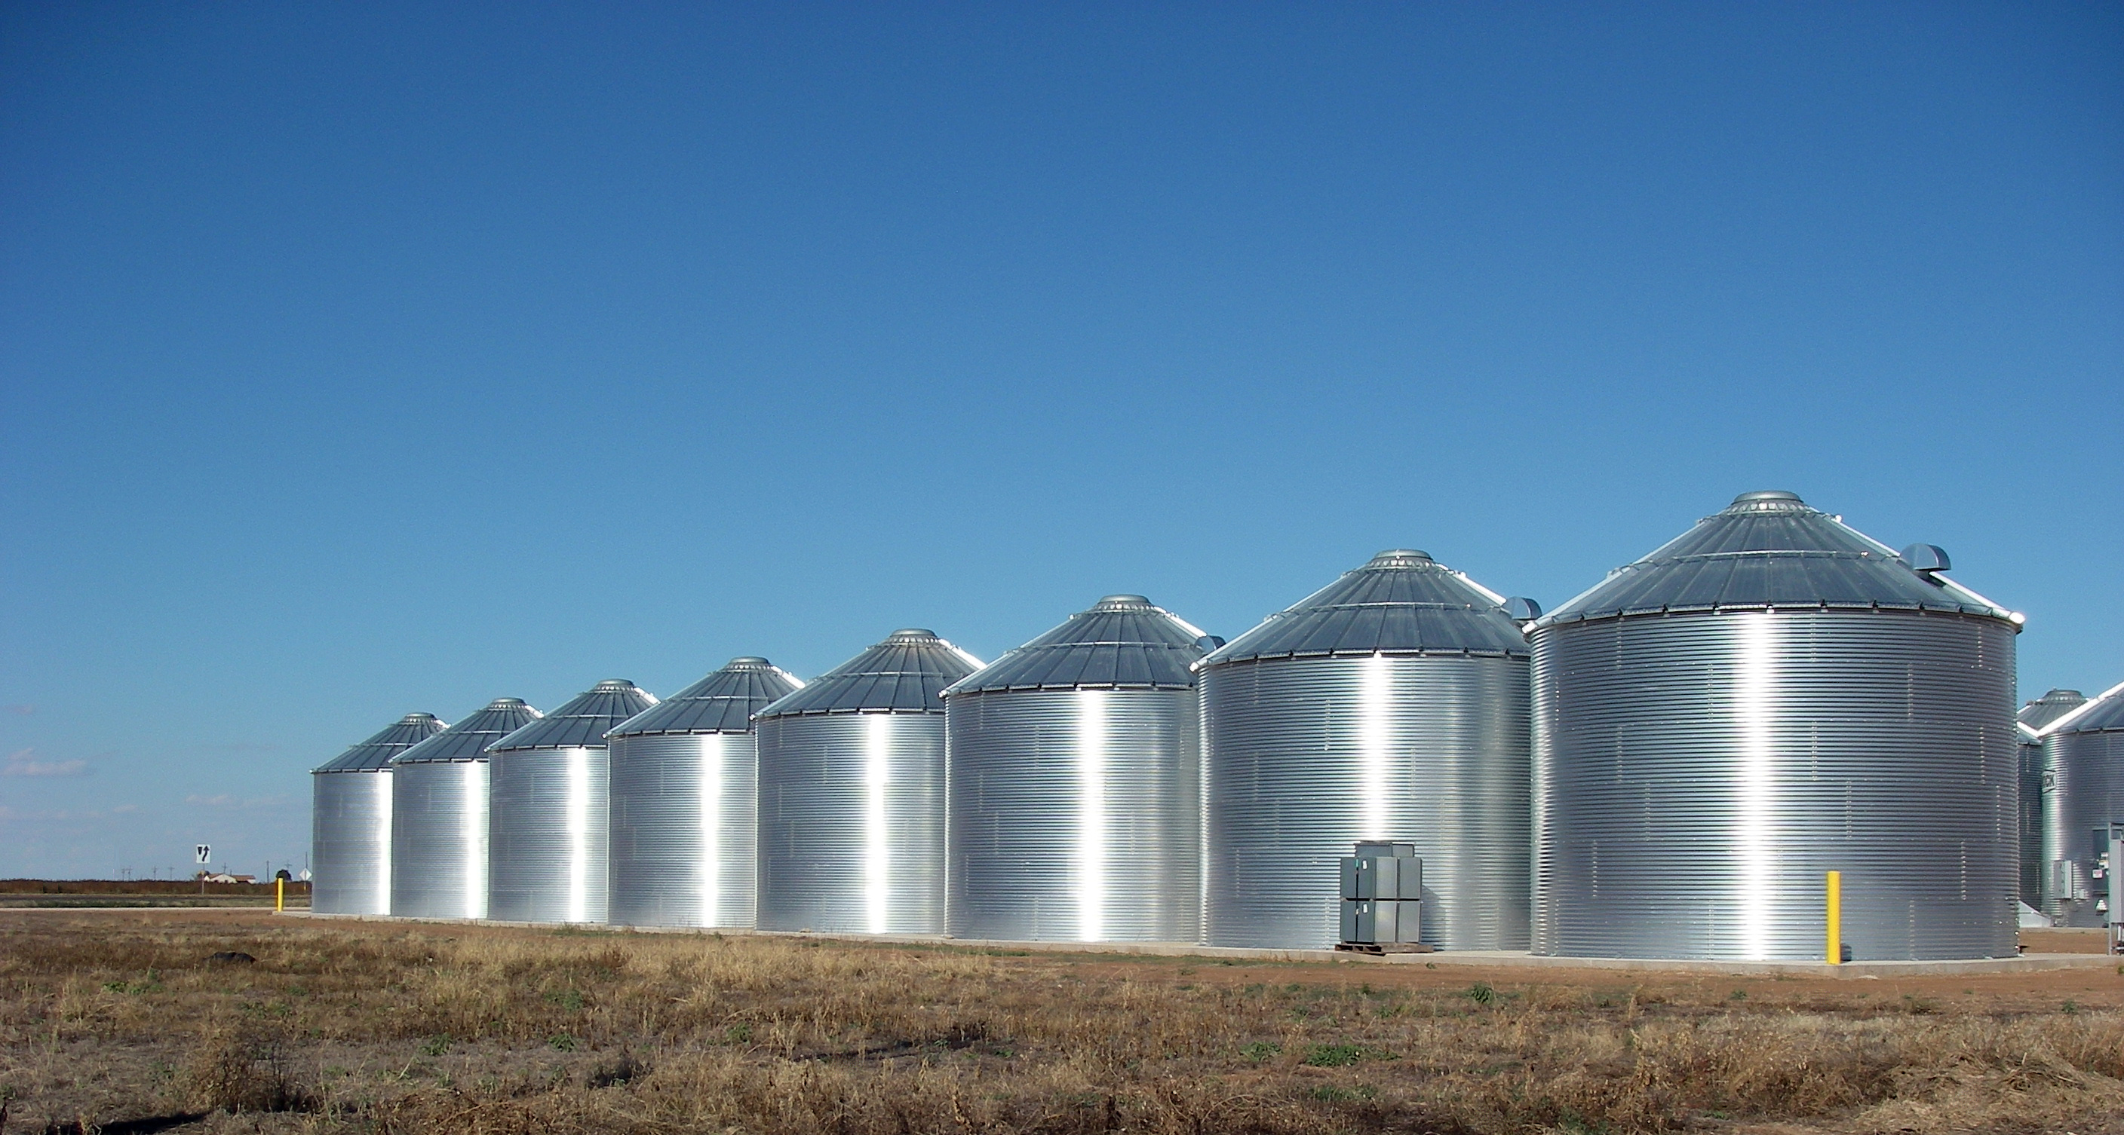
Notes:
Not in shiny new silos

Slide 4
Notes:
Or in comfortable old ones
Because “that is what we have always done . . . “

Slide 5
Notes:
We are all new at this project, so we start at the same place.
Embedding and integrating planning and evaluation in everything we do.
Not relying on anecdotal evidence but collecting data to support our work.
Not working in silos but working together.
It is a good time to be at BC.

Slide 6
How do we know that what we do makes a difference?
Notes:
How do we SHOW that what we do makes a difference?

Slide 7
Classroom
Notes:
SLOs; pictures from BC website

Slide 8
Library
Notes:
SLOs; data

Slide 9
Counseling
Notes:
SLOs, data

Slide 10
Offices
Notes:
Couldn’t find any pix on website

Slide 11
→ Program Review
Student Learning outcomes
Program learning outcomes
Notes:
Instructional
Administrative units
Student affairs

Slide 12
What about the college level?

Slide 13
How do we know we are an effective institution?
How do we continue to improve?
Notes:
How do we assess our work and measure our improvement?

Slide 14
Institutional Learning Outcomes
Notes:
We have begun assessing these, starting with critical thinking.

Slide 15
We have a plan
Strategic directions
2015-2018

Slide 16
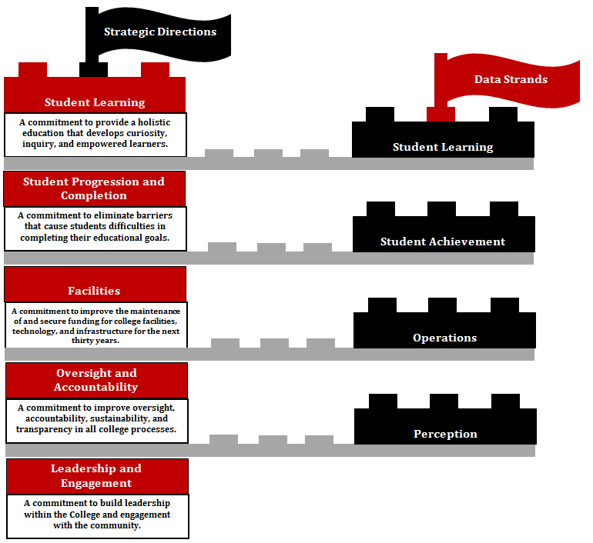
Notes:
Review scorecard concept and data strands
We are working on Oversight & Accountability.

Slide 17
What are our goals?
We have set strategic directions for the college, pathways for our students.
How will we reach them?
We have developed initiatives.
We also develop individual, group, and committee work plans.

Slide 18
How do they fit together? How do we know?

Slide 19
Integrated Planning
Regular and Meaningful Evaluation
Notes:
Institutional Quality and Effectiveness

Slide 20
Accreditation & Institutional Quality (AIQ): Review and monitor evaluation activities to ensure they result in integrated, meaningful, and sustained college improvement.
https://committees.kccd.edu/bc/committee/accreditation
Notes:
AIQ—how would we do it? Monitoring work on initiatives
Last year we looked at the previous initiatives and tried to determine whether they had been accomplished, were in progress, or had never been started. Sometimes we had to guess because we didn’t know.
Now we have built in a way for all of us to know.

Slide 21
Implementing Strategic Directions
Presentation October 2, 2015
Kate Pluta

