Slide 1
EDUCATIONAL MASTER PLAN 2020-2023
Grace Commiso, Faculty Lead
Todd Coston, Administrative Lead
Contributors: Billie Jo Rice, Lesley Bonds, Amber Hroch, Bill Moseley, Bill Potter, &
Jessica Wojtysiak

Slide 2
Introduction of Process & Timeline
MARCH
 | 2-Mar | ISIT
 | 3-Mar | Program Review
 | 4-Mar | Facilities and Sustainability
 | 4-Mar | Academic Senate – Approval (postponed to Mar 18)
 | 6-Mar | College Council – Approval (postponed to Mar 20)
 | 13-Mar | Board of Trustees – Initial Submission for Approval
APRIL
 | 9-Apr | Board of Trustees – Approval (@BC)
JANUARY
 | 16-Jan | Open Forum
FEBRUARY
 | 19-Feb | Academic Senate – 1st Review
 | 21-Feb | College Council – 1st Review
 | 25-Feb | AIQ
 | 28-Feb | FCDC

Slide 3
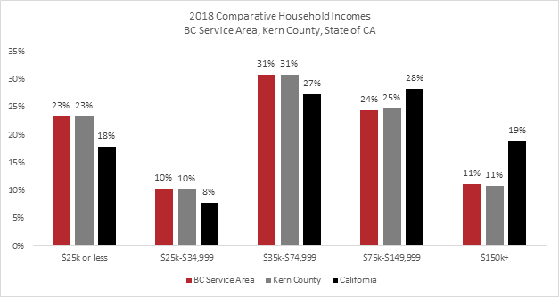
External & Internal Environmental Scan
Higher education policy and trends
AB 1809, New Funding Formula; aligned with
CCCCO system’s Vision for Success
Economy & Employment
per capita income is among the lowest in California, at $21,094, well below the state average of $31,458
Population
Hispanic 52% in Kern & 48% in City.
The next largest in Kern, White, 37% but expected to shrink over 1% by 2021.
Median age around 31.3, expected to remain relatively young.
Notes:
Higher Education policy and trends:
In 2018, the governor and California legislature established AB 1809, a new funding formula for community colleges (Chapter 33, Statues of 2018).
AB 1809 requires districts to adopt college-level performance goals that are aligned with the goals outlined with the Vision for Success Goals, measurable, and with a clear timeline for improvement (Foundation for California Community Colleges, 2018).
Economy and employment:
Despite these thriving sectors, the per capita income in this area is among the lowest in California, at $21,094, well below the state average of $31,458 (see the chart below).
Population:
Hispanic ethnic residents currently constitute about 52% of Kern County’s population and 48% of Bakersfield’s population (ACS, 2019). The next largest ethnic group in Kern County, White, represents 37% of the population but is expected to shrink over 1% by 2021.
In addition , the median age of Kern County is around 31.3 years old, and will continue to remain relatively young (ACS, 2019).

Slide 4
External & Internal Environmental Scan
Enrollment and FTES Trends by site
Not focusing on main campus but stead increase in capacity to serve students in locations beyond main campus (eg. Increases in Dual 11%, Inmate 12%, Distance Ed 8%, BCSW 36%)
Student Population
While BC is not the largest geographically, it is the most densely populated, serving over 36,000 students annually. Specifically, BC represents approximately 75% of the district-wide FTES count.
Committment to serving the diverse economic, cultural, and educational backgrounds within our community.
Notes:
Student Population:
Bakersfield College is steadily increasing its capacity to serve students in locations beyond the main Panorama campus. These additional locations are integral to the college’s strategy to make college accessible to its students.
While Bakersfield College is not the largest geographically, it is the most densely populated (see the map below), serving over 36,000 students annually. Specifically, Bakersfield College students represent approximately 75% of the district-wide Full-Time Equivalent Student (FTES) count.
From fall 2018 to fall 2019,
BC Dual Enrollment census enrollments increased by 534 or 11%,
BC Inmate Scholars census enrollments increased by 199 or 12%,
BC Distance Education (Online & Hybrid) census enrollments increased by 3246 or 8%,
BC Rural (North and South Kern) census enrollments increased by 44 or 1%, and
BC Southwest Campus census enrollments increased by 1132 or 36%.
“Bakersfield College is committed to serving the diverse economic, cultural, and educational backgrounds within our community. Students enroll in Bakersfield College with hopes and dreams to pursue their goals in life, and BC’s annual unduplicated headcount continues to increase.”

Slide 5
Intersegmental Approach for the Future
CCCs have the greatest capacity to produce a massive volume of highly qualified workers and have the ability to grow enrollment at faster rates than CSUs and UCs
Scale the Bachelor of Science in Industrial Automation
Scalability via Early College – addressing equitable college access (eg. 90% students of color with 90% course success rate consistently)
Notes:
Baccalaureate Scalability via Early College: Intentional alignment with BC’s Early College program – among the largest in the state with over 14,000 enrollments annually will expand program capacity and the college’s ability to address statewide demand by 2030. Early College is also BC’s signature strategy in addressing equitable college access and completion, with students of color representing 90% of participants and achieving a 90% course success rate consistently
Currently, 374 high school students are already on track to BC’s B.S. in Industrial Automation degree. As BC scales its Early College efforts to additional high school sites, we can expect to see the number of B.S in Industrial Automation degree holders grow.

Slide 6
Intersegmental Approach for the Future
Intersegmental Curricular Data Alignment
Expansion of Transfer Pathway Mapping
Publication of baccalaureate maps in Program Pathways Mapper
Note: the college has earned several prestigious state awards since 2016 for this work
• Campaign for College Opportunity Award for 900% growth in ADT offerings (2016)
• CCC Chancellor’s Office Student Success Award for Transfer Pathways (2018)
• Dr. John W. Rice Student Success Award (2019)
• Campaign for College Opportunity Champion of Higher Education (2019)
Notes:
Looking ahead, BC will utilize the resources and visibility earned through initial innovation to expand its curricular alignment and mapping work to the full CSU system and begin deepening alignment with the UC Transfer Pathways. In particular, STEM pathways to UC baccalaureate completion will be of primary focus.

Slide 7
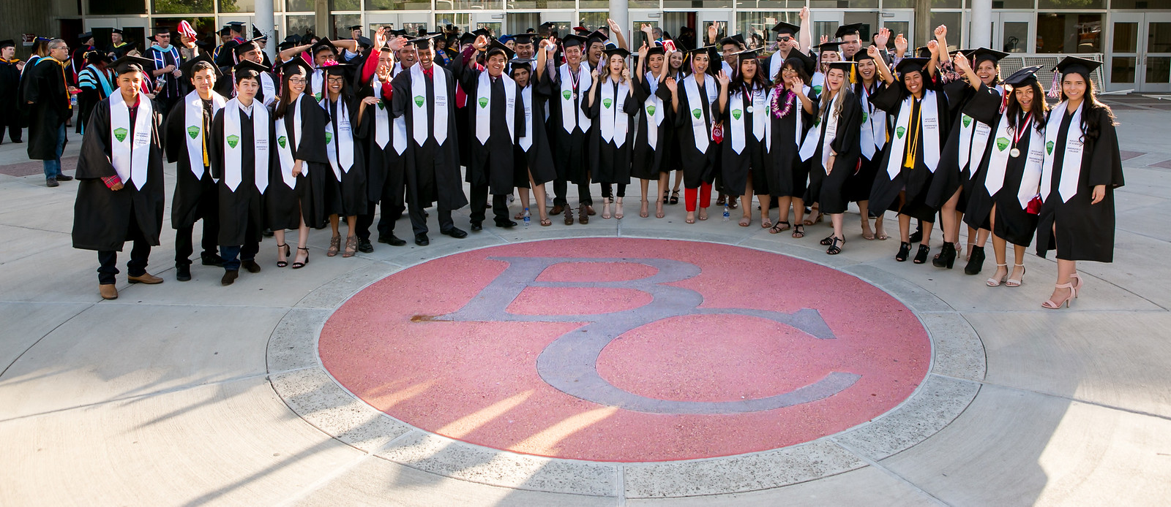
Intersegmental Approach for the Future
Address Barriers via the College Promise
Academic and Non-Academic Barriers to Completion
Moving Forward: Two key projects focused on holistic student health and addressing housing insecurity among students.
Wellness Project Collaboration with Centric Health
Housing & Homelessness Project.

Slide 8
Equity and Completion Through Guided Pathways for the Future
Enrollment
Learning and Career Pathways (2019 enrollments)
Include FTIC for each pathway
Example:
Business (Fall 2018 FTIC: 563)
Future Enrollment Projections
Looking at a steady increase of 5% per pathway with Vision for Success (VfS) goal for increasing ADT completion set at about 35%

Slide 9
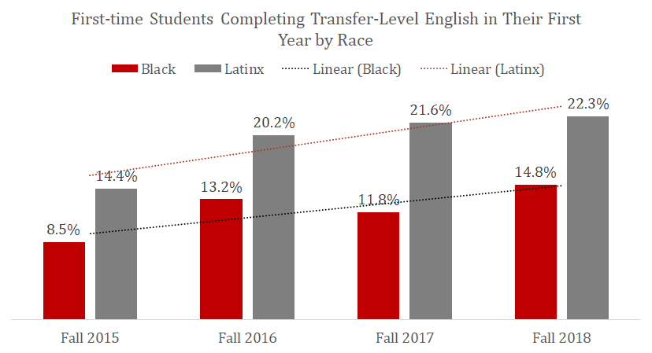
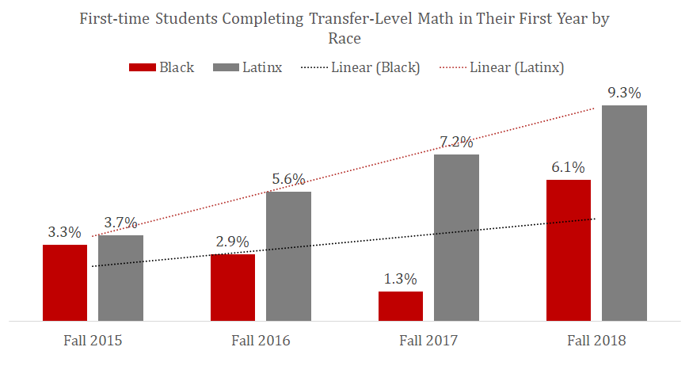
Equity and Completion Through Guided Pathways for the Future
Progression & Momentum
GP Momentum Points
Transfer Math & English
15 units & 30 Units
Include disproportionately impacted students
Average Units Completed
Transfer Math & English
15 units & 30 Units
Note: VfS Goal: Decrease the average units earned per completed associate
degree from 92 in 2016-17 to 84 in 2021-22, a decrease of 9 percent.

Slide 10
Equity and Completion Through Guided Pathways for the Future
Completion & Transfer
2019 graduation data: 3,335 degrees & certificates, 2,746 graduates, 94 rural high school students earned ADT & a high school diploma through Early College. 90% of color who achieved 90% course success rate.
VfS Goals:
Bakersfield College will increase the total number of annually completed associate degrees from 1165 in 2016-2017 to 1552 in 2021-22, an increase of 33 percent.
Bakersfield College will increase the total number of completed ADT degrees from 552 in 2016-2017 to 745 in 2021-22, an increase of 35%.
Bakersfield College will increase the percent of exiting CTE students who report being employed in their field of study from 66% in 2014-15 to 69% in 2021-22, an increase of 3 percent.
New Workforce Programs: To meet evolving economic demands
Entrepreneurship, Noncredit CDCP’s, Homeless to Work, Health Education and Learning

Slide 11
Student Learning: Leveraging Academic Technology for the Future
Academic Technology: Scheduling & Analytics
implement a campus-wide scheduling system with predictive analytics improving ability to make data-driven scheduling decisions
Distance Education: Quality, Completion and Success
Improve the quality of offerings by offering online certification series for faculty
Partnership with CVC-OEI and BC’s Academic Support Programs, BC will improve student support for online learning by increasing the number and quality of academic services available online
Professional Development: Microcredentialing
expand faculty training for equity in instructional practice

Slide 12
Facilities & Infrastructure: Opportunities for the Future
Future Capacity for Growth
Linking internal and external scan to Weekly Student Contact Hours (WSCH) and space considerations. Considering economic and fiscal factors projections of WSCH growth set at an average of 3%
Baseline Term Analysis and WSCH Projections
Planning model was created to address capacities for future growth
Space Projections
Outlined and aligned with Facilities Master Plan, striving to:
assure sufficient facilities to accommodate higher enrollment numbers;
improve the teaching/learning environment;
address new program development;
integrate the latest technological innovations; and,
provide adequate space configuration that permits flexible teaching methods.

Slide 13
Questions?
Questions?

