Slide 1
Academic Senate
The ISER
What you need to know.
9/19/2018
BAKERSFIELD COLLEGE
Presented by:
Jason Stratton and Alisha Loken

Slide 2
Accreditation Basics
Accrediting Commission for Community and Junior Colleges (ACCJC) evaluates and accredits Junior Colleges
Accreditation allows our students to receive federal financial aid dollars
Allows us to engage in continuous evaluation and quality improvement

Slide 3
ACCJC
Our evaluation team is comprised of educators and administrators
ACCJC has established four major accreditation standards
Under those four standards are 14 subsections
We demonstrate compliance via a written self report…the Institution Self-Evaluation Report (ISER)

Slide 4
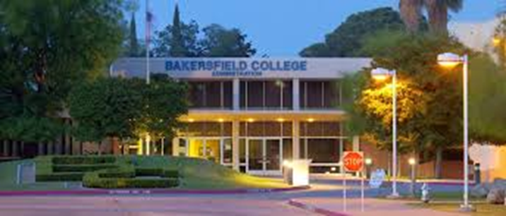
Standards
Standard I: Mission, Academic Quality, and Institutional Effectiveness and Integrity
Standard II: Student Learning Programs and Support Services
Standard III: Resources
Standard IV: Leadership and Governance

Slide 5
ISER
The ISER explains how we meet the 4 standards and all subsections
The ISER also contains a quality focus essay (QFE) describing goals
QFE highlights two projects-Program Mapper and Academic Support Services
ACCJC has our ISER, and peer reviewers are prepping for a site visit.
Our ISER is found here:
https://www.bakersfieldcollege.edu/accreditation/2018ISER
Notes:
Add information about the QFE, link the QFE to the mission

Slide 6
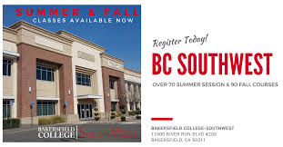
Site Visit
October 1-4th: the peer review team will be on campus, in our classrooms and in our committee meetings.
Each team member is responsible for verifying a specific standard.
They will talk with administrators, faculty, classified personnel, and students .
They will review all of our documents and data.
They will sit in our classes and will talk with committees.
Notes:
Add something about peer review team verifying the information presented in the ISER

Slide 7
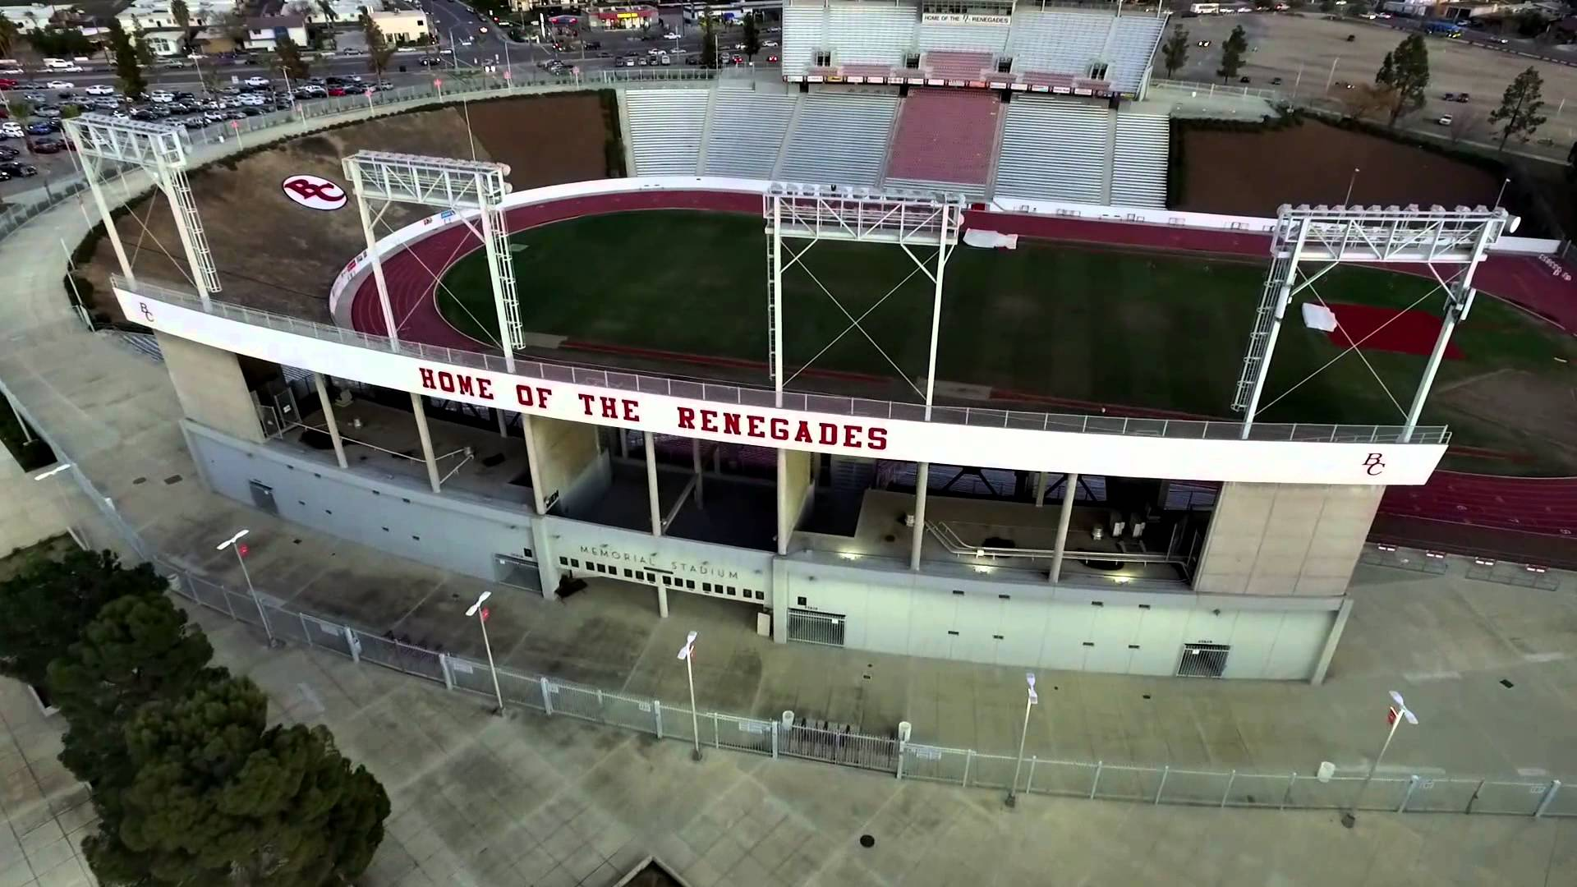
All Campus Preparation
Everyone should be familiar with-
Mission Statement
Strategic Directions
Institutional Learning Outcomes
Core Values
Student population
College Processes
Collegial Governance
See BC Cheat Sheet:
https://www.bakersfieldcollege.edu/download/27323

Slide 8
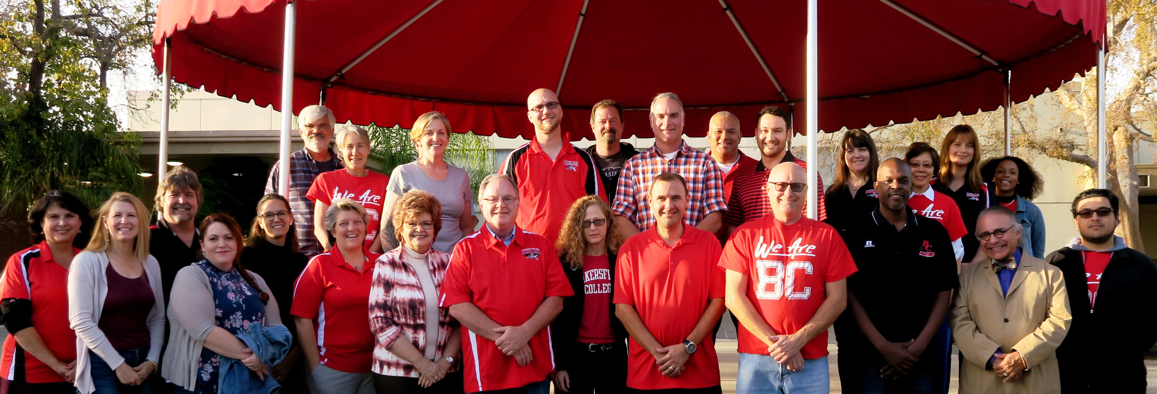
Committee Preparation
What is your committee’s charge? Where do you find it?
Do you understand how you are represented in the ISER?
We should use a common language
What standards and subsections apply to your committee?
How is your committee helping BC meet those standards?
Where can you locate the information?

Slide 9
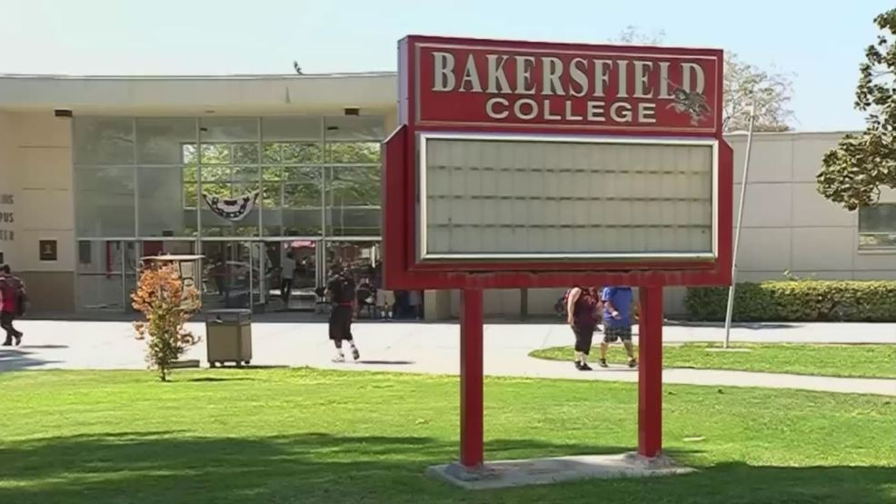
Where Can I Find My Committee Information?
https://committees.kccd.edu/bc/

Slide 10
Academic Senate
Charge-
The purpose of the Senate is to provide the means to represent the “Senate Association” in the formation and implementation of policy on academic and professional matters.
In implementing policies, the Senate will represent the Senate Association” to the President of the College and to the Board of Trustees with respect to academic and professional matters {so called 10+1 issues} and exercise the powers granted by the California Education Code and the Board of Governors.
The Senate shall assume primary responsibility in the areas of curriculum and academic standards as specified in the California Education Code

Slide 11
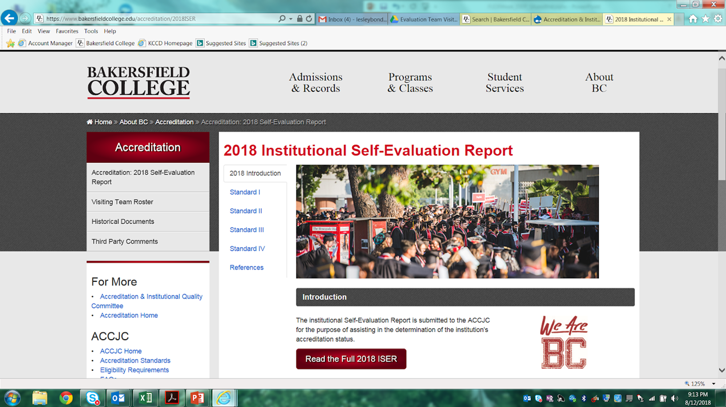
Where Are You Mentioned in the ISER?
https://www.bakersfieldcollege.edu/accreditation
Click “Accreditation: 2018 Self-Evaluation Report” in upper left corner of page.
Click big red button that says “Read the Full 2018 ISER” in middle of page to download ISER.
Use CTRL+F for a document search.
The term “Academic Senate” appears 38 times in the ISER.

Slide 12
Academic Senate in the ISER
Where are you located within the ISER? A HECK of a lot of places!
I.A.1 | I.C.12 | III.A.2 | IV.A.6
I.B.3 | I.C.13 | IV.A.1 | IV.B.1
I.B.4 | II.A.2 | IV.A.2 | IV.B.3
I.B.7 | II.A.5 | IV.A.3 | IV.D.4
I.B.8 | II.A.8 | IV.A.4 | QFE
I.C.5 | II.A.15 | IV.A.5 | Both Indexes

Slide 13
Standard I
Approve the mission statement
Discuss and validate metrics for student achievement
AIQ monitors eval of student achievement and Strategic Directions and is a member of the AS executive board
AS reviews board policies, provides feedback to District Consult Council and approves governance committee charges
Assessment and Program Review report to AS to ensure communication
Use our minutes to reflect adherence to ACCJC guidelines

Slide 14
Standard II
AS approved the California Community College rubric for OEI
Curriculum Committee is a subcommittee of AS-reviews and approves curriculum
BC follows the AS’s procedure for Program Discontinuance-ensure students still get to complete their education in a timely manner when a program is discontinued

Slide 15
Standard III
AS approves screening committees for new faculty.
This has resulted in significant expansion of our faculty over the past 4 years, as is evident from the BC New Academic Faculty page:
https://www.bakersfieldcollege.edu/employees/new-academic-faculty

Slide 16
Standard IV
AS approves college level policy, review district level board policy and make recommendations to District Consultation Council-part of intentionally designed formal structure
Students are represented on AS
In Board Policy, after each Table of Contents is a page titled Governance Processes Relative to the District Board Policy Manual and Collegial Consultation with Academic Senate-it lists policies and procedures that require consult with AS
Curriculum
Degree and Certificate requirements
Ed program development
Processes for Program Review
Institutional planning and budget development

Slide 17
Standard IV (continued)
AS President is on Budget, College Council, District Consultation Council-ensures inclusion and consideration of appropriate constituent perspectives
Intentionally designed decision making and communication structure-AS members report back to their constituents
AS supported the President and commended her for “progressive, innovative and visionary leadership.”
AS formally approved the Strategic Directions and commitment statements
AS coordinates with the President on the budget
Communication between the colleges and district facilitated by AS membership on College Council

Slide 18
Quality Focus Essay (QFE)
Continuous quality improvement is a mark of institutional effectiveness. The ISER results in a QFE that identifies areas of needed change, development, institutionalization, and expansion.
Our QFE identifies successes in the Guided Pathways project and development of Completion Coaching Communities. Furthermore, we link Guided Pathways and Strategic Directions for future educational innovations!
Our QFE identifies has two projects for improvement:
1: Clarify the Path with the Program Pathways Mapper.
2: Keep Students on the Path by Scaling and Integrating Student Support &
Learning.
Notes:
Reports on progress on QFE will be made to AS

Slide 19
Full ISER Review
The ISER describes how BC has met the four standards and all subsections.
ACCJC peer review team has our ISER and is preparing for our site visit.
The team will be at BC October 1-4th and will talk with administrators, faculty, classified personnel, and students.
They will be talking with committee leaders and members about the ISER.
Please review the documents we’ve provided so that we have a common language and can articulate all we do.

Slide 20
ISER Resources- Check them out!
BC has put together a wonderful Accreditation Resource page.
It is located at: https://www.bakersfieldcollege.edu/accreditation/resources
Here you will find:
The ISER
Past Presentations
Bluff Notes
Cheat Sheets
And, on the left, a link for wonderful short videos on each of the 4 ISER Standards.
Check these resources out, and be informed!

Slide 21
We
Are,
BC!
Brought to you by your friendly neighborhood Accreditation Team.

